Slide 1
MVP Presentation Zyphron
Idea Title : Data Mind Agent
Team Captain Name : Vedha Shri k S
Team members Names : Amjath Hussain S , Prahul Sanjay T, Sri Gayathri S
College Name : K . Ramakrishnan College Of Engineering

Slide 2
Data Mind Agent
Problem Statement
Solution Description
Enterprises store 10TB–5PB of Hadoop data but only SQL-skilled engineers can access it.
80%+ of business users are locked out of insights.
Gartner (2025): Poor data accessibility costs $12.9M/year in delayed decisions.
Analyst queues cause 2–3 day delays for ad-hoc queries.
DataMind Agent: AI-powered multi-agent system that translates plain English into HiveQL/SparkSQL.
Executes queries on Hadoop backend and returns interactive charts, tables, and plain-English summaries in under 30 seconds.
4-agent pipeline: Planner → Executor → Analytics → Visualiser.
Guardrails: Blocks unsafe queries, ensures transparency with SQL display.

Slide 3
Data Mind Agent
Uniqueness / Innovativeness
Business Impact
Schema-aware grounding: LLM always uses live Hive Metastore schema.
Write-operation firewall: Blocks DDL/DML queries.
Semantic query cache: Cuts LLM cost by ~60%.
Confidence scoring: SQL-match indicator for user trust.
Purpose-built for Hadoop ecosystems, unlike generic BI copilots.
Query turnaround: 2–3 days → 30 seconds.
65% reduction in ad-hoc query tickets.
Saves ~15 hrs/week per team of 10 users.
Enterprise deployment: $120K–180K/year analyst time recovered.
Faster product decisions → 8–12% improvement in time-to-insight KPI.

Slide 4
Data Mind Agent
Technical Design and architecture
Stack: Python 3.10, FastAPI, Streamlit, DuckDB , Hive , Mcp Servers & Tools and AWS Sevices.
AWS Services: Bedrock (Claude Haiku), S3 (datalake), DynamoDB (memory), CloudWatch (observability).
Workflow:
Upload CSV → stored in S3 → loaded into DuckDB and Hive.
NL → SQL via Bedrock.
Guardrails enforce SELECT-only.
Execute → Summarise → Visualise → Save to DynamoDB.
** Use additional slides to include other relevant details, as required.

Slide 5
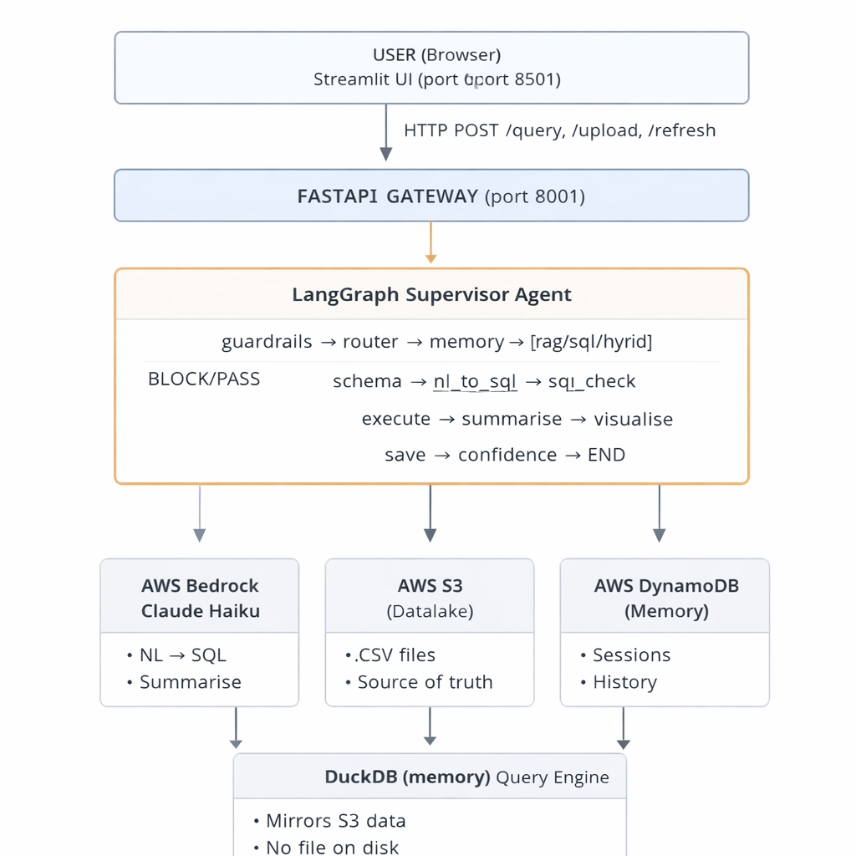

Slide 6
Data Mind Agent
Scalable / Reusable
Roadmap
Horizontal scaling: Stateless FastAPI agents on Kubernetes.
Spark jobs auto-scale on YARN/EMR.
Works across 1TB–5PB+ data lakes without architectural changes.
Reusable for any Hive-compatible schema.
Phase 1 (POC): Basic Working Demo (DONE)
Phase 2 (Integration): Connect System & Add Memory
Phase 3 (Hardening): Make System Strong & Secure
Phase 4 (Pilot): Test with Real Users
Phase 5 (Scale): Grow to Large System
Phase 6 (AI Evolution): Advanced Intelligent System

Slide 7
We were thrilled to be part of Technoverse, as it was our first time traveling for such an exciting and enriching experience.
We successfully cleared the first two rounds with confidence, which motivated us even more for the final stage.
Traveling from Tamil Nadu to Pune for the third round was a completely new and memorable experience for our team.
This hackathon helped us learn new concepts in a calm, focused, and practical environment with excellent organization throughout.
It has been a great honor to present our MVP on such a big stage—thank you for this wonderful opportunity.

Slide 8
GIT HUB REPOSITORY :
https://github.com/amjathhussain31/Data-Agent
Deployed Link:
http://98.80.64.8:8501

Slide 9
Thank you

Slide 10
For student’s consumption : Technoverse – MVP Evaluation Criteria
Dimension | What is Expected
Problem & Use-Case Clarity | A well-defined, industry-relevant problem statement with a clearly articulated use case aligned to a Technoverse '26 theme.
MVP Functional Completeness | A fully functional end-to-end MVP with a demonstrable core user journey, handled edge cases, and demo readiness.
Technical Design & Architecture | A clean, modular, and scalable architecture with documented design decisions and demonstrated scalability considerations.
Use of AWS / GenAI Capabilities | Thoughtful, value-adding integration of AWS services (Bedrock, Agents, Q, Kiro IDE) where GenAI meaningfully enhances core functionality. AWS is not mandatory but good if they have used understand its applicability.
Quality of Demo & Presentation | A crisp, well-structured demo with confident Q&A covering both technical and business perspectives.
Business Impact & Scalability | A strong business case with a clear deployment path, compelling ROI narrative, and a credible phased roadmap beyond the hackathon.

