Slide 1
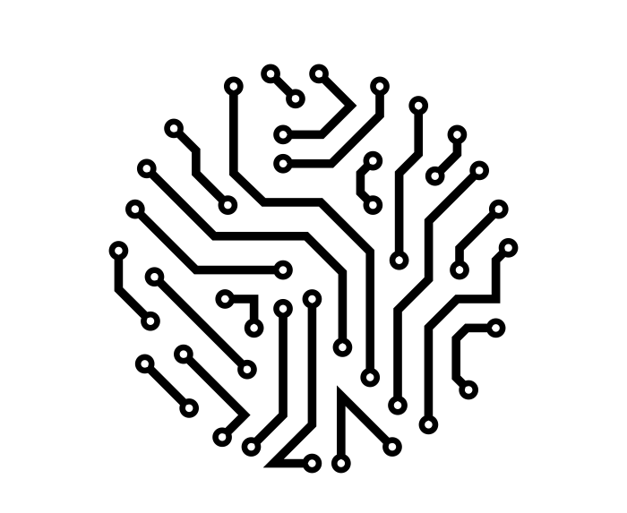
Color
Balancing
2017 Spring, Algorithm
Final Project Presentation
NTUEE Group 3
B03901004 高子佳
B03901014 張雅量
B03901017 董子維

Slide 2
Outline
Problem description
Algorithm
Implementation
Result
Discussion

Slide 3
Problem description
Probl

Slide 4
Color Balancing
Color Balancing for Double Patterning
ICCAD 2015 Contest
Read in file and graph construction
Color conflict detection
Window based optimization
Output format

Slide 5
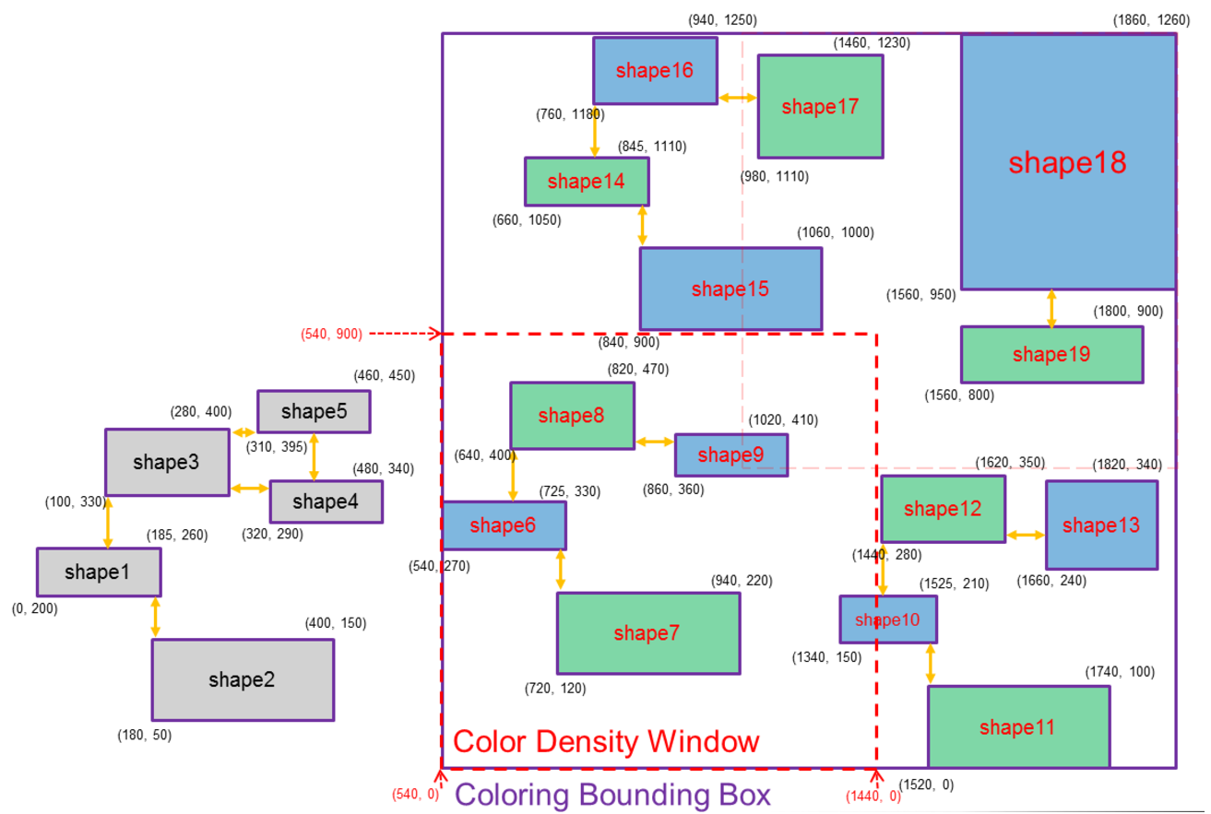
Notation
Graph
Node
Edge
Graph
Subgraph
Window
(Color) Conflict
Color density
Node
Subgraph
Conflict
Edge

Slide 6
Algorithm
Algori

Slide 7
4 stage
Graph construction
Brute force method
Color conflict detection
DFS search, alternatively paint
Color violation → color conflict
Also construct subgraph
Window based optimization
Greedy algorithm
Flip or not flip the subgraph
Nodes across windows?
Output format

Slide 8
Implementation
Imple

Slide 9
Data structure
Graph
Read in file
Subgraph construct
Color bounding box
Window
Subgraph set
Color density calculate
Greedy color balancing
Subgraph
Color difference value
Color conflict
Node & Edge
Corner location
Color

Slide 10
Greedy color balancing
Sort subgraph set with color difference
Pick one as begin
Flip color when color diff > 0
Change begin and obtain the min color diff
Don’t flip
Color diff = blue – green < 0
begin
begin
flip
Next begin
Color diff = blue – green > 0

Slide 11
Result
Resul

Slide 12
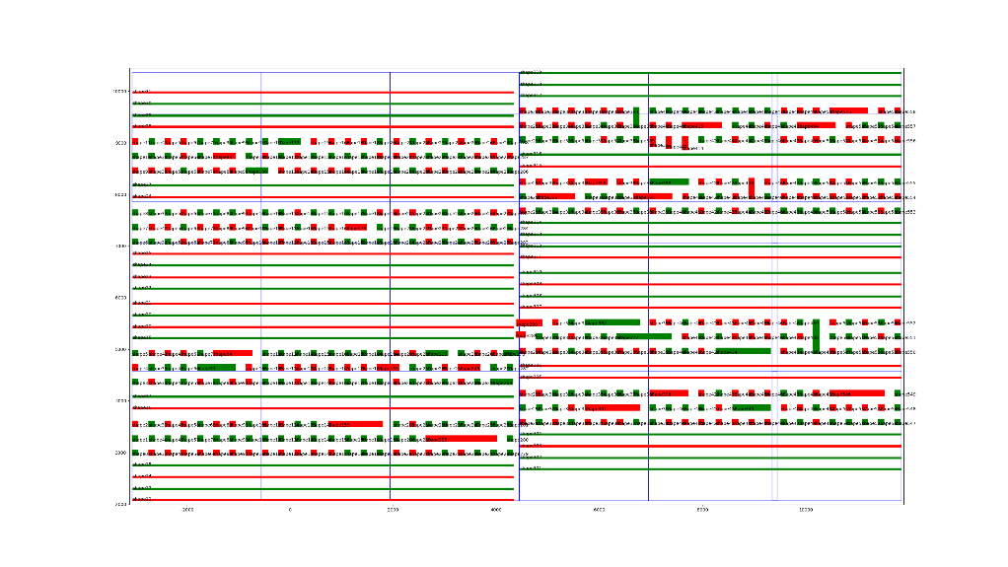
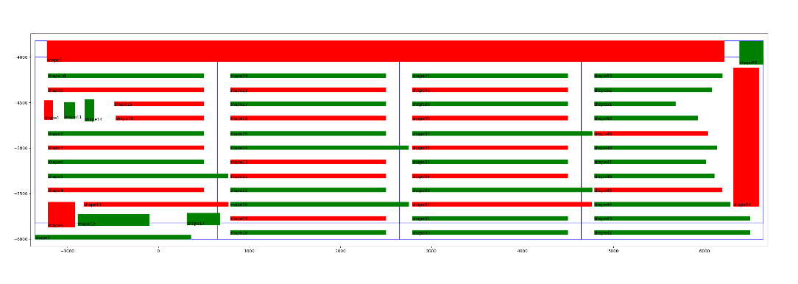
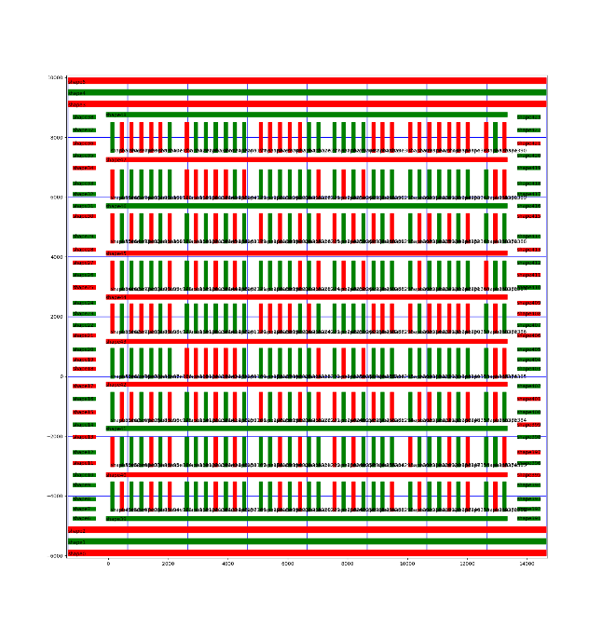
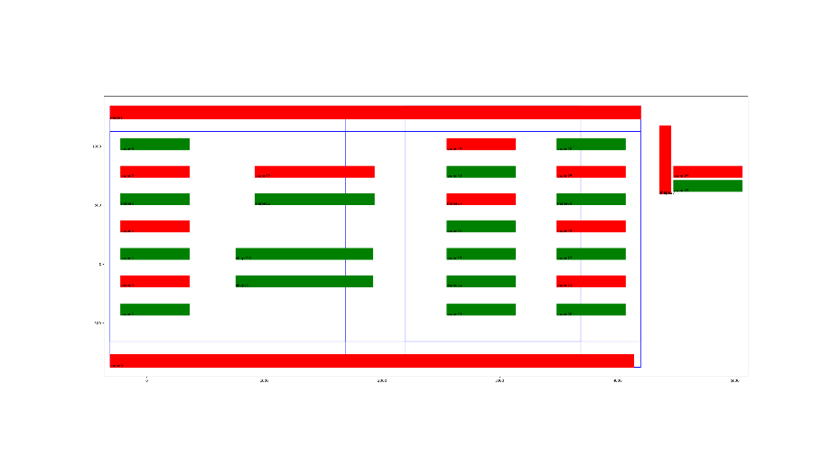
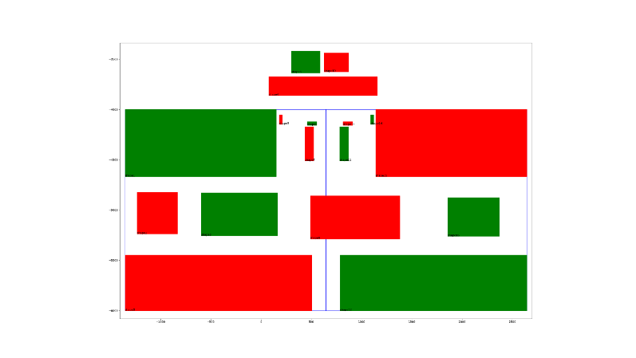
Painting result

Slide 13
Discussion
Discu

Slide 14
Discussion
Code inefficient
Read in file
Edge construction
Better color balancing method?

