Slide 1
Title: Neural Network Classification of Fashion-MNIST
Name : Bhargav Sai Devineni
Student ID: P2906544
Course: M. Sc Artificial Intelligence

Slide 2
Introduction
Background: Fashion-MNIST is a benchmark dataset of clothing images used to evaluate image classification models in machine learning.
Why This Topic: Comparing ANN and CNN helps understand how network architecture impacts performance on visual data.
Problem Statement: Identify which model ANN or CNN achieves higher accuracy and better generalization for Fashion-MNIST image classification.

Slide 3
Objective & Goals
Compare the performance of ANN and CNN architectures on the Fashion-MNIST dataset.
Analyze how model structure affects accuracy, convergence speed, and generalization.
Demonstrate the advantages of CNNs for visual pattern recognition tasks.
Identify key factors (like learning rate, batch size, and optimizer) influencing performance.
Propose improvement strategies such as data augmentation and batch normalization for future enhancement.

Slide 4

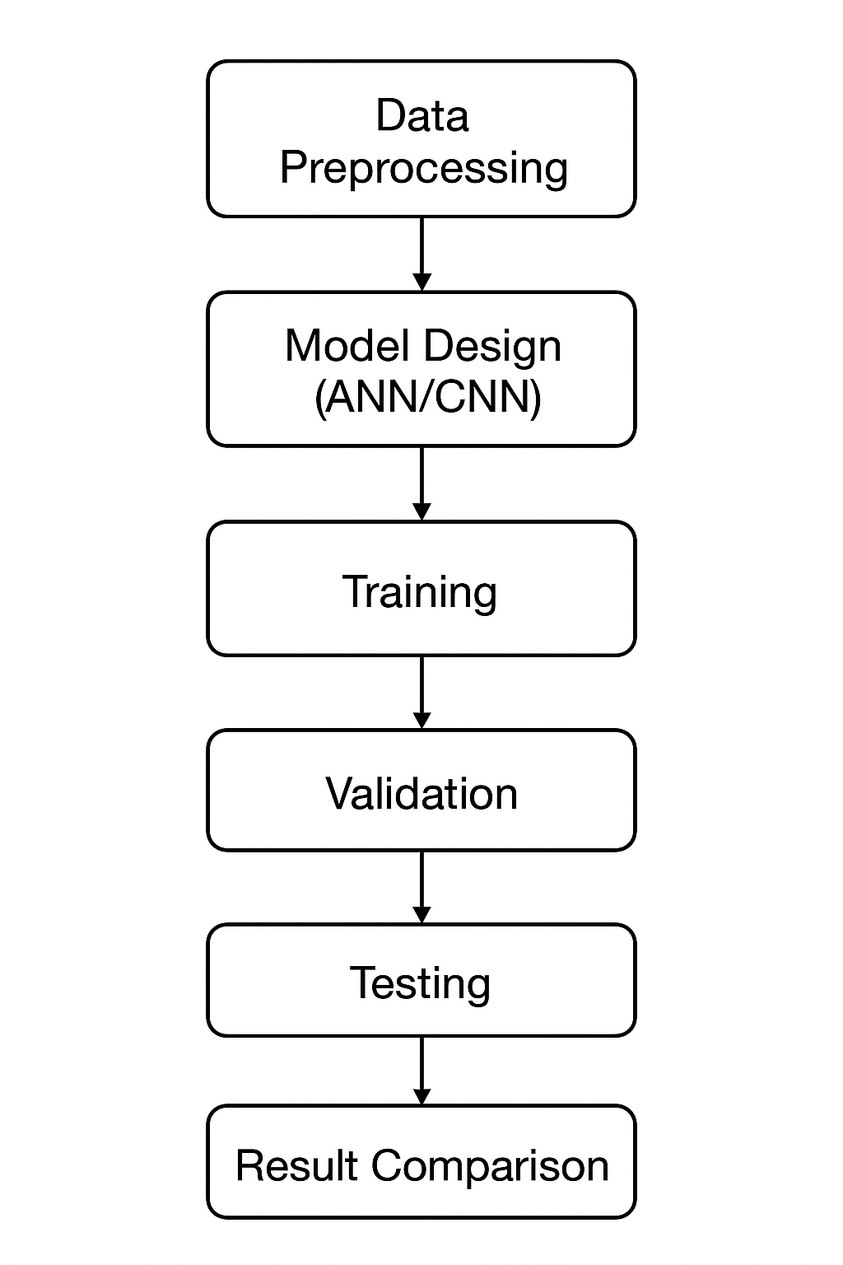
Methodology
Dataset Preparation:
Used Fashion-MNIST dataset with 70,000 images (28×28 grayscale).
Split into Training (50,000), Validation (10,000), and Test (10,000) sets.
Applied normalization (scaling 0–255 → 0.0–1.0) for stability and faster convergence.
Model Development:
Implemented two architectures —> ANN and CNN, for performance comparison.
Both trained using Adam Optimizer and Categorical Cross-Entropy loss.
Applied Early Stopping (patience = 5) to prevent overfitting.
Hyperparameter Tuning:
Experimented with learning rate (0.001) and batch size (64) for optimal results.
Tools & Environment:
Implemented in Python (TensorFlow/Keras) on a GPU-supported environment.

Slide 5

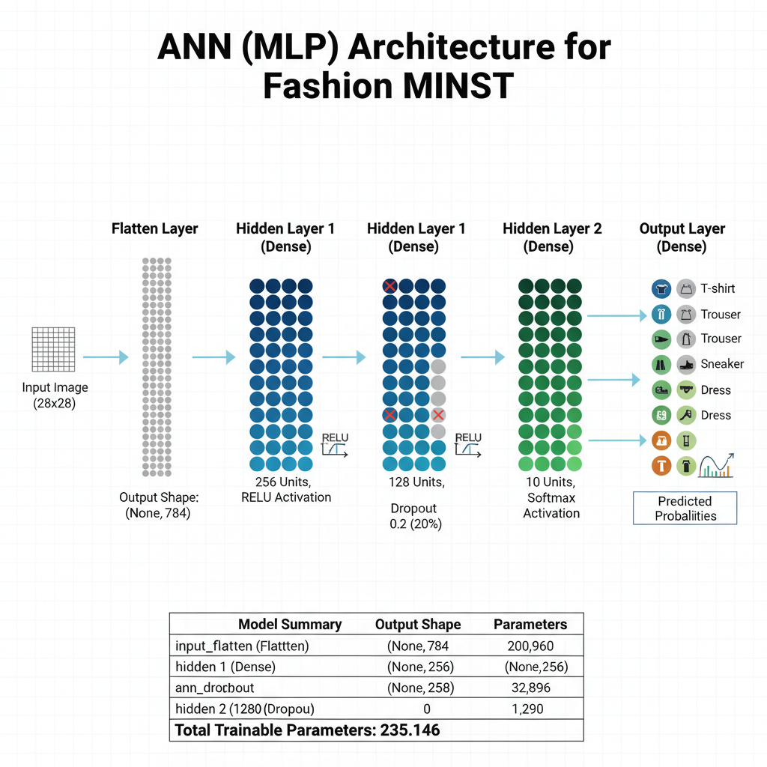
Model 1: ANN Architecture
Sequential Model
Flatten: Converts ( 28 , 28 , 1 ) to 784
•
Hidden 1: Dense (256, ReLU)
•
Regularize: Dropout (0.2)
•
•
Hidden 2: Dense (128, ReLU)
Output: Dense (10, Softmax)
•

Slide 6
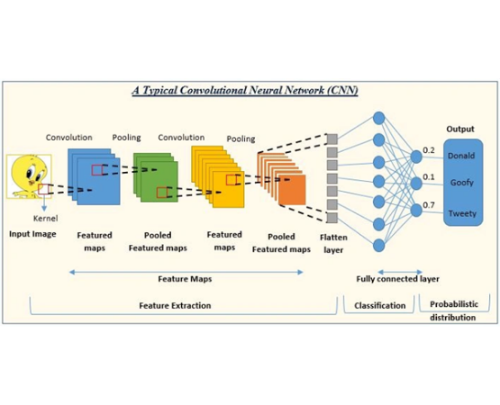
Model 2: CNN Architecture
Feature Extraction
•
Block 1: Conv2D (32) → MaxPool
•
Block 2: Conv2D (64) → MaxPool
•
Block 3: Conv2D (128) → MaxPool
Classification Head
•
Flatten
•
Dense (128, ReLU)
•
Dropout (0.5)
•
Output: Dense (10, Softmax)

Slide 7





Training Methodology
Core Setup
Early Stopping
Model Checkpoint
•
Adam Optimizer (0.001 LR)
Monitors 'val_loss' with patience = 5
Prevents overfitting by restoring best weights.
Saves only the best performing model (lowest 'val_loss') to disk during training.
•
Sparse Categorical Crossentropy
•
10 max Epochs
•
Batch Size 64

Slide 8
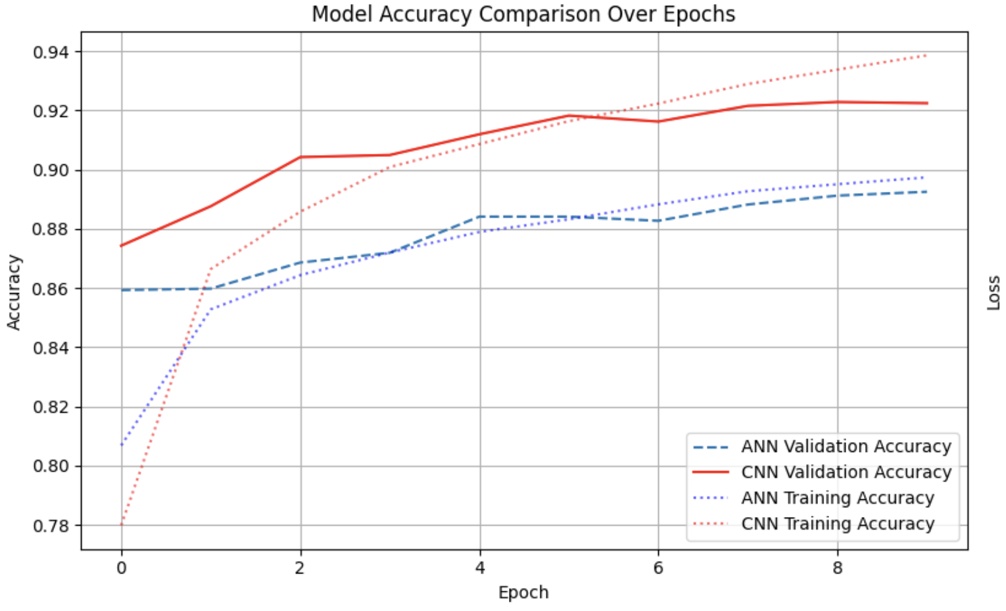
Training History
Key Observations
•
The CNN (red) achieves higher accuracy and lower loss on the validation set.
•
The ANN (blue) flattens earlier, showing it's less capable of learning complex patterns.
Early Stopping halts training when validation loss stops improving.
•

Slide 9

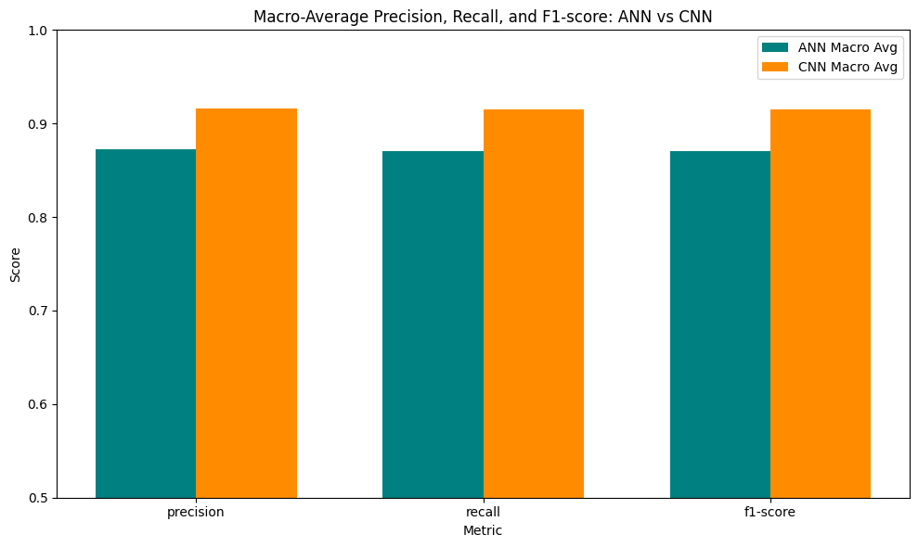
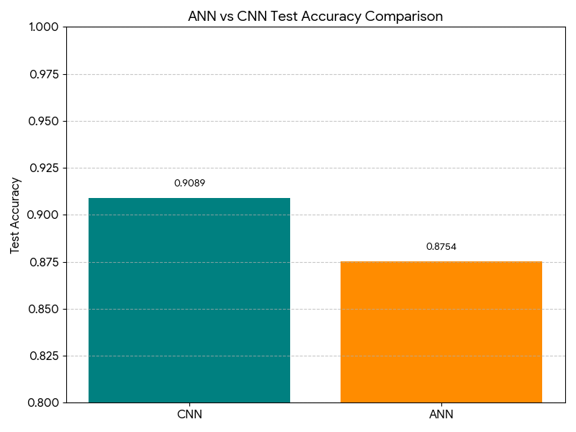
Final Test Accuracy
87.5%
90.8%
ANN Accuracy:
CNN Accuracy:
The CNN's spatial awareness provides a significant 2.7% accuracy boost, making it the clear winner for image-based tasks.

Slide 10
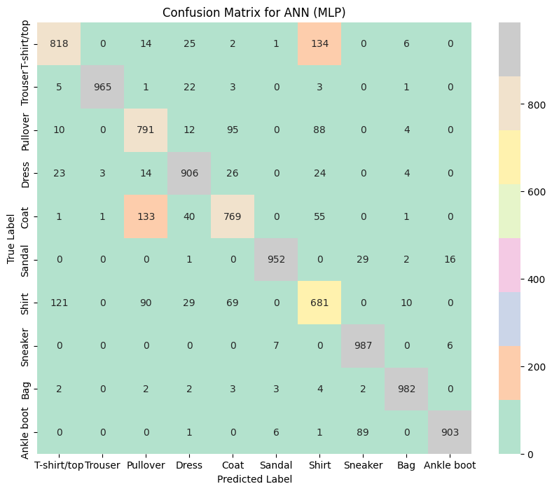
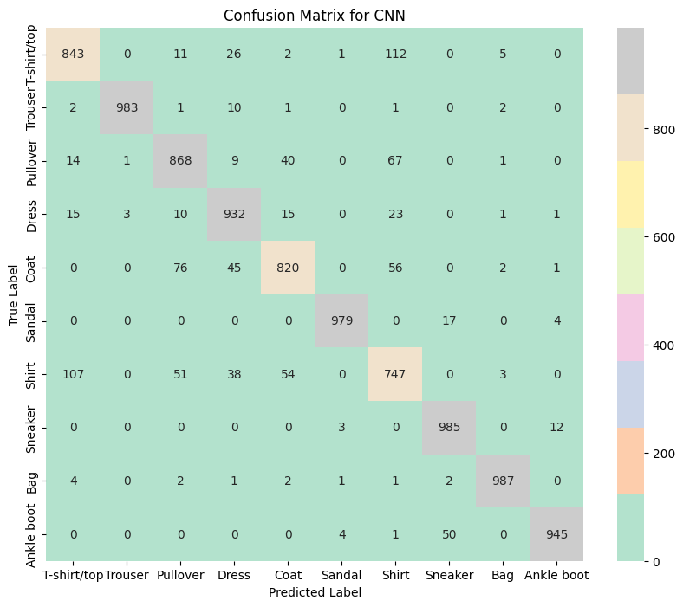
Confusion Matrices
ANN (MLP)
CNN
Shows high confusion between similar items like Shirt, T-shirt, Pullover, and Coat.
A much cleaner diagonal. It still struggles with "Shirt" but has clearly separated most other classes.

Slide 11
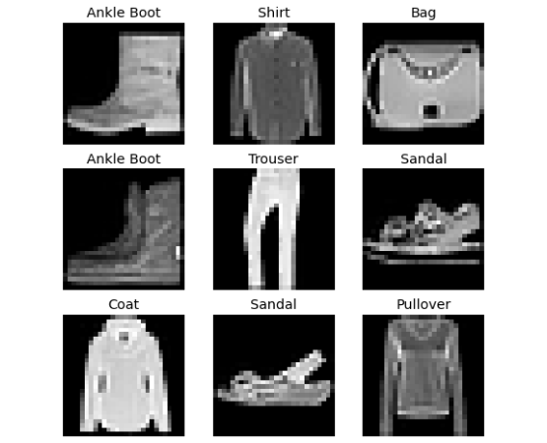
Analysis: Why the CNN Wins
•
Shirt? The ANN confuses this with T-shirts, Pullovers, and Coats. The CNN is better at seeing the collar and buttons.
Pullover? The ANN struggles with texture. The CNN learns the knitted texture is different from a Coat's flat texture.
•
Ankle boot? The ANN confuses this with Sneakers. The CNN is better at identifying the key feature: the heel.

Slide 12
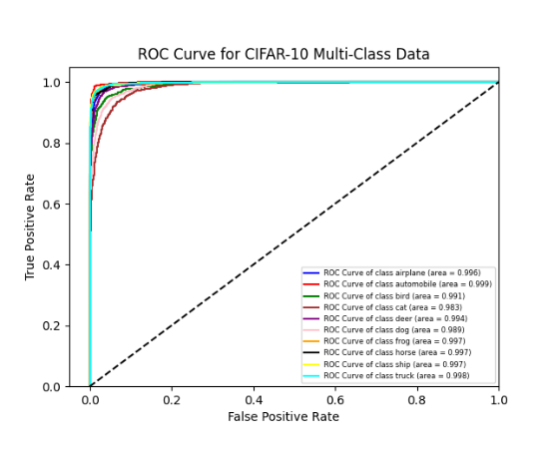
Final Proof: CNN ROC Analysis
One-vs-Rest AUC
This plot shows the CNN's ability to distinguish each class from all other classes.
•
•
Micro-Average AUC (0.992): High overall performance.
Macro-Average AUC (0.985): Strong performance, even for rarer classes.
•
•
The high AUC scores confirm the model is highly discriminative.

Slide 13
Questions?
Thank you.

