Slide 1
A Neural Network Model for Fashion-MNIST Image Classification
By Maha Khan
(p2594573)

Slide 2
Introduction and Background
Image classification is one of the central task in ML and CV
Classical ANN usually struggles with spatial dependencies in data image
CNN have convolution and weigh sharing that make model spatial structure effective
To evaluate which one is better we will experiment with Fashion MNIST dataset.

Slide 3
The Aims
Implement and compare ANN(Artificial Neural Networks and CNN (Convolutional Neural Networks):
Design + implement neural network model for ANN + CNN
Train + validate
Compare accuracy, learn behaviour + generalisation

Slide 4
Methodology
Framework + Tools:
Implementtion: Python using PyTorch
Torchvision for dataset and tranforms, scikit learn for metric and Matpotlib for plots.
Approch:
Divide data: 90 percent for training and 10 percent for validation testing.

Slide 5
Data / Material / Inputs
Dataset:
60,00 training and 10,000 test grayscale images 28 x 28 pixels.
10 classifications: t shirts/tops, trousers, pullover, dress, coat, sandal, shirt, sneaker, bag, ankle boot
Parameter:
Batch size: 128
Epochs: 20
Patience: 5 early - stopping

Slide 6
Implementation
ANN:
2 HIDDEN LAYERS: 256 -> 128 neurons
200k parameters
CNN:
Conv 1x28x28 -> 32 -> 64 -> 128 filters + batch norm + maxpool
1.2 M parameters
raining Process
AdamW (lr = 3 × 10⁻⁴, weight decay = 3 × 10⁻⁴)
Load -> Train -> Validate -> Test -> Evaluate

Slide 7
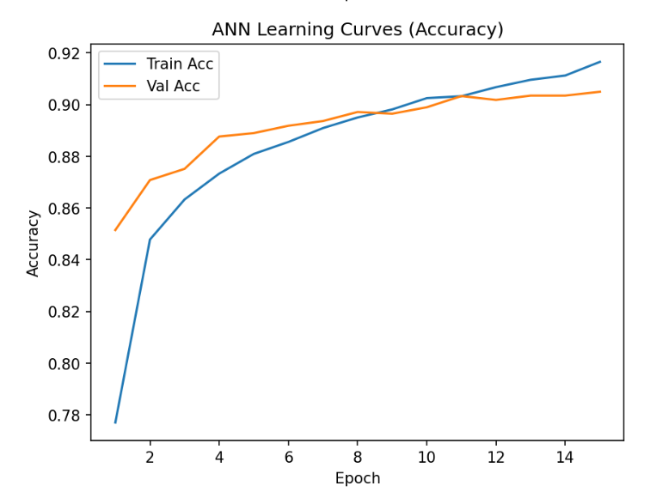
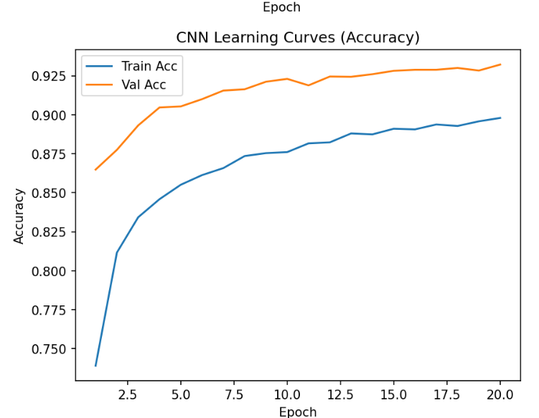
Result
Model | Parameters | Test Accuracy | Test Loss
ANN | 200 k | 88.97 % | 0.5609
CNN | 1.2 M | 91.85 % | 0.5043
CNN outperformed ANN by 3 percent accuracy
ANN faster but overfitted
CNN generalised better + smoother validation curves

Slide 8
Discussion
CNN capture the edges texture and spatial heriarchies -> superior accuracy
ANN lack spatial bias -> struggle with identifying similar items
Misclassification between shirt and coat
Near perfect classification for sneaker, sandal, bag

Slide 9
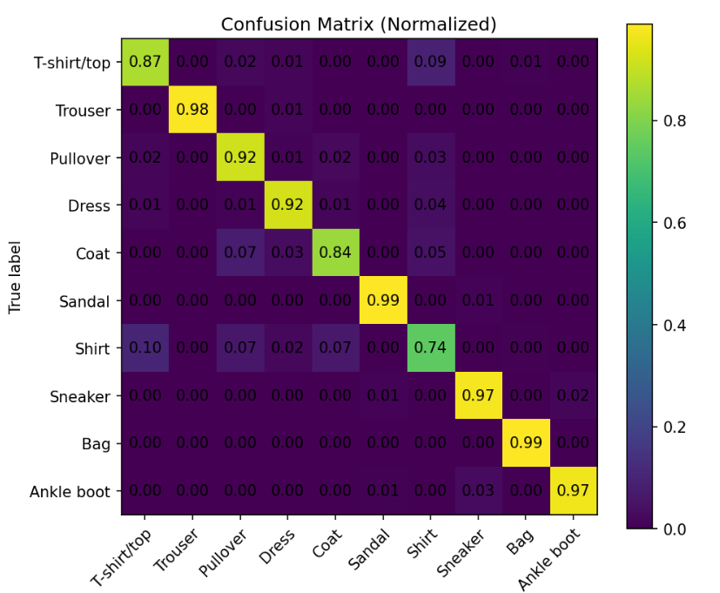
Conclusion
Both models show success
CNN achieves 91.85% versus
ANN 88.97 %

Slide 10
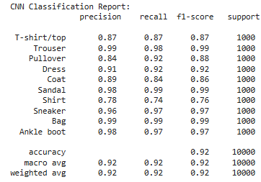
Thank you!

