Slide 1
COMPARATIVE STUDY OF ANN,CNN AND ENSEMBLE MODELS ON THE FASHION- MNIST DATASET
Presented by : Mohith Nithin Inavolu
Student id: p2896359
Module name: Artificial Neural Networks & NLP
Module code: CSIP5103
De Montfort university
04-11-2025

Slide 2
INTRODUCTION
The project explores deep learning-based image classification using the fashion-mnist dataset, which consists of 70,000 grayscale images across 10 fashion categories.
This project contrasts three architectures, ANN, CNN, and an adaptive deep neural ensemble integration (ADNEI) method to improve generalisation and robustness to model interpretation
The project aims to show how ensemble learning captures performance improvements in a representation by combining global and spatial features across models.
All models were trained to consistent accuracy with minimal overfitting through the use of tensorflow 2.19 using the acceleration of gpu units.
The project proposes intelligent visual recognition systems, which relate to retail analytics, recommendation systems, and intelligent image tagging.

Slide 3
OBJECTIVES / GOALS
to build and implement an ann and cnn model specifically designed for fashion-mnist classification.
to build and implement an ensemble integration model, (adnei) that integrates the output of a ann and cnn using weighted soft voting.
to evaluate model performance using particular metrics - accuracy, precision, recall and f1-score - such that comparison is possible.
to analyse how ensemble learning stabilises predictions and reduces misclassification among visually similar apparel items.
to explore how the proposed approach can be extended to broader ai applications such as healthcare diagnostics and fraud detection.

Slide 4
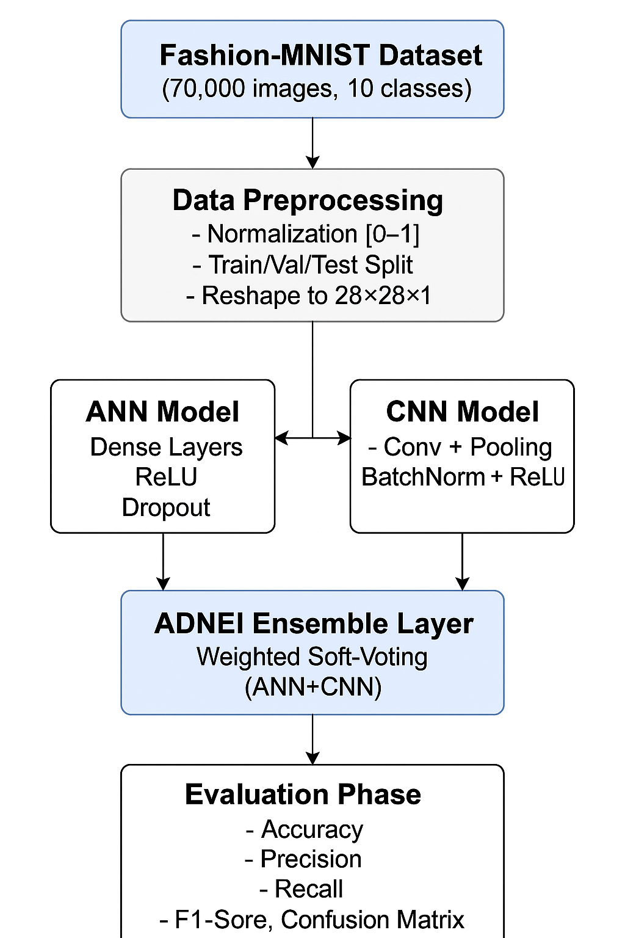
METHODOLOGY / APPROACH
Framework: TensorFlow 2.19 / Keras with GPU acceleration (XLA JIT enabled).
Pre-processing: normalised pixel values [0–1]; reshaped to 28×28 format.
Training: 15 epochs, batch size 64, Adam optimiser, categorical cross-entropy.
Validation split: 50 000 train / 10 000 validation / 10 000 test.
ADNEI Ensemble: combines ANN & CNN outputs via weighted soft-voting.
Tools: NumPy, Matplotlib (for curves & confusion matrices).

Slide 5
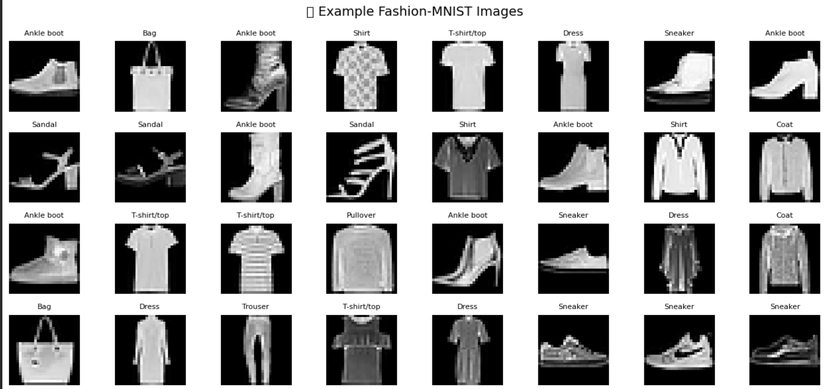
DATA / MATERIALS / INPUTS
Dataset: Fashion-MNIST (by Zalando).
Grayscale images of size 28×28 pixels.
Ten categories (e.g., T-shirt/top, trouser, coat, sandal, sneaker).
Balanced classes → no bias in training.
Data loaded via keras.datasets.fashion_mnist.
Normalisation improves convergence speed & model stability.

Slide 6
IMPLEMENTATION / PROCESS
Trained ANN and CNN separately for 15 epochs.
Applied XLA JIT for faster computation.
Used validation accuracy for model checkpointing.
Generated plots for loss/accuracy curves and confusion matrices.

Slide 7
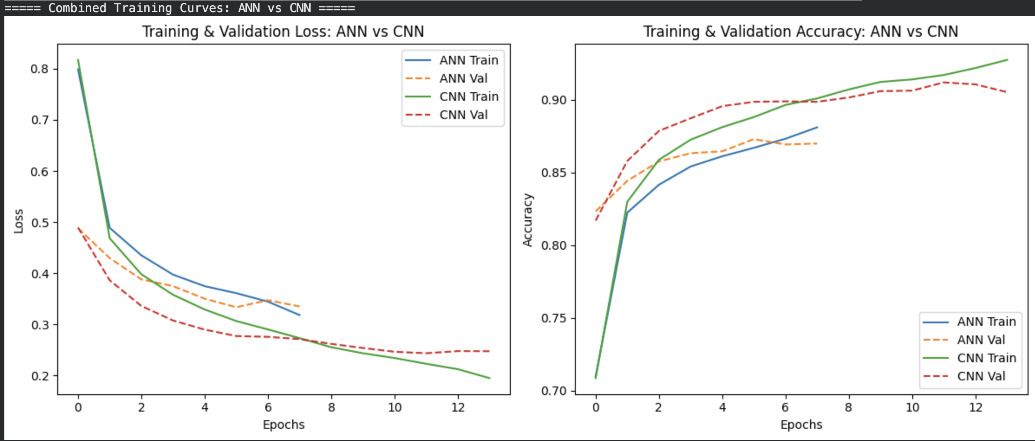
IMPLEMENTATION
Trained ANN and CNN separately for 15 epochs.
Applied XLA JIT for faster computation.
Used validation accuracy for model checkpointing.
Generated plots for loss/accuracy curves and confusion matrices.

Slide 8
RESULTS / FINDINGS
CNN showed best accuracy (90.01 %).
ADNEI offered more balanced performance across metrics.
Ensemble reduced confusion in similar classes (e.g., shirt vs coat).
Model | Accuracy(%) | Precision | Recall | F1 score
ANN | 86.79 | 86.88 | 86.79 | 86.63
CNN | 90.01 | 89.98 | 90.01 | 89.96
ADNEI | 89.58 | 89.54 | 89.58 | 89.49

Slide 9
DISCUSSION / INTERPRETATION
ANN: Captured generalised patterns but struggled with fine visual differences.
CNN: Excelled at spatial feature extraction and visual detail.
ADNEI: Combined both strengths → improved reliability and reduced error rate.
Ensemble results demonstrate how hybrid deep learning enhances accuracy and stability.

Slide 10
CONCLUSION / SUMMARY
Implemented and evaluated ANN, CNN, and ADNEI on Fashion-MNIST.
CNN achieved the highest accuracy (90.01 %).
ADNEI provided better metric balance and model stability.
Ensemble approach validated for robust image classification.
Results highlight the benefits of adaptive deep learning integration.

Slide 11
FUTURE WORK / ACKNOWLEDGMENTS
Introduce data augmentation & learning-rate scheduling to improve accuracy.
Apply Explainable AI (Grad-CAM) for interpretability of model decisions.
Extend ADNEI to transformer or attention-based models for complex datasets.
Deploy the framework in real-world AI applications (fashion, healthcare, fraud detection).
Acknowledgment: Thanks to De Montfort University and TensorFlow open-source community.

Slide 12


