Slide 1

A Neural Network Model for Fashion-MNIST
Image Classification
Creating and comparing ANN and CNN models for image classification using preprocessing techniques and Python.
Student ID: P2661071
Module: CSIP5103
Course: I40073
Date: 13/11/2025

Slide 2
Introduction
Motivation:
This project was selected to meet the core learning outcomes of the module.
A key aim is to determine whether an Artificial Neural Network (ANN) or a Convolutional Neural Network (CNN) performs better for this classification task.
Key Questions:
How accurately can neural networks classify 10 distinct clothing categories?
What preprocessing and normalisation techniques yield the best results?
Which model architecture (ANN vs. CNN) is better for this problem, and what metrics prove this?
Where do the models tend to make mistakes, revealed by confusion matrices?
Background & Context:
This project focuses on image classification, a fundamental problem in computer vision and artificial intelligence.
The goal is to build, train and test neural network models that can accurately classify images of clothing into one of 10 distinct categories: ‘T-shirt’, ‘Trouser’, ‘Pullover’, ‘Dress’, ‘Coat’, ‘Sandal’, ‘Shirt’, ‘Sneaker’, ‘Bag’, and ‘Ankle boot’.
The Fashion-MNIST dataset is a widely used benchmark consisting of 70,000 small 28x28 pixel greyscale images.

Slide 3
Project Objectives and goals
Core objectives:
To build and configure both an ANN and CNN in Python using Google Colab and GitHub.
To correctly load, preprocess and normalise the dataset, splitting it appropriately into training, testing and validation sets.
To train and evaluate both models' performance using key metrics such as test accuracy, confusion matrices and plotting.
Compare and analyse ANN and CNN results, suggesting areas for improvement.
Demonstration aims:
Develop a practical understanding of how to build and train neural networks.
Present clear, evidence-based findings on which architecture is more effective for image classification and why.
An analysis of the models’ shortcomings and suggest possible improvements.
Main aim: to successfully develop, test and compare two different neural network models (ANN and CNN) for the task of Fashion-MNIST image classification.

Slide 4

Methodology and approach
Project workflow:
Data loading, preprocessing & splitting.
Model implementation: ANN & CNN.
Train both models on the training set, using validation set to monitor for overfitting.
Final evaluation and comparison: test both models on unseen data.
Tools:
Language: Python 3.
Core Libraries: torch.nn, torch.optim, torchvision.
Evaluation: scikit-learn (for classification and confusion matrices).
Visualisation: Matplotlib and Seaborn.
Notes:
1) normalize, one-hot encoding, data augmentation, training, test and validation sets, 2) multi-layer perceptron for ANN.4

Slide 5
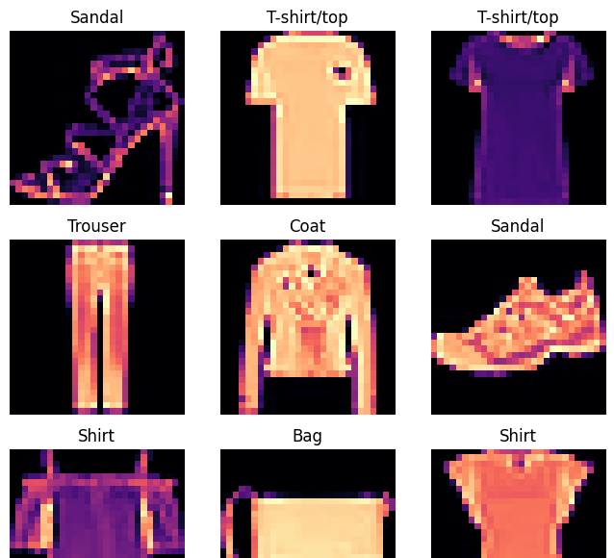
Data/materials/inputs
Dataset loaded via ‘keras.datasets’.
The 70,000 images are split into training (50,000), test (10,000) and validation (10,000) sets.
Preprocessing:
Pixel values are normalised from [0, 255] range to [0, 1].
Class labels (0-9) were one-hot encoded.
Data augmentation was applied in the CNN model to increase the size and diversity of the training set, helping to reduce overfitting.

Slide 6
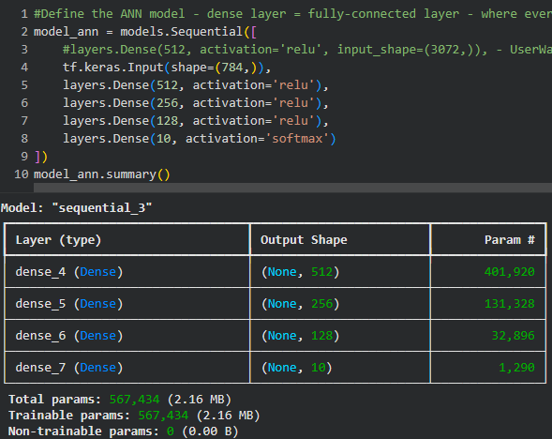
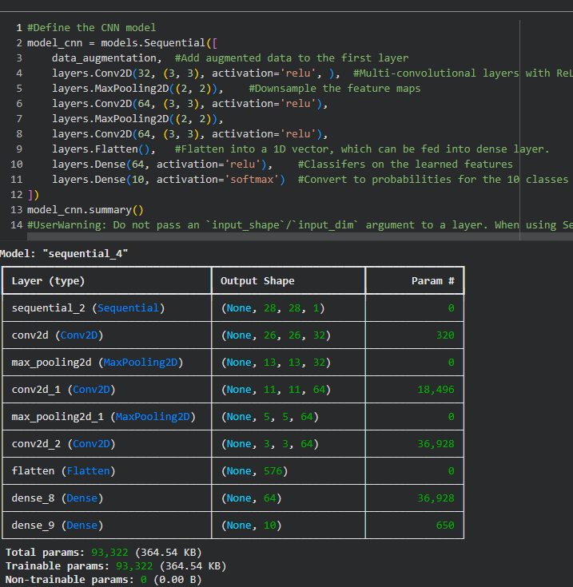
Implementation and process
ANN (Multilayer Perceptron) implementation: Input images were flattened to a 1D vector of 784 pixels; each neuron in a layer is fully connected to all neurons in the previous layer. The ReLU activation function is used in the hidden layers to introduce nonlinearity, and the Softmax activation function is used in the output layer to model probabilities.Network is compiled using Adam optimiser and categorical cross-entropy loss function.
CNN implementation: input models were kept as 2D to preserve spatial data. Augmented data was added to the first layer. Multiple convolutional layers with ReLU activation are used to learn hierarchical features and max pooling to downsample the feature map, before the data is flattened into a 1D vector for the dense layers to apply ReLU and SoftMax.

Slide 7
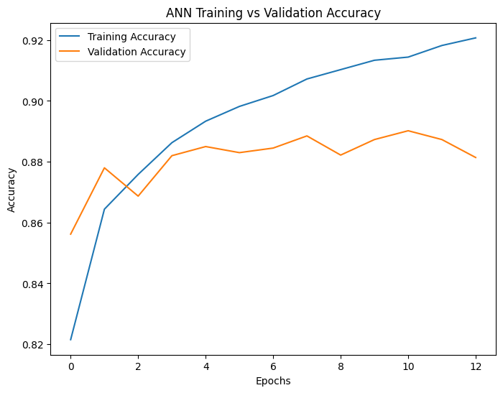
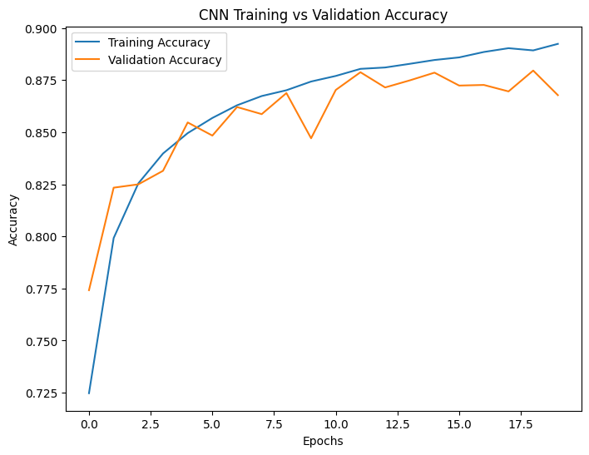
Results and findings
The ANN Achieved An Overall Test Accuracy Of 88.31%, While The CNN Achieved 87.77%. The ANN’s Validation Accuracy Peaked At 89% (Epoch 11), With The Best Weights Restored From Epoch 10 (Val Loss: 0.3103). The CNN's Validation Accuracy Peaked At 87.9%, With The Best Weights Restored From Epoch 15 (Val Loss: 0.3385).

Slide 8
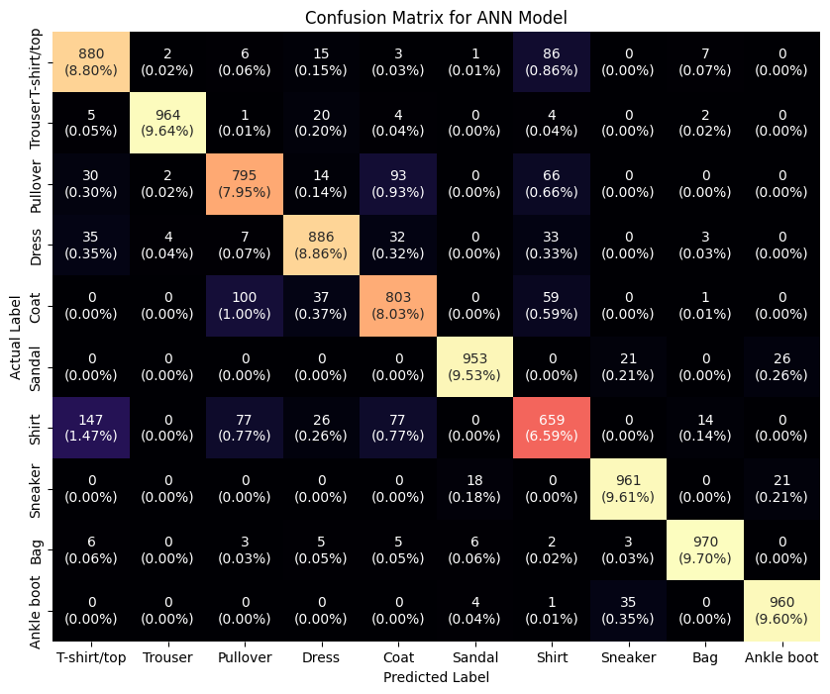
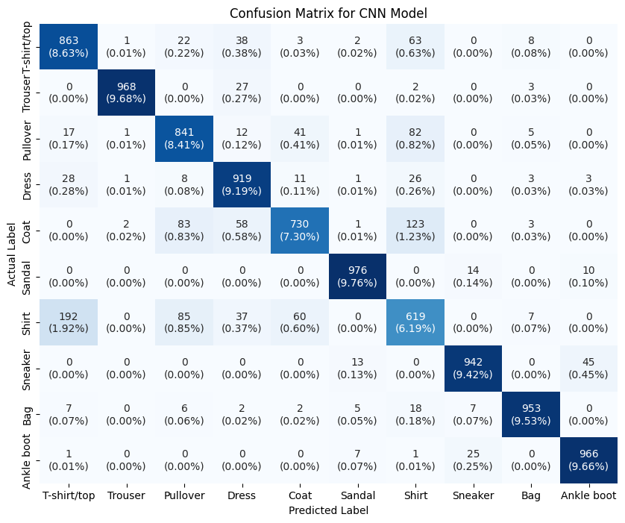
Discussion and interpretation
The simpler ANN (MLP) model outperformed the CNN, which is unusual for image classification because CNNs are designed to handle spatial data and hierarchical patterns. This suggests that my CNN architectural design was perhaps too simple or that the dataset simply suited ANNs well.
As seen in the confusion matrices, both models struggled with visionally similar categories. ‘Shirt’ was the most confused class. Frequently mis-predicated as ‘Shirt’, ‘Pullover’, or ‘Coat’.
Notes:
28x28 greyscale pixel images.

Slide 9
conclusion
Achievements:
Key takeaways:
Successfully built, trained and evaluated an ANN and CNN model to classify the Fashion-MNIST dataset.
Both models achieved high accuracy, with ANN performing slightly stronger than CNN.
While CNNs are typically superior for complex image tasks, this ANN (MLP) proved highly effective for this dataset, demonstrating strong classification power from flattened pixel data.
The primary limitation of both models is their difficulty in distinguishing between visually similar items, such as different types of tops (Shirts, Coats, Pullovers).

Slide 10
Future work
Tune hyperparameters such as optimiser, learning rate for both models.
Implement a more complex CNN architecture like ResNet or VGG to see if it can better capture spatial hierarchies and overcome the ANN’s performance.
Dropout regularisation was tested, but it performed slightly worse, suggesting minimal overfitting due to early stopping.
Acknowledgements:
Module leader: Amudhavel Jayavel
Dataset: Zalando Research (Fashion-MNIST)
Tools: TensorFlow, Keras, Matplotlib, NumPy, Google Colab, GitHub and Python 3.
Notes:
Early stopping: preventing the program from running extra epochs if it is unlikely to improve.

