Slide 1
Comparative Analysis of ANN and CNN on Fashion-MNIST
Shalom Raja Kasim (P2933643)

Slide 2


Introduction and Problem Statement
Project Context
The Problem
This project builds, trains, and tests deep learning models to classify images from the Fashion-MNIST dataset.
The core problem is the need for an automated system that can accurately and efficiently categorize ten different types of fashion goods (e.g., T-shirts, trousers, jackets) from 28x28 greyscale photographs.
The primary goal is to explore how well different neural network architectures perform and understand the factors that affect model error.

Slide 3


Project Objectives
How does a Convolutional Neural Network (CNN) perform on this task versus a basic Artificial Neural Network (ANN)?
What are the most significant aspects influencing model performance and causing errors?
To determine the superior architecture for this specific image-based classification task.

Slide 4





Methodology: Two Models Compared
ANN (MLP)
CNN
Framework
A baseline Multi-Layer Perceptron. This simple design has 3 fully connected layers (784 inputs → 128 nodes → 64 nodes → 10 outputs).
A Convolutional Neural Network comprising 2 convolutional layers, a MaxPool2d layer, and 2 fully connected layers to process spatial data.
Both models were built, trained, and evaluated using PyTorch and the Torchvision library for loading the dataset.

Slide 5
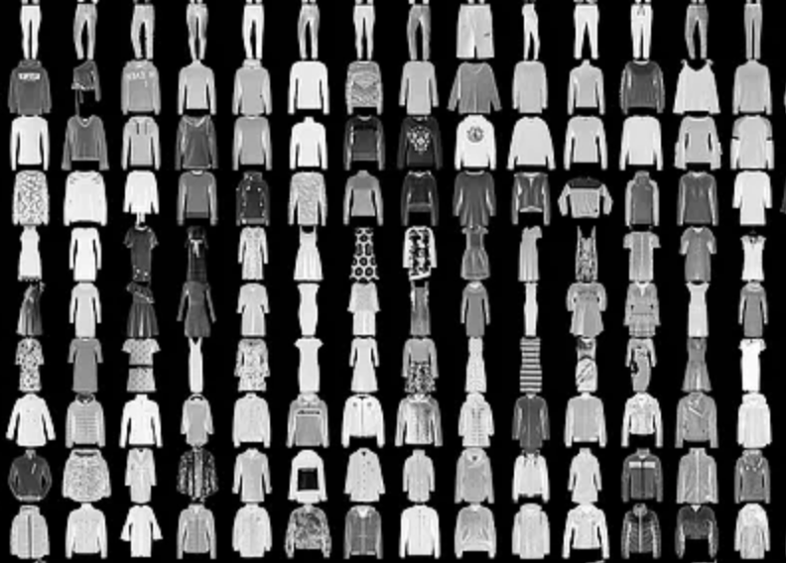
The Dataset: Fashion-MNIST
•
Source: The Fashion-MNIST dataset, available in `torchvision.datasets`.
•
Content: 70,000 total 28x28 greyscale images across 10 distinct fashion categories.
•
Split: The data was divided into 60,000 samples for training and 10,000 samples for testing.
•
Preprocessing: All pixel values were normalized before being fed into the models.

Slide 6
Implementation Workflow
2. Preprocess
4. Train & Evaluate
Normalize pixel values and split the training data into training and validation sets.
Train the networks and evaluate their final performance on the test set using accuracy.
1. Load Data
3. Design Models
Load the Fashion-MNIST dataset using Torchvision and create data loaders.
Implement the simple ANN (MLP) and the CNN architectures in PyTorch.

Slide 7
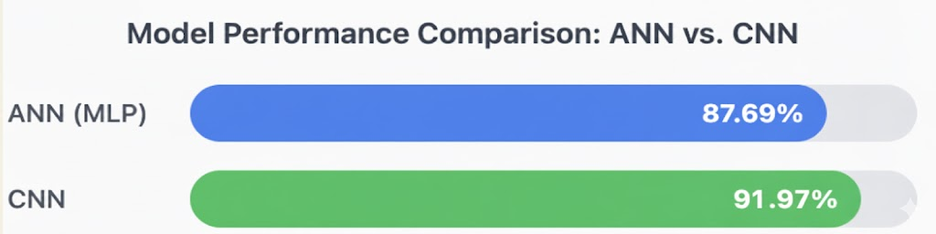
Results: Final Test Accuracy
The final evaluation on the 10,000-image test set clearly shows how well the CNN performed. The outcomes unequivocally show how advantageous the CNN architecture is for this image-based task.

Slide 8
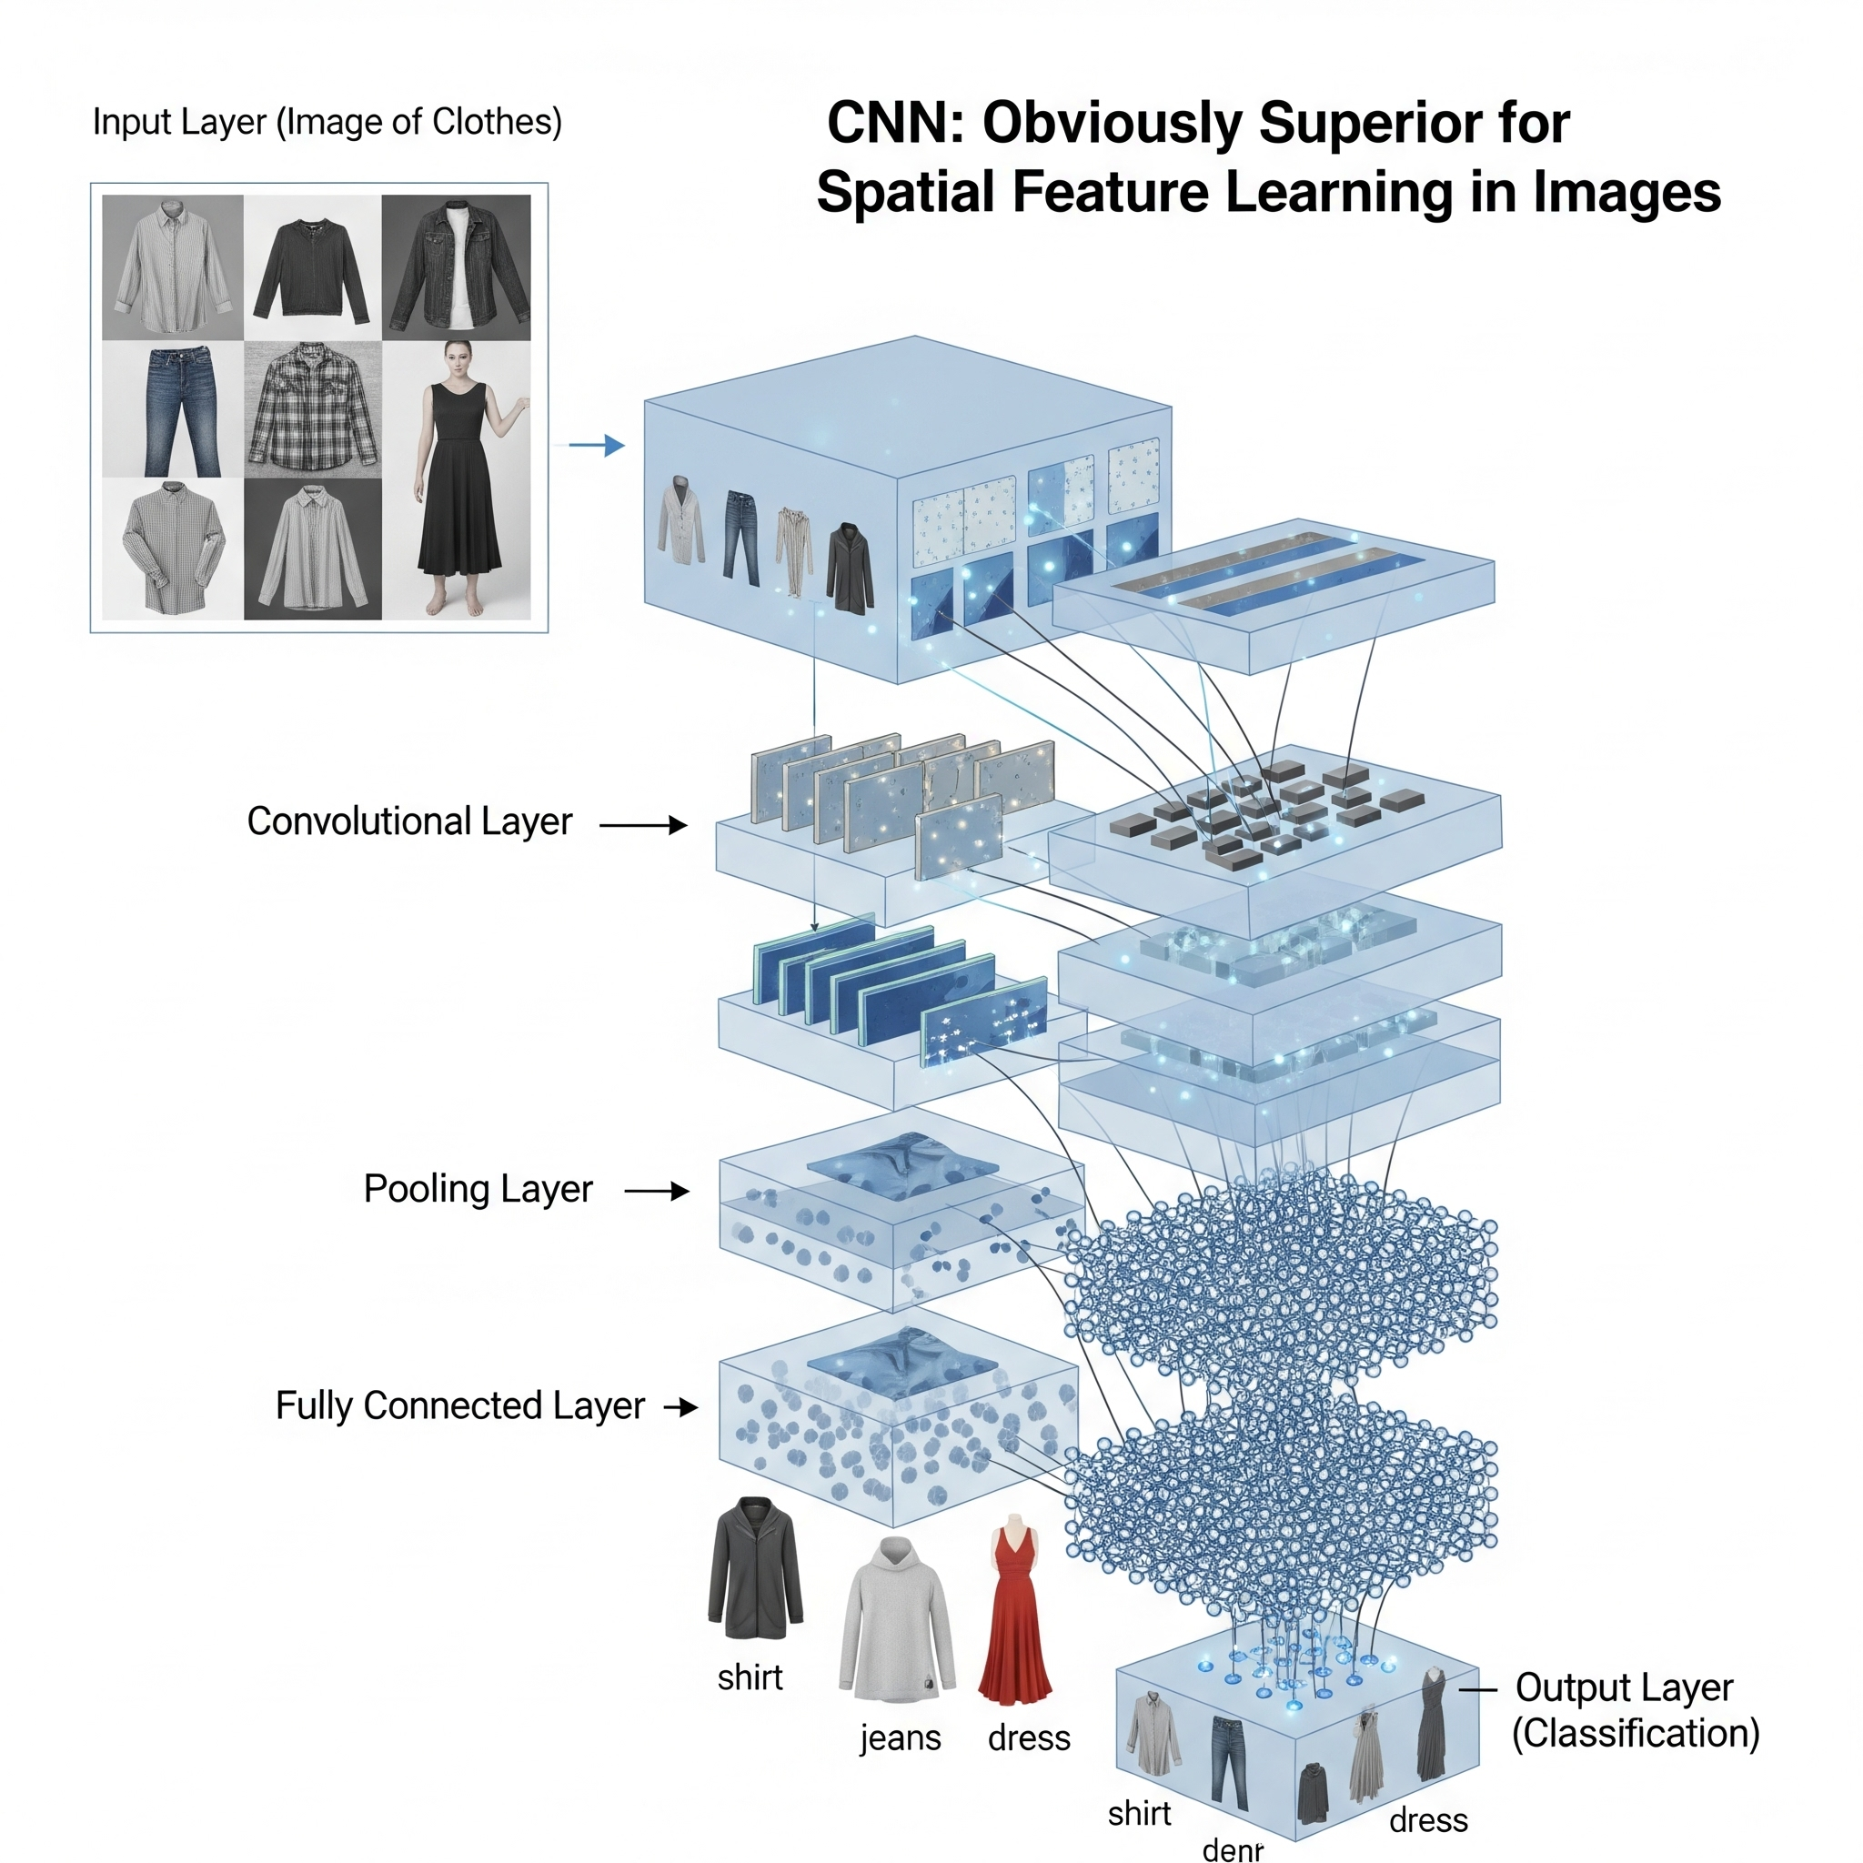

Discussion: Why the CNN Won
•
Key Insight: The CNN is the "obviously superior" model because its architecture is designed to learn spatial characteristics (features, patterns, and edges) from images.
•
Error Analysis: The faults in the model are not random. The confusion matrix shows the model struggles to distinguish between visually similar classes.
•
Main Challenge: The most confused items were "T-shirt/top," "Shirt," "Pullover," and "Coat."

Slide 9
Conclusion & Key Takeaway
The CNN's architecture is designed to learn spatial characteristics, making it the obviously superior model for this image job, with a 92.25% accuracy rate.
"
"
— The main takeaway... is that the model's principal shortcoming is not random mistakes but rather a specific, high confusion rate between visually similar objects.

Slide 10





Recommendations & Future Work
Data Augmentation
Refine Architecture
Optimize Training
Experiment with other optimisers (like SGD with momentum), modify the learning rate scheduler, or train for additional epochs.
Apply transformations (e.g., random rotations, zooms, horizontal flips) to the training photos to prevent misunderstanding between visually similar classes.
Add Batch Normalization layers following convolutional layers to help stabilise training and possibly enhance convergence.

Slide 11
"
THANKYOU
"
SHALOM KASIM

