Slide 1
Image Classification on Fashion-MNIST:
A Comparative Study of ANN and CNN Architectures
Course:
Neural Systems & NLP - CSIP5103_2025_601
Presented by:
Tobi Obadiah
P2936872

Slide 2
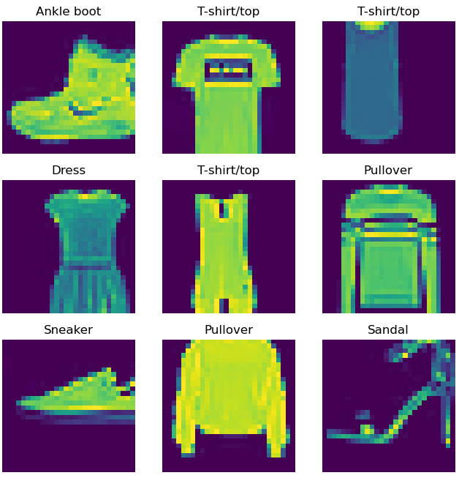
Project Overview
Objective:
To develop and compare two neural network models for classifying fashion images into 10 categories.
Fashion-MNIST Dataset:
60,000 training images + 10,000 test images.
Grayscale, 28x28 pixels.
10 Classes: T-shirt, Trouser, Pullover, Dress, Coat, Sandal, Shirt, Sneaker, Bag, Ankle boot.

Slide 3
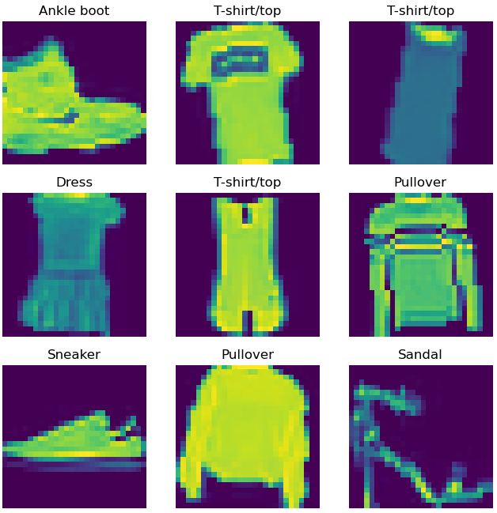
Preparing the Data
Preprocessing:
* Scaled pixel values from [0, 255] to [0, 1] using ToTensor().
* Normalized using Fashion-MNIST specific means (0.2859) and standard deviations (0.3530)
Data Augmentation (Training Set Only):
* Why? To improve model generalization and prevent overfitting.
* Techniques: Random Horizontal Flips, Random Rotations (±10°), Random Resized Crops.

Slide 4
The Two Models: ANN vs. CNN
Multi-Layer Perceptron (ANN):
* Input: Flattened 28x28 image (784 pixels).
* Architecture: 4 Fully Connected (Linear) layers: 784 → 512 → 256 → 128.
* Activation: ReLU.
* ANN Parameters: 567,434
Convolutional Neural Network (CNN):
* Feature Extraction: 3 Conv Layers with BatchNorm and MaxPooling.
* Classifier: Adaptive Average Pooling → 64 units → Output.
* Key Idea: Learns spatial hierarchies of features (edges, textures, patterns).
* CNN Parameters: 224,906

Slide 5
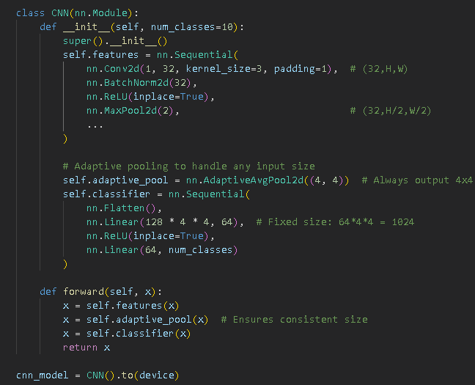
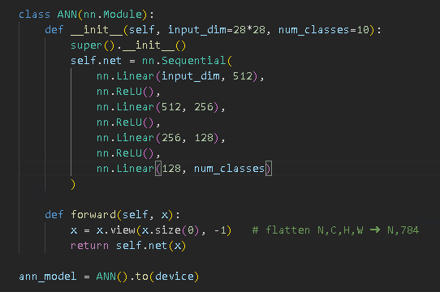
Implementation Highlights

Slide 6
Experimental Setup & Key Results
Training Configuration (Identical for both):
* Loss Function: CrossEntropyLoss
* Optimizer: Adam (lr=0.001)
* Epochs: 15
* Batch Size: 64
Final Test Accuracy:
* ANN Model: 87.4%
* CNN Model: 92.2%

Slide 7
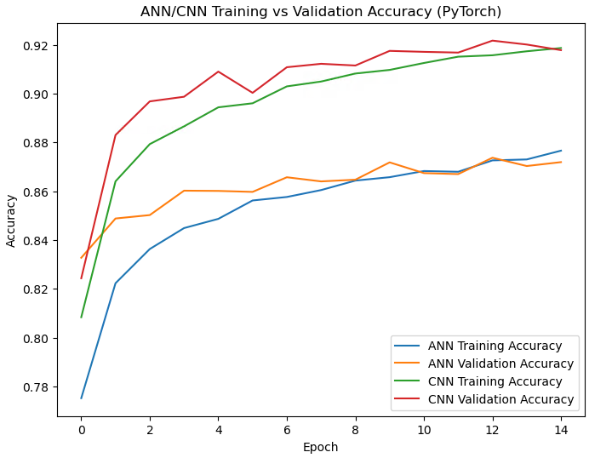
Performance Comparison
Key Takeaways from the Plot:
* CNN achieves higher accuracy from the start.
* CNN's validation accuracy is more stable and consistently higher than the ANN's.
* This graph provides clear, visual evidence of the CNN's superiority.

Slide 8
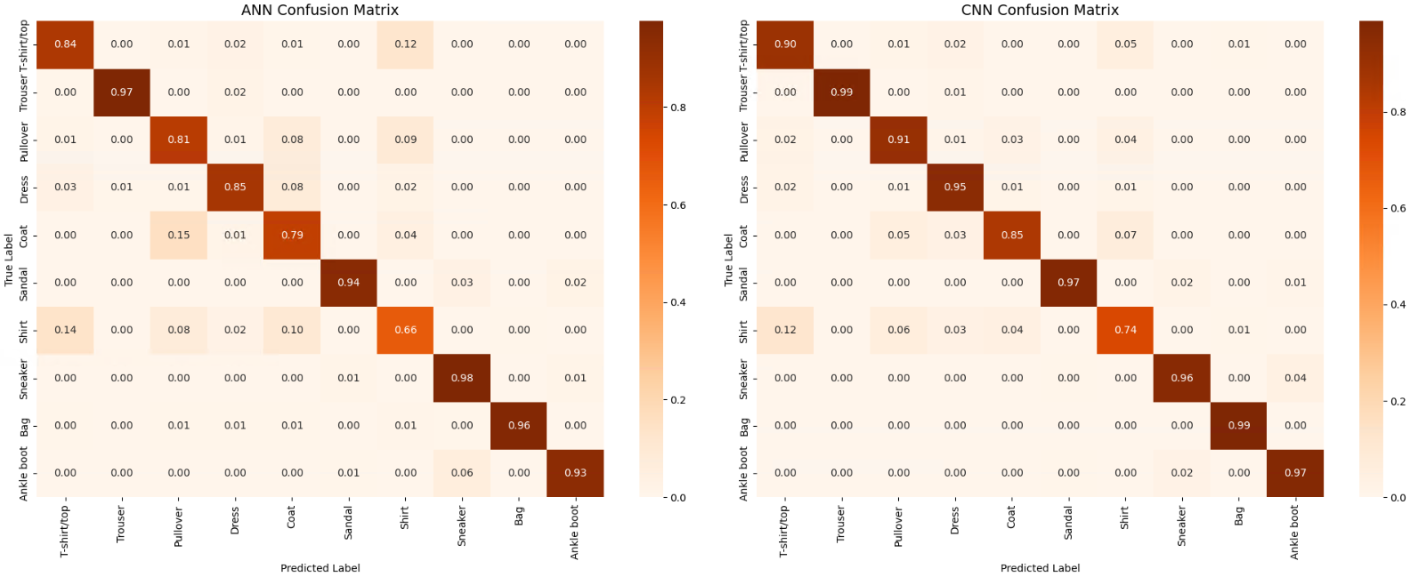
Confusion Matrices

Slide 9
Why Did the CNN Perform Better?
Spatial Hierarchies:
CNNs are designed (using filters) to learn local patterns (edges, corners) and combine them into more complex features (sleeves, collars). This is ideal for images.
Parameter Sharing:
Filters are shared across the image, making CNNs more efficient and requiring fewer parameters than a similarly powerful ANN.
Translation Invariance:
A bag is a bag, whether it's in the corner or center of the image. CNNs naturally handle this.
The ANN's Limitation:
By flattening the image, the ANN loses all spatial information, treating nearby pixels equally, which is not optimal.

Slide 10
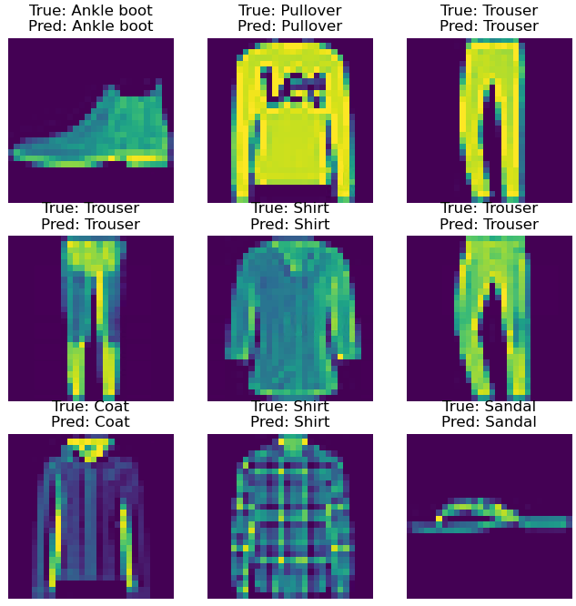
Model Predictions on Test Set (CNN)

Slide 11
Conclusion & Next Steps
Conclusion & Next Steps
Conclusion & Next Steps
Conclusion:
* CNNs are demonstrably more effective for image classification than ANNs, as shown by the 3.9% performance gain.
* The architectural advantages of CNNs in processing spatial information are clear and decisive.
Future Improvements:
* Hyperparameter Tuning: Using SGD optimizer with adaptive learning rate, training for longer epoch.
* Advanced Architectures: Use pre-trained models (Transfer Learning) or deeper CNNs like ResNet.

Slide 12
Thank You & Questions
Presented by:
Tobi Obadiah
P2936872

