Slide 1
Fashion-MNIST Classification Using ANN and CNN
Presenter: [Ahsan Khalid / P2955075]
Course: [Neural Systems]
Date: [17/11/2025]

Slide 2
Introduction
Fashion-MNIST is a benchmark image dataset for clothing classification.
Replaces MNIST digits with more complex visual features.
Project explores deep learning models to improve accuracy.
Comparison between ANN and CNN architectures.
Notes:
Explain dataset purpose and why deep learning comparison is meaningful.

Slide 3
Objectives / Goals
Build, train, and evaluate ANN and CNN on Fashion-MNIST.
Compare accuracy and confusion patterns.
Apply best practices in preprocessing and model tuning.
Suggest improvements for future enhancement.

Slide 4
Methodology / Approach
Frameworks: PyTorch.
ANN: fully connected layers with ReLU and Softmax.
CNN: convolutional + pooling layers for spatial features.
Evaluation: accuracy, loss curves, confusion matrix.
Notes:
Include a model architecture diagram for ANN and CNN.

Slide 5
Data / Materials / Inputs
Dataset: Fashion-MNIST (60k training, 10k test images).
Preprocessing: normalized pixel values (0–1).
Data split: training, validation, and testing sets.
Data loader used for batch processing.

Slide 6
Implementation / Process
ANN: 3 dense layers (input → hidden → output).
CNN: 2 convolutional layers + max pooling + FC output.
Training setup: Adam optimizer, CrossEntropy loss, 20 epochs.
GPU acceleration for faster training.

Slide 7
Results / Findings
ANN Accuracy ≈ 85%; CNN Accuracy ≈ 90–92%.
CNN outperforms ANN due to spatial learning.
Confusion between visually similar classes (e.g., coat vs. shirt).
Visuals: accuracy/loss curves, confusion matrix.
Notes:
Insert graphs and confusion matrix visuals.

Slide 8
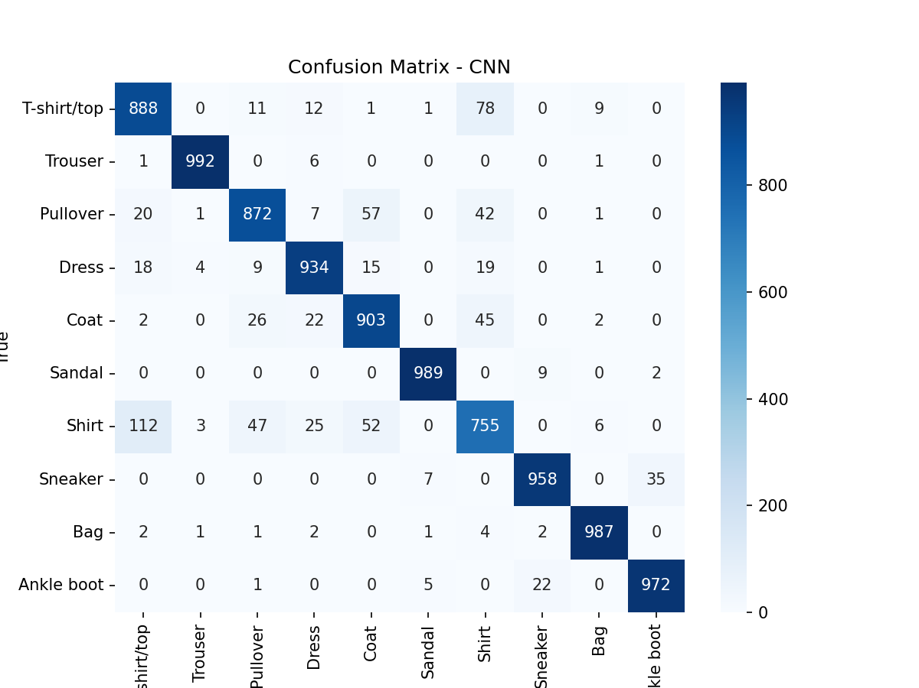
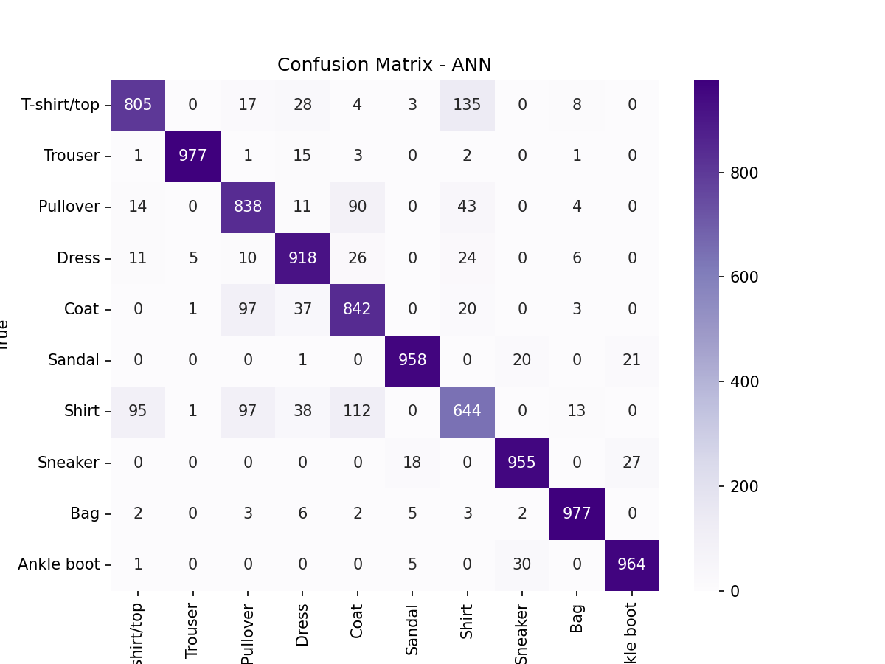
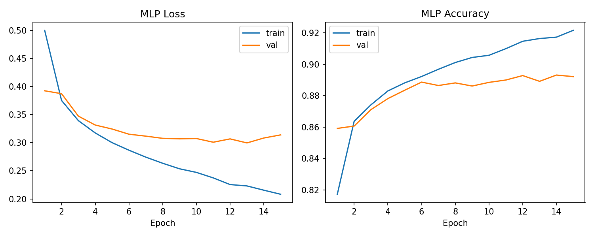

Slide 9
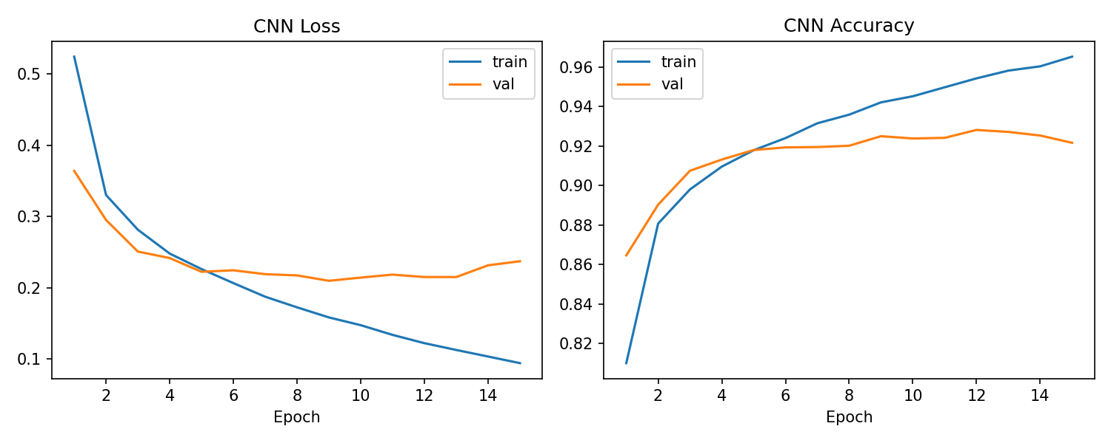
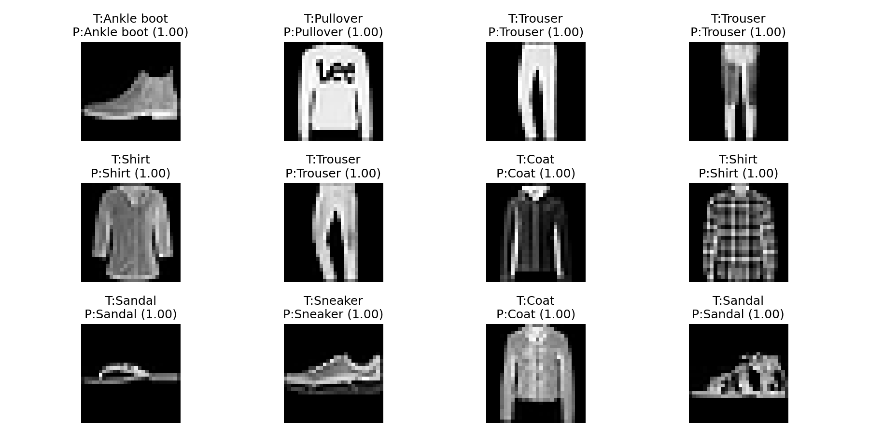

Slide 10
Discussion / Interpretation
CNN generalizes better through spatial hierarchies.
ANN limited by flat feature representation.
Dropout and regularization reduce overfitting.
Feature visualization enhances explainability.

Slide 11
Conclusion / Summary
CNN superior for image-based classification tasks.
Both models achieved strong learning performance.
Gained understanding of architecture design and evaluation.

Slide 12
Future Work / Acknowledgments
Future Enhancements: data augmentation, advanced CNNs.
Add learning rate schedulers for optimization.
Acknowledgments: supervisor, PyTorch/TensorFlow resources.
References: Fashion-MNIST GitHub, related research papers.

