Slide 1
Module Name - Artificial Neural Networks & NLP
Module Code - CSIP5103
A Neural Network Model for Fashion-MNIST
Image Classification – Presentation
Student ID - P2938154
Student Name - Patel jay Maheshkumar

Slide 2
Introduction
This report provides the technical application of image classification with the help of the “Fashion-MNIST dataset”, which provides grayscale images of clothing elements of ten categories.
Accurate classification of images by two models of deep learning, an “Artificial Neural Network (ANN)” and a “Convolutional Neural Network (CNN)”, are aimed to be designed, trained, and evaluated.
Notes:
The comparison shows the way the various network architectures treat spatial data and what the areas of confusion between similar classes, visually like shirts and coats, share.

Slide 3
Objectives / Goals
To generate and contrast the Fashion-MNIST image classification Artificial Neural Network (ANN) and Convolutional Neural Network (CNN) models.
To determine the accuracy of models, performance, and misclassification trends according to clothing category.
To illustrate the best feature extraction that CNN has, and recommend how it can be improved to achieve better generalization and reliability.
Notes:
The slide has outlined the main goals of the project that involve the development and comparison of ANN and CNN models, the ability of the models to perform classification tasks and the fact that the CNN has a greater ability to detect the visual features successfully.

Slide 4
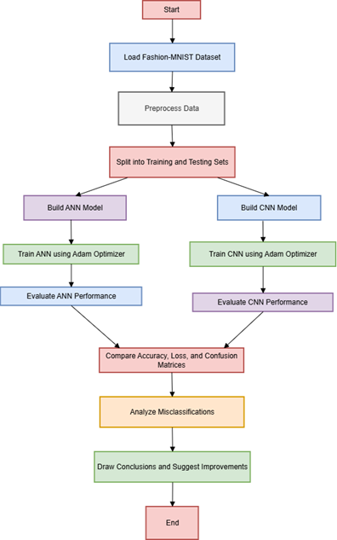
Methodology / Approach
ANN and CNN models were implemented and trained on the Fashion-MNIST dataset with the utilisation of TensorFlow and Keras (Xhaferra et al. 2022).
Normalisation, category encoding, and applied preprocessing to increase the performance of the models.
Assessed accuracy, loss, and confusion tables to compare architectures and assessability of classification on the various fashion types.
Notes:
The slide has outlined the general methodology adopted, such as preprocessing of the data, model implementation on both TensorFlow and Keras and model evaluation in terms of accuracy, loss and confusion matrix analysis to compare the performance of ANN and CNN models.

Slide 5
Data / Materials / Inputs
Trained on the use of the Fashion-MNIST dataset of 70,000 grayscale images in 10 fashion categories in training and testing.
Normalised and reshaped the data and one-hot encoded the data to feed the ANN and CNN models.
Presumption of equal image size (28×28) as well as equal distribution of classes, so as to have effective model training (Nocentini et al. 2022).
Notes:
The slide has outlined the steps of the data set and preprocessing, including the application of the Fashion-MNIST data, normalisation, reshaping and encoding, and presumption of equal image size and balanced coverage of classes to allow the model to be trained correctly.

Slide 6
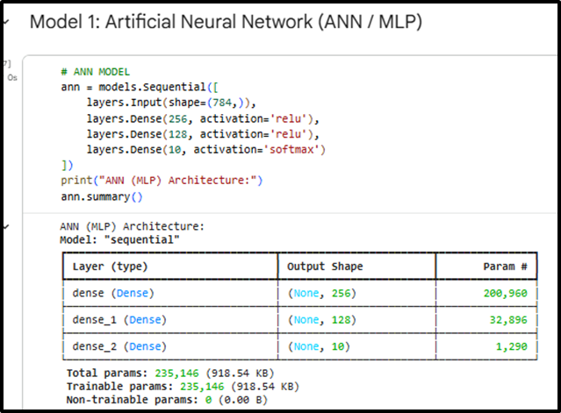
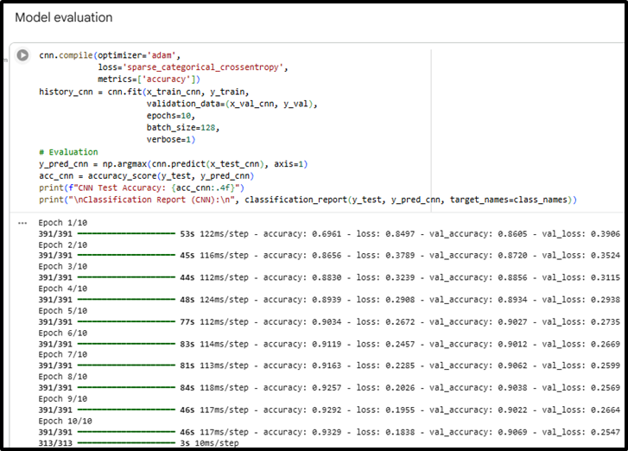
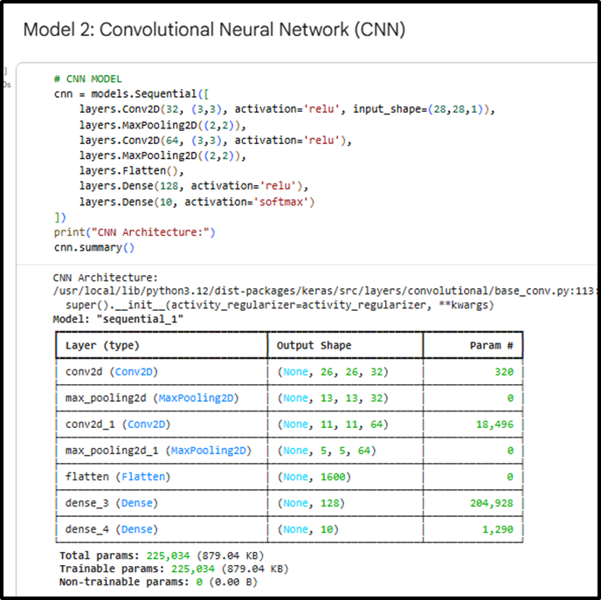
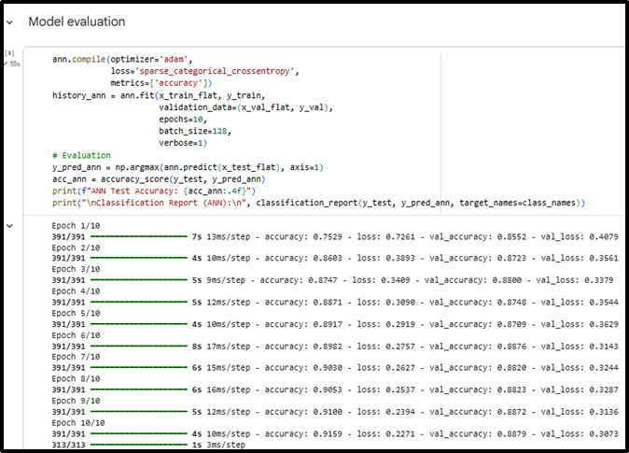
Implementation / Process
The ANN is made of three fully connected layers, two hidden layers with 256 and 128 neurons with the help of the ReLU function, and a softmax output layer with 10 classes
The ANN is made of three fully connected layers, two hidden layers with 256 and 128 neurons with the help of the ReLU function, and a softmax output layer with 10 classes
The default Adam learning rate of 0.001 was used on both models. Other hyperparameters were ReLU activation in the hidden layers, and softmax in the outputs and accuracy as the main measure of evaluation.
Notes:
The parameters gave a trade-off between generalisation and the speed of convergence.

Slide 7
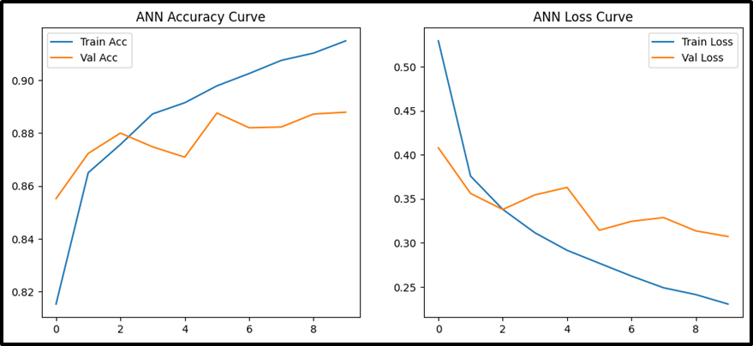
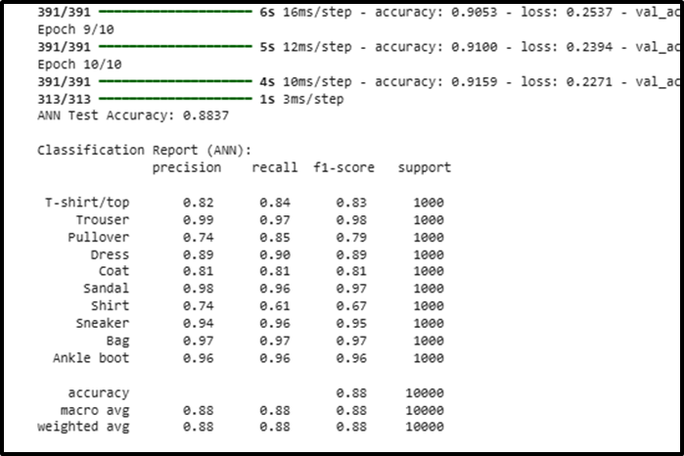
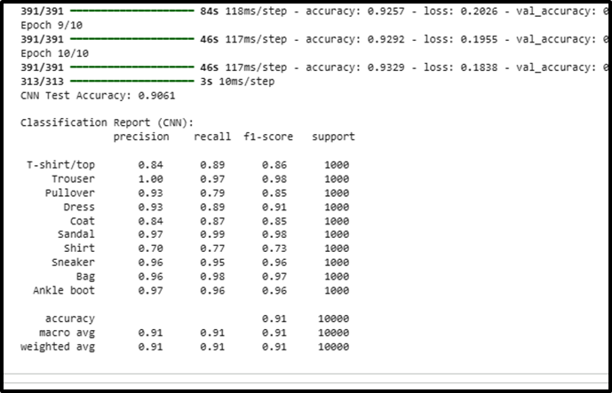
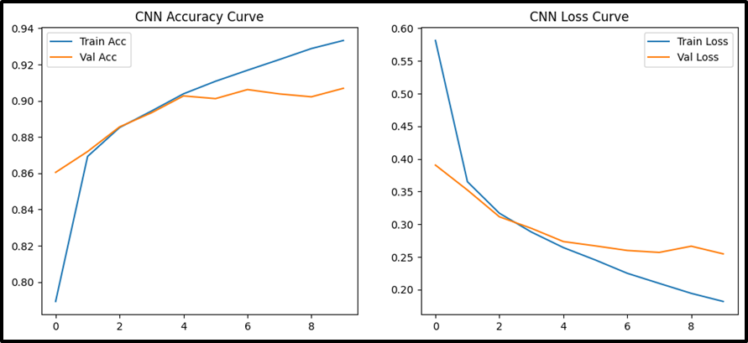
Results / Findings
The ANN model has a consistent improvement with the increase in the number of epochs and eventually reaches around 91.6 percent of training accuracy and 88 percent of validation accuracy.
The CNN model has the limits of around 93.3% training and 90.7% validation accuracy, which is higher generalization in comparison to the ANN.
The ANN scored 88.4 per cent in the test, with good performance in the majority of classes.
The CNN had a test percentage of 90.6, making it better than the ANN.
Notes:
It was able to identify the majority of the classes but had some confusion between the shirt and pullover, owing to their mate visual textures.

Slide 8
Discussion / Interpretation
The CNN performed a lot better than the ANN, with 90.6 and 88.4 test accuracy, respectively.
The convolutional layers of CNN are used to detect spatial and texture features and enhance the recognition of detailed clothing features (Bbouzidi et al. 2024).
Nevertheless, the two models had poor performance with visually similar categories, such as Shirt, T-shirt and Coat, because of overlapping pixel structure.
Notes:
Although ANN was trained quickly and used fewer hard powers, it did not have spatial recognition. CNN was more accurate, but it required more resources and time to train. The two models have good generalization, with CNN being more applicable to image tasks.

Slide 9
Conclusion / Summary
Its performance on the model is summarised, with CNN having a higher accuracy (90.6) compared to ANN (88.3).
Shows superior spatial feature acquisition and fewer cases of misclassification by CNN.
Finds that CNN is more effective in image-based classification, such as Fashion-MNIST.
Notes:
The major findings have been explained in the slide, with CNN being more accurate, feature learning, and false identification, thus concluding that CNN outperforms ANN when it comes to tasks of recognition of fashion images.

Slide 10
Future Work / Acknowledgments
● Recommends further work like data augmentation, hyperparameter optimization and more profound CNN designs (Sumera et al. 2022).
● Suggests the transfer learning exploration to improve accuracy.
● Credits successful experimentation with the use of Google Colab, TensorFlow, and the Fashion-MNIST dataset.
Notes:
The slide has presented the possible future innovations, such as data augmentation, model tuning, and recognised the important resources necessary to implement deep learning, which include TensorFlow, Google Colab, and Fashion-MNIST.

Slide 11
References
Xhaferra, E., Cina, E. and Toti, L., 2022, October. Classification of standard fashion MNIST dataset using deep learning based CNN algorithms. In 2022 international symposium on multidisciplinary studies and innovative technologies (ISMSIT) (pp. 494-498). IEEE.
Nocentini, O., Kim, J., Bashir, M.Z. and Cavallo, F., 2022. Image classification using multiple convolutional neural networks on the fashion-MNIST dataset. Sensors, 22(23), p.9544.
Bbouzidi, S., Hcini, G., Jdey, I. and Drira, F., 2024. Convolutional neural networks and vision transformers for fashion mnist classification: A literature review. arXiv preprint arXiv:2406.03478.
Sumera, S.R., Anjum, N. and Vaidehi, K., 2022. Implementation of CNN and ANN for Fashion-MNIST-Dataset using Different Optimizers. Indian Journal of Science and Technology, 15(47), pp.2639-2645.

Slide 12
THANK YOU…

