Slide 1

COMPARATIVE STUDY OF ENHANCED ANN AND CNN MODELS FOR FASHION-MNIST IMAGE CLASSIFICATION
STUDENT ID : P2901017

Slide 2
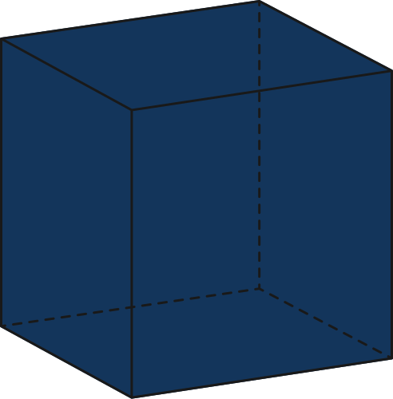

INTRODUCTION
Background: Artificial Neural Networks (ANNs) and Convolutional Neural Networks (CNNs) are powerful learning models widely used in image classification.
Motivation: While ANNs process flattened data, CNNs learn spatial hierarchies directly from images — a key advantage in visual tasks.
Aim of the Study: To build, enhance, and compare the performance of ANN and CNN models on the Fashion-MNIST dataset, using improved regularization and augmentation techniques.

Slide 3
OBJECTIVES / GOALS
Primary Objectives:
Design and implement enhanced ANN and enhanced CNN architectures using PyTorch.
Apply data normalization, augmentation, and regularization to improve generalization.
Evaluate model performance using multiple metrics — accuracy, loss curves, and confusion matrices.
Expected Outcome:
CNN is expected to outperform ANN due to its ability to extract spatial features from images.

Slide 4
Step-by-Step Framework:
Dataset Preparation: Load, normalize, and augment Fashion-MNIST.
Model Development: Construct and fine-tune ANN and CNN architectures.
Training Strategy: Optimize with RMSprop, monitor validation loss, apply learning rate scheduling.
Evaluation: Compare results using test accuracy, per-class recall, and confusion matrix.
METHODOLOGY / APPROACH
Tools & Frameworks:
Programming: Python (PyTorch)
Visualization: Matplotlib, Seaborn
Optimization: RMSprop (lr=0.01, weight decay=1e-4)
(INCLUDE FLOWCHART: DATA → PREPROCESSING → MODEL DESIGN → TRAINING → EVALUATION)

Slide 5
DATA / MATERIALS / INPUTS
Dataset:
Image Size:
Fashion-MNIST — 70,000 grayscale images of clothing items (10 categories).
Split: 50k training, 10k validation, 10k testing.
28 × 28 pixels, single channel (grayscale).
Preprocessing:
Dataloader Configuration:
Normalization using mean = 0.1307 and std = 0.3081.
Data Augmentation (applied to training set only):
RandomRotation(10°)
RandomHorizontalFlip (p=0.5)
RandomCrop(28, padding=2)
Batch size = 128, shuffle = True, num_workers = 2.

Slide 6
Enhanced ANN (Multi-Layer Perceptron):
Input: Flattened 784 features
Hidden Layers: 512 → 256 → 128 (ReLU activations) •
Enhancements: BatchNorm1d and Dropout (p=0.5) to prevent overfitting
Parameters: 569,226
IMPLEMENTATION / MODEL DESIGN
Enhanced CNN (Convolutional Neural Network):
Convolution Blocks: (1→32→64→128) with 3×3 kernels, padding=1
Each block includes BatchNorm2d, ReLU, MaxPooling (2×2), Dropout2d (0.25)
Fully Connected Layer: 256 neurons + Dropout(0.5) → Output(10)
Parameters: 391,370

Slide 7
TRAINING AND EVALUATION
Training Configuration:
Epochs: 20
Loss Function: CrossEntropyLoss
Optimizer: RMSprop
Scheduler: ReduceLROnPlateau (factor=0.5, patience=3)
Validation Strategy:
Monitored accuracy and loss per epoch.
Saved model with best validation performance.
Performance Trends:
ANN: ~73% training → 80% validation accuracy
CNN: ~85% training → 89% validation accuracy

Slide 8
RESULTS AND ANALYSIS
Per-Class Improvement (CNN vs ANN)
Shirt: +23%
Pullover: +20%
Coat: +14%
Model | Validation Accuracy | Test Accuracy
ANN | 80.12% | 79.79%
CNN | 89.29% | 88.72%
Confusion Matrix Insights
CNN greatly reduced misclassifications (e.g., Shirt→T-shirt: 233→107).
Highest accuracy: Sneakers (98%) and Trousers (97%)
Most confusion: Upper body wear classes due to grayscale similarity.

Slide 9
Key Takeaways:
CNN outperformed ANN by ~9%, demonstrating its strength in spatial feature learning.
Regularization (Dropout, BatchNorm) effectively reduced overfitting.
Data augmentation improved robustness and generalization
DISCUSSION AND KEY INSIGHTS
Challenges:
Visual similarity between certain classes (shirt, coat, pullover)
Limited color information in grayscale images. )
Interpretation:
CNNs provide scalable, hierarchical representations suitable for real-world image recognition tasks.

Slide 10
CONCLUSION AND
FUTURE WORK
Summary:
Implemented and compared enhanced ANN and CNN architectures on Fashion-MNIST.
CNN achieved superior classification accuracy and robustness.
Analysis revealed how architecture choice impacts performance and error patterns
Future Scope:
Integrate deeper networks (e.g., ResNet, VGG).
Apply transfer learning for faster convergence.
Extend evaluation to colored and real-world datasets (e.g., CIFAR-10)
Acknowledgments:
Zalando Research for the Fashion-MNIST dataset.
PyTorch, Matplotlib, Seaborn for implementation and visualization.
Mentors and faculty for guidance and support.

Slide 11
THANK YOU

