Slide 1
A Neural Network Model For (Fashion-MNIST) Image Classification
Student ID: P2944593
MSc Artificial intelligence
De Montfort University,
November 2025

Slide 2
Introduction and Problem
The Dataset:
Fashion-MNIST
It contains 70,000 grayscale images (60k training, 10k test) 10 classes like (shirt, coat,).
Each image is 28x28 pixels.
The Task:
To build a model that can correctly classify each image into one of 10 clothing categories (like 'T-shirt/top', 'Trouser', 'Coat', 'Sandal', etc.).
Models: ANN (MLP with 109,386 parameters) CNN ( 225,034 parameters)
Training: Adam optimizer, cross-entropy loss, 17 epochs

Slide 3
Objectives and Learning Outcomes
• Build & train ANN and CNN for classification
• Preprocess images
• compare architectures/performance
• Analyze confusions(Shirt vs Coat) and Suggest improvements

Slide 4
Methodology
Load and Explore: Loaded the data directly from keras.datasets and visualized samples.
Preprocess: Normalize 0-1, add channel, 10% validation split, one hot lablel
Train: Batch 64/128, monitor value loss
Analyze & Compare: Compared test accuracy, F1-scores, and confusion matrices to see which model was better and why.

Slide 5

Data and Preprocessing
• Original shapes: Train 60K (28x28), Test 10K
• After Preprocessing: Normalized, channel added (28x28x1), balanced classes

Slide 6
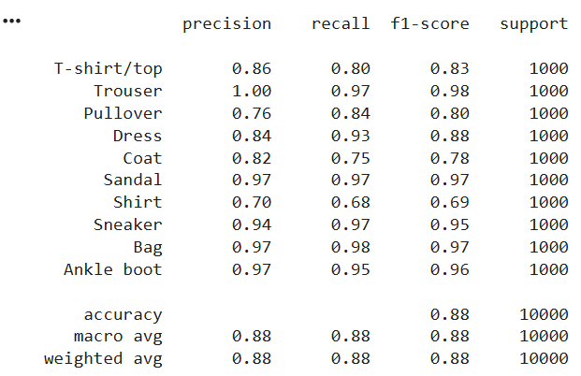
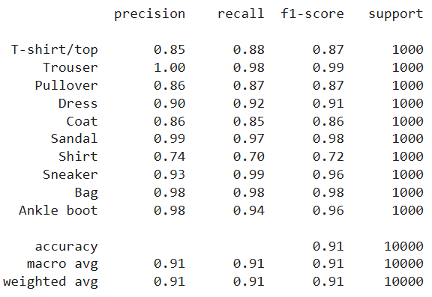
Model Implementation
ANN: Flatten + Dense 128/64 + Droputout 0.2
CNN: Conv2D 32/64 + MaxPool + Dropout 0.3/0.5 + Dense (for features)

Slide 7
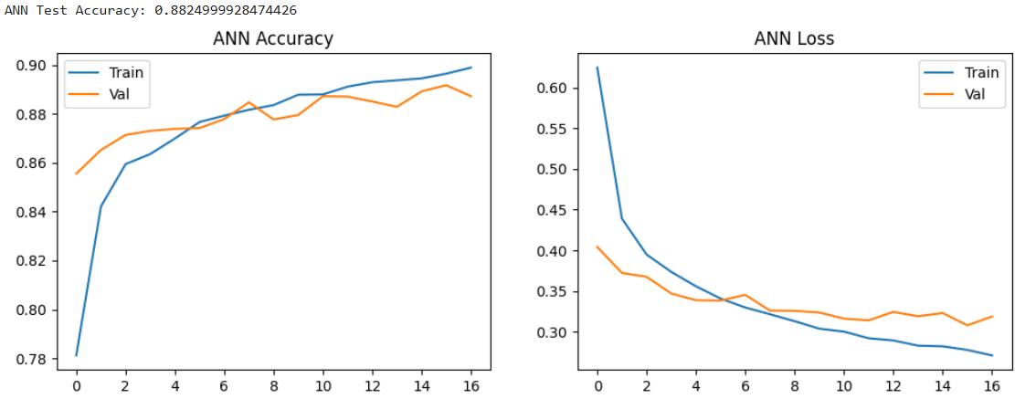
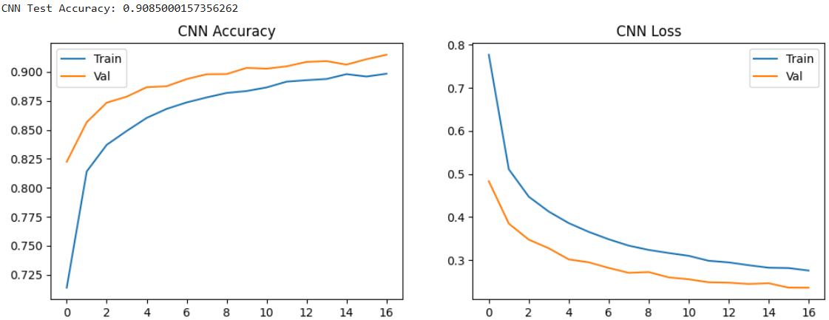
Training Results
ANN Test Accuracy: 88.25%
CNN Test Accuracy: 90.85% (2.6% improvement)
Time ~45-60s GPU

Slide 8
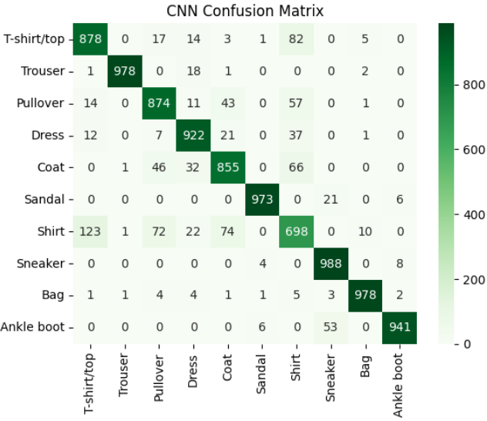
Evaluation and Analysis
CNN Macro Average: 0.91 (Precision/Recall/F1)
Confusions: Shirt vs Coat (~180 in ANN and ~140 CNN misclassifications)
CNN performs better on similar classes

Slide 9
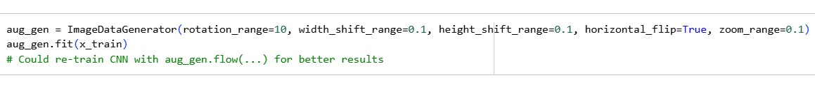
Innovation and Improvements
• Innovation: Data augmentation (rotations/shifts/flips/zoom via ImageDataGenerator)
• Regularization: Dropout 0.2-0.5 minimized overfitting.
• Suggest: Batch normalization/scheduler for >92%

Slide 10
Conclusion and Future Work
• Conclusion: CNN superior due to spatial processing; met all outcomes
• Insights: Preprocessing is the key; confusions highlights challenges (shirt/coat)
Future work: To push accuracy over 92%, I would re-train the CNN using data augmentation.
I also experiment with Batch Normalization layers and a learning rate scheduler to further optimize training.

