Slide 1

A Neural Network Model for Fashion-MNIST Classification
Sneha Yenugula (P2899592)
Neural Networks
04 November 2025

Slide 2
Introduction
Fashion-MNIST dataset: 70,000 grayscale 28x28 images of clothing items.
Challenge: Recognize and classify clothing items accurately using ANN and CNN.
Motivation: Investigate how model architecture, regularization, and hyperparameter tuning affect performance.
Focus: Compare ANN (fully connected) vs CNN (convolutional) models for image classification tasks.

Slide 3
Objectives / Goals
Evaluate and compare test accuracy of ANN and CNN over multiple epochs.
Analyze convergence speed, validation trends, and learning stability.
Examine class-level performance using confusion matrices.
Understand impact of architecture, regularization (dropout), and tuned hyperparameters on performance.
Provide a technical foundation for improving image classification models in future work.

Slide 4
Methodology / Approach
ANN: 4-layer MLP (Flatten → 512 → 256 → 128 → 10) with ReLU and Dropout(0.2).
CNN: 2 convolutional blocks with BatchNorm, MaxPooling, Dropout2D(0.25), then Dense layer 512→10.
Training: Adam optimizer, lr=0.001, weight decay=1e-4, batch size 128, epochs: 5/8/10.
Validation: ReduceLROnPlateau scheduler for adaptive learning rate.
Load Dataset → Data Preprocessing → Model Initialization
Training → Validation → Testing → Evaluation & Visualization

Slide 5
Data / Materials / Inputs
Dataset split: 48k training, 12k validation, 10k testing samples.
Preprocessing: Normalize to [-1,1], convert to tensors, shuffle training set.
Key parameters: batch size 128, reproducible splits, consistent data pipeline.
Tools: PyTorch for model implementation and training, Matplotlib & Seaborn for visualization.

Slide 6
Implementation / Process
Step 1: Load and preprocess Fashion-MNIST data.
Step 2: Initialize ANN and CNN models with tuned hyperparameters.
Step 3: Train models for 5, 8, 10 epochs and record training/validation metrics.
Step 4: Evaluate on validation and test sets; save best-performing models.
Step 5: Generate graphs: training loss, validation loss, accuracy trends.

Slide 7
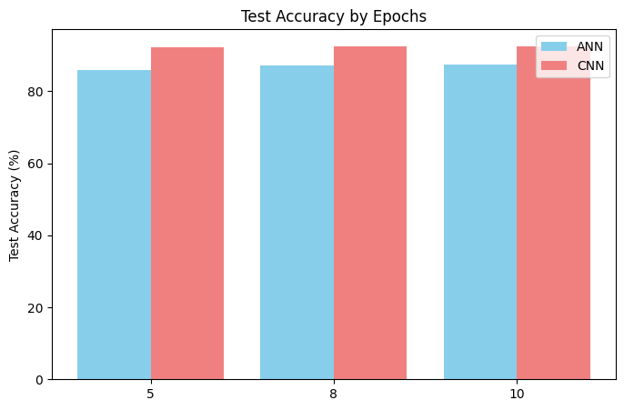
Results / Findings
Validation Accuracy: ANN 82.6→88.3%, CNN 89.0→92.9% over 10 epochs.
Test Accuracy (5/8/10 epochs): ANN 85.9/87.1/87.4%, CNN 92.2/92.4/92.5%.
CNN consistently outperforms ANN due to spatial feature extraction.
Observations: Faster convergence, smoother learning curves, lower misclassification rates.

Slide 8
Discussion / Interpretation
ANN shows confusion between visually similar classes (Shirt→Coat: 92 errors).
CNN reduces this confusion to 54, demonstrating superior spatial feature extraction.
Overall, CNN achieves higher per-class precision and recall.
Insight: Convolutional layers effectively capture hierarchical patterns (edges → textures → object).
Challenges: Misclassification persists for similar textures; handled via Dropout and batch normalization.

Slide 9
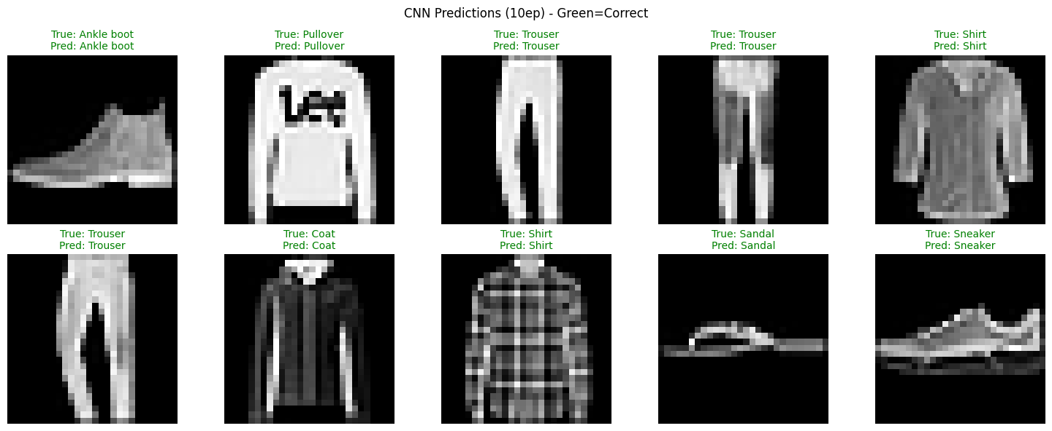
Predictions / Demonstration
Visual examples of CNN predictions (epoch 10).
Green = Correct prediction, Red = Incorrect prediction.
Demonstrates CNN's ability to correctly classify difficult items.
Highlights the effectiveness of convolutional layers and dropout for generalization.

Slide 10
Conclusion / Summary
Trained and evaluated ANN and CNN on Fashion-MNIST dataset.
CNN outperforms ANN in validation and test accuracy across epochs.",
Confusion matrices highlight CNN's improved per-class classification.
CNN captures spatial hierarchies, enhancing accuracy for similar items.
Regularization and hyperparameter tuning improved generalization.

Slide 11
Future Work / Acknowledgments
Apply data augmentation (rotations, flips, scaling) for robustness.
Explore deeper CNNs (ResNet-18, EfficientNet) for higher accuracy.
Experiment with advanced LR schedules and optimizers.
Acknowledgments: Fashion-MNIST dataset, PyTorch, Matplotlib, Seaborn, supervisor/peers.

