Slide 1
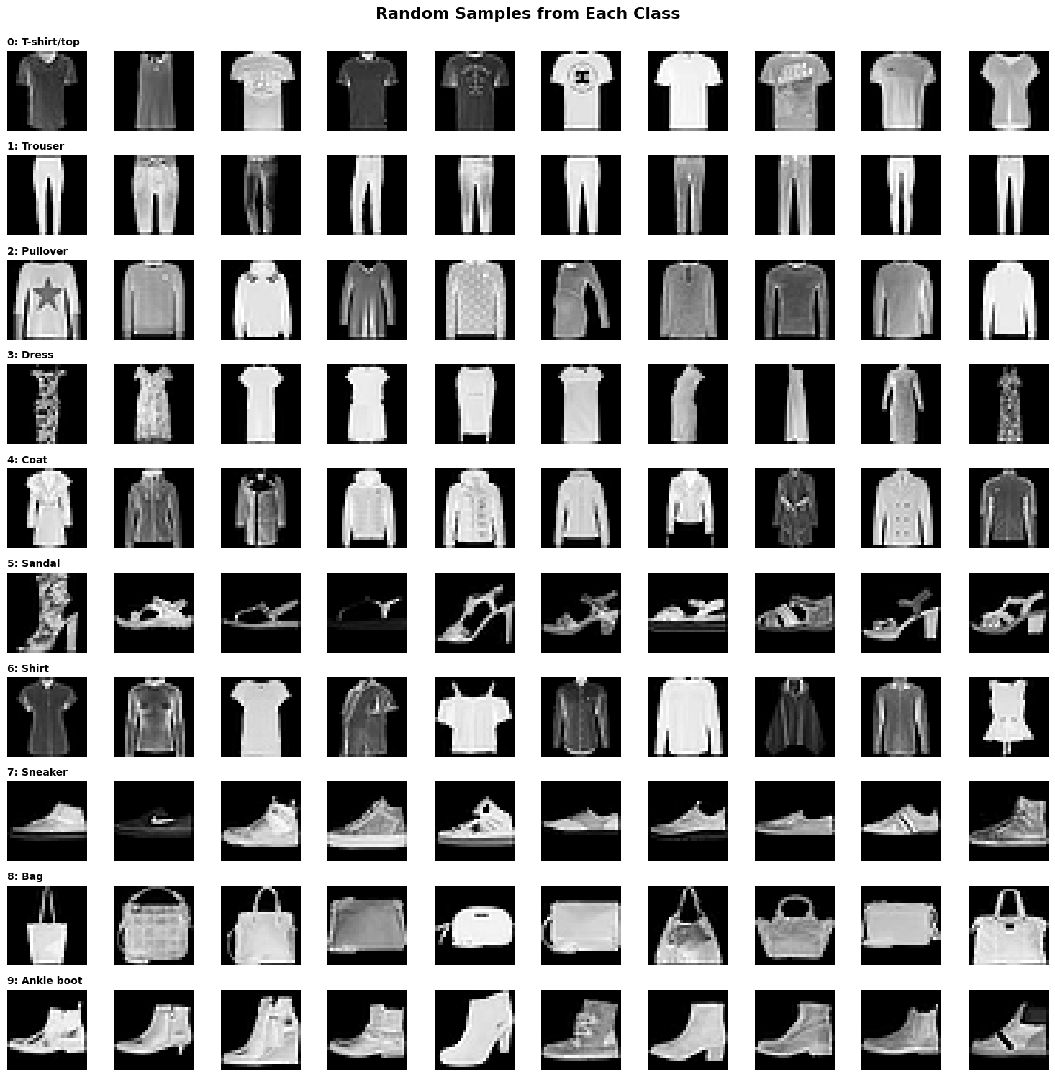
Fashion-MNIST Classification using CNN and ANN
Alif Tasbir
ID : P2939792
Course : Neural Systems and Natural Language Processing
Date : 13 November 2025

Slide 2
Introduction
Fashion-MNIST: 70,000 grayscale images of clothing items
Industry need: Automated product categorization for e-commerce
Practical application in fashion retail and inventory management
Opportunity to demonstrate end-to-end ML pipeline development

Slide 3
Objectives
Compare ANN vs CNN performance on Fashion-MNIST
Implement proper data handling with leakage prevention
Reusable, production-ready code pipeline
Interactive inference system for real-world deployment

Slide 4
Methodology
[ Load Dataset ] → [EDA] → [Preprocessing] → [Model Training] → [Optimization] → [Deployment]
Framework: TensorFlow 2.9.0 / Keras
Platform: Google Colaboratory (GPU)
Language: Python 3.8+
Libraries: NumPy, Matplotlib, Scikit-learn

Slide 5
Data
Dataset : Fashion-MNIST
Training: 60,000 images (28×28 pixels)
Split: Train (54K) / Validation (6K) / Test (10K)
Normalization: [0, 255] → [0, 1]
Some classes visually similar (Shirt/T-shirt)
Data leakage prevention : Statistics from training only

Slide 6
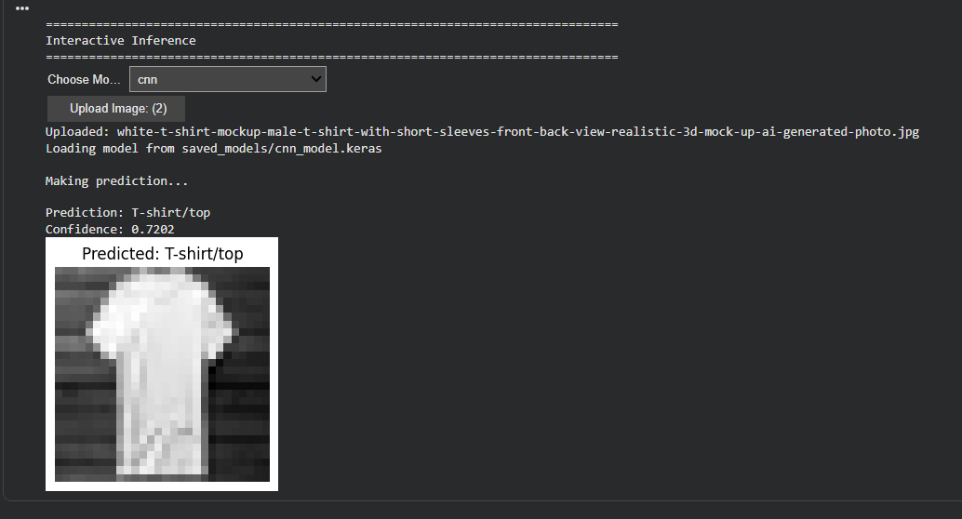
Implementation
ANN: 2 hidden layers [128,64]
CNN: 3 conv blocks [32→64→128]
Training: 30 epochs, batch size 256, learning rate : 0.0005 ,Dropout rate :0.2
Optimizer : Adam, Loss function : Sparse Categorical Cross-entropy
Deployment: Interactive inference UI with custom image support

Slide 7
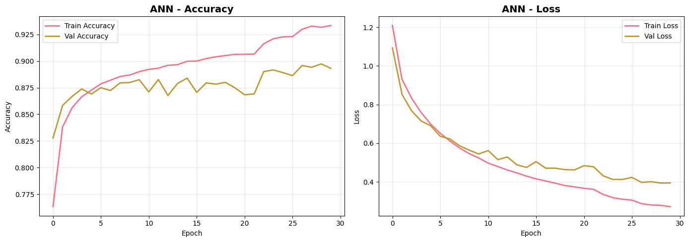
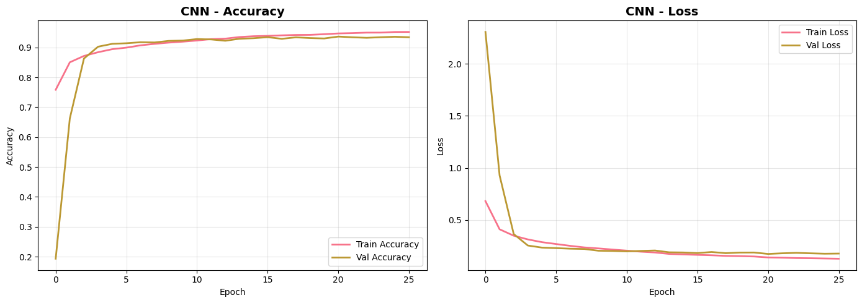
Results
Top Confused Class Pairs: (ann)
  Shirt → T-shirt/top: 124 (12.40%)
  Pullover → Coat: 107 (10.70%)
  T-shirt/top → Shirt: 102 (10.20%)
  Shirt → Coat: 83 (8.30%)
  Pullover → Shirt: 78 (7.80%)
Top Confused Class Pairs: (cnn)
  T-shirt/top → Shirt: 87 (8.70%)
  Shirt → T-shirt/top: 66 (6.60%)
  Coat → Shirt: 48 (4.80%)
  Shirt → Coat: 48 (4.80%)
  Pullover → Shirt: 42 (4.20%)

Slide 8
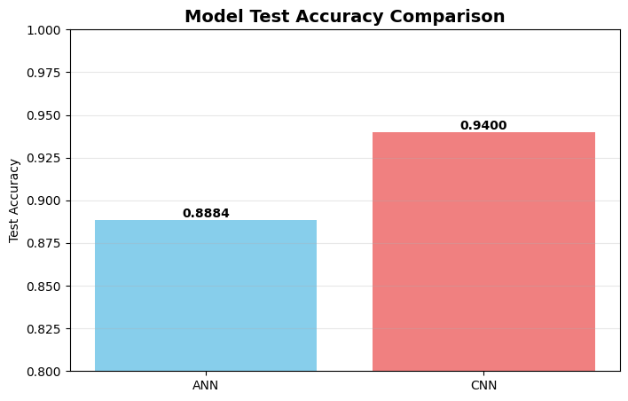
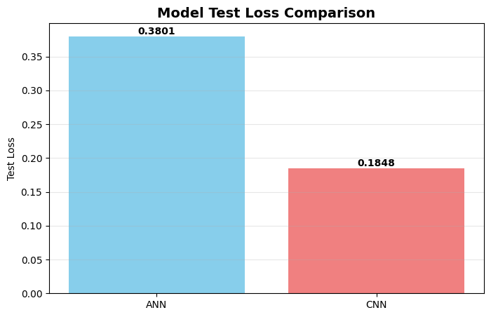
Interpretation
CNN outperforms ANN by 5.81% (spatial features crucial)
Adding depth improves accuracy but requires proper regularization
Each enhancement contributes measurable gains

Slide 9
Summary
What was achieved ?
Comprehensive ML pipeline from EDA to deployment
Data leakage prevention with automated verification
Production-ready inference system with model persistence

Slide 10
Future Work
Ensemble methods combining architecturally diverse models
Attention mechanisms to focus on discriminative features
Transfer learning from larger fashion datasets. Additionally, integrating model interpretation techniques (Grad-CAM, saliency maps) would provide insights into decision-making processes, crucial for trust in production systems.
References
Fashion-MNIST: Xiao et al. (2017) - arXiv:1708.07747
TensorFlow Documentation: tensorflow.org
Project repository: https://github.com/amjvl-git/csip-5103-coursework-2025-a1if/tree/main

