Slide 1

Fashion-MNIST Classification Using Neural Networks
Satya Abhishek Kasukurti | Student ID: P2895904
MSc Artificial Intelligence | Module: Neural Networks

Slide 2
Introduction
Fashion-MNIST is a benchmark dataset for image classification.
It contains 70,000 grayscale images across 10 clothing categories.
Objective: Build and compare Artificial Neural Network (ANN) and Convolutional Neural Network (CNN) models.
Implementations carried out using TensorFlow/Keras.

Slide 3
Objectives / Goals
Implement ANN and CNN models for Fashion-MNIST classification.
1
Preprocess image data and split into training, validation, and test sets.
2
Train both models and compare performance metrics.
3
Evaluate models using accuracy, loss, and confusion matrix.
4

Slide 4
Methodology / Approach
Tools: TensorFlow, Keras, NumPy, Matplotlib, Seaborn, Scikit-learn.
Approach: Load → Preprocess → Train → Evaluate → Compare.
10-epoch training with 10% validation split.
Optimizer: Adam | Loss: Sparse Categorical Crossentropy.

Slide 5
Data / Materials / Inputs
Dataset: Fashion-MNIST (28x28 grayscale images).
Training set: 60,000 | Test set: 10,000.
Normalization: Pixel values scaled to [0, 1].
Input shapes: ANN (784), CNN (28x28x1).

Slide 6
Implementation / Process
ANN: Two hidden layers (128, 64 neurons) with ReLU activation.
CNN: Two Conv2D layers (32, 64 filters) + MaxPooling + Dense(100).
Softmax output layer with 10 classes.
Training monitored with validation accuracy.

Slide 7
Results / Findings
ANN Test Accuracy: 88.29%, Loss: 0.3516.
CNN Test Accuracy: 91.3%, Loss: 0.2728.
CNN demonstrated superior performance due to spatial feature extraction.
Confusion Matrix and Accuracy Curves confirm stable training.

Slide 8

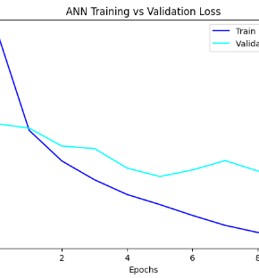
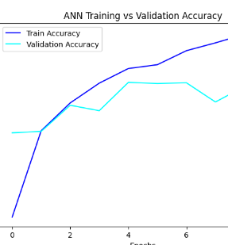


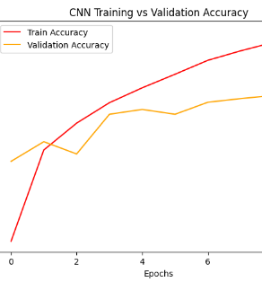
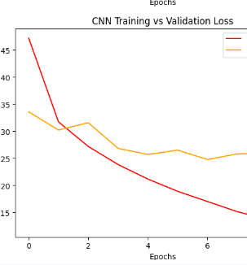


Slide 9
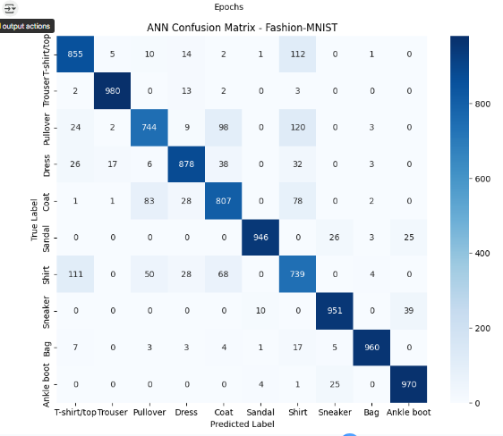
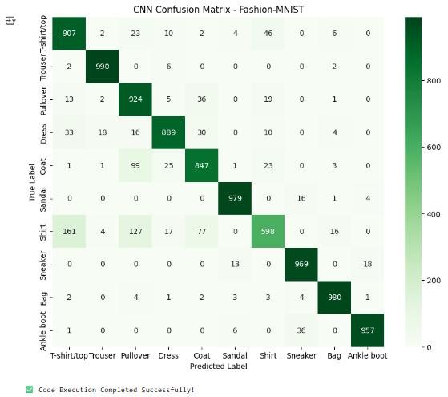

Slide 10
Discussion / Interpretation
CNN significantly outperformed ANN by ~4.4%.
Confusion mainly occurred between visually similar classes (Shirt vs Coat).
High precision achieved for distinct classes (Sneaker, Sandal).
Results validate the efficiency of CNN for image-based learning tasks.
CNN achived higher generalization performance due to convolutional feature extraction
ANN performed adequately but lacked spatial awareness
Both models showed stable convergence with minimal overfitting

Slide 11
Conclusion / Summary
Successfully implemented and compared ANN and CNN architectures.
CNN achieved higher accuracy and better generalization.
Demonstrated key concepts of neural network training and evaluation.
Learned insights into data preprocessing, model tuning, and analysis.
Both models trained stabily with consistent accuracy and loss curves,confirming robust learning behaviour.

Slide 12
Future Work / Acknowledgments
Implement data augmentation and dropout for improved generalization.
Experiment with deeper CNNs or transfer learning models (e.g., VGG16).
Acknowledgments: TensorFlow/Keras, Scikit-learn, Matplotlib.
Thank you for your attention.

