Slide 1
A Neural Network Model for
Fashion-MNIST Image Classification
AKAASH CHELLAPANDIYAN - P2910240
CSIP 5103: Neural Networks & NLP
November 5, 2025

Slide 2
Project Overview
Objective:
• To build and train neural networks to classify clothing items from the Fashion-MNIST dataset.
Models Compared:
• MLP Classifier (ANN): A baseline fully connected network.
• Convolutional Classifier (CNN): An advanced network for image recognition.
Goal:
• To compare the performance of the two classifiers and analyze the results.

Slide 3
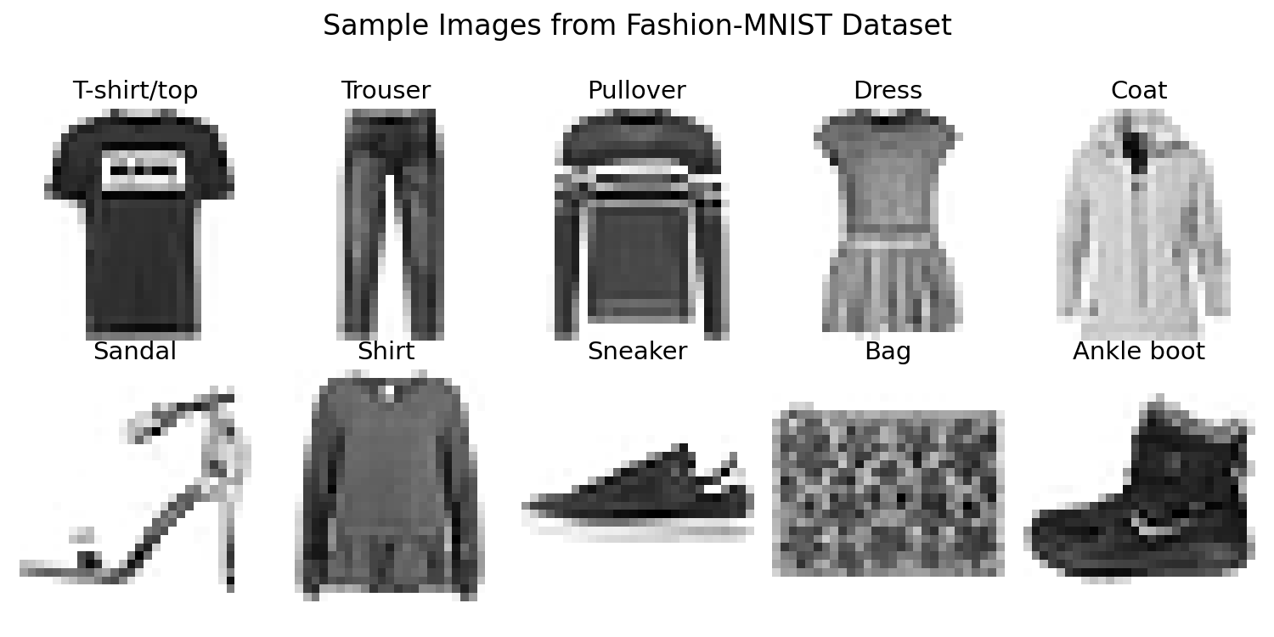
The Fashion-MNIST Dataset
• Source: Loaded directly from local files cloned from the official GitHub repository.
• Content: 60,000 grayscale images (28×28 pixels).
• 10 Apparel Categories: T-shirt/top, Trouser, Pullover, Dress, Coat, Sandal, Shirt, Sneaker, Bag, Ankle boot.

Slide 4
Data Preprocessing
Key Steps:
1. Load Data: A custom function was used to read the raw data files.
2. Normalize Pixel Values:
• Scaled pixel values from 0-255 down to 0-1.
• This step is crucial for efficient training.
3. Reshape Data for CNN:
• A channel dimension was added to the image arrays specifically for the CNN.
Final Data Shapes for Training:
• MLP Input Shape: (60000, 28, 28)
• CNN Input Shape: (60000, 28, 28, 1)

Slide 5
Model 1: The MLP Classifier (ANN)
A simple Multi-Layer Perceptron.
Architecture (mlp_classifier):
1. Flatten Layer: Converts the
(28, 28) image into a 784-pixel
vector.
2. Dense Layer: 128 neurons
(ReLU activation).
3. Output Layer: 10 neurons for
10 classes (Softmax activation).
MLP Architecture Diagram
Input (28×28)
↓
Flatten (784)
↓
Dense (128, ReLU)
↓
Output (10, Softmax)

Slide 6
Model 2: The Convolutional Classifier (CNN)
Designed to recognize spatial patterns in images.
Architecture (convolutional_classifier):
CNN Architecture Diagram
Input (28×28×1)
↓
Conv2D (32) + Pool
↓
Conv2D (64) + Pool
↓
Flatten
↓
Dense (128)
↓
Output (10)
1. Conv2D Layer (32 filters) +
MaxPooling
(Input shape: 28, 28, 1)
2. Conv2D Layer (64 filters) +
MaxPooling
3. Flatten Layer
4. Dense Layer (128 neurons)
5. Output Layer (10 neurons)

Slide 7
Performance Results
The evaluation on the 10,000-image test set produced a clear winner.
Classifier | Test Accuracy
MLP (ANN) | 88.39%
CNN | 90.98%
Key Takeaway: The CNN's specialized architecture is far more effective for image data.

Slide 8
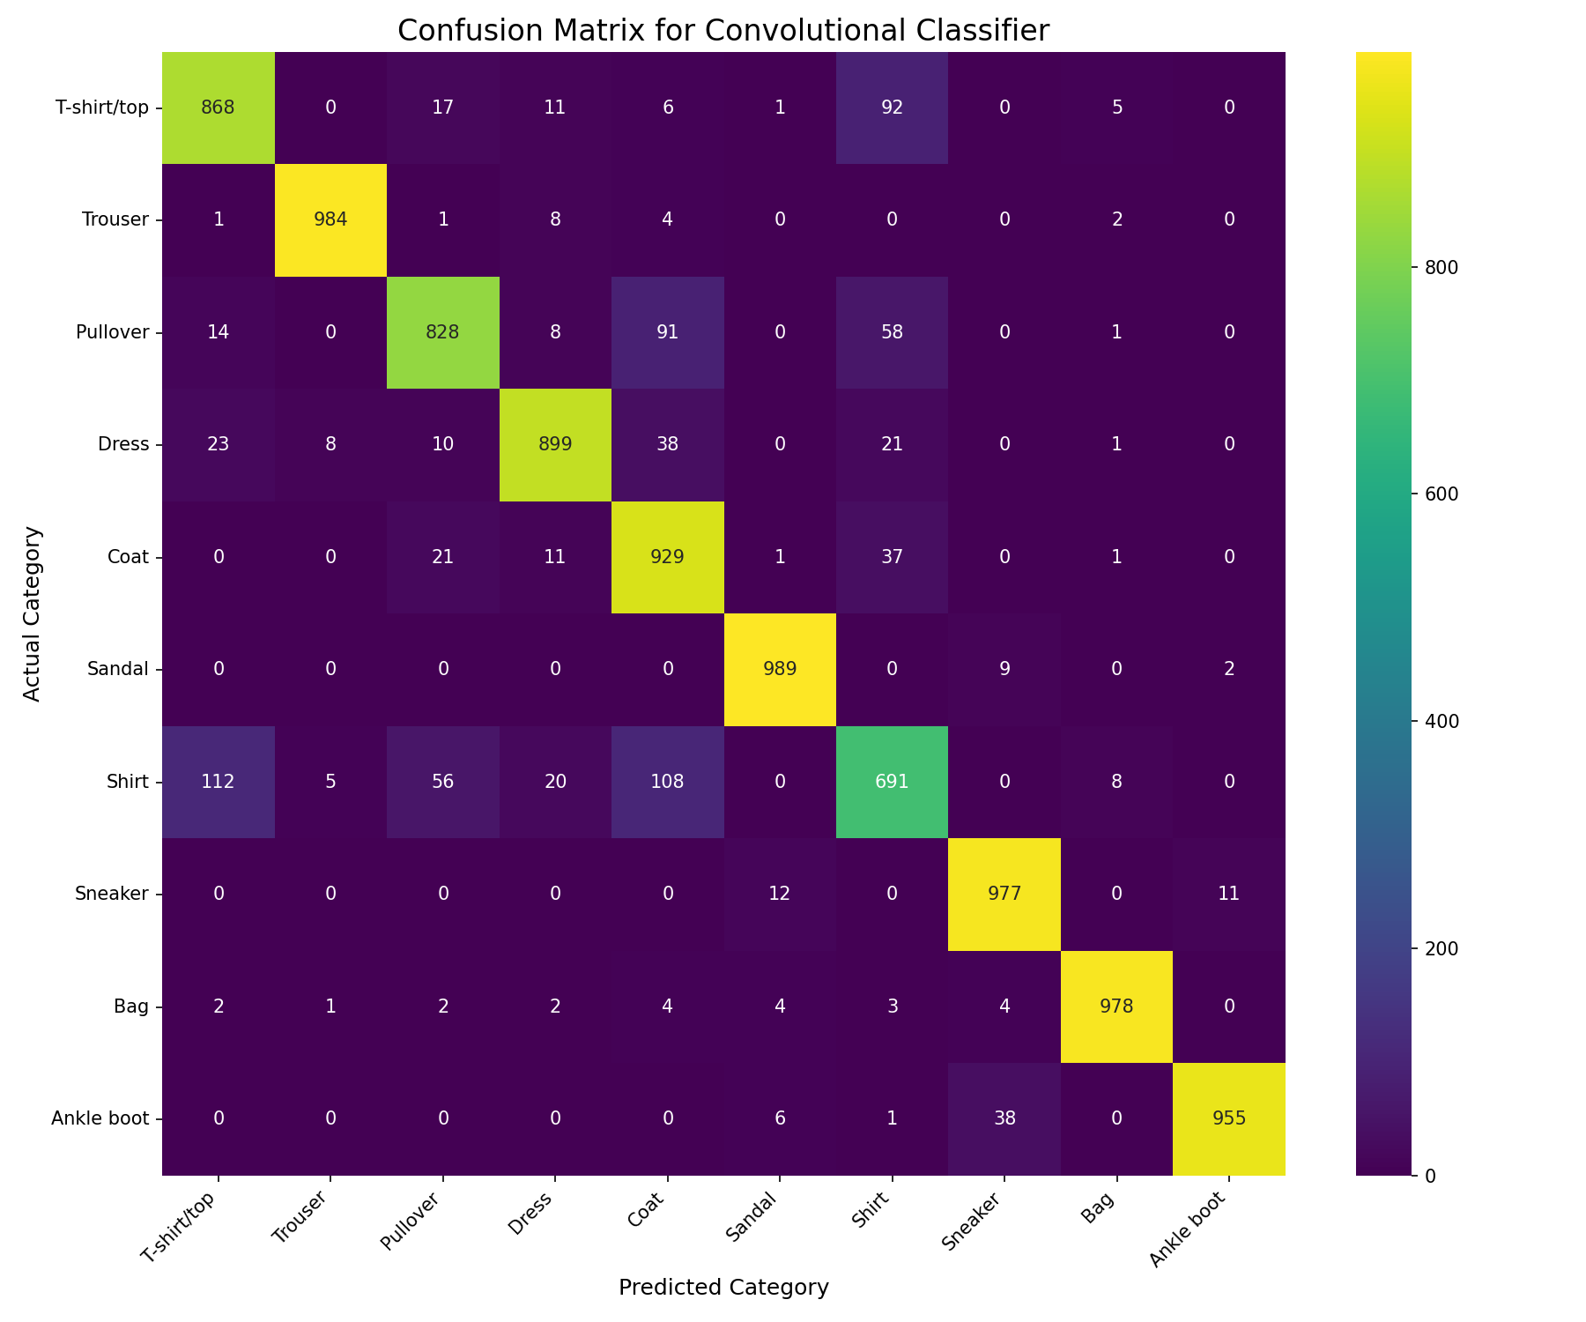
Where Does the CNN Get Confused?
Analysis of the Confusion Matrix:
• The model easily identifies distinct
items like Trousers, Sandals, and Bags.
• Most prediction errors happen between
visually similar classes.
Example Misclassifications:
• "Shirt" is sometimes confused with
"T-shirt", "Pullover", and "Coat".

Slide 9
Live Demonstration
Let's test the trained convolutional_classifier on a few random images from the test set.
🔴 LIVE DEMO

Slide 10
Conclusion & Future Work
Conclusion:
• The Convolutional Classifier is the superior model, achieving 90.98% accuracy.
• The project successfully demonstrates the importance of architecture selection for the data type.
Future Work to Improve Performance:
• Data Augmentation: To build a more robust model.
• Dropout Regularization: To reduce overfitting.
• Architectural Tuning: Experiment with deeper or wider networks.

Slide 11
Conclusion & Future Work
Thank you! Any Questions?

