Slide 1

Architectural Comparison: ANN vs. CNN for Fashion-MNIST
Presented by: Raj Ghanshyambhai Dankhra
Student Id: P2930749

Slide 2

Introduction: The Deep Learning Challenge
This project compares the classification performance of two fundamental neural network architectures—an Artificial Neural Network (ANN) and a Convolutional Neural Network (CNN)—on the Fashion-MNIST dataset.
The core question addressed is: How effectively do these models handle complex image data, and which architecture is superior for visual feature extraction and classification?

Slide 3



Project Objectives and Scope
Our primary goal is to conduct a rigorous, side-by-side performance evaluation, providing clear metrics and insights for ML deployment decisions.
Benchmark Performance
Analyze Model Complexity
PyTorch Implementation
Establish baseline accuracy and training metrics for both ANN and CNN models.
Examine how architecture differences (dense vs. convolutional layers) impact training time and feature learning.
Demonstrate robust deep learning workflow implementation using PyTorch, covering data loading, model definition, and evaluation.

Slide 4




Methodology: Standardized Training Environment
All experiments were conducted under identical conditions and hyperparameters to ensure a fair comparison between the two models.
Hardware/Device
Hyperparameters
Leveraging available cuda:0 for accelerated training; gracefully falling back to CPU.
Standardized settings across both models: 10 EPOCHS, BATCH = 64, LR = 0.05, and MOMENTUM = 0.9.
Regularization
A Dropout Rate of 0.4 was applied to critical layers in both networks to mitigate overfitting.

Slide 5


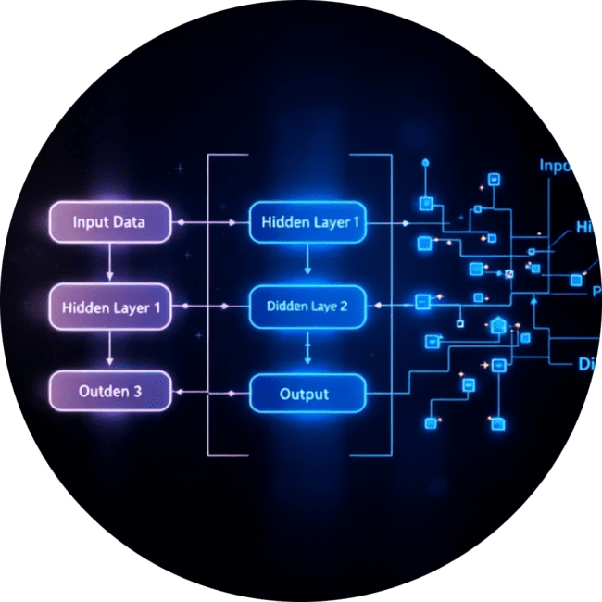
Data Preparation and Augmentation
We used the Fashion-MNIST dataset, containing 60,000 training and 10,000 test images across 10 classes, with a 10% validation split.
Dataset Overview
Preprocessing & Normalization
Data Augmentation
10 distinct classes of grayscale fashion items, providing a good balance for testing classification complexity.
Images are converted to tensors and normalized to a mean and standard deviation of 0.5.
Training data utilizes RandomRotation(10) and RandomHorizontalFlip() for increased robustness.

Slide 6


Model Architectures Defined
Artificial Neural Network (ANN)
Convolutional Neural Network (CNN)
The ANN uses a fully connected design, treating the 28x28 image as a flat 784-dimension vector input.
The CNN leverages spatial locality with convolutional layers, designed for superior image feature extraction.
Input Layer: 784 neurons
Conv Layer: 1 input channel, 16 output channels, kernel size 3x3, padding=1 (ReLU)
Hidden Layer 1: 128 neurons (ReLU activation)
Pooling Layer: MaxPool 2x2
Hidden Layer 2: 64 neurons (ReLU + Dropout 0.4)
Dropout Layer: Rate 0.4
Output Layer: 10 classes
Flatten & Fully Connected: From 16x14x14 to 32 neurons, then to 10 classes

Slide 7


Training and Validation Metrics
Both models were trained for 10 epochs. The training process tracks average loss and validation accuracy per epoch.
The CNN model shows a more rapid convergence and consistently achieves higher validation accuracy compared to the ANN throughout the training process.

Slide 8
Core Results: Final Test Accuracy
Post-training evaluation on the held-out test set reveals the definitive performance advantage of the CNN architecture.
84.22%
91.56%
ANN Test Accuracy
CNN Test Accuracy
Good baseline performance, but limited by feature extraction on raw pixel data.
Significantly higher accuracy due to effective use of convolutional filters for spatial features.

Slide 9
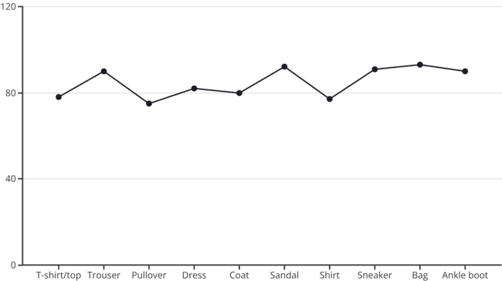
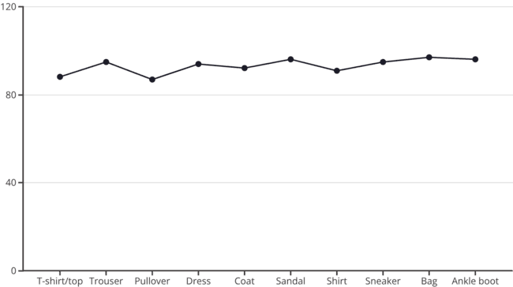
Model Interpretation: Classification Accuracy by Category
These line graphs illustrate the classification accuracy of each model across different fashion categories, providing insights into their performance strengths and weaknesses.
ANN Classification Accuracy
CNN Classification Accuracy
The ANN model exhibits fluctuating accuracy across categories, with notable dips for 'T-shirt/top' and 'Pullover', aligning with its tendency to confuse similar items.
The CNN model consistently achieves higher accuracy across most categories, demonstrating particularly strong performance in distinguishing 'Coat', 'Dress', and 'Shirt', reflecting its superior feature extraction capabilities.

Slide 10




Conclusion: Leveraging Convolutional Power
This study confirms that the CNN architecture is the superior choice for image classification tasks like Fashion-MNIST, validating its role as a standard for computer vision.
ANN: Limited Feature Learning
Effective for simpler, non-spatial data, but struggles with the inherent complexities and patterns in images.
CNN: Superior Spatial Understanding
The use of convolution and pooling layers allows the model to learn translation-invariant features, drastically improving accuracy.
Future Work
Investigate deeper CNNs (e.g., ResNet) or advanced techniques like transfer learning for further performance gains.

Slide 11

Thank You!

