Slide 1

Comparative Analysis of ANN and CNN Models on Fashion-MNIST Dataset

Slide 2
Introduction
Background:
Deep learning has transformed image classification through neural networks capable of recognizing complex visual patterns.
Why this topic:
Fashion-MNIST provides a challenging yet manageable dataset to explore how Artificial Neural Networks (ANN) and Convolutional Neural Networks (CNN) perform on visual data.
Problem Statement:
Which architecture (ANN or CNN) achieves higher accuracy and better generalization in image classification tasks?

Slide 3

Objectives / Goals
To implement and train both ANN and CNN models using PyTorch.
To compare model performance in terms of accuracy, training stability, and generalization.
To evaluate the impact of regularization and optimization techniques.
Expected Outcome: CNN will outperform ANN due to its ability to extract spatial features from images.

Slide 4
Methodology / Approach
Framework: PyTorch
Loss Function: CrossEntropyLoss
Optimizer: Adam (learning rate = 0.001)
Regularization: Dropout layers for overfitting control
Evaluation Metrics: Training/validation accuracy, loss, confusion matrix

Slide 5
Data / Materials / Inputs
Dataset: Fashion-MNIST (70,000 grayscale images, 28×28 pixels, 10 classes)
60,000 for training (80/20 split for train/validation)
10,000 for testing
Transformations:
Convert to tensor
Normalize pixel values (–1, 1)
Batch Size: 64
Key Classes: T-shirt/top, Trouser, Dress, Coat, Sneaker, etc.

Slide 6

Implementation / Process
Data Preprocessing: Normalized and batched data.
Model Design: Defined ANN and CNN architectures with dropout layers.
Training: 10 epochs using Adam optimizer and ReLU activation.
Validation: Performance tracking after each epoch.
Testing: Evaluation on unseen test data.
Visualization: Accuracy/loss curves and confusion matrices plotted using Matplotlib.

Slide 7
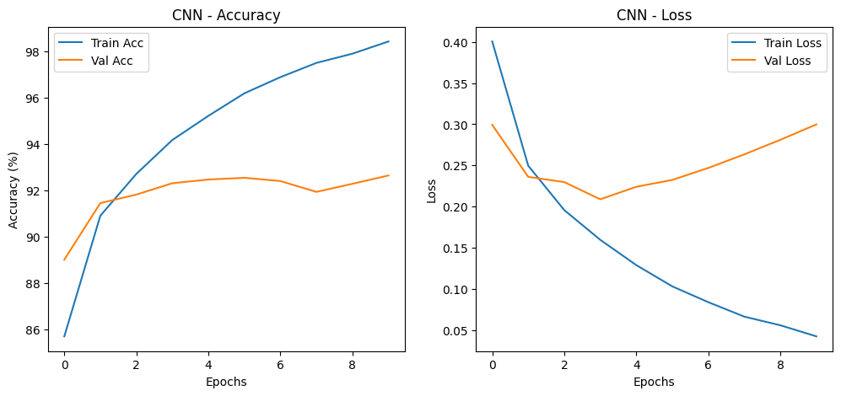
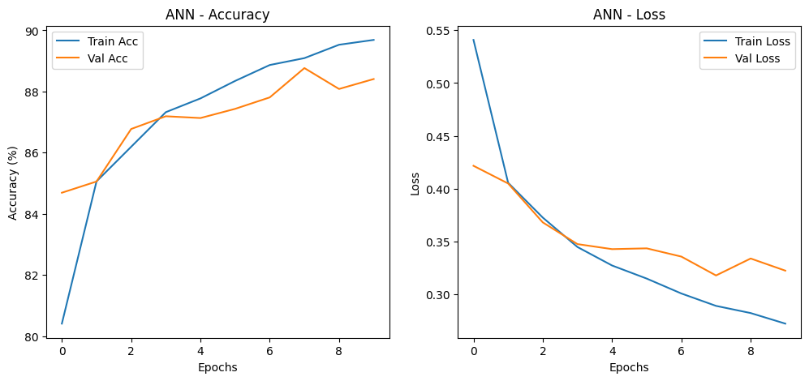
Results / Findings

Slide 8
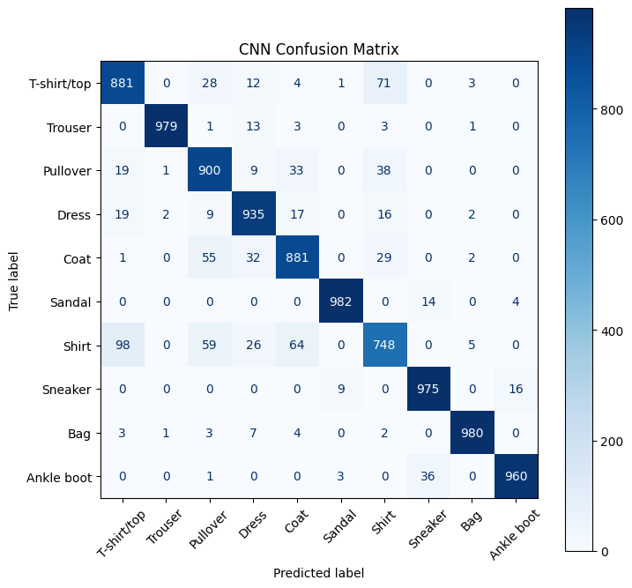

Discussion / Interpretation
Performance Insight: CNN achieved higher accuracy due to its convolutional layers capturing spatial hierarchies.
Efficiency: ANN trained faster but had limited feature learning capacity.
Overfitting Control: Dropout regularization improved generalization.
Challenges: Longer CNN training times and tuning hyperparameters.

Slide 9

Conclusion / Summary
Implemented and evaluated both ANN and CNN models on Fashion-MNIST.
CNN outperformed ANN in both validation and test performance.
Demonstrated the effectiveness of regularization and Adam optimizer.
Concluded that CNNs provide higher accuracy and generalization for visual classification.

Slide 10
Future Work / Acknowledgments
Future Improvements:
Apply Batch Normalization and Early Stopping
Experiment with learning rate scheduling
Explore Transfer Learning with pretrained CNNs
Acknowledgments:
PyTorch Documentation
Fashion-MNIST Dataset by Zalando Research
Harvard Writing Center (for Executive Summary framework)

