Slide 1
Title: Fashion MNIST Classification with ANN and CNN
Subtitle:
PyTorch-based Deep Learning Pipeline
Presented by: Elina Shirazi
P2935918

Slide 2
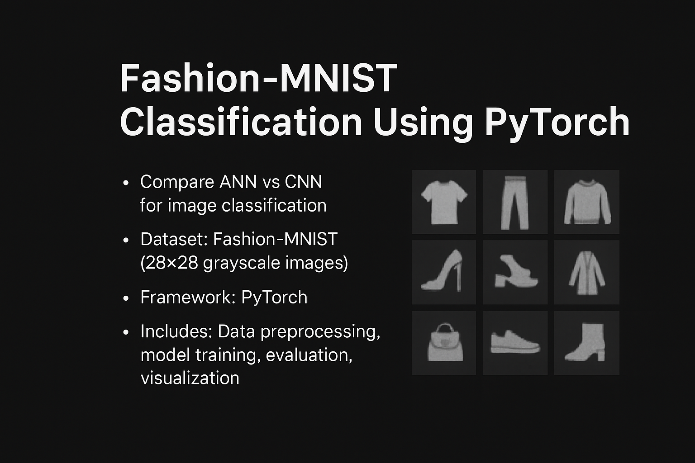
Project Overview
Objective: Classify FashionMNIST images using ANN and CNN
Frameworks: PyTorch, torchvision, sklearn, seaborn
Models: Artificial Neural Network (ANN) and Convolutional Neural Network (CNN)
Evaluation: Accuracy, Confusion Matrix, Class-wise Report

Slide 3
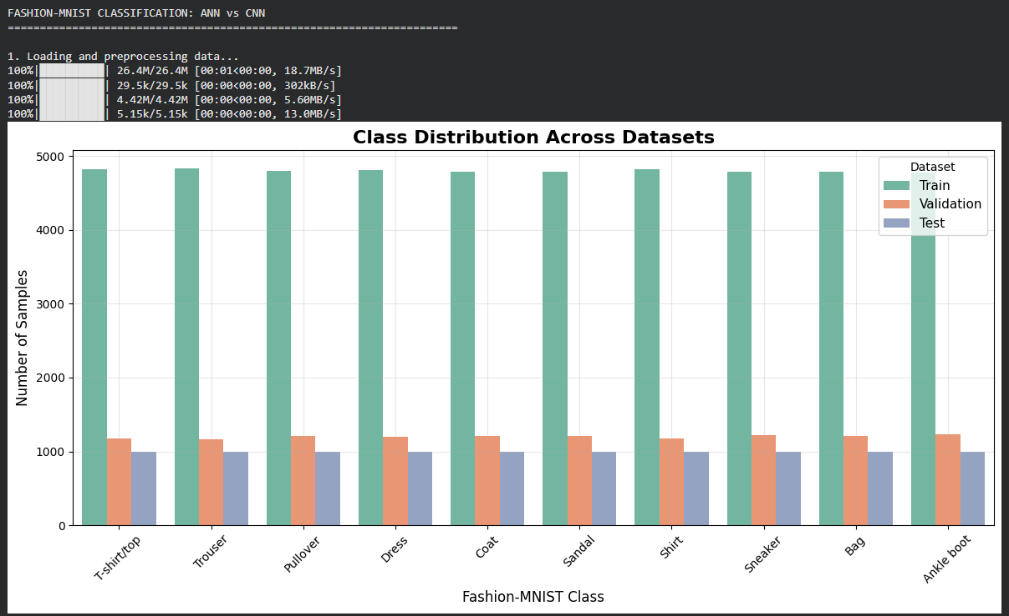
Data Preprocessing
Dataset: FashionMNIST
Transformations:
Random Horizontal Flip
Random Rotation
Normalization
Split: 80% training, 20% validation
Loaders: Train, Validation, Test

Slide 4
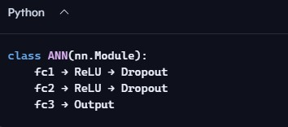
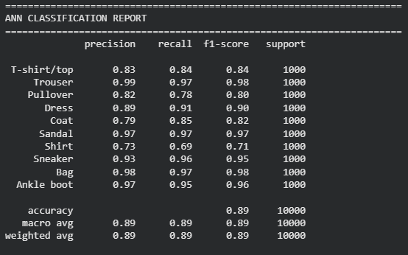
ANN Model Architecture
Input: 784 features
Hidden: 256 units
Output: 10 classes

Slide 5
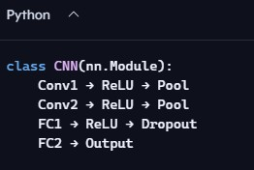
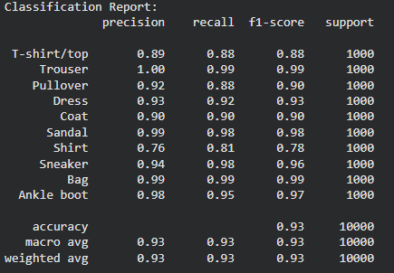
CNN Model Architecture
Input: 1×28×28 image
Output: 10 classes

Slide 6
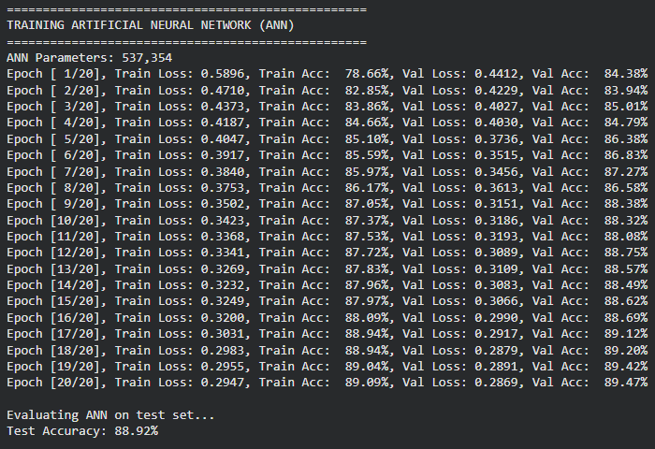
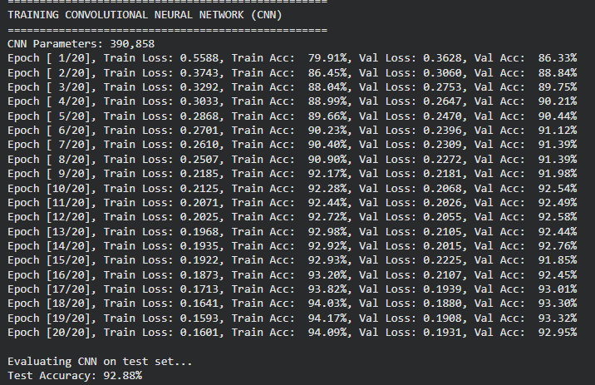
Training Loop
Epochs: 20
Optimizer: Adam
Scheduler: StepLR
Metrics:
Loss (Train/Val)
Accuracy (Train/Val)

Slide 7
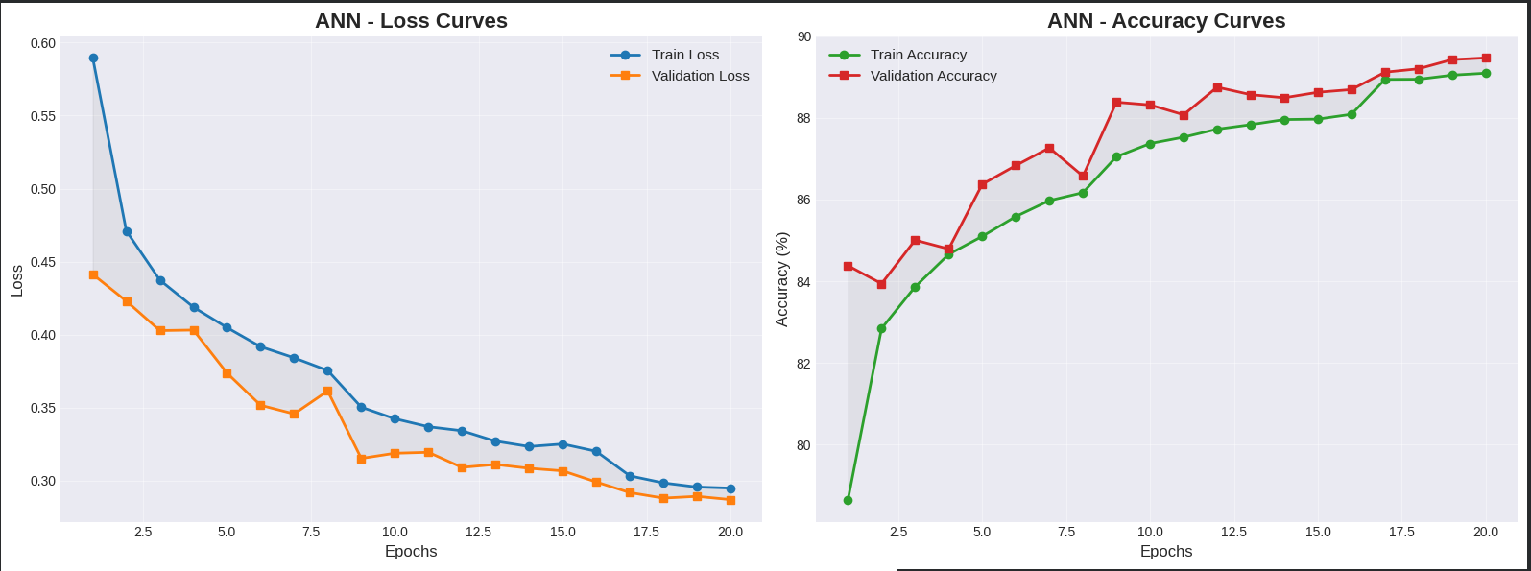
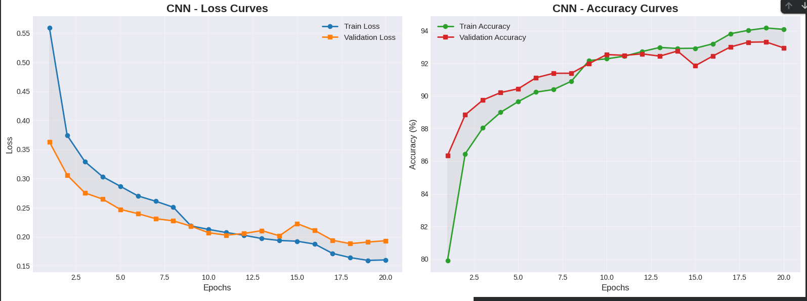
Training Curves
Loss vs. Epoch
Accuracy vs. Epoch
Separate plots for ANN and CNN

Slide 8
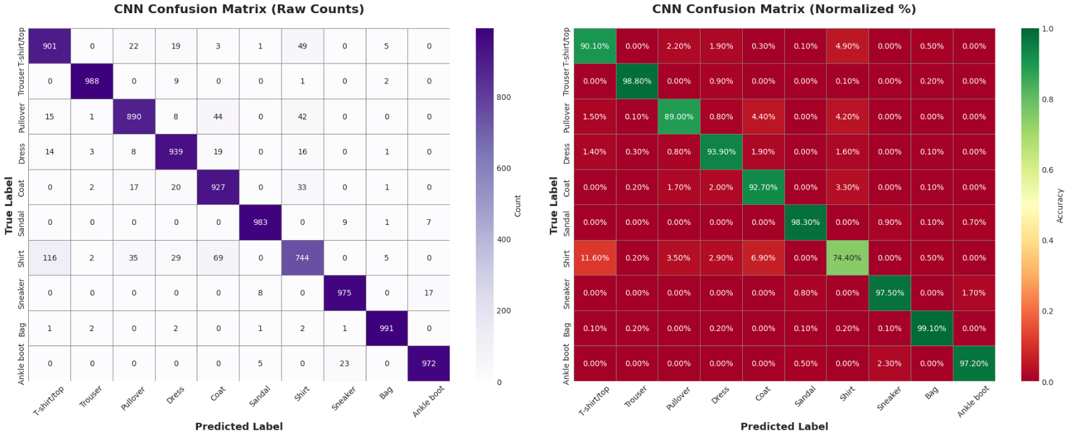

Confusion Matrix
Visualized using seaborn heatmap
Labels: 10 FashionMNIST classes
Comparison: ANN vs. CNN

Slide 9
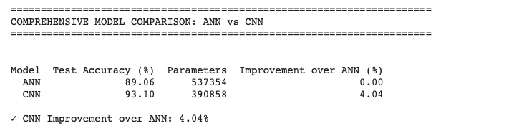
Results Summary

