Slide 1
Fashion-MNIST Classification using ANN and CNN
Muhammad Hassan
P2905508
MSc Artificial Intelligence
De Montfort University
2025

Slide 2
Project Overview
Objective: Compare ANN and CNN performance on Fashion-MNIST
Dataset: 70,000 grayscale clothing images (28x28 pixels)
Goal: Identify which architecture performs better for classification

Slide 3
Problem Statement
Accurate image recognition is vital for AI and automation
Visually similar items cause misclassification challenges
Need to evaluate ANN vs CNN for fashion item recognition

Slide 4
Dataset Description
Fashion-MNIST: 60,000 training and 10,000 testing images
Ten classes: T-shirt, Trouser, Pullover, Dress, Coat, Sandal, Shirt, Sneaker, Bag, Ankle Boot
Used normalization and data augmentation (rotation, flip)

Slide 5
Model Design – ANN
Two hidden layers: 512 and 256 neurons
Activation: ReLU with Batch Normalization and 30% Dropout
Optimizer: Adam | Loss: CrossEntropyLoss
Trained for 15 epochs using StepLR scheduler

Slide 6
Model Design – CNN
Three convolutional layers: 32, 64, 128 filters
ReLU activation, Batch Normalization, Max Pooling, Dropout (25%)
Fully connected layers: 256 neurons → 10 output classes
Trained with same optimizer and parameters as ANN

Slide 7
Training Process
Implemented in PyTorch framework
Batch size: 64 | Epochs: 15
StepLR dynamically reduced learning rate
Evaluation based on validation and test accuracy

Slide 8
Results & Analysis
ANN Accuracy = Apr. 85% | CNN Accuracy = Apr. 93%
CNN captures spatial and textural features better
Confusion between visually similar classes (shirt, coat, pullover)
CNN converges faster and generalizes more effectively

Slide 9
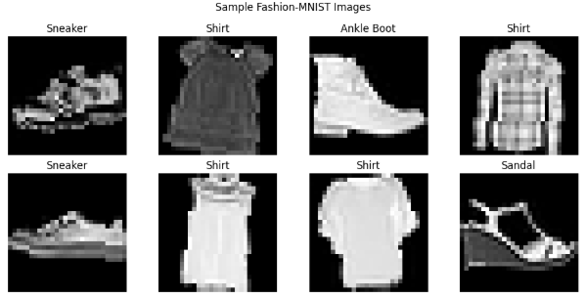
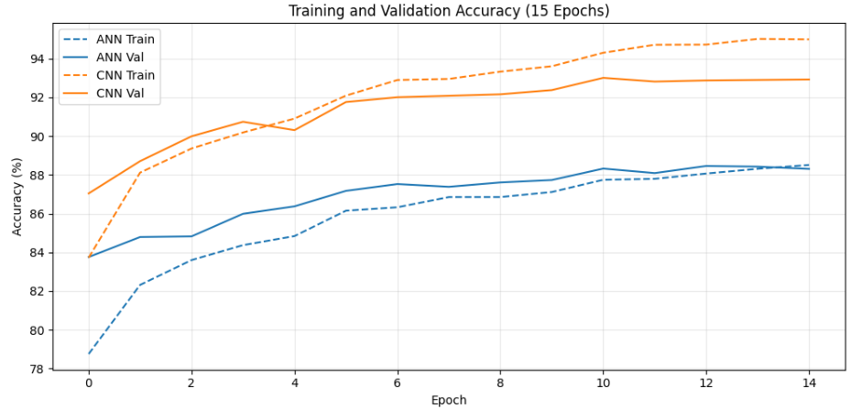
Visuals
Sample images from the Fashion-MNIST dataset showing ten clothing categories including shirts, trousers, coats, and shoes. Each image is grayscale with a 28×28 pixel resolution
Training and validation accuracy curves for both ANN and CNN models. The CNN achieved faster convergence and higher accuracy, demonstrating its superior ability to learn spatial features.

Slide 10
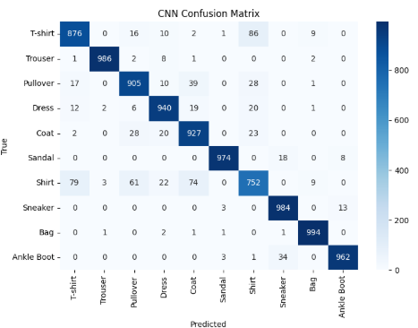
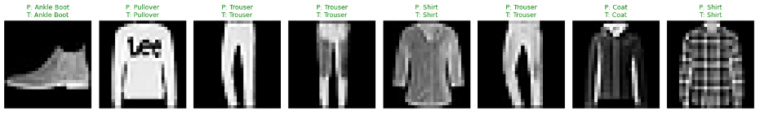
Confusion matrix for the CNN model on the test set (93.11% accuracy). Misclassifications are concentrated between visually similar classes: Shirt ↔ T-shirt, Pullover ↔ Coat, and Shirt ↔ Dress, highlighting limitations in fine-grained texture discrimination.
“This figure illustrates sample predictions from the trained CNN

Slide 11
Innovations & Future Work
Incorporate attention mechanisms (SE-Blocks or CBAM)
Use Mixup/CutMix for advanced data augmentation
Adopt AdamW optimizer or ResNet/VGG for deeper learning
Edge deployment for retail automation applications

Slide 12
Conclusion
CNN outperformed ANN in image classification tasks
ReLU, Batch Normalization, and Dropout improved performance
Future work: deeper architectures and stronger augmentation
Highlights AI’s potential in intelligent fashion analytics

