Slide 1
Title Slide
Title: Fashion-MNIST Image Classification using ANN & CNN
Name: Kirtan Nitin Patel (P2952845)
Course: Msc in Artificial Intelligence
Date: 12th November 2025

Slide 2
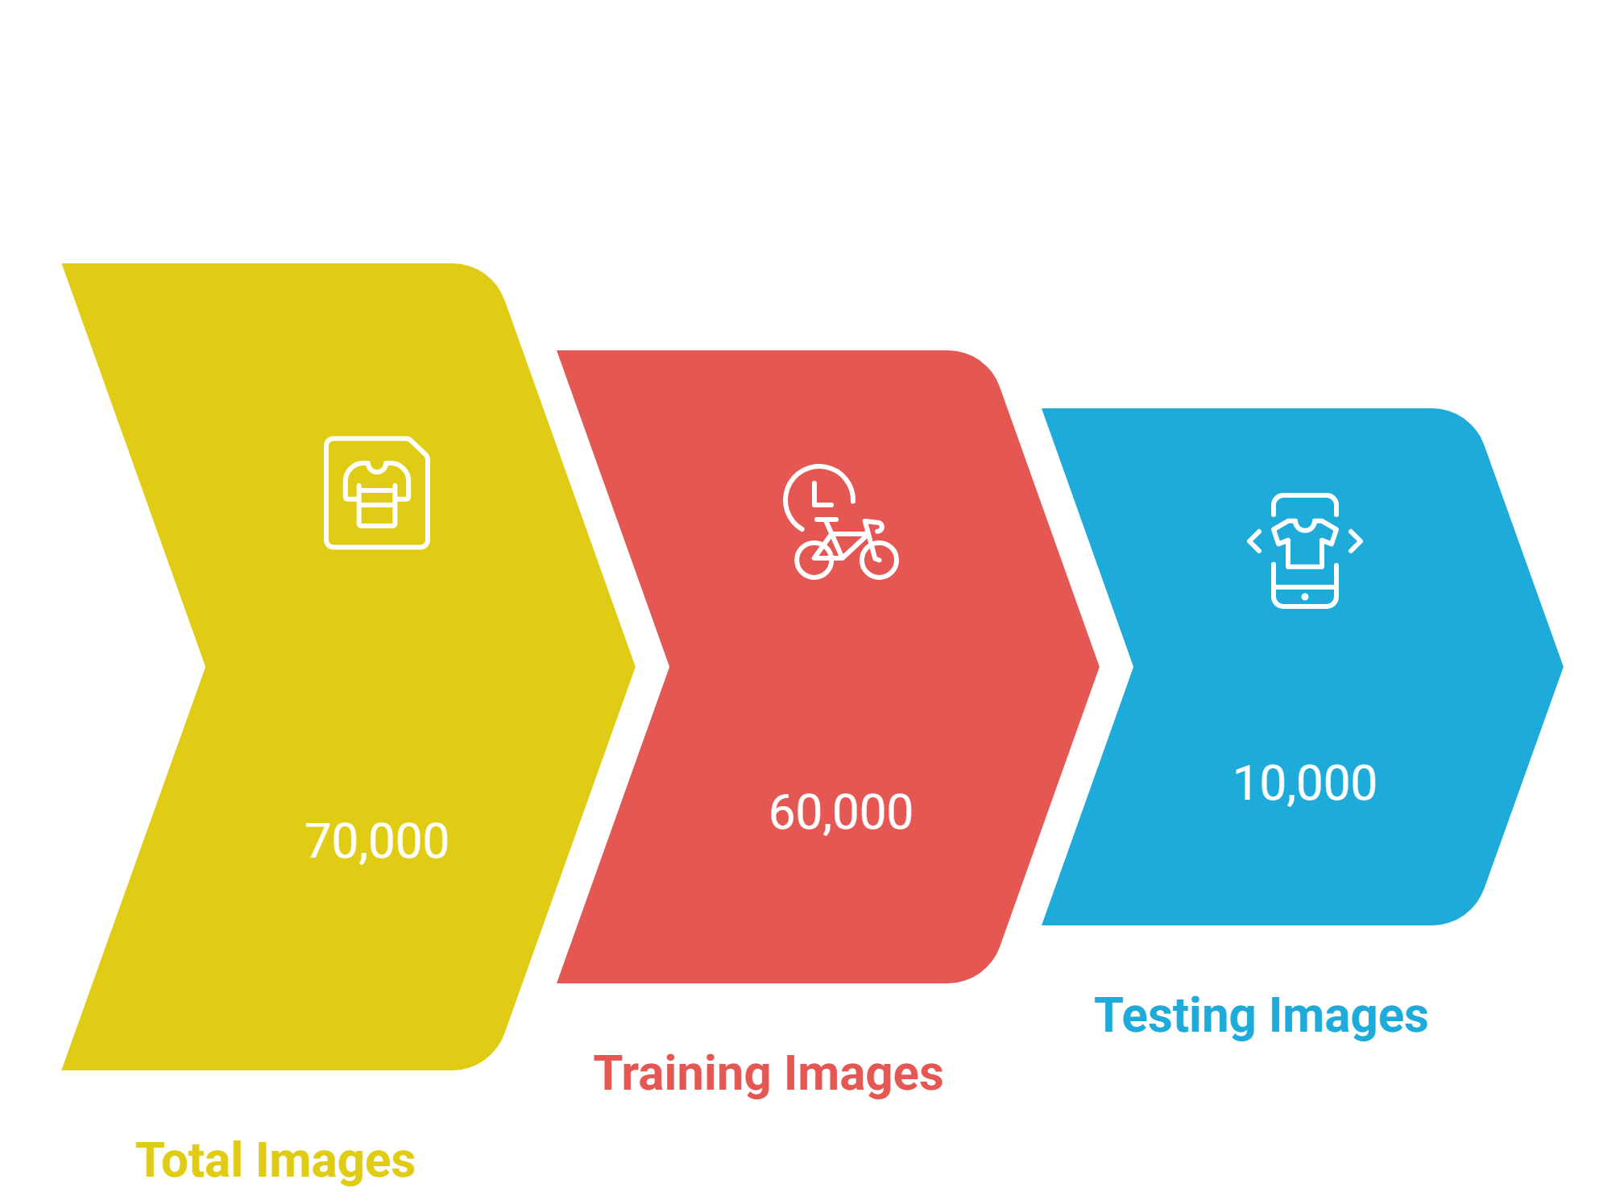
Dataset Introduction

Slide 3
Introduction
Focused on classifying clothing images from the Fashion-MNIST dataset (70,000 grayscale images, 10 classes).
Motivation: to understand and compare ANN and CNN architectures for visual recognition.
Problem: how network design and training choices affect classification accuracy.

Slide 4
Objectives / Goals
Build and train ANN and CNN models for Fashion-MNIST.
Compare model performance based on accuracy and reliability.
Explore the impact of optimization and regularization methods.
Identify the most effective approach for image recognition.

Slide 5
Methodology / Approach
Used Python + PyTorch on GPU for faster computation.
ANN: 2 hidden layers (256 & 128 neurons), ReLU activation, dropout 0.3.
CNN: 2 convolution layers (32 & 64 filters), ReLU, max-pooling (2×2).
Optimizer: Adam (learning rate 0.001), Loss: CrossEntropyLoss.
Training: 25 epochs.
Data → Model → Training → Evaluation → Results

Slide 6
Data / Materials / Inputs
Dataset: Fashion-MNIST (train/test split: 60K/10K).
Preprocessing: normalization, data augmentation (rotation, flipping).
Assumptions: grayscale images 28×28 pixels; 10 categories.

Slide 7
Implementation / Process
Loaded dataset and transformed images.
Trained both ANN and CNN architectures.
Used dropout and normalization to prevent overfitting.
Monitored training using accuracy/loss curves.
Visualized confusion matrices for performance evaluation.

Slide 8
Results
Model | Accuracy | Precision | Recall | F1-Score
ANN | 87% | 0.87 | 0.86 | 0.86
CNN | 92% | 0.92 | 0.92 | 0.91

Slide 9
Discussion / Interpretation
CNN captured spatial hierarchies, improving classification accuracy.
ANN struggled with visually similar classes (e.g., coats vs. shirts).
Regularization (dropout, normalization) reduced overfitting.
Data augmentation boosted robustness to input variations.

Slide 10
Conclusion / Summary
Explore advanced architectures: ResNet, VGG, Transfer Learning.
Apply interpretability tools (e.g., Grad-CAM).
Acknowledgment: PyTorch framework, GPU resources, dataset providers.

