Slide 1
Neural Systems Coursework
Myles Wheatley – P2963116

Slide 2
ANN Architecture
Layer | Type | Size | Activation
Input | Image | 28x28x1 | -
Flatten | Flatten | 784 | -
1 | Linear | 392 | ReLU
2 | Linear | 196 | ReLU
3 | Linear | 98 | ReLU
Output | Linear | 10 | Log Softmax

Slide 3
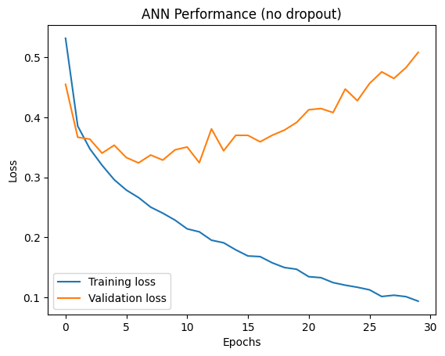
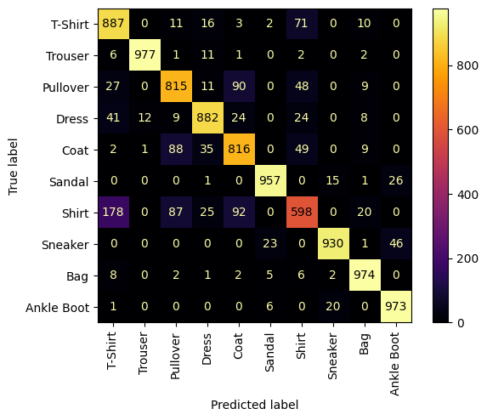
Training Performance

Slide 4
Implementing Dropout
Layer | Type | Size | Activation
Input | Image | 28x28x1 | -
Flatten | Flatten | 784 | -
1 | Linear | 392 | ReLU
 | Dropout | p=0.2 | -
2 | Linear | 196 | ReLU
 | Dropout | p=0.2 | -
3 | Linear | 98 | ReLU
 | Dropout | p=0.2 | -
Output | Linear | 10 | Log Softmax

Slide 5
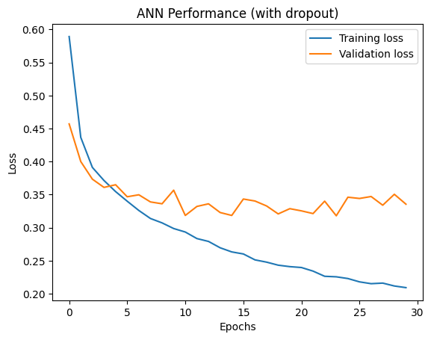
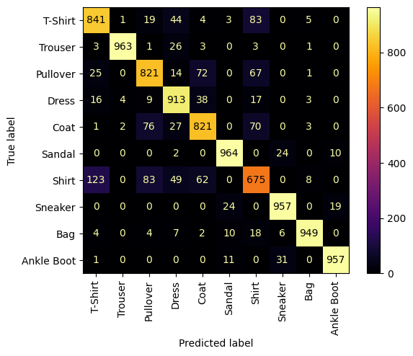
Training Improvements

Slide 6
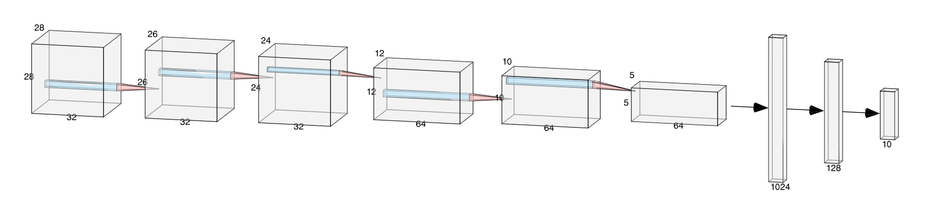
CNN Architecture
4 convolution layers with 2 max pool layers.
3 Dense layers after flattening the output of the convolution layers.

Slide 7
Overall:
Layer |  | Feature Maps | Size | Kernel Size | Stride | Activation
Input | Image | 1 | 28x28x1 | - | - | -
1 | Convolution | 32 | 26x26x32 | 3x3 | (1,1) | ReLU
2 | Convolution | 32 | 24x24x32 | 3x3 | (1,1) | ReLU
 | Max Pooling | 32 | 12x12x32 | 2x2 | (2,2) | -
3 | Convolution | 64 | 10x10x64 | 3x3 | (1,1) | ReLU
4 | Convolution | 64 | 8x8x64 | 3x3 | (1,1) | ReLU
 | Max Pooling | 64 | 4x4x64 | 2x2 | (2,2) | -
 | Flatten | - | 1024 | - | - | -
5 | Linear | - | 128 | - | - | ReLU
 | Dropout | - | p=0.5 | - | - | -
6 | Linear | - | 64 | - | - | ReLU
 | Dropout | - | p=0.5 | - | - | -
Output | Linear | - | 10 | - | - | Log Softmax

Slide 8
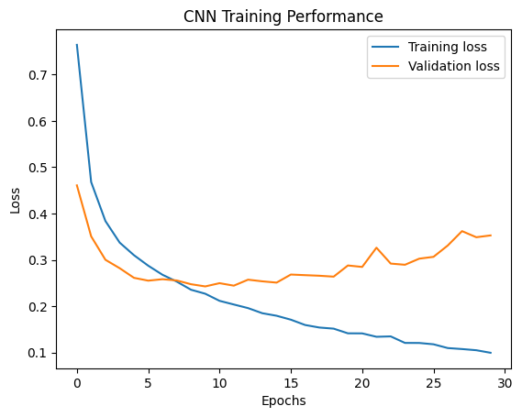

Performance

Slide 9
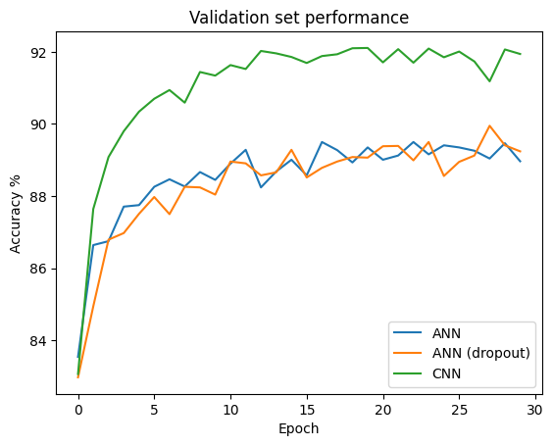
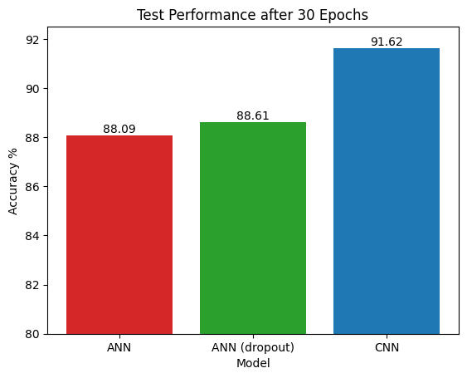
Accuracy Comparison

Slide 10
Hyperparameters
SGD vs Adam
Epochs and learning rate
Criterion/Activation – NLLLoss and Log Softmax

Slide 11
Optimiser Comparison

Slide 12
Other ways to mitigate overfitting
Data augmentation
Regularisation
Early stopping

