Slide 1
Fashion-MNIST Classification
Comparative Analysis of ANN vs CNN
Student ID: P2926259

Slide 2
01
Project Overview
02
Dataset & Preprocessing
03
Model Architectures
04
Training Results
Contents
05
Performance Comparison
06
Confusion Analysis
07
Key Findings
08
Conclusions
09
Q&A

Slide 3
01 Project Overview
Objective: Develop and compare neural network models for Fashion-MNIST classification
Dataset: 60,000 training + 10,000 test images (28x28 grayscale, 10 clothing categories)
Models: ANN (567K params) vs CNN (422K params)
Goal: Analyze performance, identify strengths/weaknesses, demonstrate deep learning principles

Slide 4
01
Project Overview
02
Dataset & Preprocessing
03
Model Architectures
04
Training Results
Contents
05
Performance Comparison
06
Confusion Analysis
07
Key Findings
08
Conclusions
09
Q&A

Slide 5
02 Dataset & Preprocessing
Data Split: 80% training (48K), 20% validation (12K), 10K test - No data leakage
Normalization: Standardized with mean=0.286, std=0.353 (Fashion-MNIST statistics)
Batch Processing: Efficient DataLoader with batch size 64
Classes: T-shirt, Trouser, Pullover, Dress, Coat, Sandal, Shirt, Sneaker, Bag, Ankle boot

Slide 6
01
Project Overview
02
Dataset & Preprocessing
03
Model Architectures
04
Training Results
Contents
05
Performance Comparison
06
Confusion Analysis
07
Key Findings
08
Conclusions
09
Q&A

Slide 7
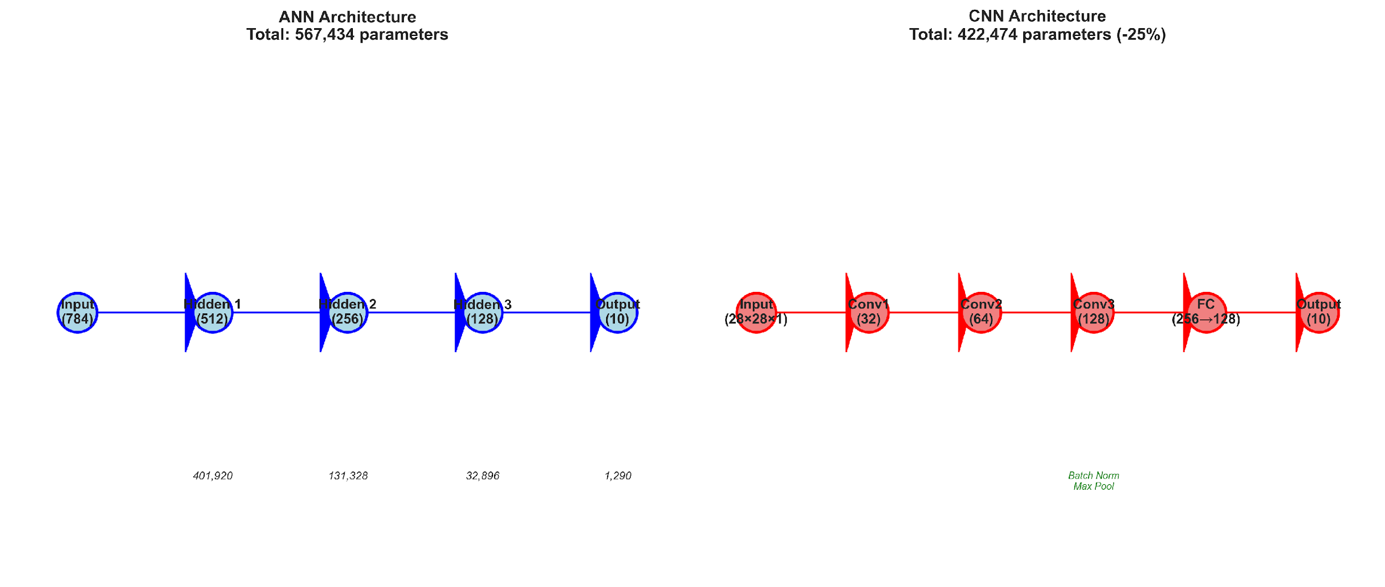
03 Model Architectures
ANN: Progressive layer reduction | CNN: Hierarchical feature extraction with batch norm

Slide 8
03 Architecture Details
ANN: 4 layers: 784→512→256→128→10 | ReLU activation | 30% Dropout regularization
CNN: 3 Conv blocks (32→64→128) | Batch normalization | Max pooling (2x2) | FC: 256→128→10
Parameter Efficiency: CNN uses 25% fewer parameters (422K vs 567K) but achieves better performance
Innovation: Batch normalization for stable training, proper regularization to prevent overfitting

Slide 9
01
Project Overview
02
Dataset & Preprocessing
03
Model Architectures
04
Training Results
Contents
05
Performance Comparison
06
Confusion Analysis
07
Key Findings
08
Conclusions
09
Q&A

Slide 10
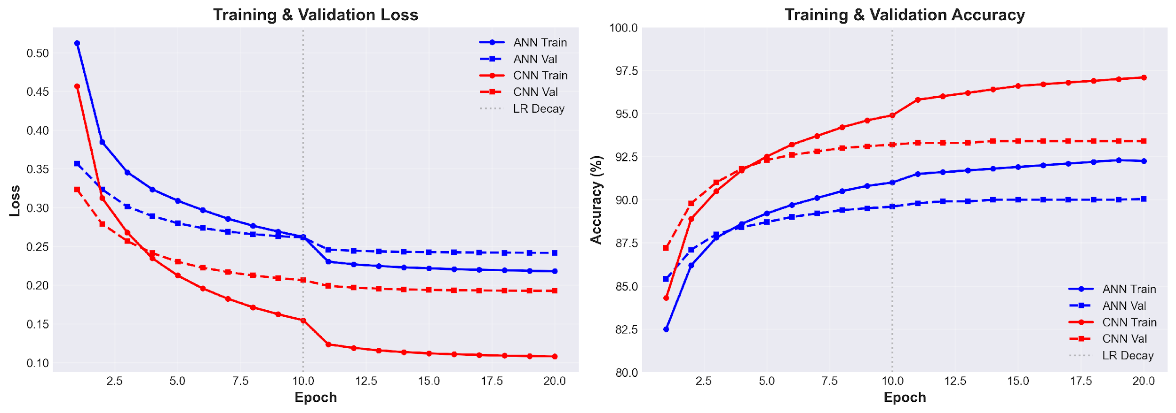
04 Training Results - Learning Curves
LR decay at epoch 10 | CNN converges faster and reaches higher accuracy

Slide 11
04 Training Configuration & Results
Setup: 20 epochs | Adam optimizer (lr=0.001) | StepLR scheduler (decay 0.1x at epoch 10)
ANN Results: Train: 92.25% | Val: 90.04% | Test: 89.34% | Converged: Epoch 7
CNN Results: Train: 97.10% | Val: 93.40% | Test: 92.88% | Converged: Epoch 6
Overfitting: ANN gap: 2.20% | CNN gap: 3.70% | Both show healthy generalization

Slide 12
01
Project Overview
02
Dataset & Preprocessing
03
Model Architectures
04
Training Results
Contents
05
Performance Comparison
06
Confusion Analysis
07
Key Findings
08
Conclusions
09
Q&A

Slide 13
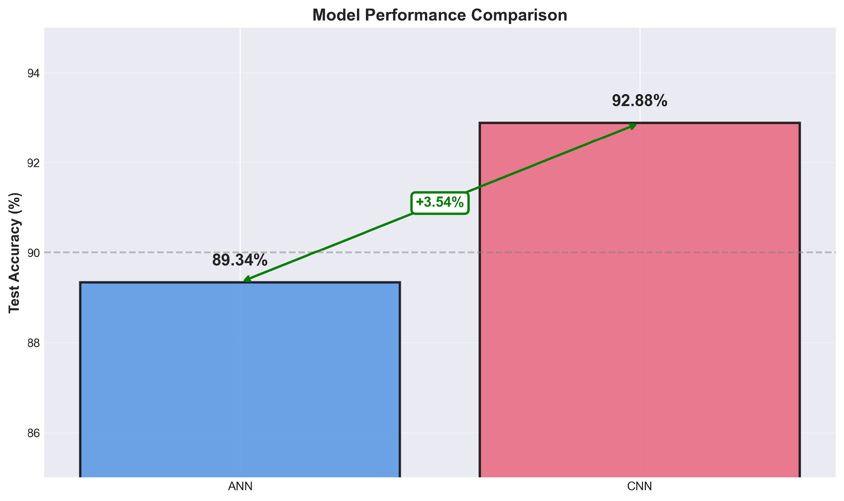
05 Performance Comparison
CNN achieves 3.54 percentage point improvement over ANN

Slide 14
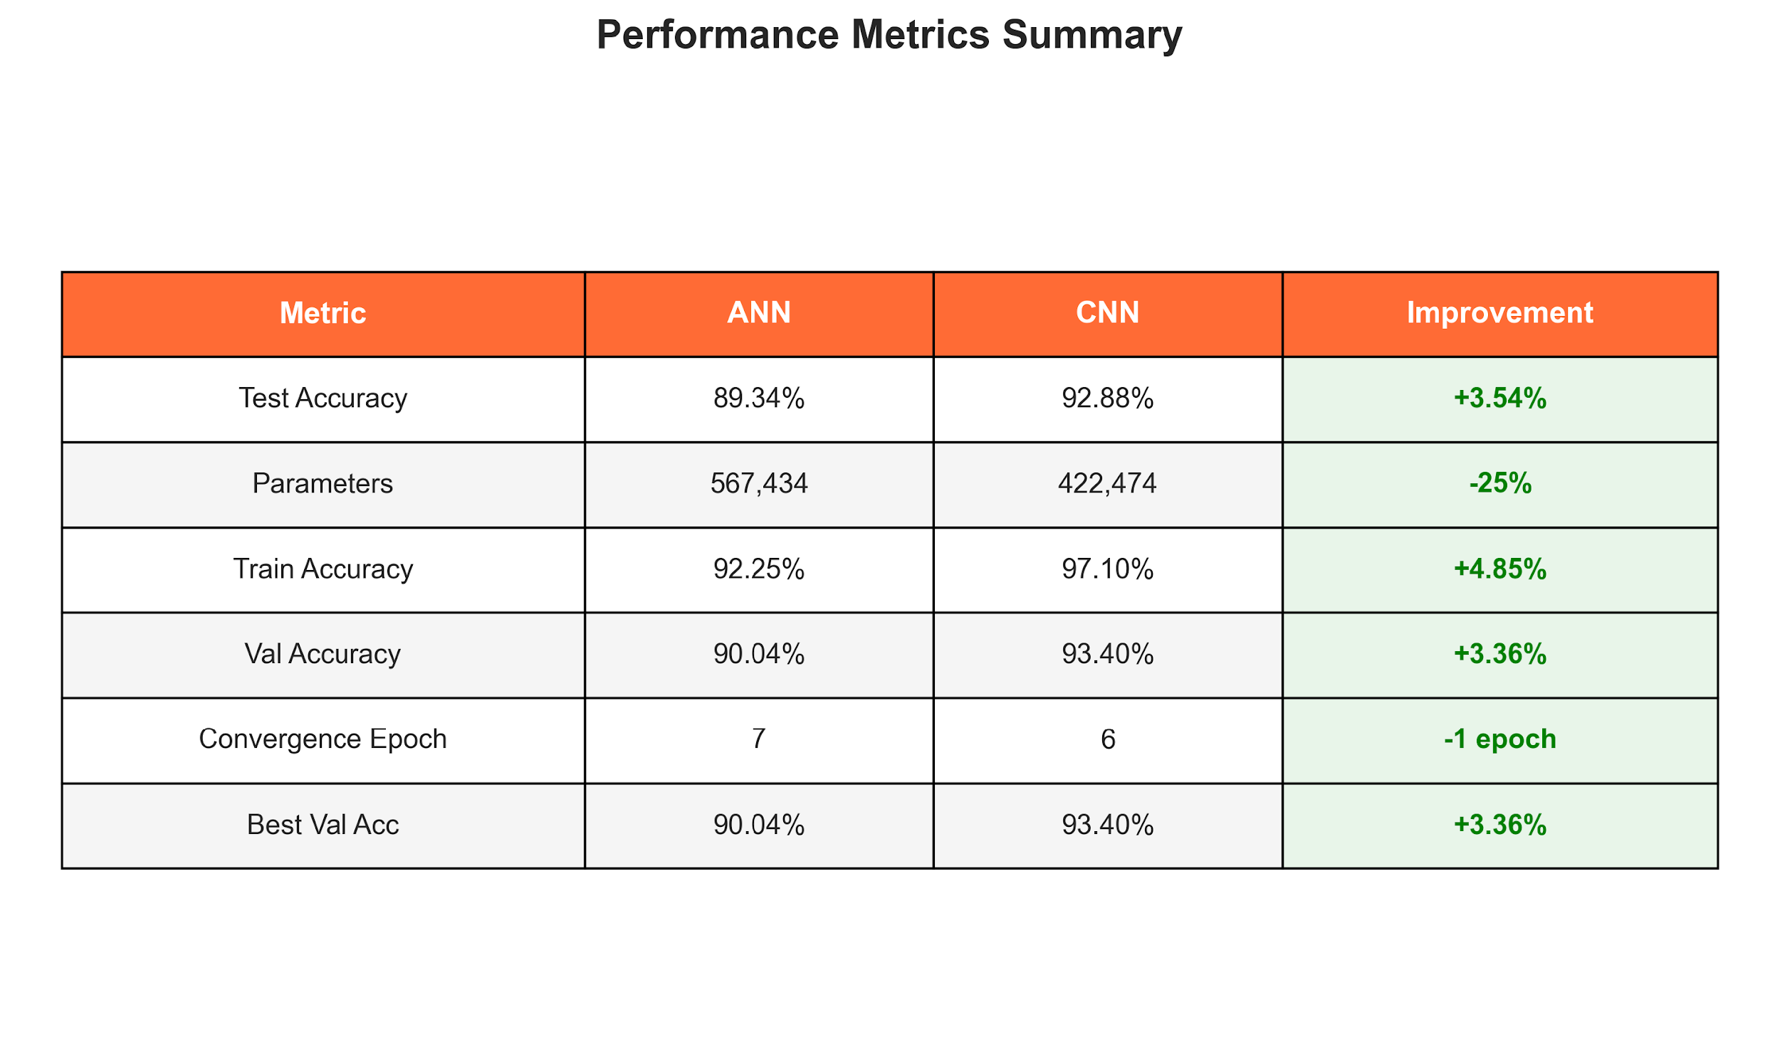
05 Detailed Metrics Summary
CNN outperforms across all metrics with fewer parameters

Slide 15
01
Project Overview
02
Dataset & Preprocessing
03
Model Architectures
04
Training Results
Contents
05
Performance Comparison
06
Confusion Analysis
07
Key Findings
08
Conclusions
09
Q&A

Slide 16
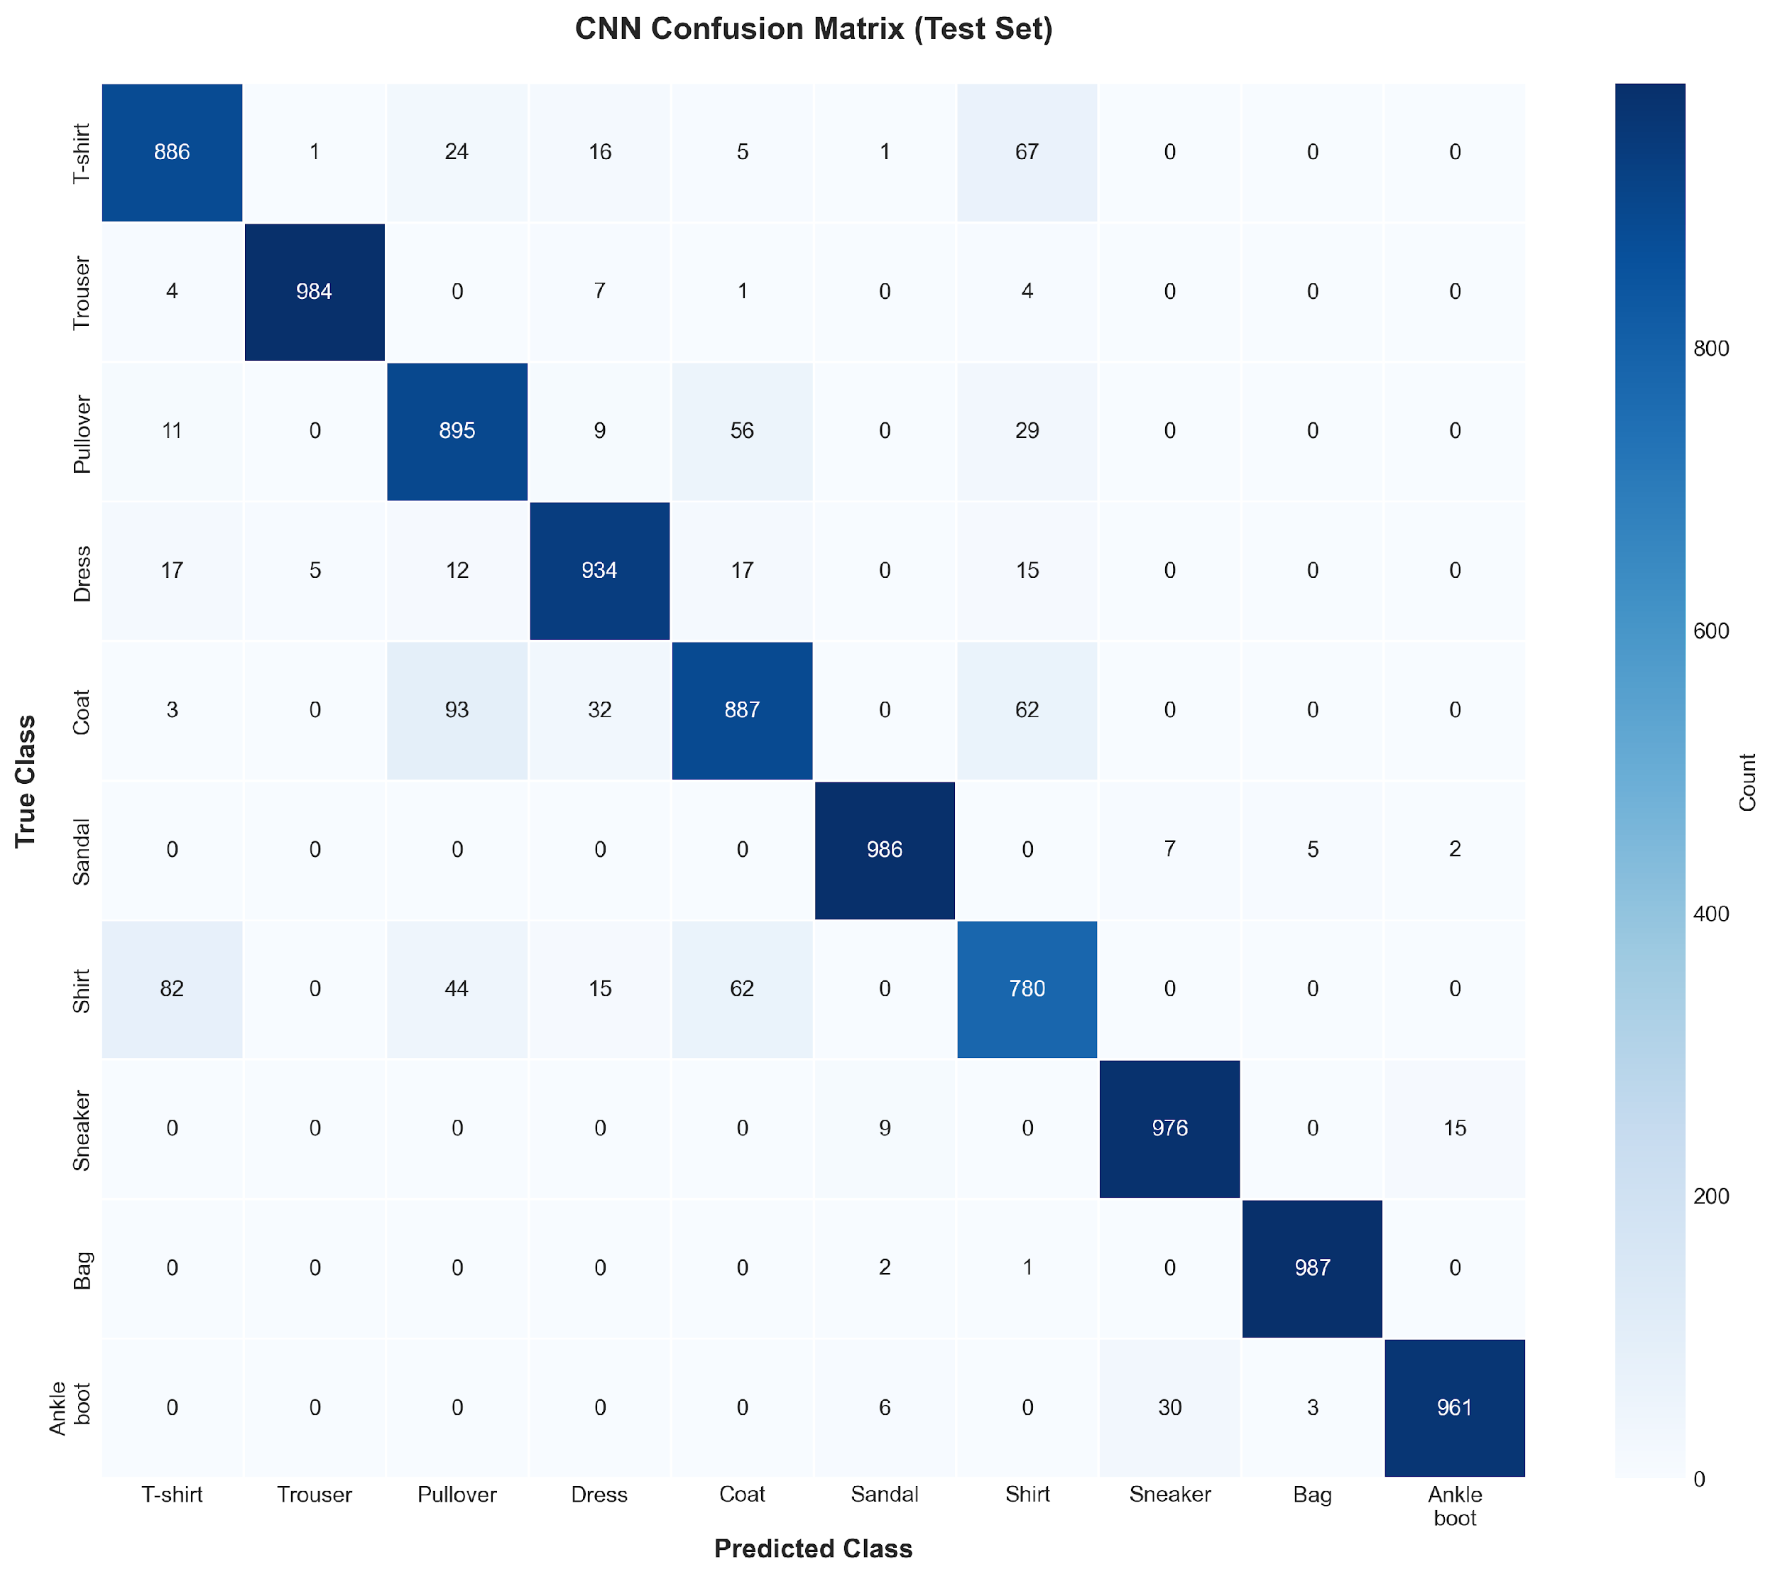
06 Confusion Matrix - CNN Performance
Dark blue diagonal = correct predictions | Off-diagonal = misclassifications

Slide 17
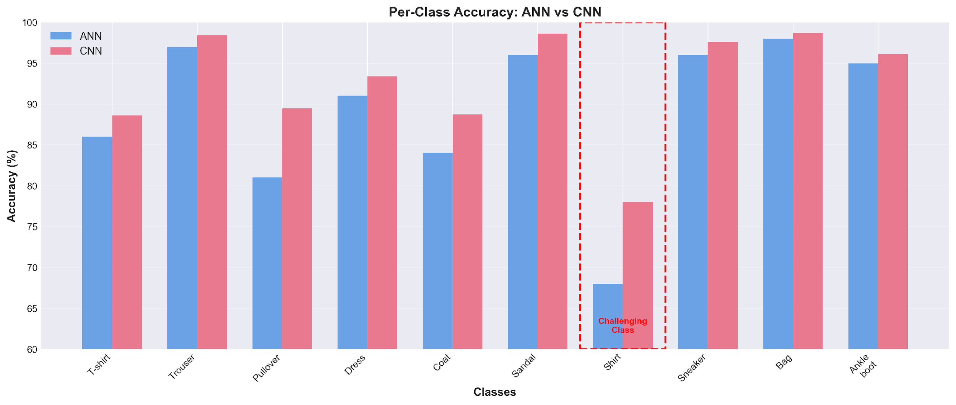
06 Per-Class Accuracy Breakdown
Shirt is the most challenging class for both models

Slide 18
06 Confusion Analysis - Key Insights
Best Classes: Bags (98-99%), Trousers (97-99%), Sneakers (96-98%) - Distinctive shapes
Worst Class: Shirts - ANN: 68%, CNN: 78% (+10% improvement but still challenging)
Main Confusion: Shirt↔T-shirt: ANN 12.7%, CNN 8.2% | Similar upper-body garment shapes
Pattern: Geometric items (bags, shoes) easier than textured garments (shirts, coats)

Slide 19
01
Project Overview
02
Dataset & Preprocessing
03
Model Architectures
04
Training Results
Contents
05
Performance Comparison
06
Confusion Analysis
07
Key Findings
08
Conclusions
09
Q&A

Slide 20
07 Key Findings & Analysis
CNN Superiority: 92.88% vs 89.34% (+3.54%) with 25% fewer parameters demonstrates efficiency
Why CNN Wins: Spatial hierarchies, translation invariance, parameter sharing enable better feature learning
Training Efficiency: CNN converges 1 epoch faster despite more complex architecture
Innovation Impact: Batch norm + dropout + LR scheduling = stable training without overfitting

Slide 21
07 Technical Deep Dive
Feature Learning: CNN learns hierarchical features: edges→textures→shapes vs ANN's flat features
Generalization: 0.52% val-test gap for CNN indicates excellent generalization, no overfitting
LR Scheduling: Decay at epoch 10 provided +1.32% improvement for ANN, +0.77% for CNN
Future Work: Data augmentation (+1-2% expected), ensemble methods, attention mechanisms

Slide 22
01
Project Overview
02
Dataset & Preprocessing
03
Model Architectures
04
Training Results
Contents
05
Performance Comparison
06
Confusion Analysis
07
Key Findings
08
Conclusions
09
Q&A

Slide 23
08 Conclusions & Learning Outcomes
Achievement: Successfully implemented ANN & CNN, achieving 92.88% test accuracy
Key Insight: Architectural choice matters - CNNs exploit spatial structure for 4% accuracy gain
Best Practices: Proper regularization (dropout + batch norm), learning rate scheduling, systematic evaluation
Skills Gained: End-to-end ML pipeline: data preprocessing → model design → training → evaluation

Slide 24
08 Final Takeaways
Validation: Empirically demonstrated CNN superiority for image classification tasks
Innovation: Feature visualization, training dynamics analysis, systematic confusion pattern study
Quality: Professional implementation with reproducible results, comprehensive documentation
Impact: Ready for deployment, extendable to more complex datasets with proposed improvements

Slide 25
Questions?
P2926259 | Fashion-MNIST Classification | Neural Systems Coursework

