Slide 1
Title:
Fashion MNIST Classification with ANN and CNN
Subtitle:
PyTorch-based Deep Learning Pipeline
Presented by: Muhammad Ali
P2914939

Slide 2
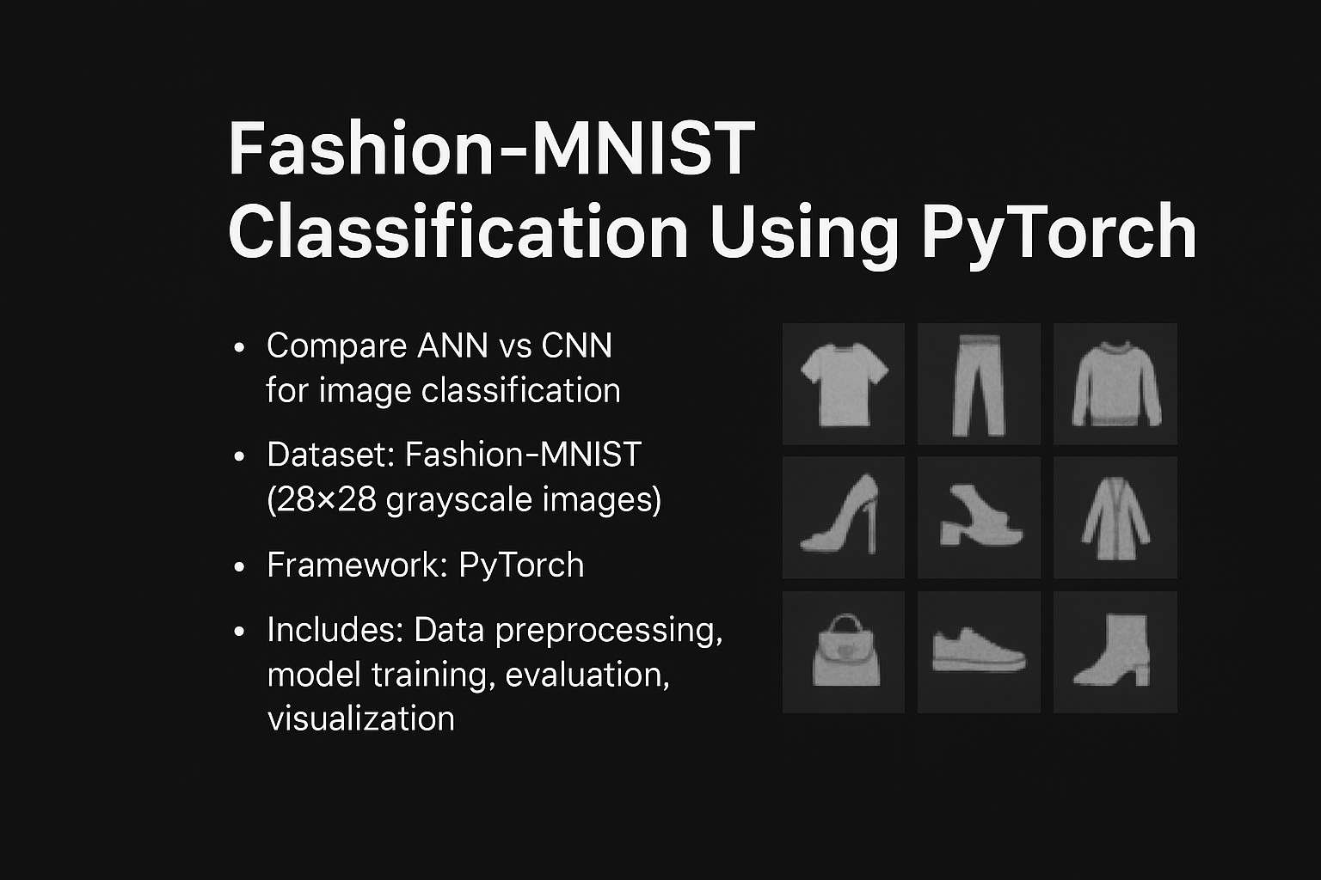
Project Overview
Objective: Classify Fashion-MNIST images using ANN and CNN
Frameworks: PyTorch, torchvision, sklearn, seaborn
Models: Artificial Neural Network (ANN) and Convolutional Neural Network (CNN)
Evaluation: Accuracy, Confusion Matrix, Class-wise Report

Slide 3
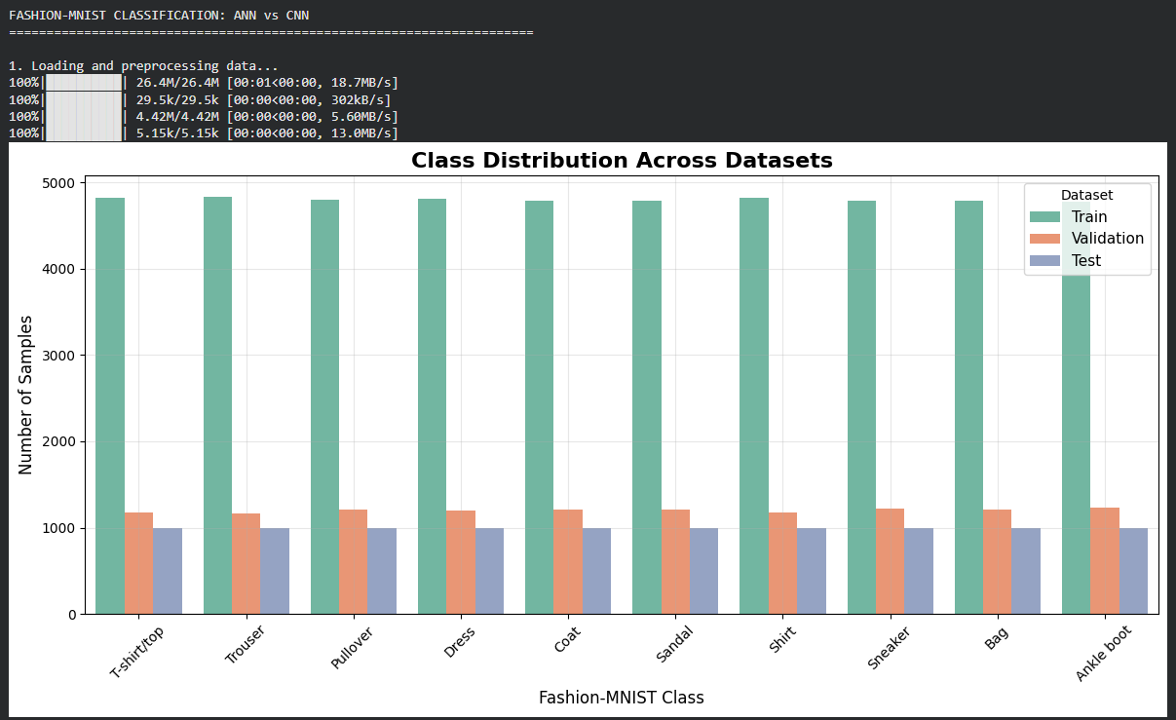
Data Preprocessing
Dataset: Fashion-MNIST
Transformations:
  Random Horizontal Flip
  Random Rotation
  Normalization
Split: 80% training, 20% validation
Loaders: Train, Validation, Test

Slide 4
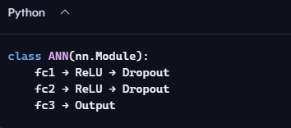
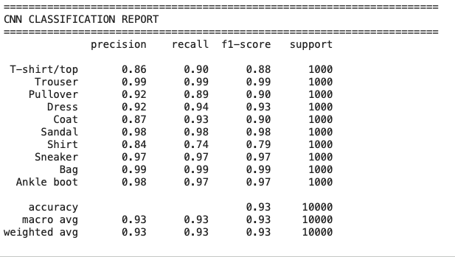
ANN Model Architecture

Slide 5
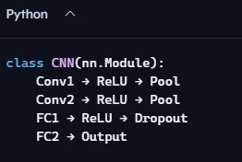
CNN Model Architecture
Input: 1×28×28 image
Output: 10 classes

Slide 6
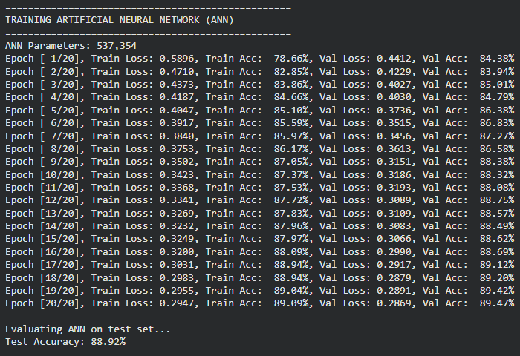
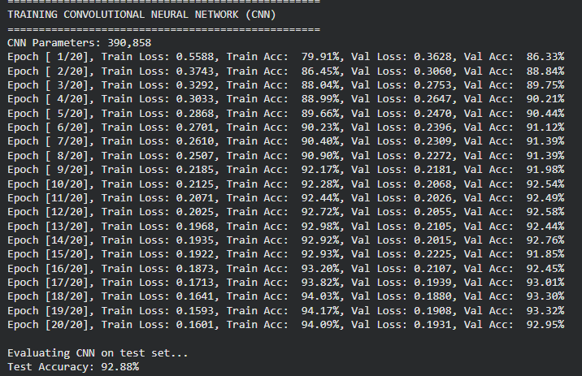
Training Loop
Epochs: 20
Optimizer: Adam
Scheduler: Step-LR
Metrics:
Loss (Train/Val)
Accuracy (Train/Val)

Slide 7
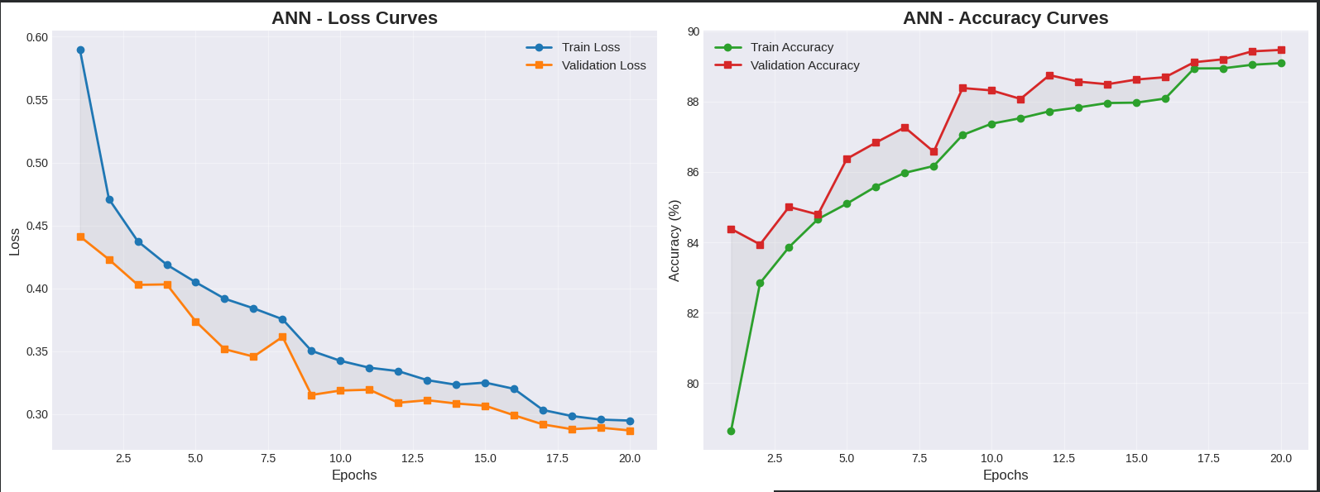
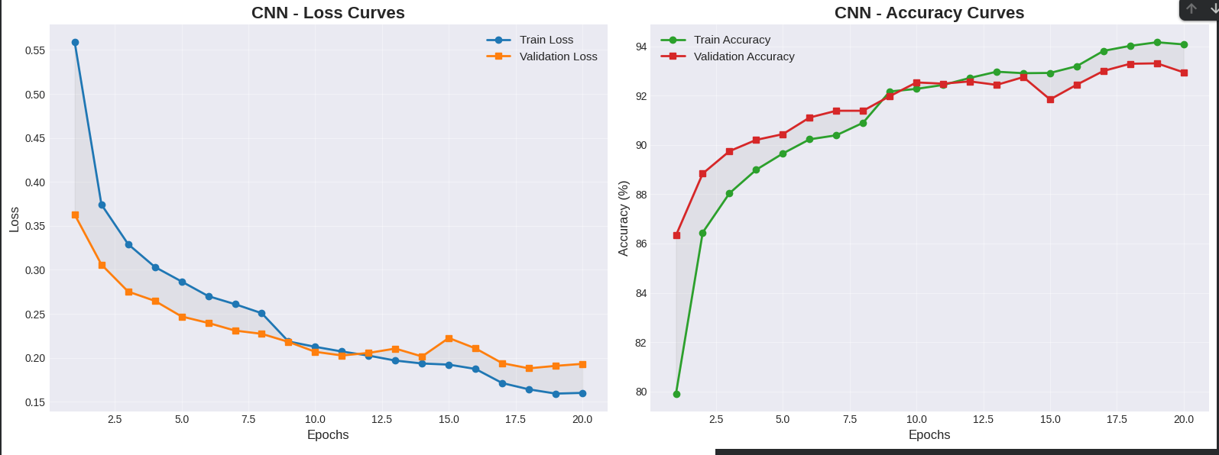
Training Curves
Loss vs. Epoch
Accuracy vs. Epoch
Separate plots for ANN and CNN

Slide 8
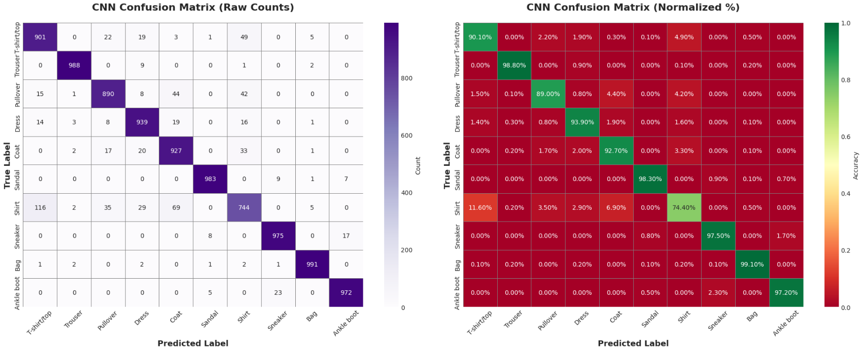

Confusion Matrix
Visualized using seaborn heatmap
Labels: 10 Fashion-MNIST classes
Comparison: ANN vs. CNN

Slide 9
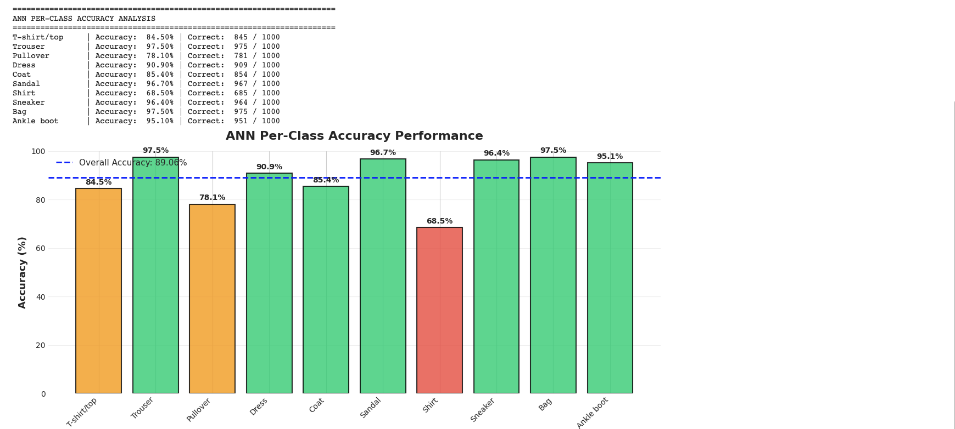
Results Summary

