Slide 1
Neural Systems – Fashion MNIST Classification
Presenter’s name: Aidan Duggan – P2918687
Course: Artificial Intelligence
Date:

Slide 2
Objectives
Train an ANN and CNN on the Fashion-MNIST dataset
Evaluate each model independently
Compare both model’s performance to each other
Identify and suggest potential for improvements or innovation

Slide 3
Approach
Load and preprocess the Fashion-MNIST dataset
Use hyperparameter tuning to identify the best set of hyperparameters
Train both the ANN and CNN model on unseen data
Test and evaluate each model
Compare performance of each model

Slide 4
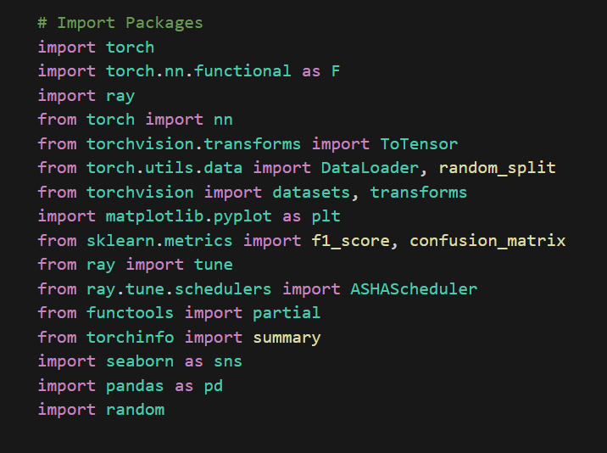
Libraries
Using Pytorch
Ray Tune for hyperparameter tuning
Plotting libraries

Slide 5
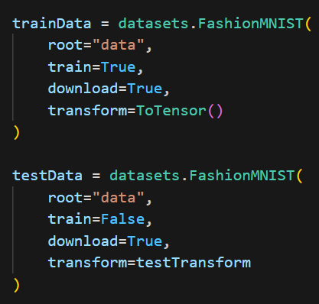
Loading in the Dataset
Load in the train and test dataset for Fashion-MNIST
Transform the data to a tensor

Slide 6
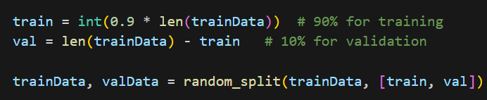
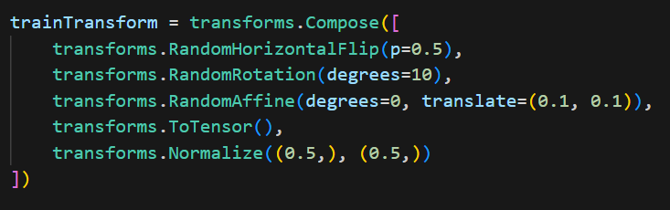
Preprocessing
Validation Split
Data Augmentation
Normalise Data

Slide 7
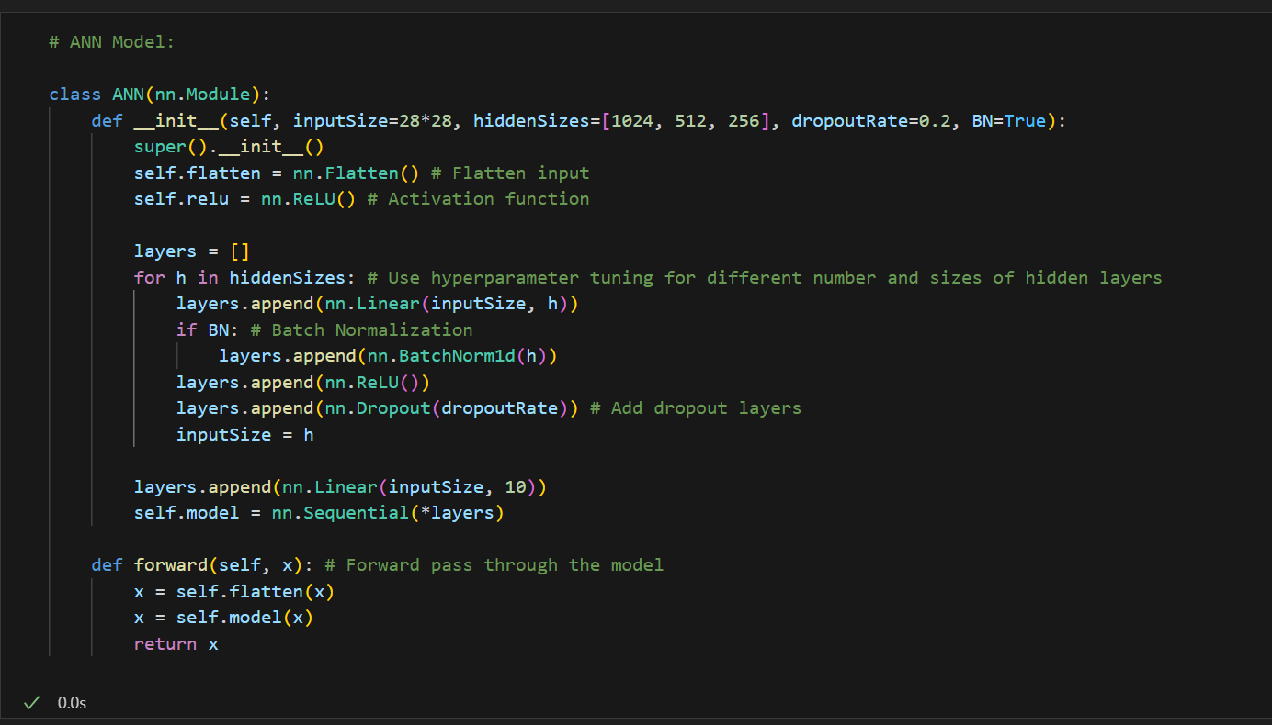
ANN Model
ANN model class
Inherits from the nn.Module class
Hyperparameter Tuning

Slide 8
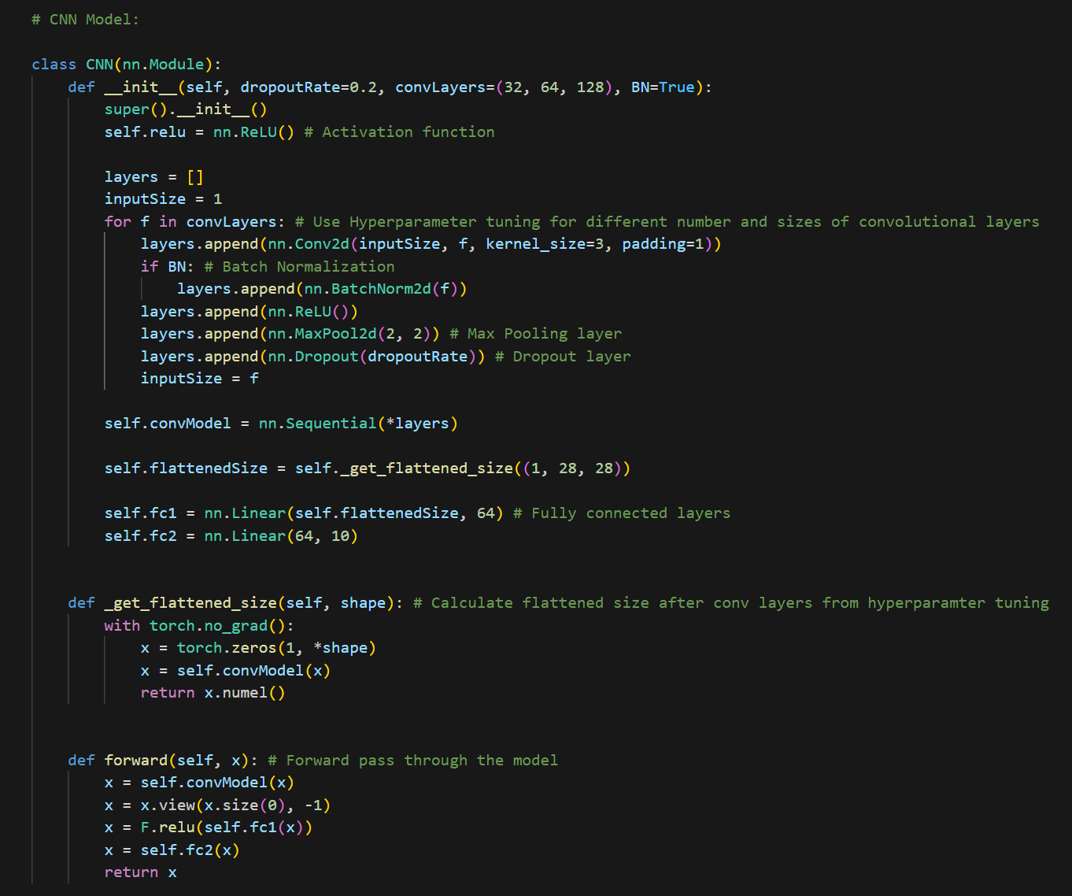
CNN Model
CNN model class
Convolution layers
Spatial features

Slide 9
Assumptions
CNN to outperform the ANN
High levels of performance for both models on the dataset
ANN more likely to be prone to overfitting than CNN

Slide 10
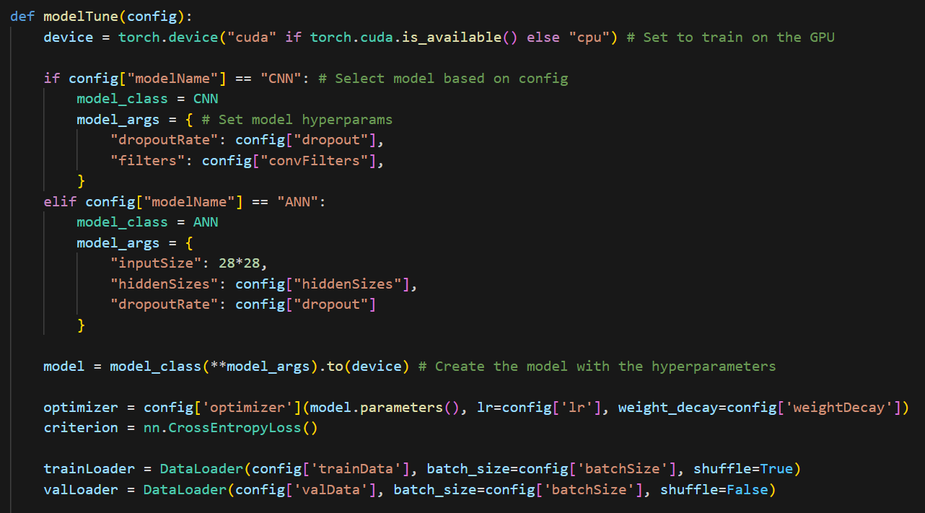
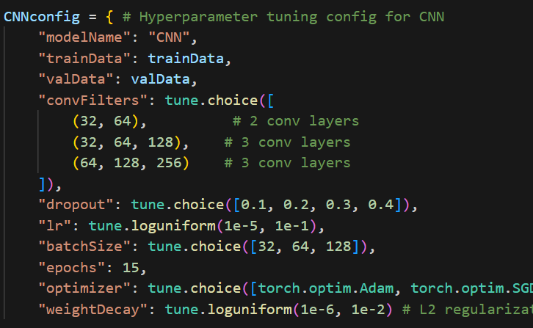
Hyperparameter Tuning
Config for both models set hyperparameter tuning parameters
Model tuning function will test different sets from the config

Slide 11
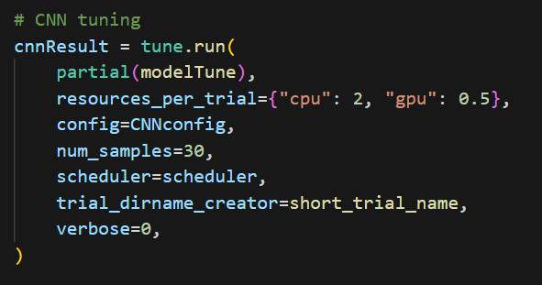
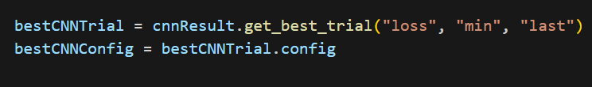
Ray Tune
Hyperparameter tuning library to avoid overfitting and maximise model performance
Test number of trials on different sets of hyperparameters
Uses Random Search

Slide 12
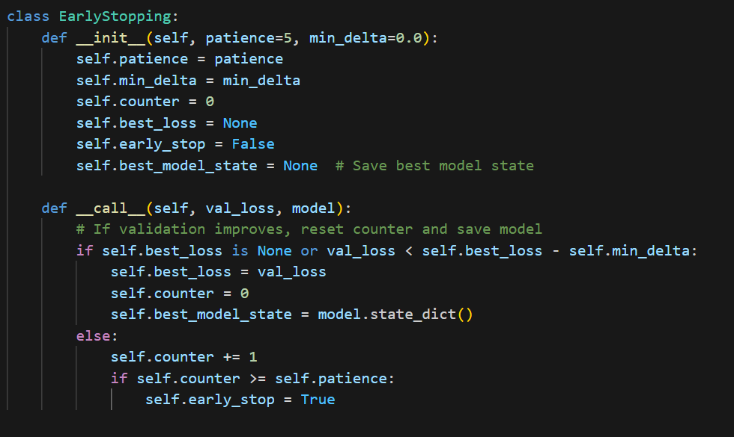
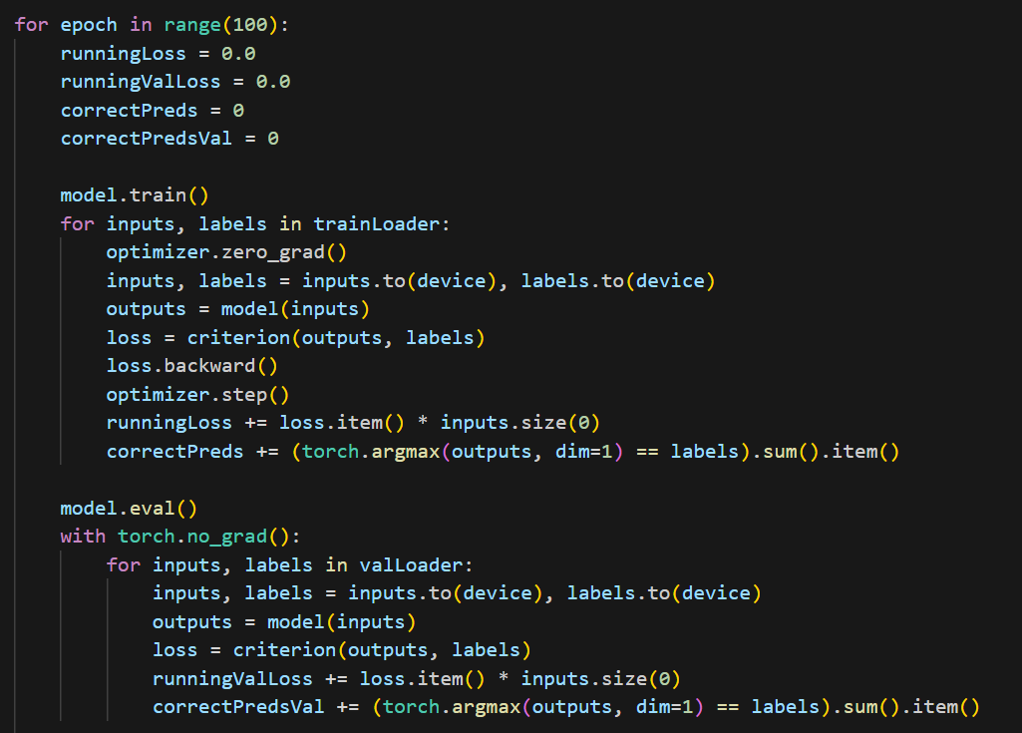
Training the Models
Use best config from hyperparameter tuning
Use early stopping class
Training data and Validation data

Slide 13
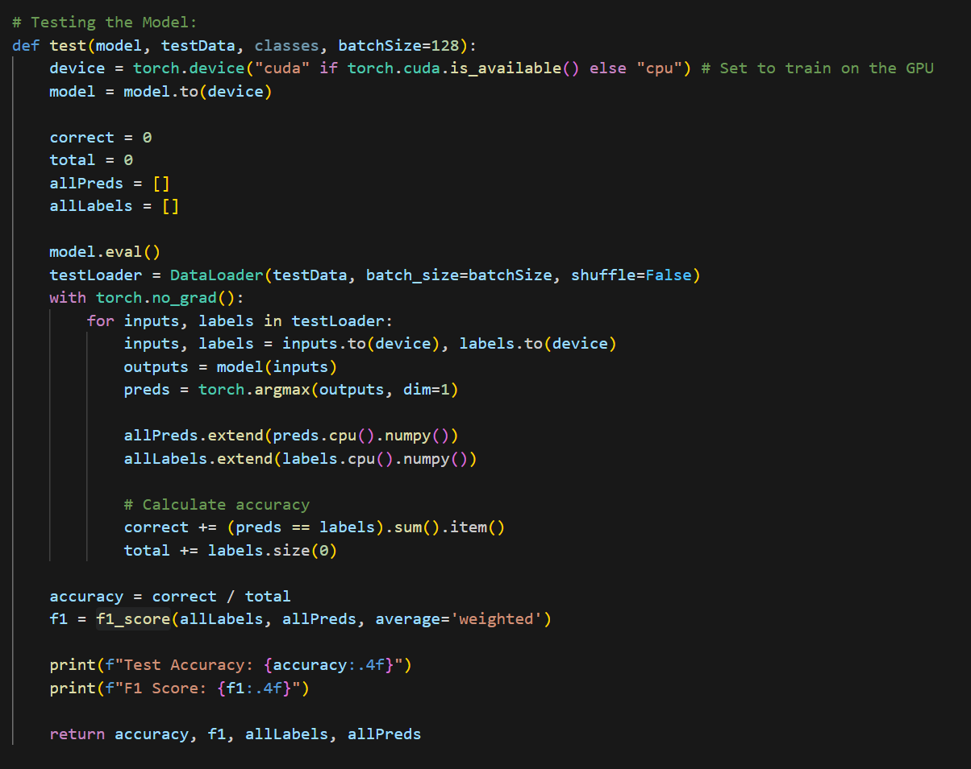
Testing the Models
Using unseen testing data
Accuracy and F1 score
Use the metrics for evaluation

Slide 14
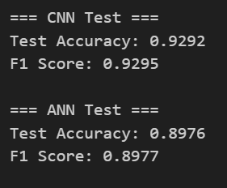
Testing the Models
CNN performs better
Accuracy and F1 score concistent
Both models performed well

Slide 15
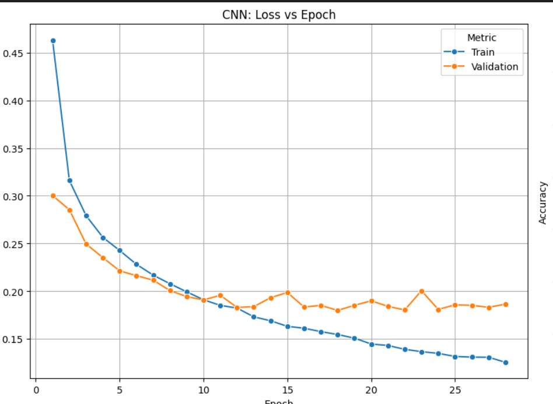
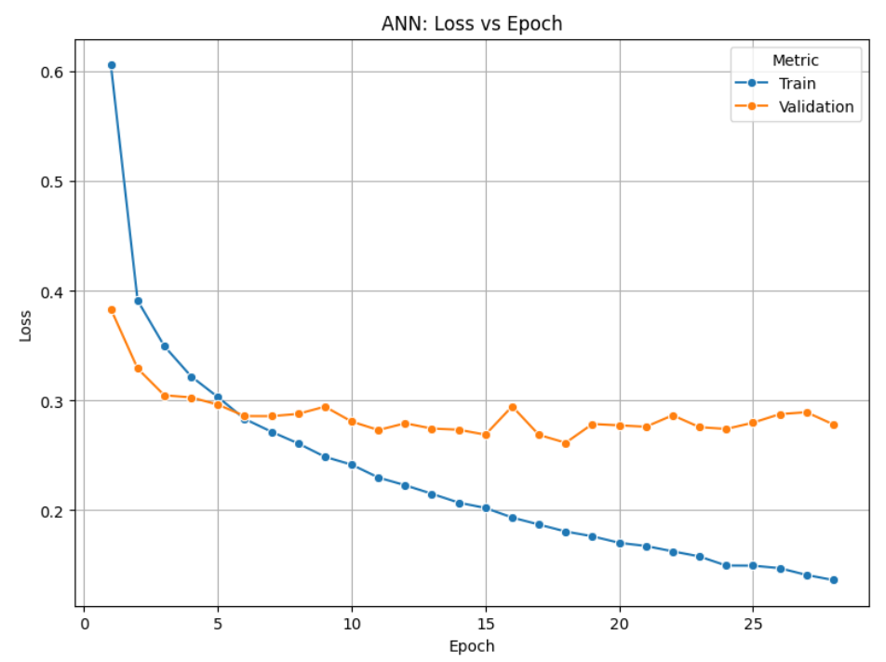
Overfitting

Slide 16
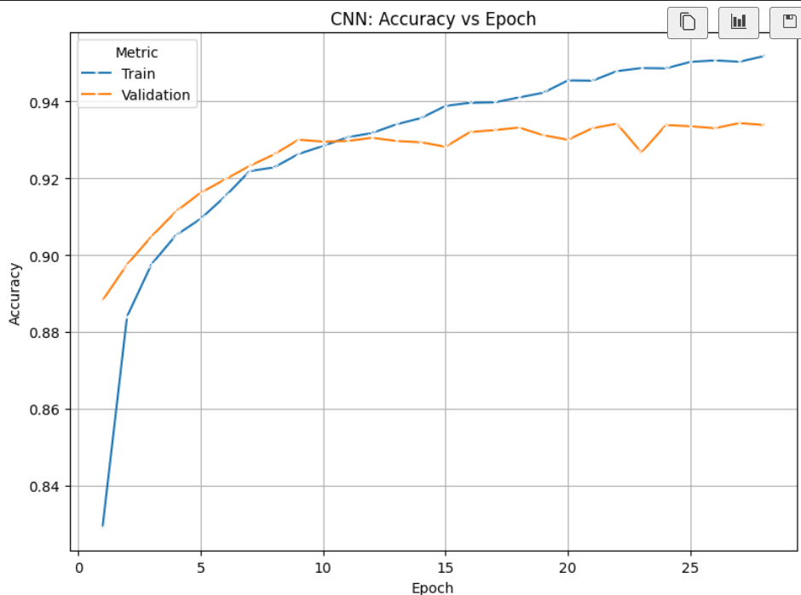
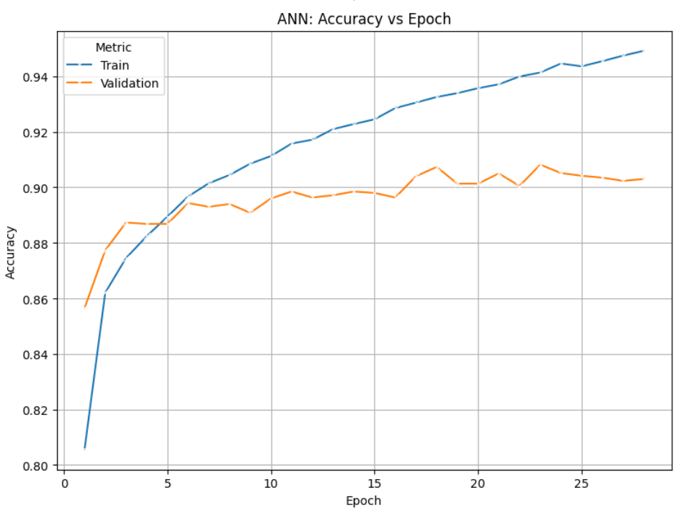
Overfitting

Slide 17
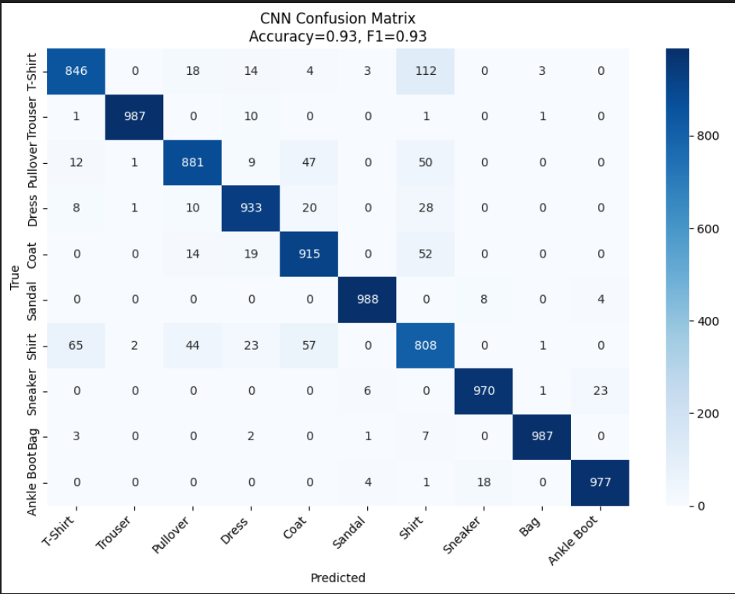
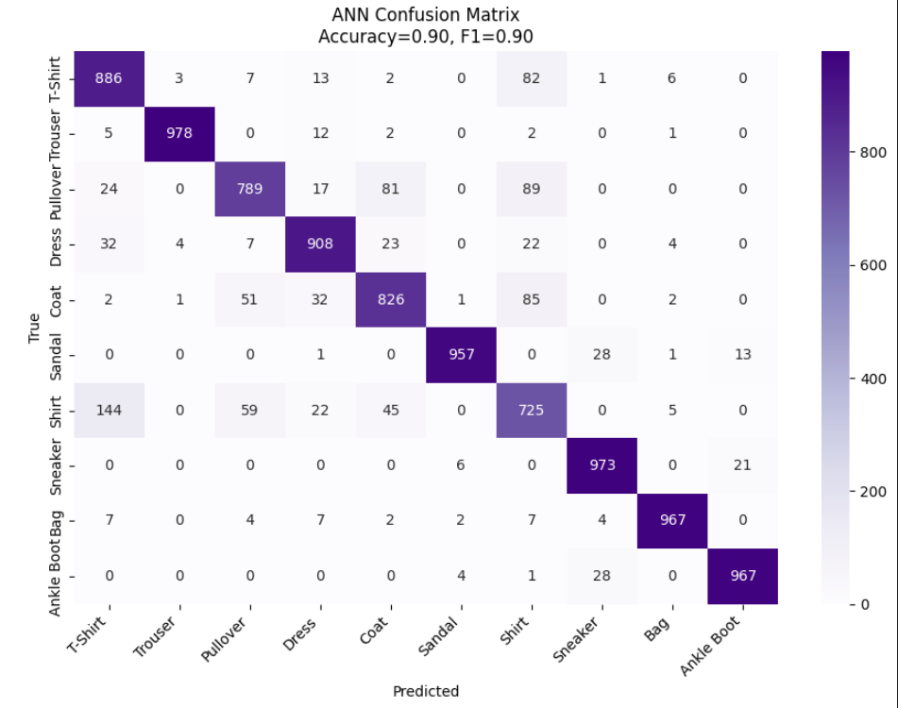
CNN vs ANN

Slide 18
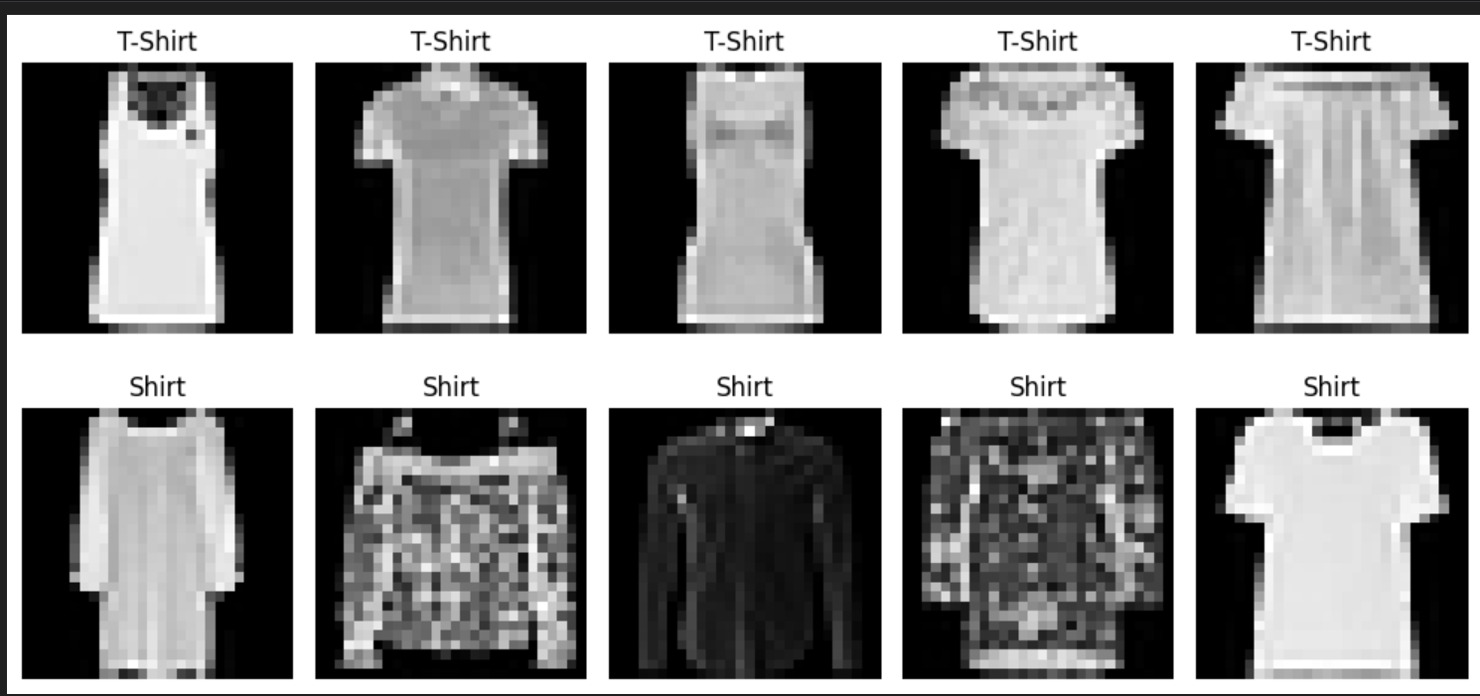

Slide 19
Innovations
Fashion-MNIST is a limited dataset
Different hyperparameter tuning methods
GAN model – more training data
Vision Transformer – more complex model

Slide 20
Summary
CNN outperforms the ANN
Both ANN and CNN perform well on the dataset
Both models can struggle with similar classes such as T-Shirt and Shirt
More or higher quality data + more complex models

