Slide 1

Neural Network Architectures for Image Classification
A Comparative Study on the FashionMNIST Dataset
AARYA PRAJAPATI
Student ID: P2954009

Slide 2

Introduction
The FashionMNIST dataset, a standard benchmark for image classification, serves as a testbed for comparing fundamental deep learning architectures: the Artificial Neural Network (ANN) and the Convolutional Neural Network (CNN).
The fashion item classification task provides a non-trivial, yet manageable, domain for benchmarking model performance.
Our primary question is to quantify the performance gap between fully connected layers (ANN) and convolutional layers (CNN) on pixel data.
This comparison will highlight the practical benefits of hierarchical feature extraction inherent to CNNs.

Slide 3



Project Objectives
Architectural Benchmarking
Quantify Performance
Derive Key Insights
Measure and compare key metrics (loss, validation accuracy, test accuracy) to establish a quantitative baseline for both models.
Analyze the confusion matrices to understand model failure modes and determine the superior model for visual pattern recognition.
Define, implement, and train robust ANN and CNN models optimized for the image data of FashionMNIST.

Slide 4

Methodology
We employed several advanced techniques to ensure the training was stable, efficient, and produced generalizable models.
Data Prep
Model Design
Training Loop
Normalization & Augmentation
Regularization
Applied normalization using dataset-specific mean/std. Employed aggressive training augmentations (rotation, cropping, flipping) to combat overfitting.
Incorporated Batch Normalization (BatchNorm) layers and Dropout (0.3 to 0.4 rate) to stabilize training and prevent co-adaptation of neurons.

Slide 5
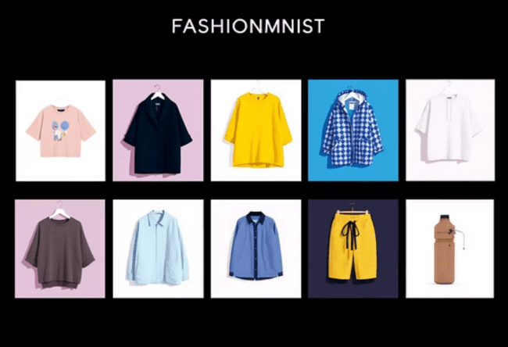

Data Setup
The initial 60,000 image dataset was carefully split, and key hyperparameters were fixed for both training experiments.
60K
10K
Training Data
90%
60,000
Validation Data
10%
12,000
Total Training Set
Test Set Size
60,000 images used for training and validation.
10,000 unseen images for final evaluation.
Test Data
100%
10,000
Key Assumptions: VAL_RATIO = 0.1 (10% of training data for validation), LEARNING_RATE = 0.001.
The class distribution across all sets is balanced, representing 10 distinct fashion categories.

Slide 6




Implementation: Code Structure and Models
The core implementation involves two distinct PyTorch nn.Module classes, optimizing each for its architectural paradigm.
FashionANN: Fully Connected
FashionCNN: Feature Maps
Input Layer: 784 neurons (for 28x28 pixel images).
Input Layer: 1x28x28 image.
Hidden Layers: 512, 256, 128 neurons.
Convolutional Layers: Two blocks with 32 and 64 feature maps, followed by MaxPool2d.
Output Layer: 10 neurons (for 10 fashion classes).
Activation: F.softplus used for non-linearity.
Fully Connected Layers: Flattens feature maps to 64*14*14, then to final 10 classes.
Regularization: BatchNorm1d and Dropout(0.4) applied.
Feature Extraction: Flattens feature maps to 64*14*14.
Regularization: BatchNorm2d/1d and Dropout(0.3) used across layers.
The train_model function standardized the training loop for both models, ensuring fair comparison over 15 epochs. It utilized the Adam optimizer with a learning rate of 0.001 and a StepLR scheduler for effective learning rate decay.

Slide 7
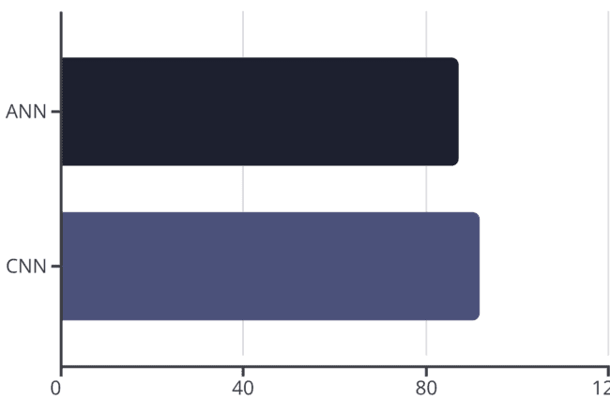



Results: Performance Metrics
The CNN model significantly outperformed the ANN model, demonstrating the superior capability of convolutions for spatial data recognition.
The CNN achieved a final test accuracy of 88.49%, exceeding the ANN’s 83.81% by nearly five percentage points.
88.49%
83.81%
91.85%
87.12%
CNN Test Accuracy
ANN Test Accuracy
Significantly higher classification success rate.
Solid performance, but lacks feature detection capability.

Slide 8



Discussion: Key insight
The performance disparity highlights the inherent advantage of CNNs in extracting hierarchical, translation-invariant features from images.
CNN: Spatial Hierarchy
ANN: Pixel Dependency
Key Misclassification
Convolutional layers learn local patterns (edges, textures) in early layers, which are combined into complex object parts in deeper layers. This efficient representation is key to its high accuracy.
The ANN treats each pixel as an independent feature. The model struggles with the high dimensionality and fails to capture spatial correlations critical for recognizing clothing items.
Both models struggle with ambiguous classes like 'Shirt', 'T-shirt/top', and 'Pullover', suggesting visual similarity and need for deeper semantic understanding.

Slide 9



Conclusion: The Power of Convolution
This comparative study demonstrated that even for a relatively simple dataset like FashionMNIST, the architectural choice has a profound impact on classification performance.
Lesson Learned
Robust Training Verified
For any task involving spatial data (images), prioritizing a Convolutional architecture over a fully connected one is crucial for achieving state-of-the-art results.
CNN Superiority Proven
The consistent improvement in validation accuracy across both models validates the effectiveness of the chosen optimization techniques (Batch Norm, Xavier Init, Augmentation).
The CNN model achieved significantly better results, confirming its suitability for computer vision tasks by leveraging convolutional filters for superior feature extraction.

Slide 10
Thank You

