Slide 1
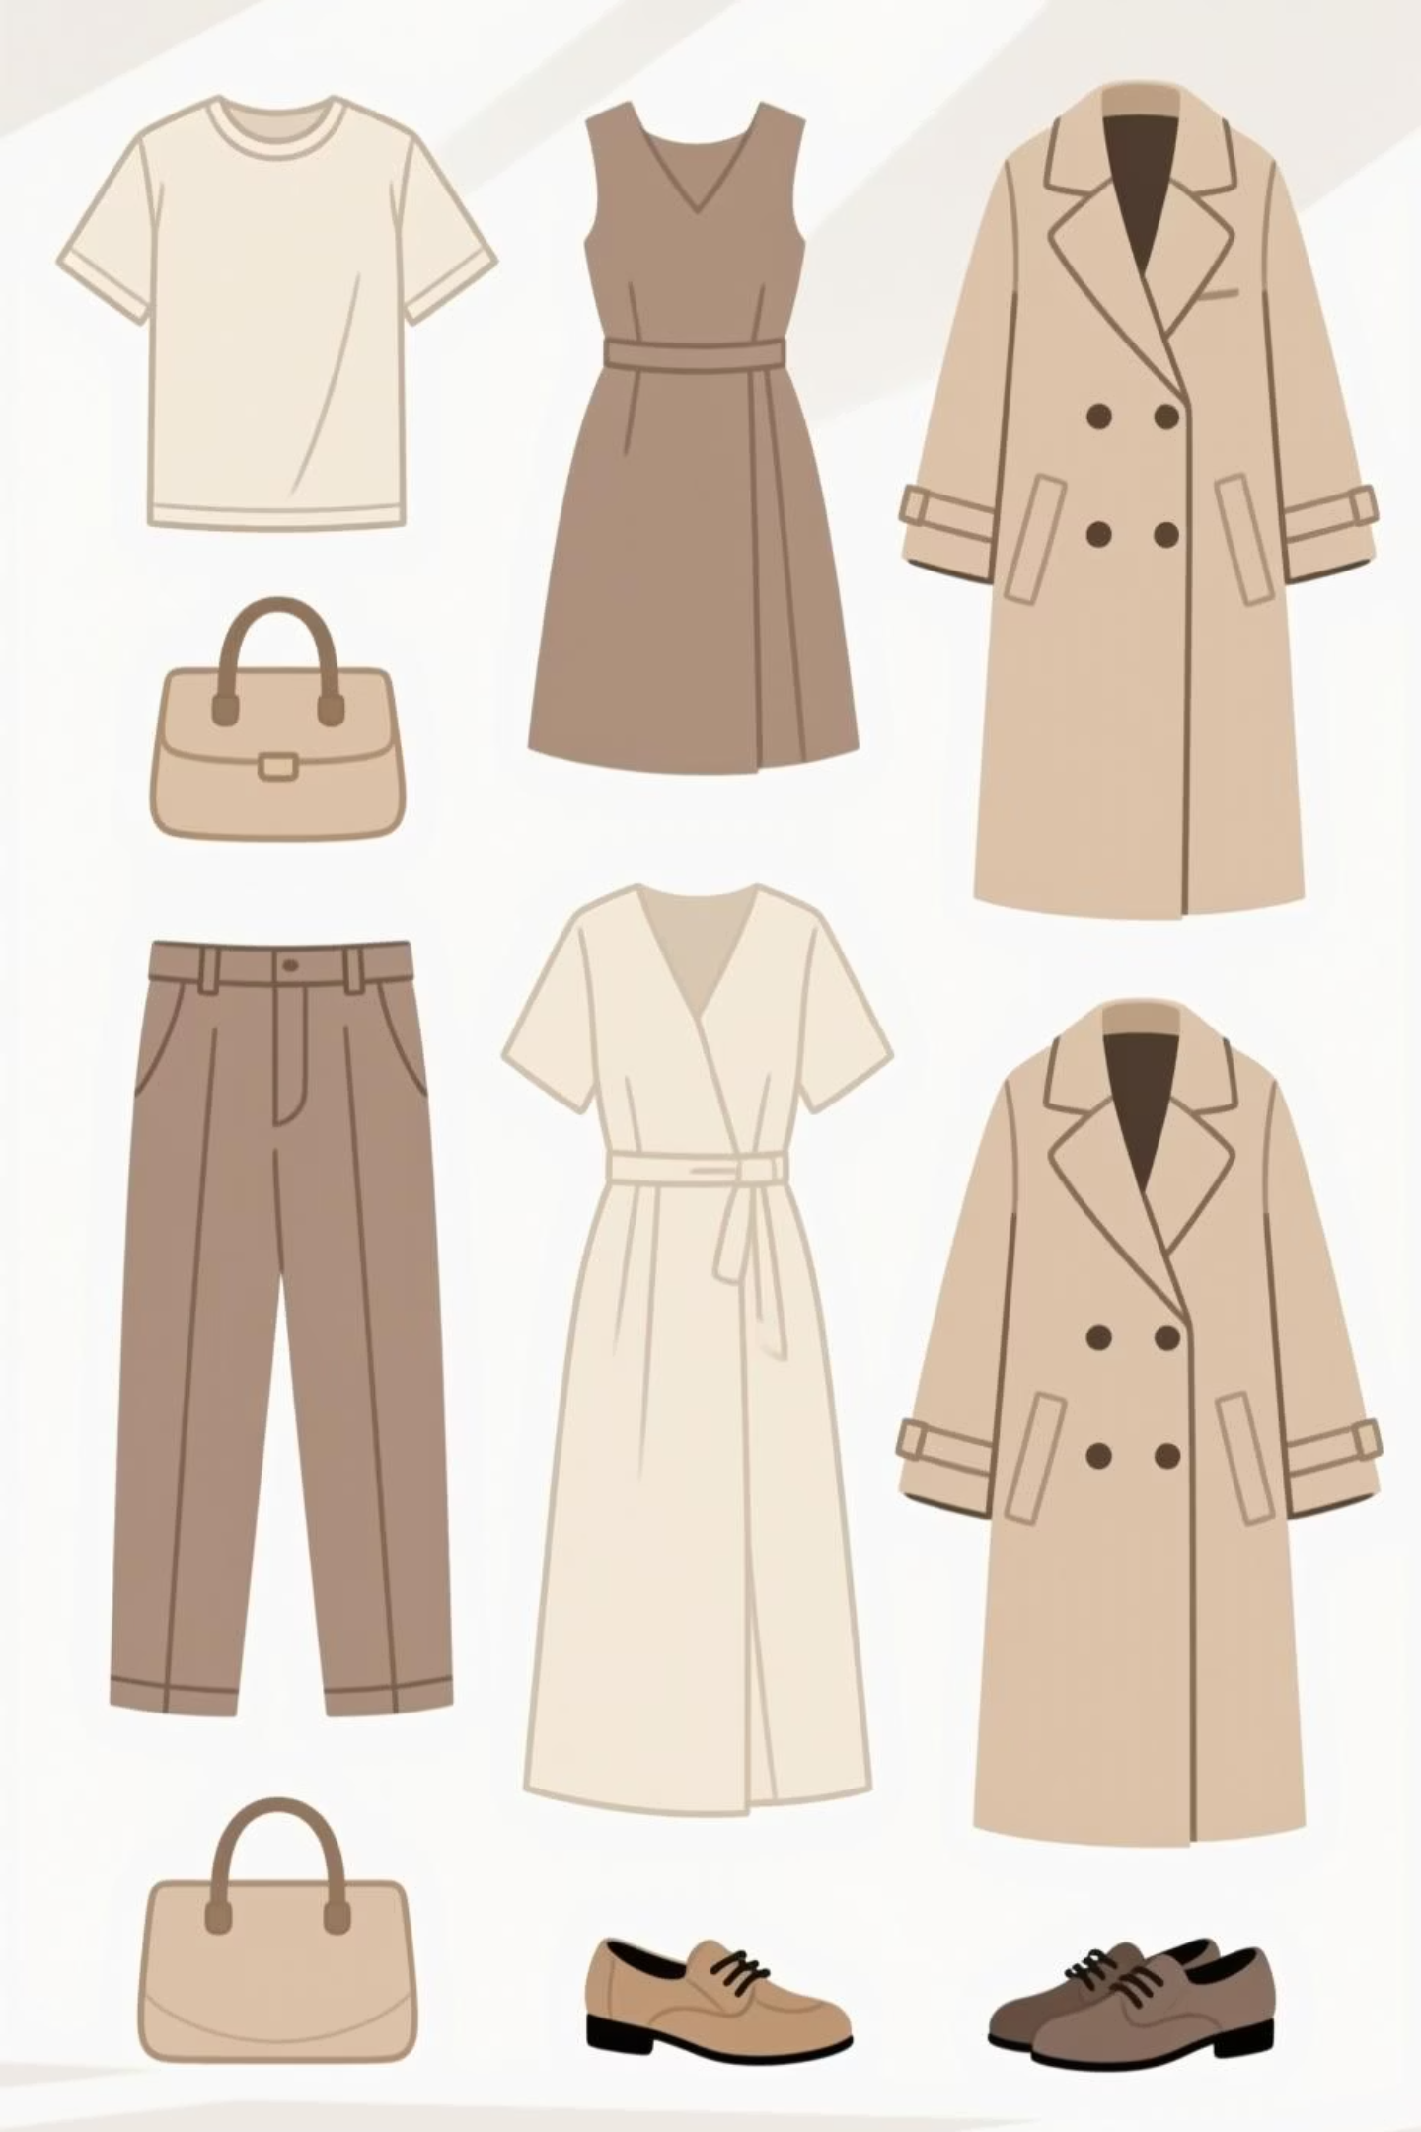
Classifying Fashion-MNIST
A Comparative Analysis of ANN and CNN Performance

Slide 2
Project Overview & Objectives
The Problem:
The "Contest":
The Goal:
To correctly classify 10,000 unseen grayscale images into 10 categories of clothing.
Model 1: A simple Artificial Neural Network (ANN), our baseline.
Implement and train both models.
Quantify the final performance difference.
Model 2: A Convolutional Neural Network (CNN), our challenger.
Analyze why and where each model succeeds or fails.

Slide 3
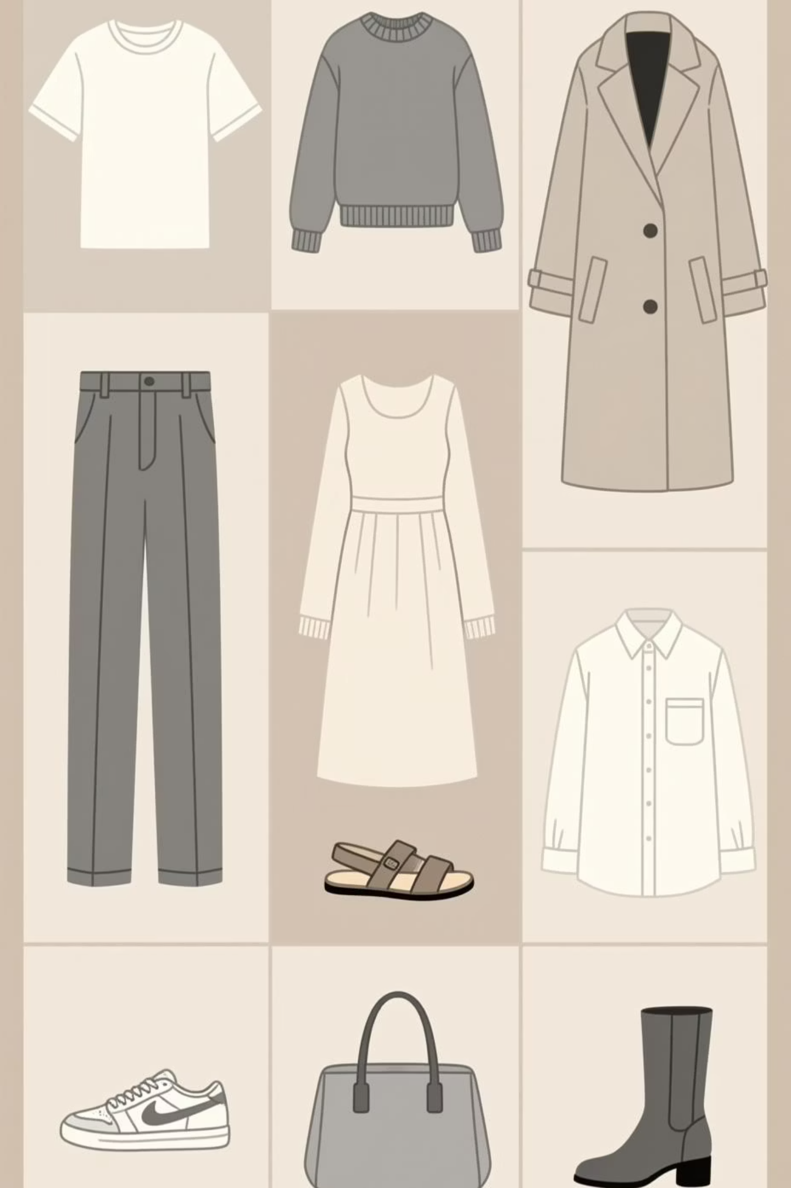
The Dataset: Fashion-MNIST
70,000 grayscale images
Dimensions: 28 x 28 pixels
60,000 for Training
10,000 for Testing
10 Classes:
T-shirt/top, Trouser, Pullover, Dress, Coat, Sandal, Shirt, Sneaker, Bag, Ankle boot

Slide 4
Methodology: Data Preprocessing
01
02
03
Load & Transform:
Data Split:
Data Loaders:
ToTensor(): Converts images to PyTorch Tensors (scales to [0, 1]).
The 60,000 training images were split:
Batch Size = 64
50,000 (Training): Used to train the model.
shuffle=True for training loader.
Normalize((0.5,), (0.5,)): Centers data by scaling to [-1, 1].
10,000 (Validation): Used to check for overfitting.

Slide 5




Model 1: Artificial Neural Network (ANN)
Architecture: A simple Multi-Layer Perceptron (MLP)
Process:
Flatten:
The 28x28 image is converted into a flat 784-pixel vector.
Linear(784 -> 128) + ReLU
Dropout(0.2)
Linear(128 -> 64) + ReLU
Linear(64 -> 10)
(Output)

Slide 6

Model 2: Convolutional Neural Network (CNN)
Architecture: A 2-Layer Convolutional Network
Process:
Conv2d (32 filters) + ReLU -> MaxPool2d
Finds simple patterns (edges, corners)
Conv2d (64 filters) + ReLU -> MaxPool2d
Combines patterns (textures, shapes)
Flatten:
Flattens the extracted features.
Linear(3136 -> 128) + Dropout(0.5)
Linear(128 -> 10)
(Output)

Slide 7
Training & Evaluation Setup
Framework:
Hardware:
PyTorch
NVIDIA GPU (via CUDA)
Optimizer:
Loss Function:
Adam (Learning Rate = 0.001)
CrossEntropyLoss (Standard for multi-class classification)
Epochs:
Progress:
10
tqdm library used for live progress bars.

Slide 8
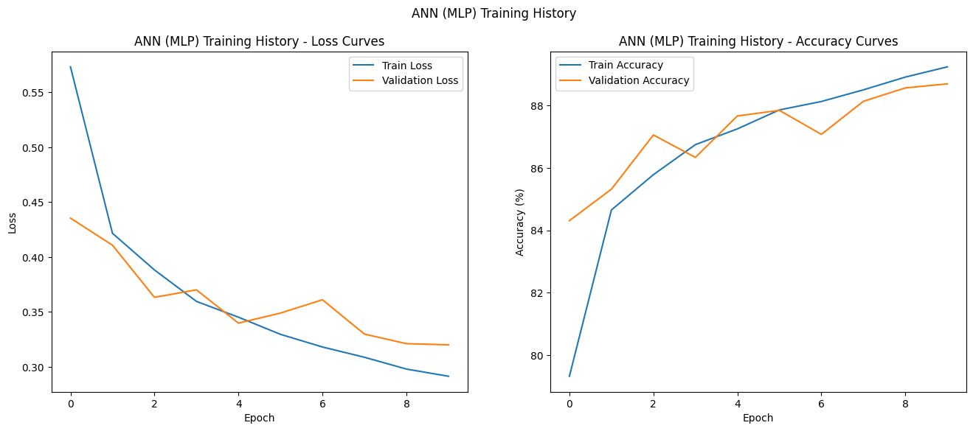
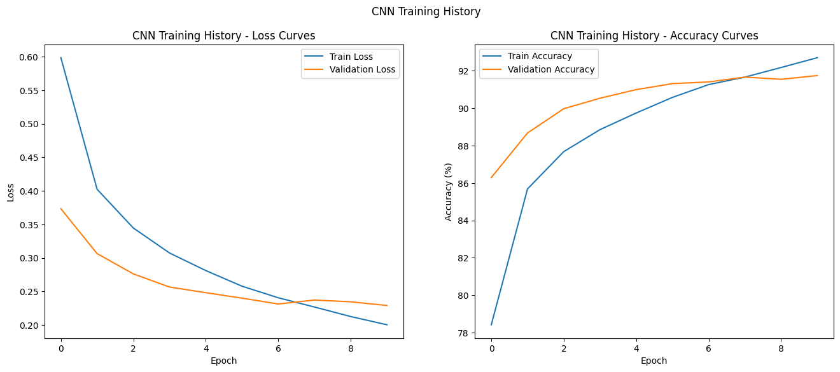
Results: Training & Validation Curves
ANN (MLP): Overfitting
CNN: Healthy Generalization
Validation loss (orange) is erratic and much higher than training loss. The model is memorizing, not learning.
Validation loss (orange) closely tracks the training loss. The model is learning the underlying patterns.

Slide 9
Results: Final Test Accuracy
Evaluation on 10,000 unseen test images:
87.59%
91.22%
+3.63%
ANN (MLP)
CNN
Performance Gap

Slide 10
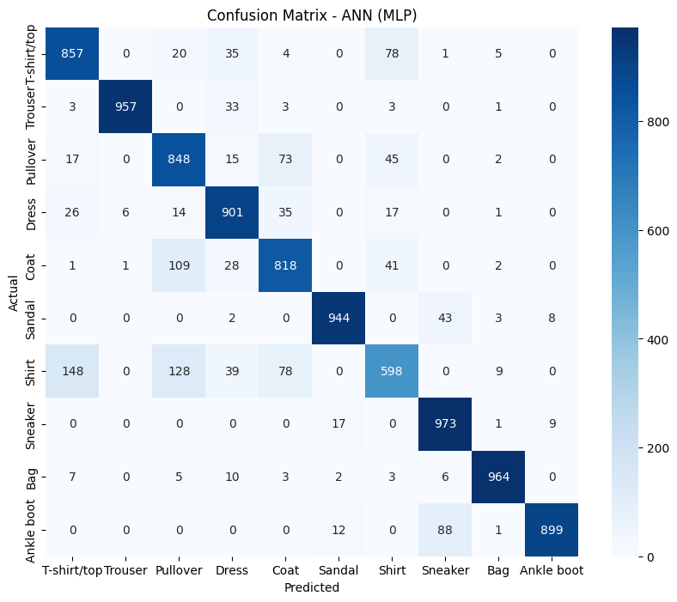
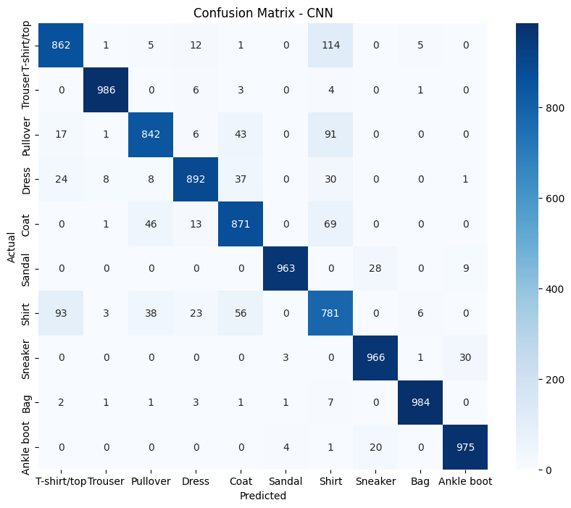
Analysis: Confusion Matrices
ANN (MLP): High Confusion
CNN: Clearer Classification
The "shirt-like" classes are a mess.
The diagonal is much "hotter" (more confident).
148 "Shirts" misclassified as "T-shirt".
Still struggles with "Shirt" (93 errors), but is a huge improvement.
109 "Pullovers" misclassified as "Coats".
Near-perfect on "Trouser," "Bag," and "Sneaker."

Slide 11
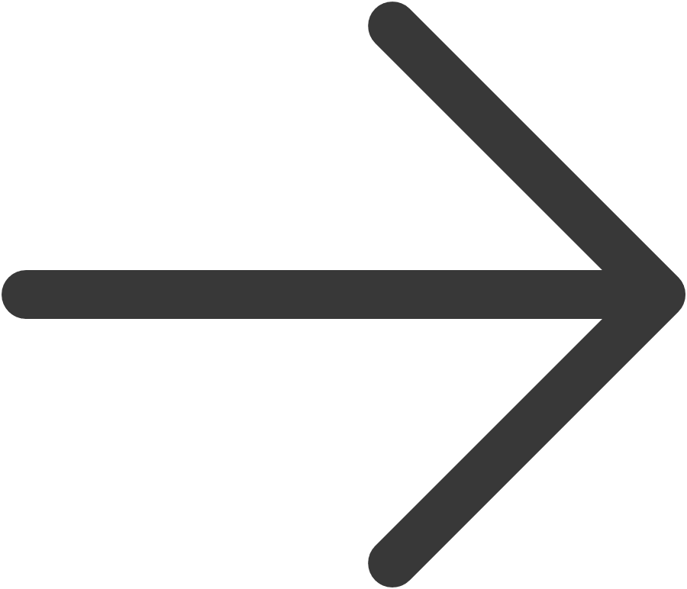
Conclusion & Future Work
Conclusion: Model Performance
Future Work: Enhancing the Model
The Convolutional Neural Network (CNN) demonstrated fundamental superiority for image classification on the Fashion-MNIST dataset.
Data Augmentation
Artificially expand the dataset through techniques like random flips, rotations, and shifts to reduce overfitting and improve robustness.
Its ability to inherently learn spatial features like edges and textures, unlike the "spatially unaware" Artificial Neural Network (ANN), proved critical.
Deeper Architectures
This architectural advantage resulted in a +3.63% higher accuracy and a much healthier model that resisted overfitting, as observed in the training and validation curves.
Implement more complex, state-of-the-art models such as ResNet to potentially achieve an accuracy exceeding 95%.

