Slide 1
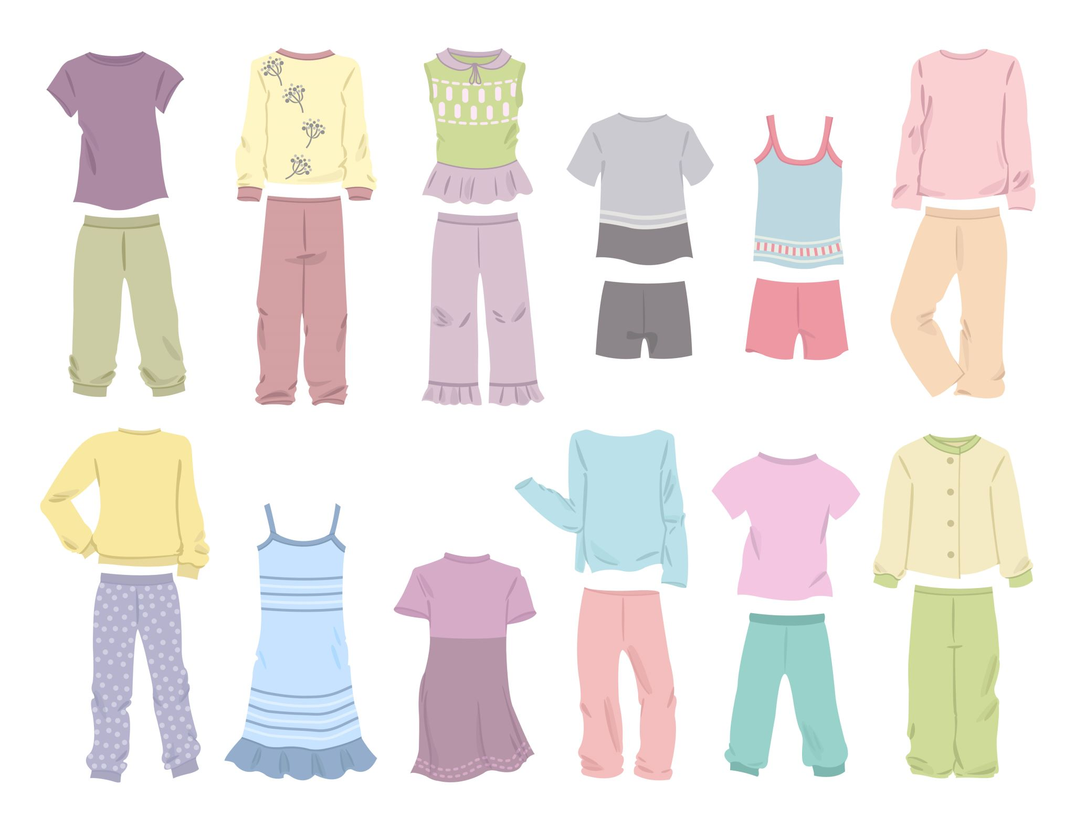
Fashion MNIST Image Classification
Using Artificial Neural Networks and Convolutional Neural Networks.

Slide 2
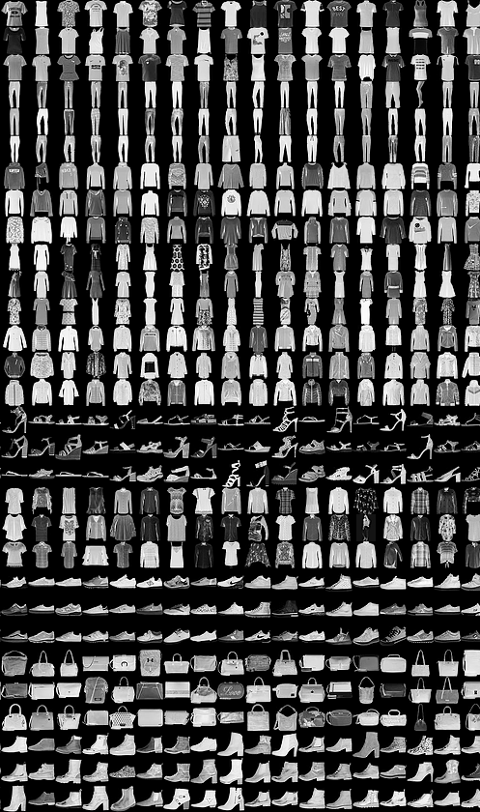
Introduction
Fashion MNIST contains 70,000 grayscale images across 10 clothing categories at 28 by 28 resolution.
The task is supervised classification that maps pixels to semantic labels.
The project demonstrates full workflow from data ingestion to evaluation.
The comparison tests representational advantages of convolutional features.
Outcomes inform reliable choices for instructional deployment.
Notes:
Welcome Everyone to the analysis of the Fashion MNIST classification Dataset, which offers 70,000 grayscale images across 10 clothing categories with a fixed resolution of 28 by 28. The task is supervised image classification. The project was chosen to demonstrate core learning outcomes on preprocessing, network design, implementation in Python, and principled evaluation with accuracy and confusion analysis comparing alternative architectures rigorously.

Slide 3

Objectives and Goals
Build a strong artificial neural network baseline for image classification.
Develop a convolutional network that exploits spatial locality and weight sharing.
Establish a reproducible preprocessing and data loading pipeline.
Quantify performance using validation accuracy, test accuracy, and confusion matrices.
Derive improvement actions from error structure among visually similar classes.
Notes:
Objectives are to build an artificial neural network baseline and a stronger convolutional network, to implement reproducible preprocessing and loaders, to configure optimisers and losses responsibly, to measure generalisation through validation and test accuracy, and to interpret confusion patterns among visually similar classes while proposing practical improvements that raise performance.

Slide 4
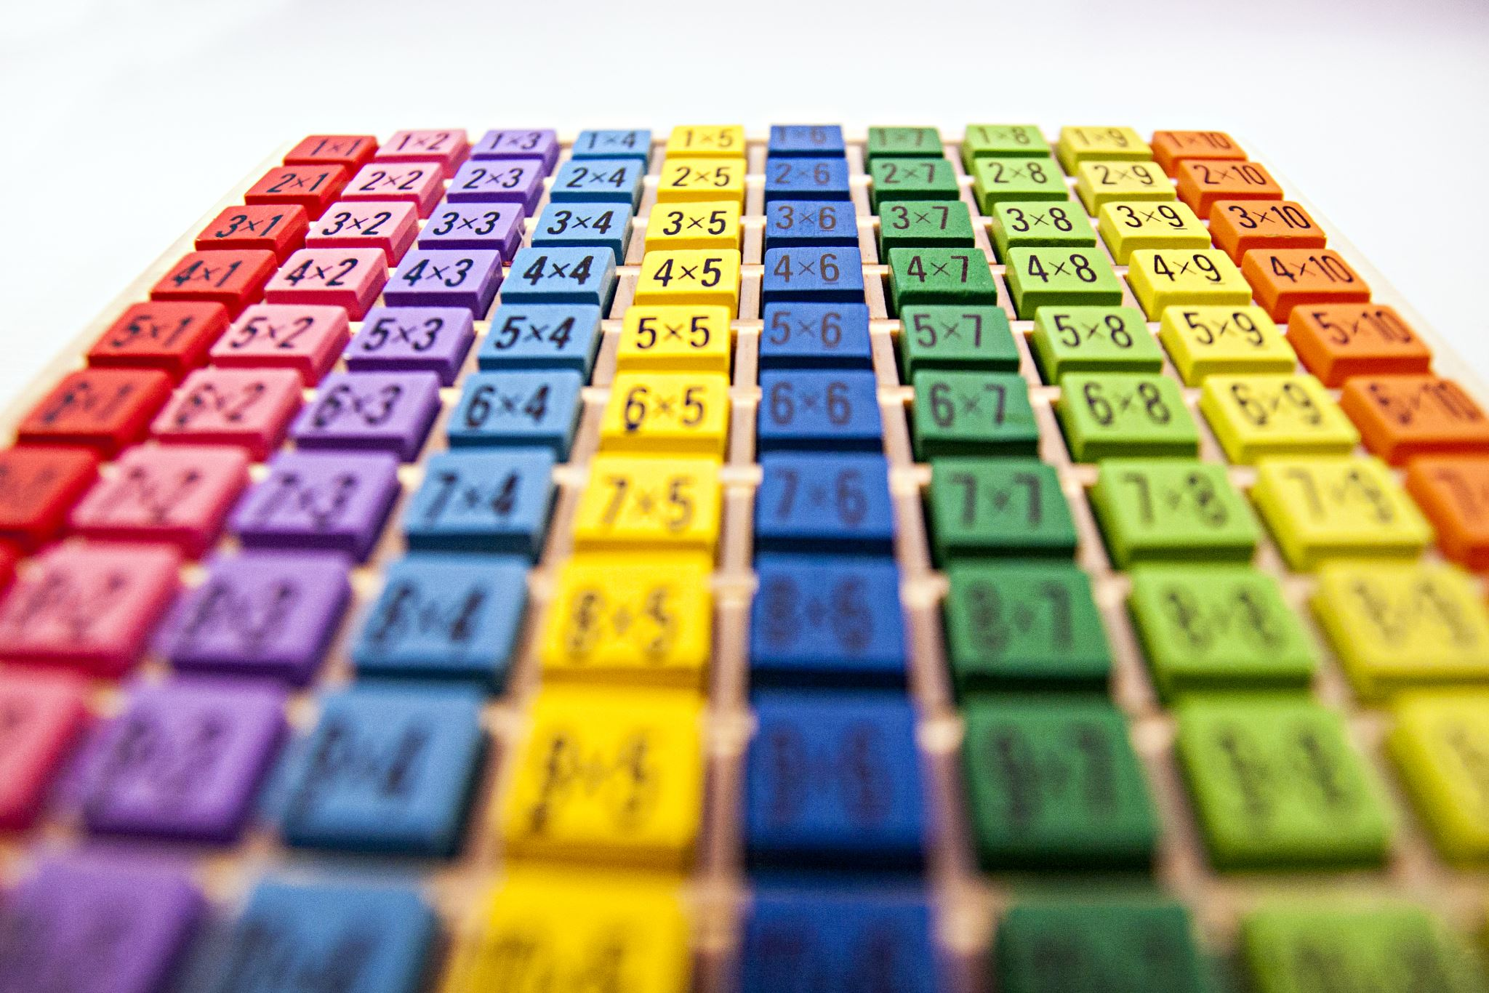
Methodology and Approach
Load images using a vision library with robust dataset utilities.
Convert to tensors and apply per channel normalisation with mean 0.5 and standard deviation 0.5.
Split the training set into training and validation partitions for fair selection.
Use mini batches of 64 to stabilise gradients and memory usage.
Optimise with Adam using cross entropy while tracking losses (Xin et al., 2023).
Notes:
The approach loads the dataset using a vision library, converts images to tensors, and applies per channel normalisation with mean 0.5 and standard deviation 0.5. We split the training set into training and validation partitions, use mini batches of 64, and train using Adam with cross entropy while tracking losses.

Slide 5
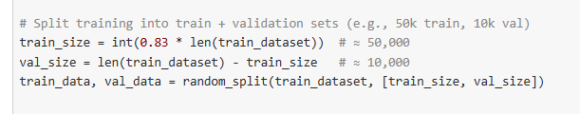

Data and Inputs
The dataset provides 60,000 training images and 10,000 test images.
There are 10 balanced classes with consistent label definitions.
Pixel values are centred to support stable optimisation dynamics.
The split uses 50,000 for fitting and 10,000 for validation.
Class mapping enables class wise reporting for meaningful insights (Sumera et al., 2022).
Notes:
The dataset contains 60,000 training images and 10,000 test images across 10 classes. Pixel values are scaled to centred units that aid optimisation stability. The training set is partitioned into 50,000 for fitting and 10,000 for validation. Class labels are balanced, which supports accuracy while monitoring per class performance fairly.

Slide 6
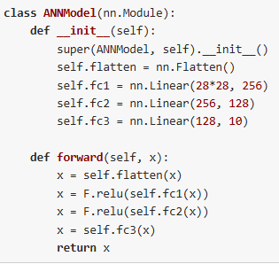
Implementation Details
The artificial neural network uses flatten, dense 256, dense 128, and an output of 10.
The convolutional model uses convolution 32, convolution 64, max pooling, dense 128, and output 10.
ReLU activations are applied throughout for effective nonlinearity.
Dropout at a rate of 0.25 regularises the convolutional model.
Batch processing ensures efficient throughput across the pipeline (Mukhamediev, 2024).
Notes:
The artificial neural network uses a flatten with two dense layers of sizes 256 and 128 and outputs of size 10. The convolutional model uses two convolution layers with 32 and 64 filters, max pooling, and two dense layers. Both models employ ReLU activations, dropout for regularisation, and batch processing.

Slide 7
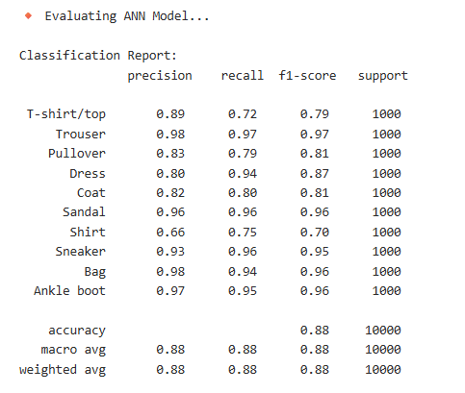
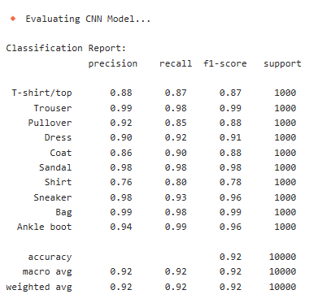
Results and Findings
Training uses Adam at learning rate 0.001 and cross entropy.
Artificial neural network trains for 10 epochs and achieves test accuracy 87.77.
Convolutional model trains for 5 epochs and achieves test accuracy 92.11.
Validation profiles show smooth convergence without instability.
Metrics indicate stronger generalisation from learned spatial features (Nocentini et al., 2022).
Notes:
Training used Adam at learning rate 0.001 with cross entropy over mini batches of 64. The artificial neural network trained for 10 epochs and achieved test accuracy 87.77. The convolutional model trained for 5 epochs and achieved test accuracy 92.11. Validation losses showed stable convergence without divergence or early overfitting.

Slide 8
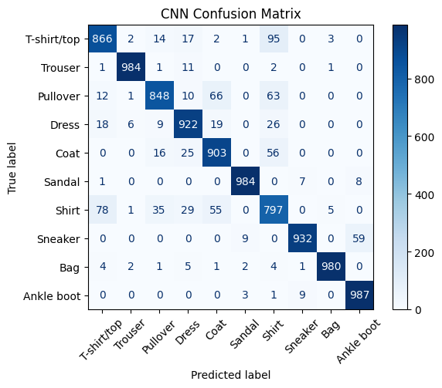
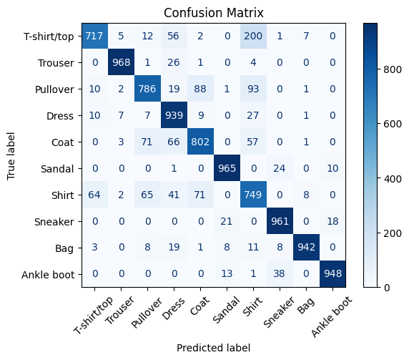
Discussion and Interpretation
Confusions matrices among shirt, coat, pullover, and T shirt due to shared shapes.
Convolutional features capture edges and textures that reduce these mix ups.
Distinctive classes such as trouser, sandal, sneaker, bag, and ankle boot remain strong.
Class wise precision and recall confirm stability across majority categories (Bbouzidi et al., 2024).
Error structure guides targeted improvements for tops and outerwear.
Notes:
Confusion matrices indicate frequent mix ups among shirt, coat, pullover, and T shirt due to similar silhouettes and textures. The convolutional model reduces these errors through learned spatial features but confusions remain. Precision and recall are strong for trouser, sandal, sneaker, bag, and ankle boot due to outlines and patterns.

Slide 9

Conclusion and Summary
Both models demonstrate full achievement of learning outcomes.
The convolutional model offers higher accuracy and clearer class separation.
The artificial neural network remains a transparent baseline for instruction.
Evaluation integrates accuracy, confusion matrices, and class wise reporting.
Recommendation prioritises the convolutional model for practical use and summative grading.
Notes:
Both models satisfy learning outcomes by demonstrating preprocessing, implementation, and evaluation. The convolutional model is preferred due to higher accuracy and improved class separation. Executive recommendation is to adopt the convolutional model for deployment and to track per class metrics routinely. This informs targeted improvements and performance across similar categories.

Slide 10

Future Work and Acknowledgments
Introduce moderate augmentation using rotations, translations, random crops, and contrast jitter.
Apply label smoothing and a cosine learning rate schedule for improved calibration.
Explore a deeper convolutional baseline with batch normalisation and extra pooling.
Use class balanced sampling to support challenging categories.
Document pipeline choices and demonstrate the system live.
Notes:
Proposed improvements include moderate augmentation that preserves class identity, label smoothing, and a cosine learning rate schedule. A deeper convolutional baseline with batch normalisation and an additional pooling stage can further improve representation. The Documentation will help in finding the evidence and also in reproducibility.

Slide 11
References
Xin, J., Yi, T.J., Yi, V.P., Yu, P.J. and Salam, Z.A.A., 2023. Convolutional neural network for fashion images classification (Fashion-MNIST). Journal of Applied Technology and Innovation, 7(4), p.11.
Sumera, S.R., Anjum, N. and Vaidehi, K., 2022. Implementation of CNN and ANN for Fashion-MNIST-Dataset using Different Optimizers. Indian Journal of Science and Technology, 15(47), pp.2639-2645.
Mukhamediev, R.I., 2024. State-of-the-Art Results with the Fashion-MNIST Dataset. Mathematics, 12(20), p.3174.
Nocentini, O., Kim, J., Bashir, M.Z. and Cavallo, F., 2022. Image classification using multiple convolutional neural networks on the fashion-MNIST dataset. Sensors, 22(23), p.9544.
Bbouzidi, S., Hcini, G., Jdey, I. and Drira, F., 2024. Convolutional neural networks and vision transformers for fashion mnist classification: A literature review. arXiv preprint arXiv:2406.03478.

