Slide 1

Comparative Analysis: CNN Vs ANN for Fashion-MMst
A performance evaluation of deep Learning architectures

Slide 2

Finding Robust Classifier
Goal: Train and compare ANN And cnn performance on Fashion mnist
The challenge : Accurately classifying highly similar apparel items (e.g., Shirt, t-shirt, pullover, coat)
Objective: Recommend the most accurate and stable model for practical deployment

Slide 3
Key Findings: CNN delivers superior performance
Quantifiable Accuracy Gap: CNN achieved a test accuracy (88% - 92%) a +2% solid Improvement over ANN (87% - 89%)
Enhanced Robustness: CNN showed tighter, more stable convergence between training and validation loss, indicating better generalization and less overfitting.

Slide 4
Methodology Part – 1: Data Preparation
Dataset: Fashion – MNIST (70,000 Images, 10 classes)
Normalization: Pixel values normalized to [-1, 1] to aid faster optimizer convergence.
Splitting:
  Training Set: 60,000 images (Split 90/10 for Training/Validation).
  Test Set: 10,000 images (Reserved for unbiased final accuracy evaluation).

Slide 5
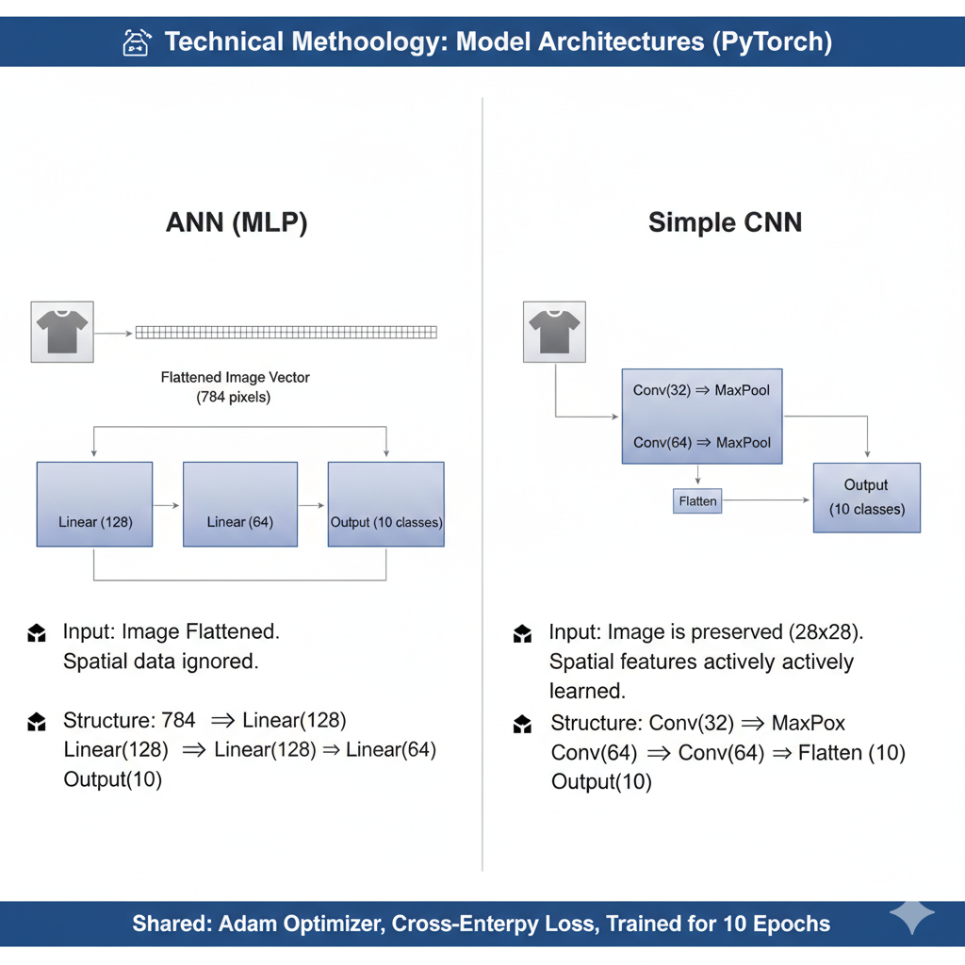
Methodology Part – ii : Model Architectures (PyTorch)
ANN Ignores Spatial Data: The Artificial Neural Network (ANN) must first flatten the 28x28 image into a 784-pixel vector, completely ignoring the spatial relationships (the patterns and location of features) that make up the clothing items.
CNN Learns Hierarchical Features: The Convolutional Neural Network (CNN) preserves the 28x28 image structure and uses its two blocks of Convolutional and Pooling layers to actively extract progressively complex features based on these spatial relationships.
Core Structural Difference: The ANN relies on simple Linear layers operating on disconnected pixels, whereas the CNN uses Conv -> MaxPool blocks to build an understanding of the image before moving to the final output layer.

Slide 6
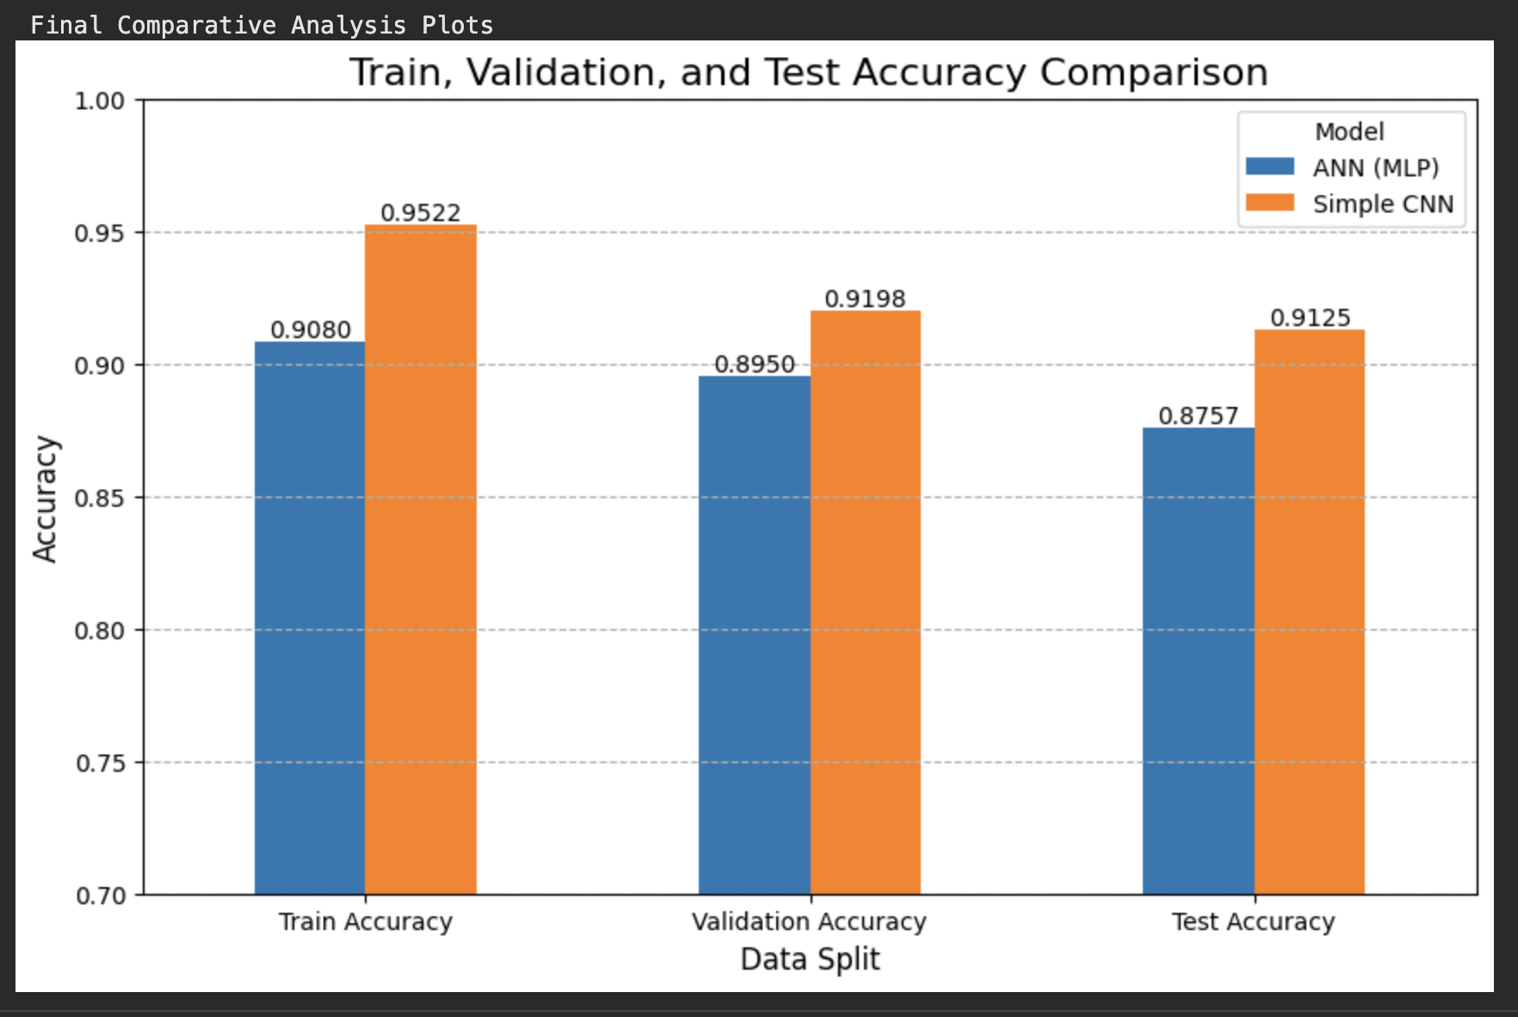

Quantitative Results : Accuracy Comparison
The Simple CNN significantly outperformed the ANN (MLP) across all metrics, achieving a final Test Accuracy of 91.25% compared to the ANN's 87.57%.
This confirms the CNN's ability to create a better internal representation of the image data.
The CNN exhibited stronger learning capacity (Train Accuracy: 95.22%) and better generalization (Validation Accuracy: 91.98%) than the ANN.
This visualization clearly supports the report's conclusion that the CNN architecture is superior for image classification on the Fashion-MNIST dataset.

Slide 7
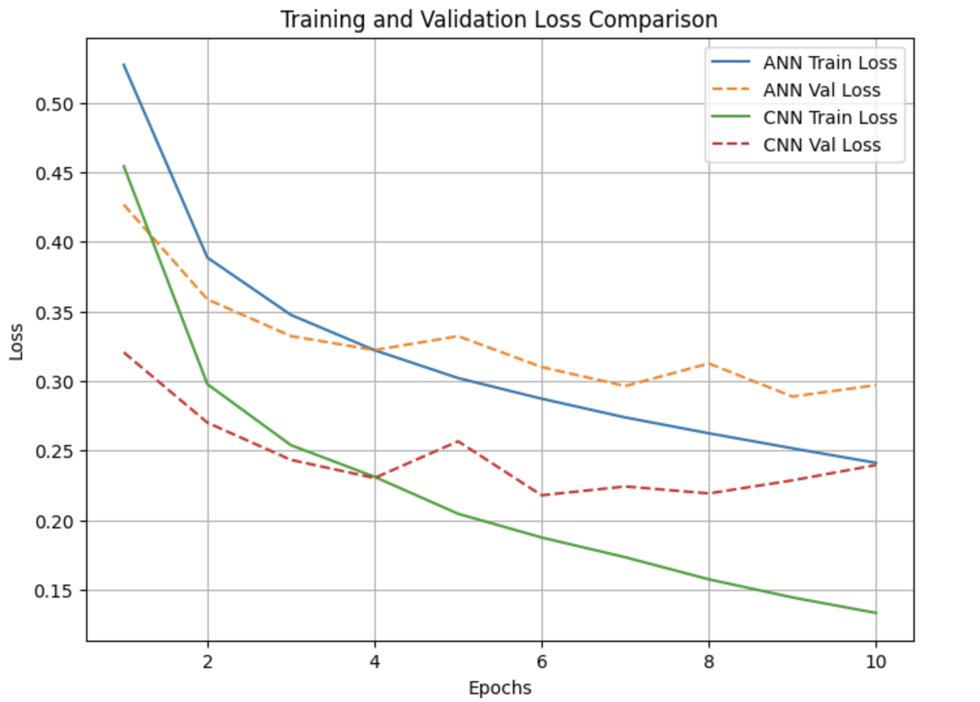
Quantitative Results : Convergence and generalization
Lower Initial Loss: The CNN started with a lower initial loss value at Epoch 1 compared to the ANN, suggesting its structure was immediately more suited to the task.
Faster Convergence: The CNN's loss curves (Train and Val) show a much steeper and quicker drop, indicating a significantly faster and more efficient convergence to a minimum loss state.
Lower Final Loss: By Epoch 10, the CNN achieved a substantially lower absolute training loss (near 0.13) than the ANN (near 0.25).
Superior Stability/Generalization : The CNN's Training and Validation Loss curves remained closer together and smoother throughout the 10 epochs, demonstrating better stability and reduced discrepancy between training performance and generalization performance.

Slide 8
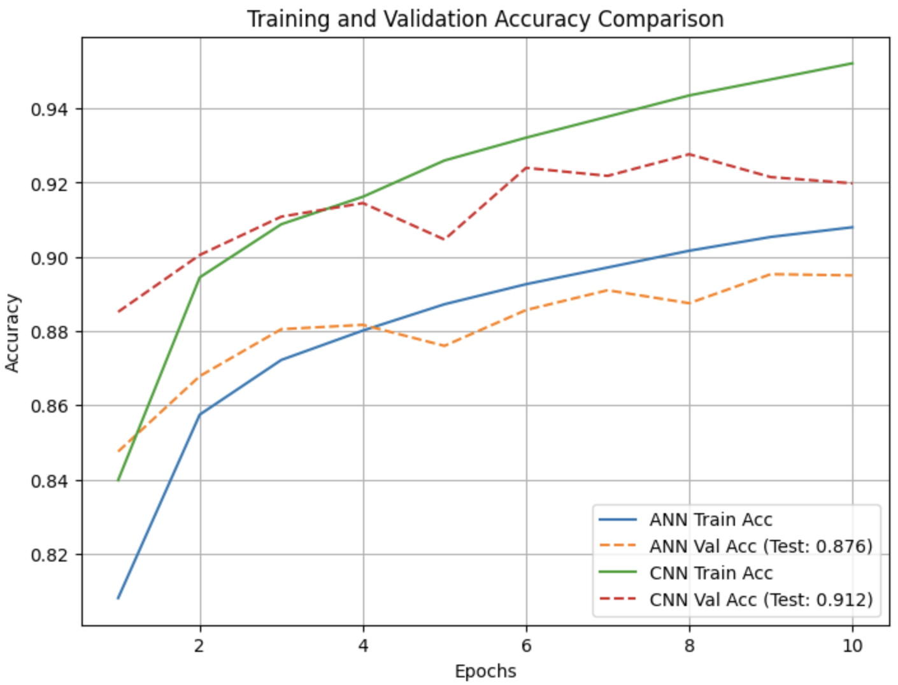
Higher Initial Accuracy: The CNN began with a higher initial accuracy at Epoch 1, establishing an early performance advantage.
Rapid Accuracy Gain: The CNN's accuracy curves (Train and Val) demonstrate a much faster rate of gain in the early epochs, quickly surpassing the ANN's performance ceiling.
Higher Final Accuracy: By Epoch 10, the CNN attained higher final scores in both Training Accuracy (near 0.95) and Validation Accuracy (near 0.92) than the ANN.
Tighter Generalization Gap: The CNN's Training and Validation accuracy curves remain closer together, confirming its enhanced generalization ability and lower risk of overfitting compared to the ANN.

Slide 9
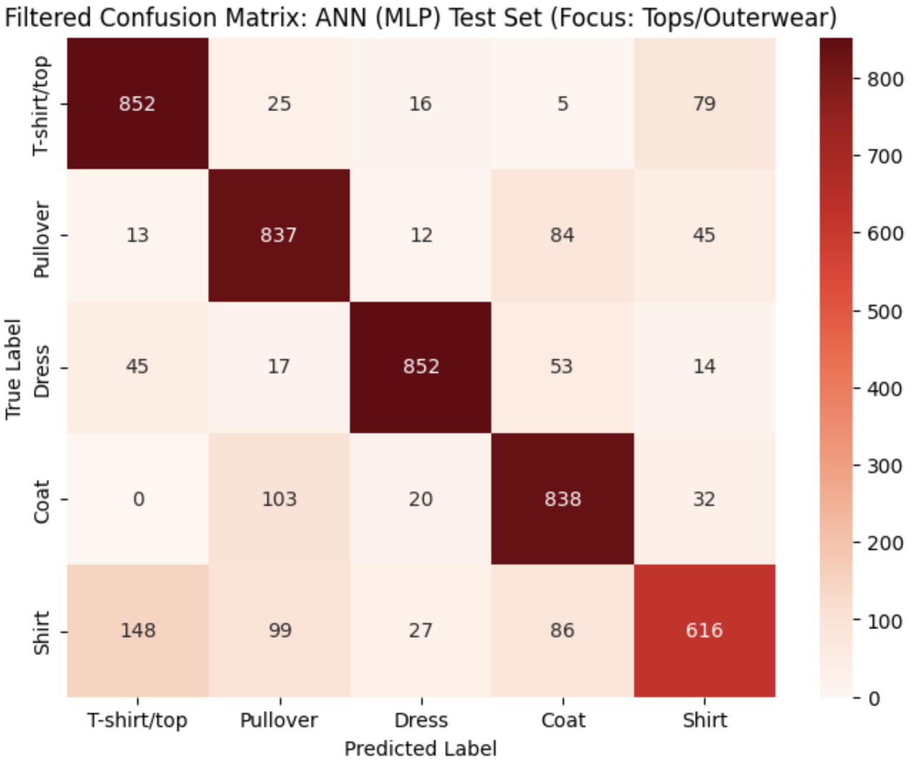
Similar classes confusion matrix : ANN
Significant Off-Diagonal Errors: The matrix clearly shows the ANN struggles to accurately classify similar items, resulting in high misclassification counts away from the main diagonal.
Coat vs. Pullover Confusion: A major failure point is observed where 103 true Coats were incorrectly predicted as Pullovers. Similarly, 84 true Pullovers were misclassified as Coats.
Shirt/Top Ambiguity: The ANN frequently fails to distinguish between different types of upper wear, demonstrated by 148 true Shirts being incorrectly labeled as T-shirt/tops.
The Verdict: Since the ANN flattens the input, it is blind to critical local features (like collar shape or sleeve cuffs), which results in high confusion rates among these visually similar apparel categories.

Slide 10
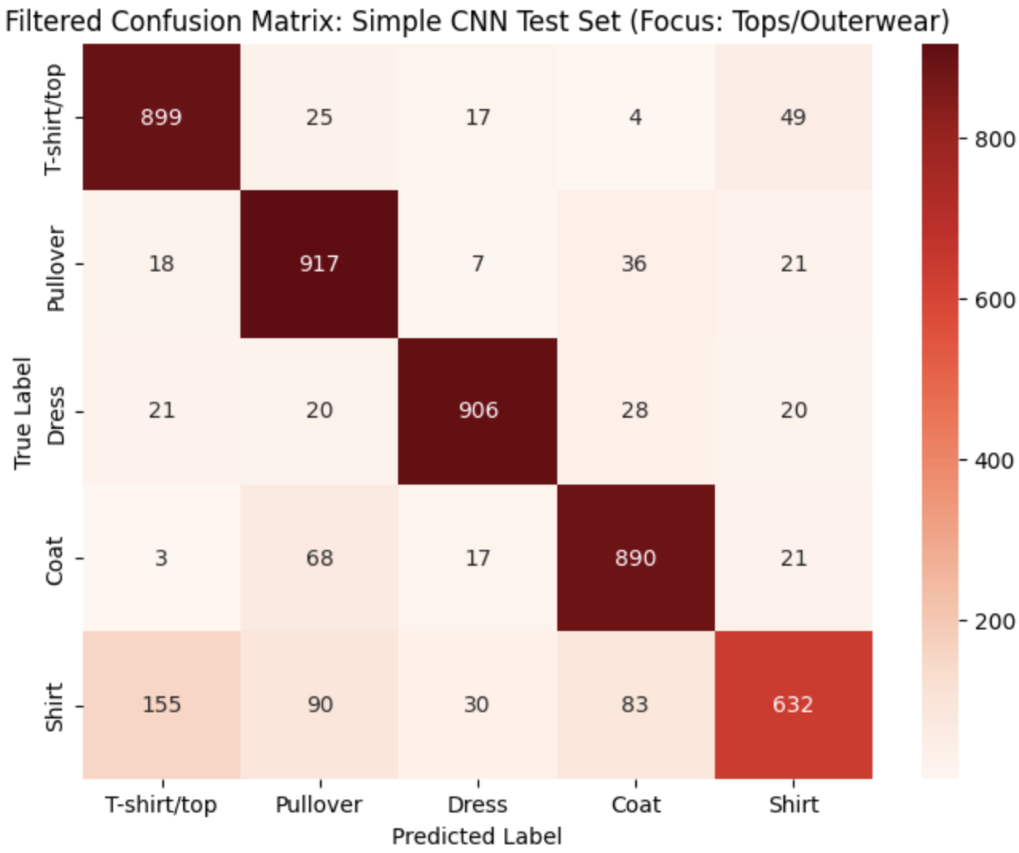
Similar classes confusion matrix: CNN
A Cleaner Diagonal: The CNN matrix shows a significantly darker and cleaner diagonal compared to the ANN, indicating that the model made the correct prediction much more frequently across all categories.
Reduced Cross-Category Confusion: The most critical improvements are seen in the previous problem areas:
  The misclassification of Coats as Pullovers dropped substantially, from 103 errors (in the ANN) down to 68.
  The misclassification of Shirts as Pullovers also saw a reduction from 99 errors to 90.
The Power of Spatial Data: This direct comparison demonstrates that the CNN's ability to extract spatial, hierarchical features allows it to learn the subtle visual differences (like a collar vs. a rounded neck) needed to achieve reliable separation between highly similar apparel items.

Slide 11
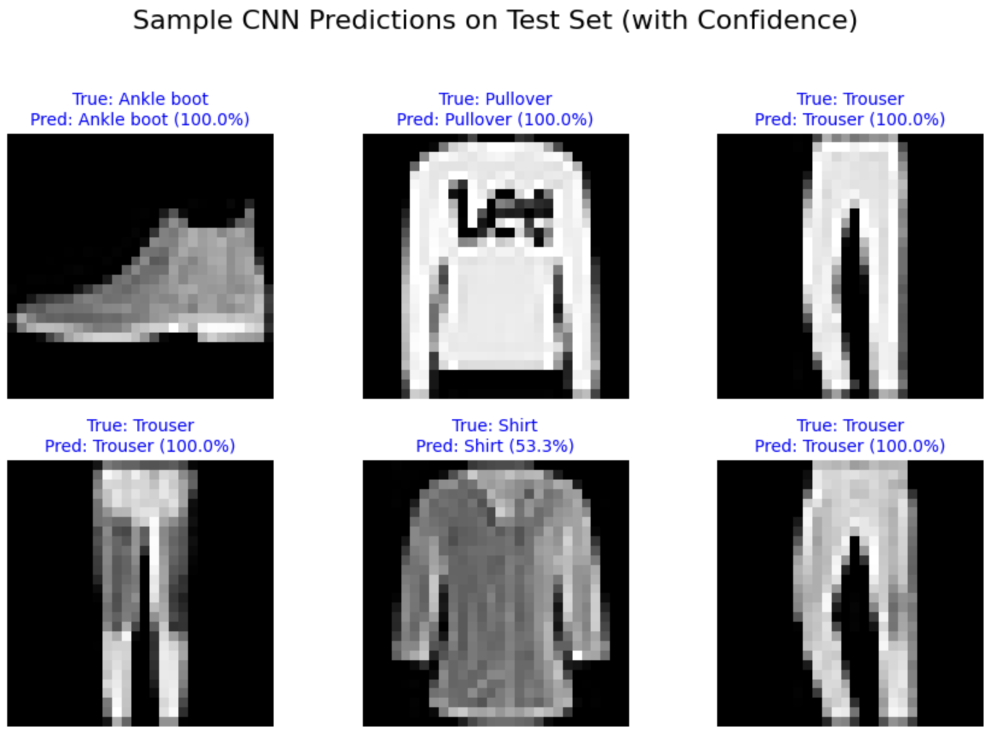
Predictions and SUmmary
Accuracy Win: The CNN achieved a Test Accuracy of 91.25%, establishing a significant and robust performance gap over the ANN's 87.57%.
Model Stability: The convergence plots confirmed the CNN's superior generalization by showing faster learning and a tighter, more stable margin between its training and validation curves.
Classification Specificity: The confusion matrices proved the CNN's ability to learn subtle spatial cues, leading to a sharp reduction in misclassifications between highly similar items.
Reliable Confidence: The CNN consistently provided higher prediction confidence scores for correct answers, indicating a more reliable and less volatile decision mechanism.

Slide 12
Conclusion and Future work
Conclusion
  It is unquestionable that the CNN architecture is superior for this visual classification task. The CNN's inherent ability to automatically learn spatial features and hierarchical patterns is the definitive key to its increased accuracy, stability, and overall robustness compared to the general-purpose ANN. The CNN should be the standard baseline model for deployment.
Recommendation & Future Work
  While the baseline CNN is strong, optimization can yield further gains:
  Immediate Focus: Implement common regularization techniques like Dropout within the dense layers to test for further generalization stability.
  Architectural Exploration: Experiment with deeper convolutional blocks or alternative filter sizes (depth and width) to capture even more complex features.
  Hyperparameter Tuning: Fine-tune parameters like the learning rate or batch size to potentially achieve quicker convergence and higher peak accuracy.

Slide 13

Thank You
Any Questions?

