Slide 1
Fashion-MNIST Classification

Slide 2
Introduction
The task on which the current project is built is the classification of the pictures of the Fashion-MNIST dataset under ten categories of shirts, coats and sneakers, among others.
The purpose of this is to develop, train, and test two deep learning networks: (ANN) Artificial Neural Network and (CNN) Convolutional Neural Network, both written in PyTorch.
Notes:
The comparison will be done in order to compare their performance, accuracy and recognition of visually similar fashion items.

Slide 3
Objectives / Goals
● To create and compare a model of Artificial Neural Network (ANN) and Convolutional Neural Network (CNN) with the topic of Fashion-MNIST image classification.
● To evaluate the performance of the models using the measurements of accuracy, loss and confusion matrix.
To identify the challenges and suggest a method of making the model more accurate and generalised.
Notes:
As described in the slide, the general objectives of the project are the development and comparison of ANN and CNN models, the evaluation of the performance of the models, and recommendations on how to improve the performance in order to realise the high accuracy and reliability of classification.

Slide 4
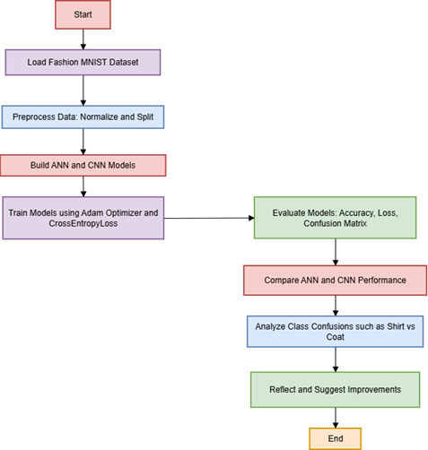
Methodology / Approach
● Basic ANN and CNN algorithms in PyTorch in Fashion-MNIST image recognition (Xhaferra et al. 2022).
● Before training, apathetic data is normalised, batched and optimised.
● Successfully made a comparison of the two models based on accuracy, loss curves, and confusion matrices.
Notes:
The slide has identified the model building process, including data preprocessing, ANN and CNN training on the basis of PyTorch and analysis of performance on the basis of the accuracy and loss, as well as the confusion matrix.

Slide 5
Data / Materials / Inputs
● The experiment was carried out on the basis of the Fashion-MNIST dataset containing 70,000 grayscale images of 10 types of clothing.
● ANN and CNN compatibility contain the data preprocessing and normalisation, along with reshaping.
● The size of the batch, learning rate, and image dimensions standardisation are some of these crucial parameters (Bbouzidi et al. 2024).
Notes:
The slide mentions the dataset and the materials along with Fashion-MNIST images, measures taken in preprocessing such as normalization and reshaping images and other parameters such as batch size, learning rate and image dimensions adjusted to the standard size of images to run the model uniformly.

Slide 6
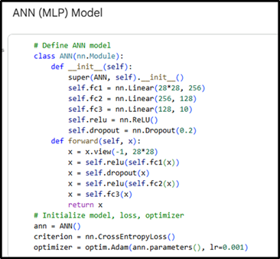
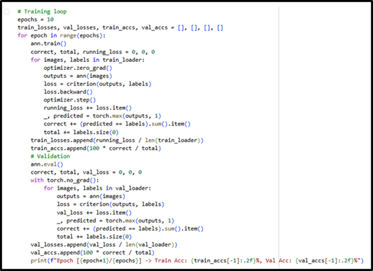
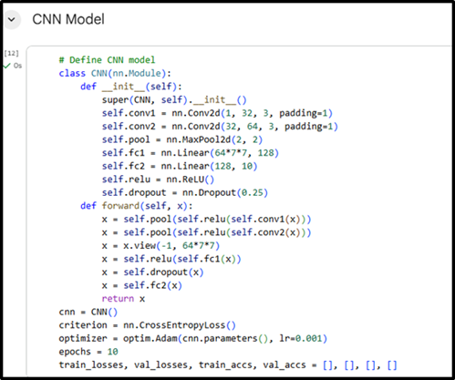
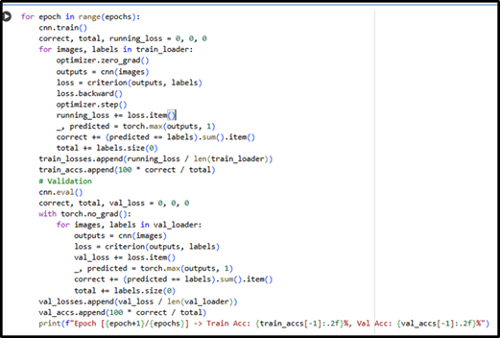
Implementation / Process
ANN Optimizer: Adam (learning rate = 0.001)
Loss Function: CrossEntropyLoss
Epochs: 10
Regularization: Dropout (0.2)
CNN Optimizer: Adam (learning rate = 0.001)
Loss Function: CrossEntropyLoss
Epochs: 10
Regularization: Dropout (0.25)
● Both models have been trained with the Adam optimiser, which is based on an adaptive learning ability since it integrates the advantages of momentum and RMSProp that resulting in swifter and sounder convergence.
Notes:
The CrossEntropyLoss function was selected as it is effective due to its multi-classification issues, as it compares the differences between the actual outcomes and the estimated outcomes via the prediction of probabilities.

Slide 7
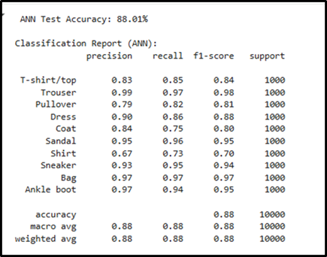
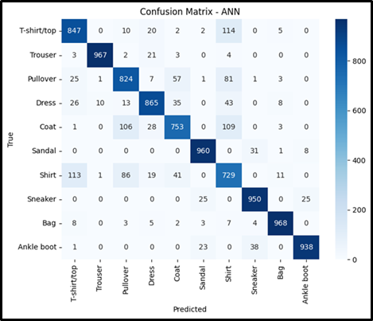
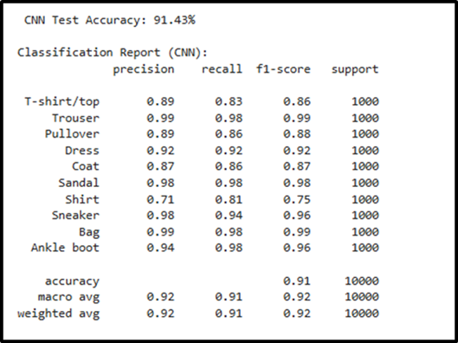
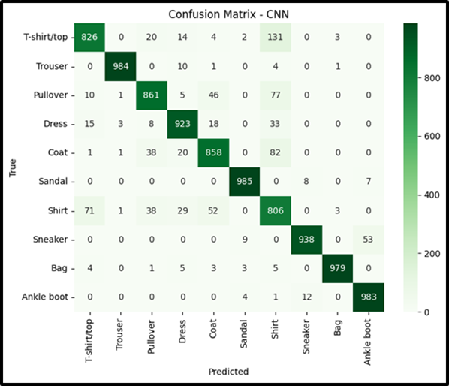
Results / Findings
● The ANN model had an overall accuracy of 88.01% which is decent.
● The confusion matrix reveals a high degree of diagonal dominance, which implies that most of the classes are highly accurate.
● The CNN had an accuracy of 91.43, thus scoring better than the ANN
● There is moderate confusion between T-shirt/top and Shirt (131) and Pullover and Coat (38) as visual similarity problems exist in some clothing types
Notes:
CNN had less confusion than the ANN, with lower misclassification rates of Shirt → Coat (5.2%), Shirt → Pullover (3.8%), and Pullover → Coat (4.6%), which meant that better visual features were extracted.

Slide 8
Discussion / Interpretation
● Findings show that CNN has a better performance because of spatial feature extraction.
● Misclassifications were mostly done between similar classes, which can be seen physically, such as shirts and coats.
● The dropout layers and validation monitoring were used to deal with training problems like overfitting (Nocentini et al. 2022).
Notes:
The slide has outlined major findings, the greater precision of CNN, the confusion in the similar classes and the effective training of the model under optimisation and regularisation of the model.

Slide 9
Conclusion / Summary
● The performance of both ANN and CNN was good in image classification.
● CNN performed better than ANN because it has a greater ability to learn its features.
● The project showed high competence in using deep learning to recognise fashion images
Notes:
The slide has explained the general findings, which were the overall summary of the model performance, the overall effectiveness of CNN, and the reaffirmation of the success of the project towards using neural networks to accomplish successful image classification of fashion images.

Slide 10
Future Work / Acknowledgments
● Next steps involve the incorporation of data augmentation and hyperparameter optimisation (Sumera et al. 2022).
● Developing more determined CNN structures.
● Credits to the Fashion-MNIST dataset and open-source tools, such as PyTorch, to make the experimentation possible.
Notes:
The potential work improvement ideas have been outlined in the slide regarding the future data augmentation and model tuning, and the fundamental resources and tools that enabled the creation of this project.

Slide 11
References
Bbouzidi, S., Hcini, G., Jdey, I. and Drira, F., 2024. Convolutional neural networks and vision transformers for fashion mnist classification: A literature review. arXiv preprint arXiv:2406.03478.
Nocentini, O., Kim, J., Bashir, M.Z. and Cavallo, F., 2022. Image classification using multiple convolutional neural networks on the fashion-MNIST dataset. Sensors, 22(23), p.9544.
Sumera, S.R., Anjum, N. and Vaidehi, K., 2022. Implementation of CNN and ANN for Fashion-MNIST-Dataset using Different Optimizers. Indian Journal of Science and Technology, 15(47), pp.2639-2645.
Xhaferra, E., Cina, E. and Toti, L., 2022, October. Classification of standard fashion MNIST dataset using deep learning based CNN algorithms. In 2022 international symposium on multidisciplinary studies and innovative technologies (ISMSIT) (pp. 494-498). IEEE.

Slide 12
THANK YOU…

