Slide 1
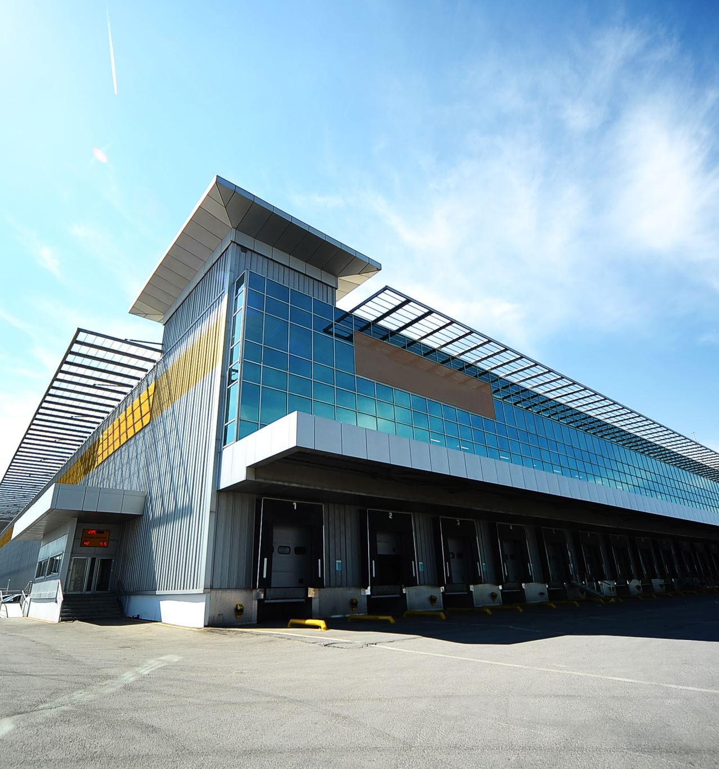
Kings Corp Real Estate Development
A data lead strategy to develop a new luxury housing community in King County

Slide 2

Outline
Business Problem
The Data
Methodology
Results
Recommendations

Slide 3

Business Problem
The company is currently too liquid and requires new investment propositions.
Use King County housing data to identify 3 core elements that King Corp can focus on in order to develop a successful high end luxury housing community.
Make sure to quantify results in order to finance to understand scalability*

Slide 4

Data
The data contains a range of features including square footage, bedrooms, location, a grade (based on a King County), and other variables.
Initial understanding of real estate markets will lead us to focus on square footage and location during model construction, but all other variables will be iterated through during modelling to determine any unseen relationships.

Slide 5
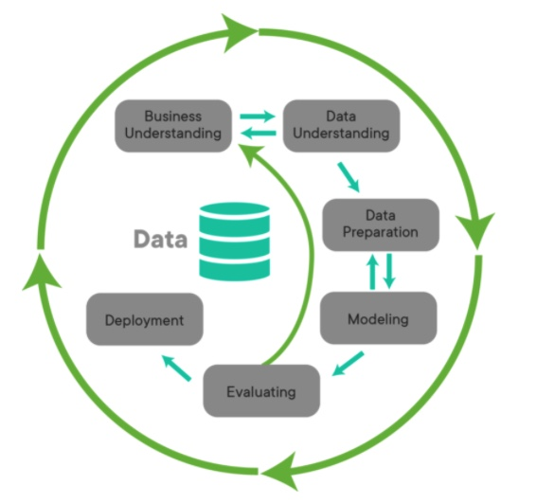
Methodology
1. Overview of Business Understanding
2. Data Understanding
3. Data Preparation
4. Modeling
5. Evaluation

Slide 6

Results:
Three features have clearly dominated our analysis:
Location – Specifically Waterfront Housing
King County Housing Grade
Size

Slide 7
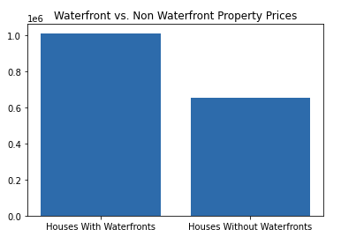
Location:
Waterfront Locations drive price higher than almost any other factor.
As seen in the graph to the right, the mean price for a waterfront house, with SQFT and Grade held constant, can be 55% higher than a non waterfront house.
Depending on sqft size and grade mix, incremental increase in pricing can range up to 3X

Slide 8
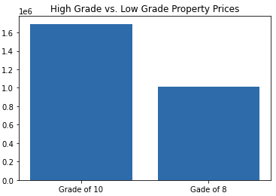
Grade:
Grade had the second highest impact on our model, displaying a potential increase of 21% increase in price between a house graded 10 and a house graded 8.
Further analysis into houses standardized at SQFT of 3k, with waterfront views showed that an increase in grade from 8 to 10 would result in price of up to 67%

Slide 9
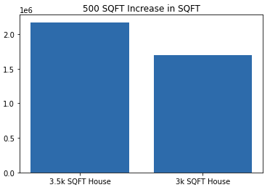
Size:
Size had the third largest impact on pricing. Specifically, when standardizing for grade and waterfront views, we found that a 500 SQFT increase in size could increase a home value by 28%

Slide 10
Deployment:
Develop a community with homes larger than 3k SQFT, Graded 10 or Higher by a waterfront community.

