Slide 1
Vulcano IB Bandwidth — Build 118 + Resp Rx S0 Optimizations
Perf 3 – 4 | IB Write & Write Immediate | Uni & Bi-direction
Build: 1.125.0-a-118 · vulcano-pulsar Resp Rx S0 opt (dbacf2e)
Q3_RX_AF_THRESHOLD=0x3e2 · Q3_RX_NAF_THRESHOLD=0x3da

Slide 2
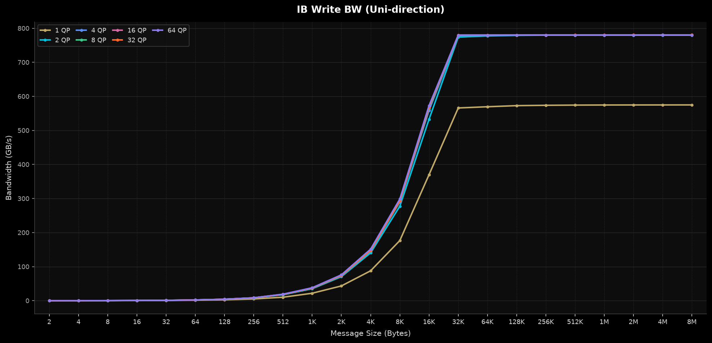
IB Write BW (Uni-direction)
Build 118 · vulcano-pulsar Resp Rx S0 opt (dbacf2e) · Perf 3–4

Slide 3
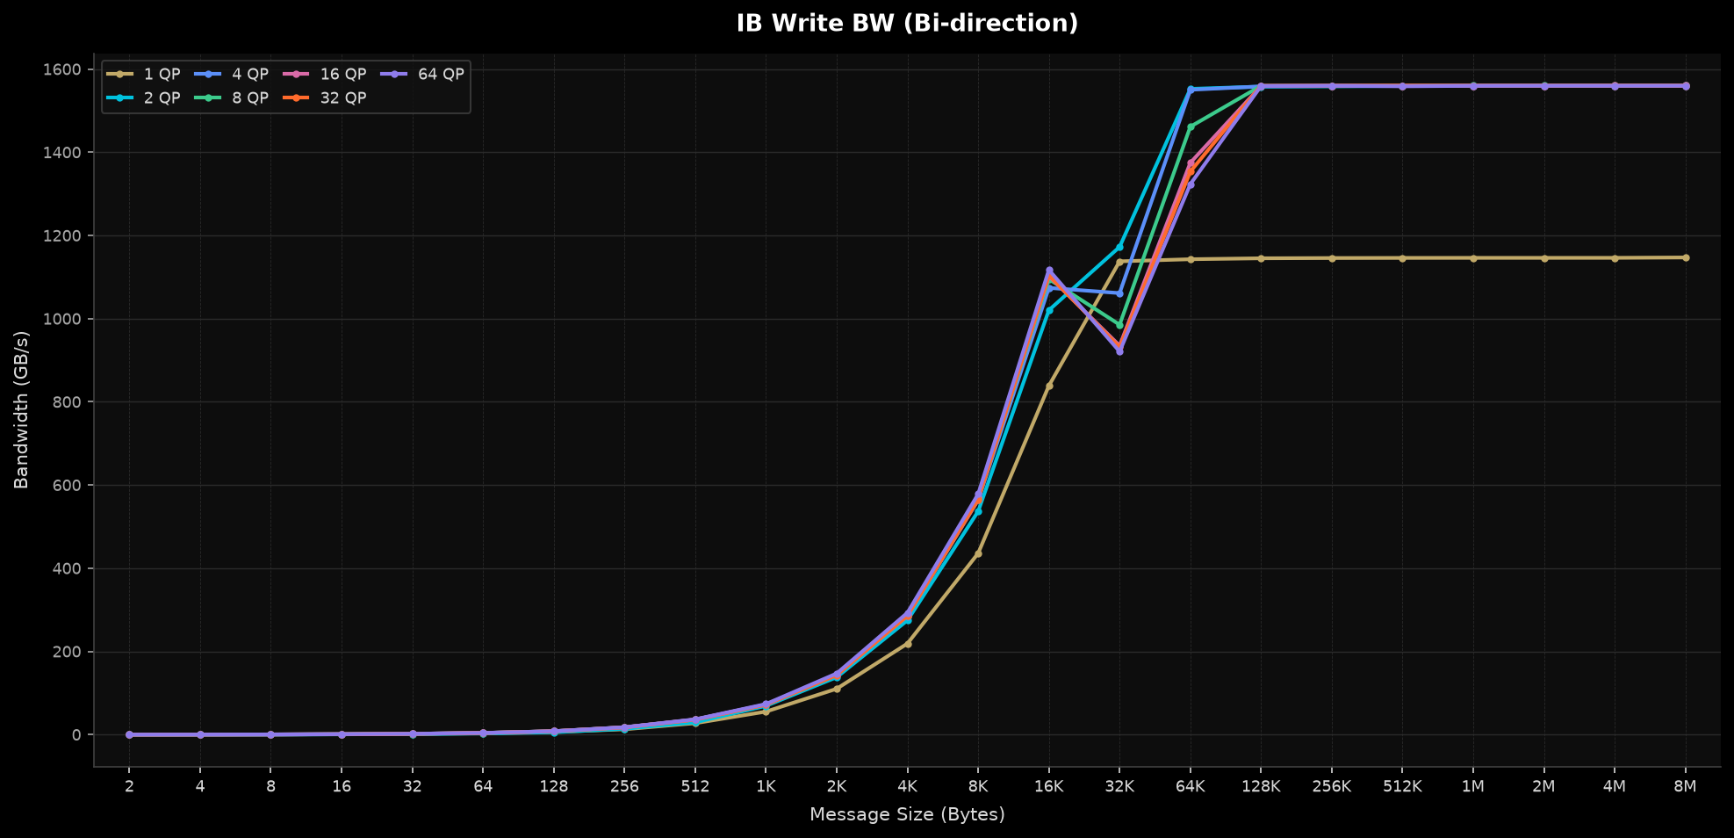
IB Write BW (Bi-direction)
Build 118 · vulcano-pulsar Resp Rx S0 opt (dbacf2e) · Perf 3–4

Slide 4
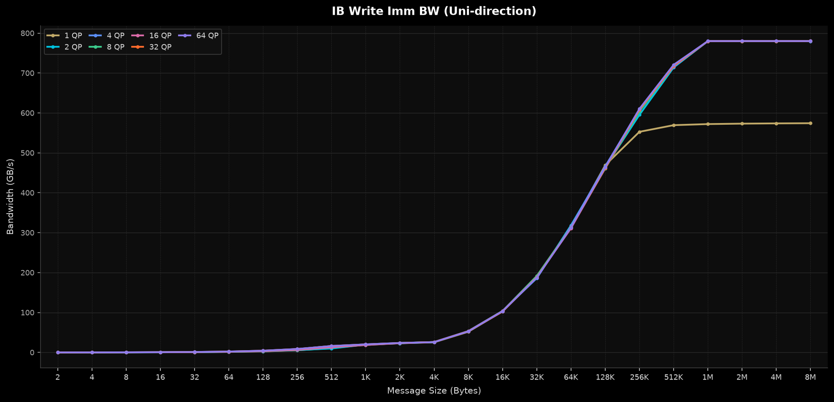
IB Write Imm BW (Uni-direction)
Build 118 · vulcano-pulsar Resp Rx S0 opt (dbacf2e) · Perf 3–4

Slide 5
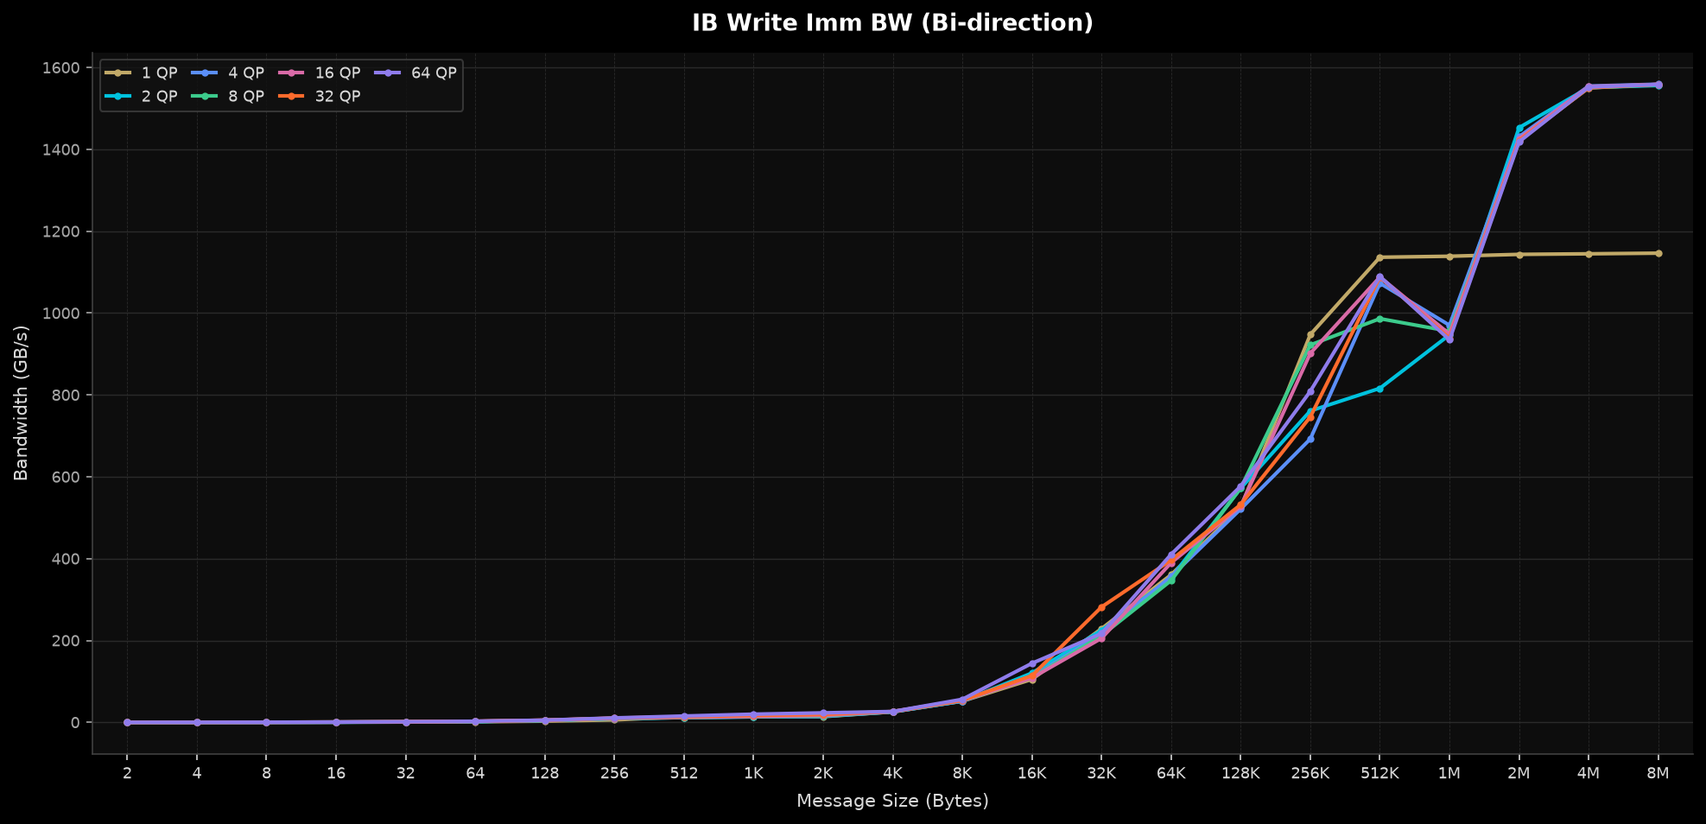
IB Write Imm BW (Bi-direction)
Build 118 · vulcano-pulsar Resp Rx S0 opt (dbacf2e) · Perf 3–4

Slide 6
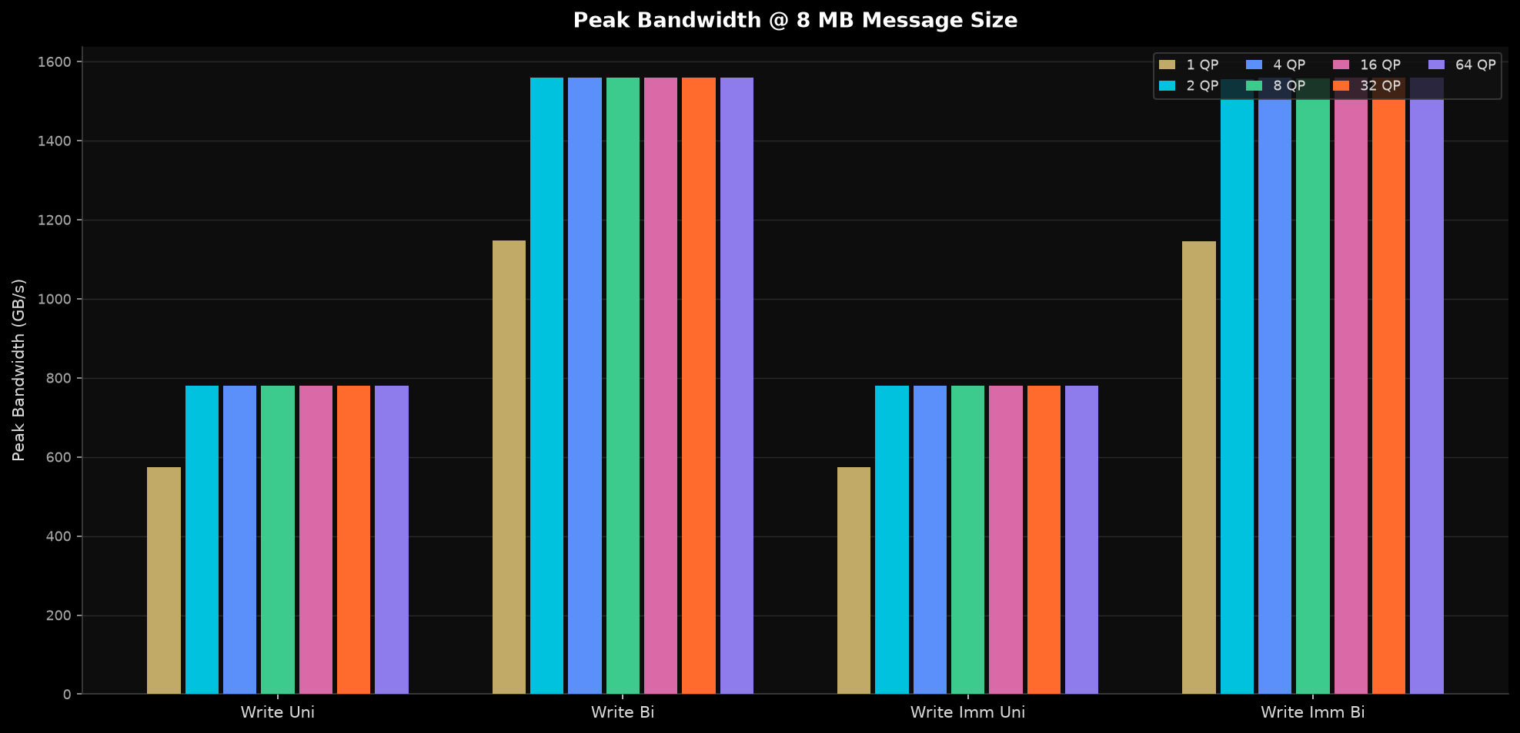
Peak Bandwidth Summary — All Tests @ 8 MB Msg Size
Build 118 · vulcano-pulsar Resp Rx S0 opt (dbacf2e) · Perf 3–4

Slide 7
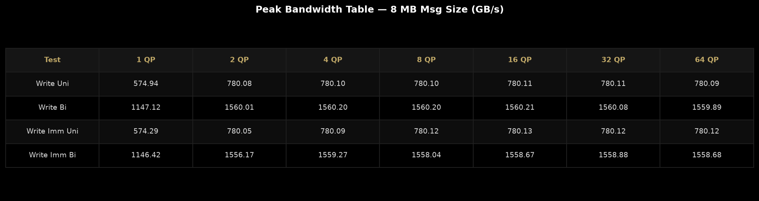
Peak Bandwidth Table — 8 MB Msg Size (GB/s)

Slide 8
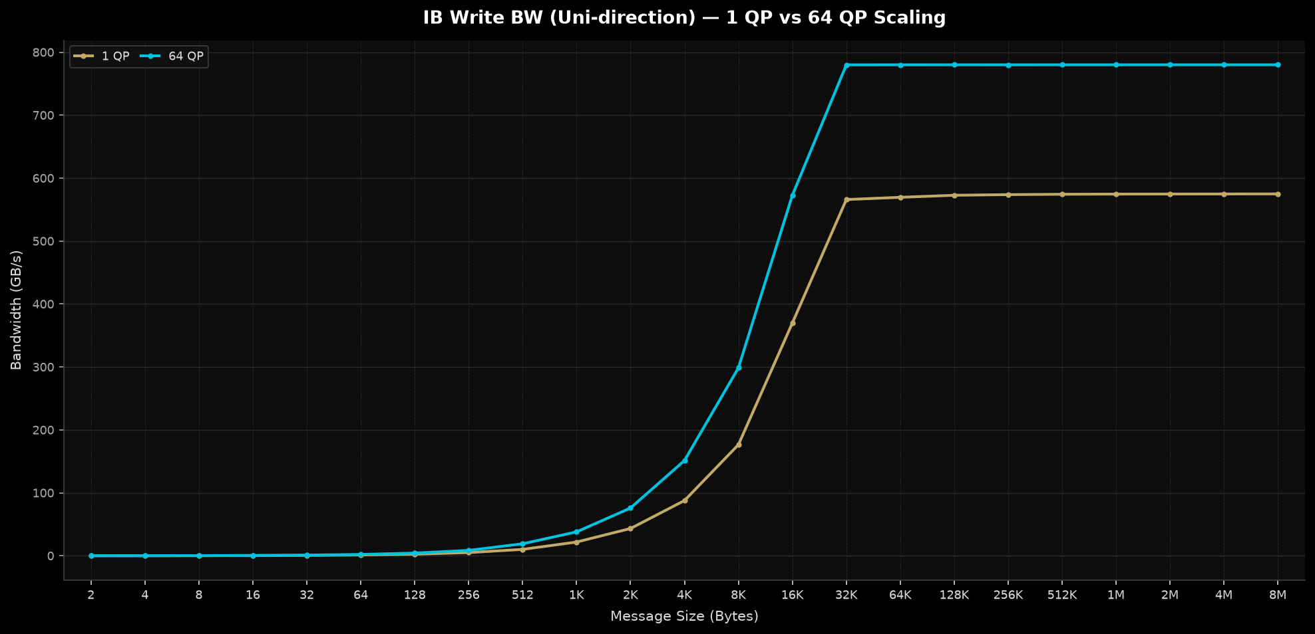
IB Write BW (Uni-direction) — 1 QP vs 64 QP
Build 118 · vulcano-pulsar Resp Rx S0 opt (dbacf2e) · Perf 3–4

Slide 9
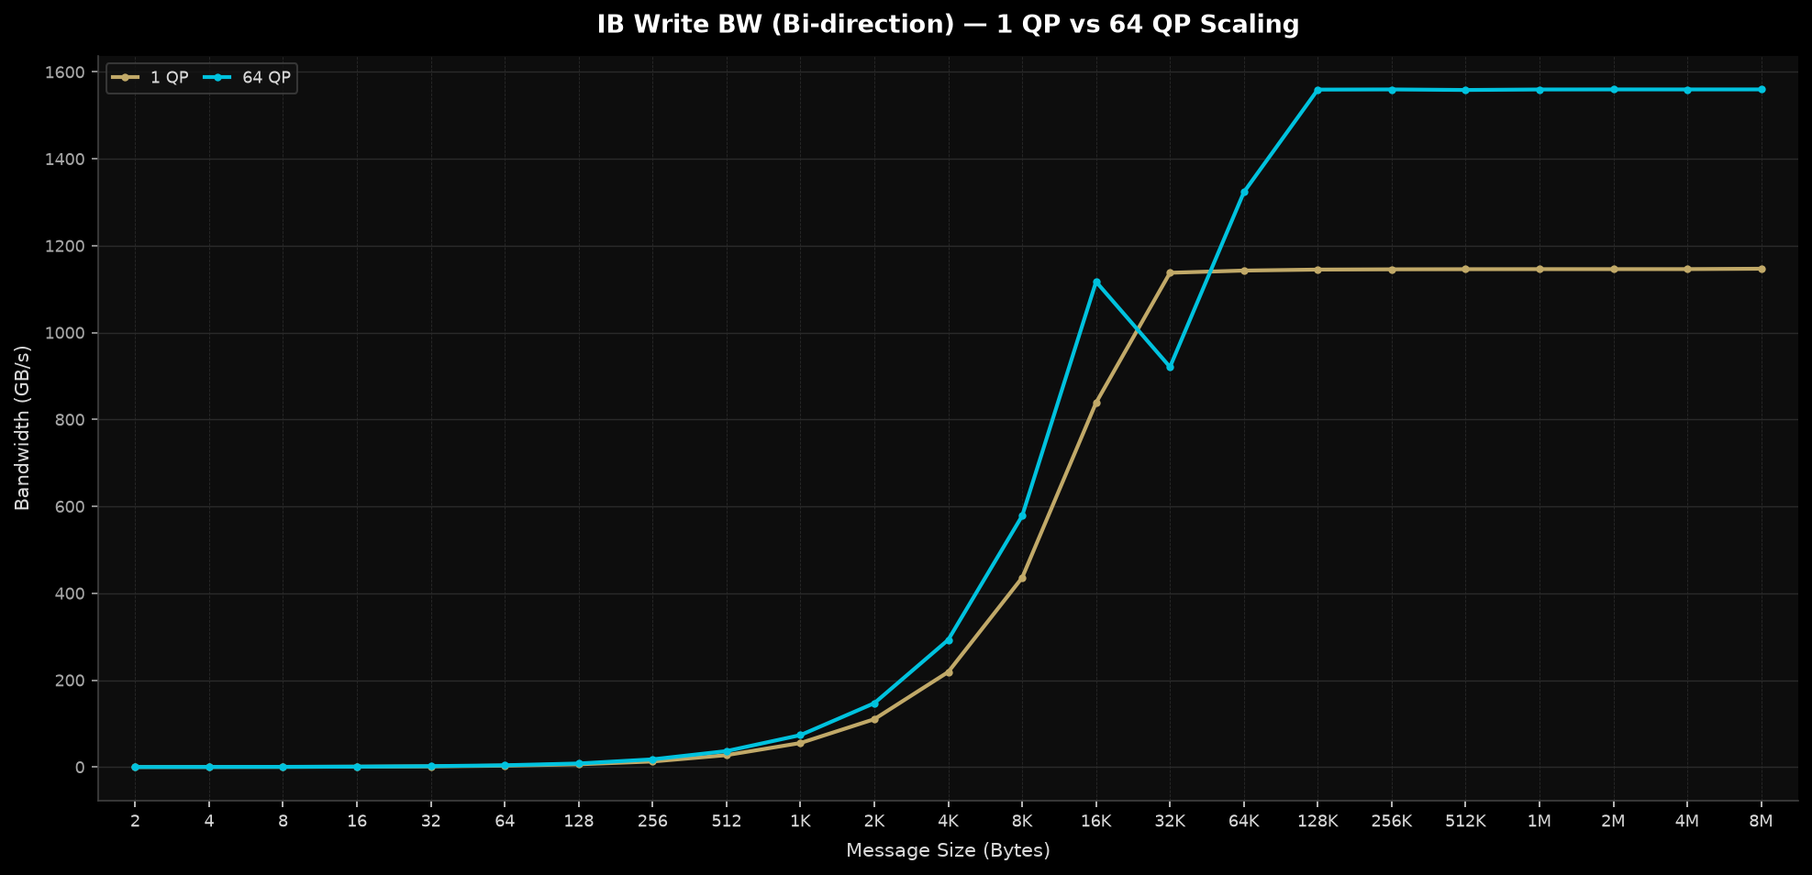
IB Write BW (Bi-direction) — 1 QP vs 64 QP
Build 118 · vulcano-pulsar Resp Rx S0 opt (dbacf2e) · Perf 3–4

