Slide 1
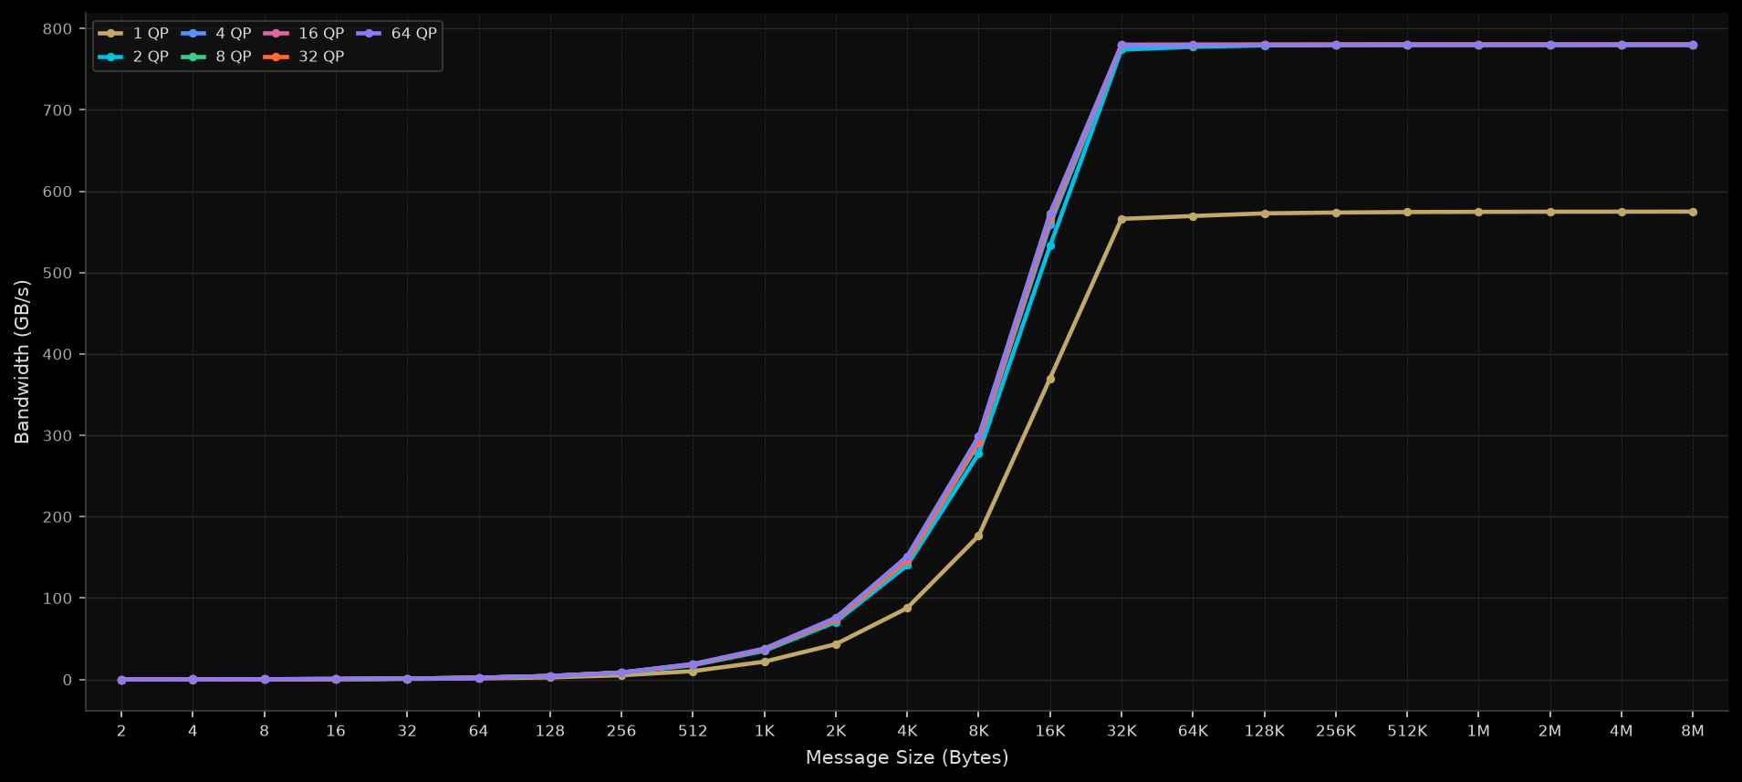
IB Write BW (Uni-direction) — Build 118 + Resp Rx S0

Slide 2
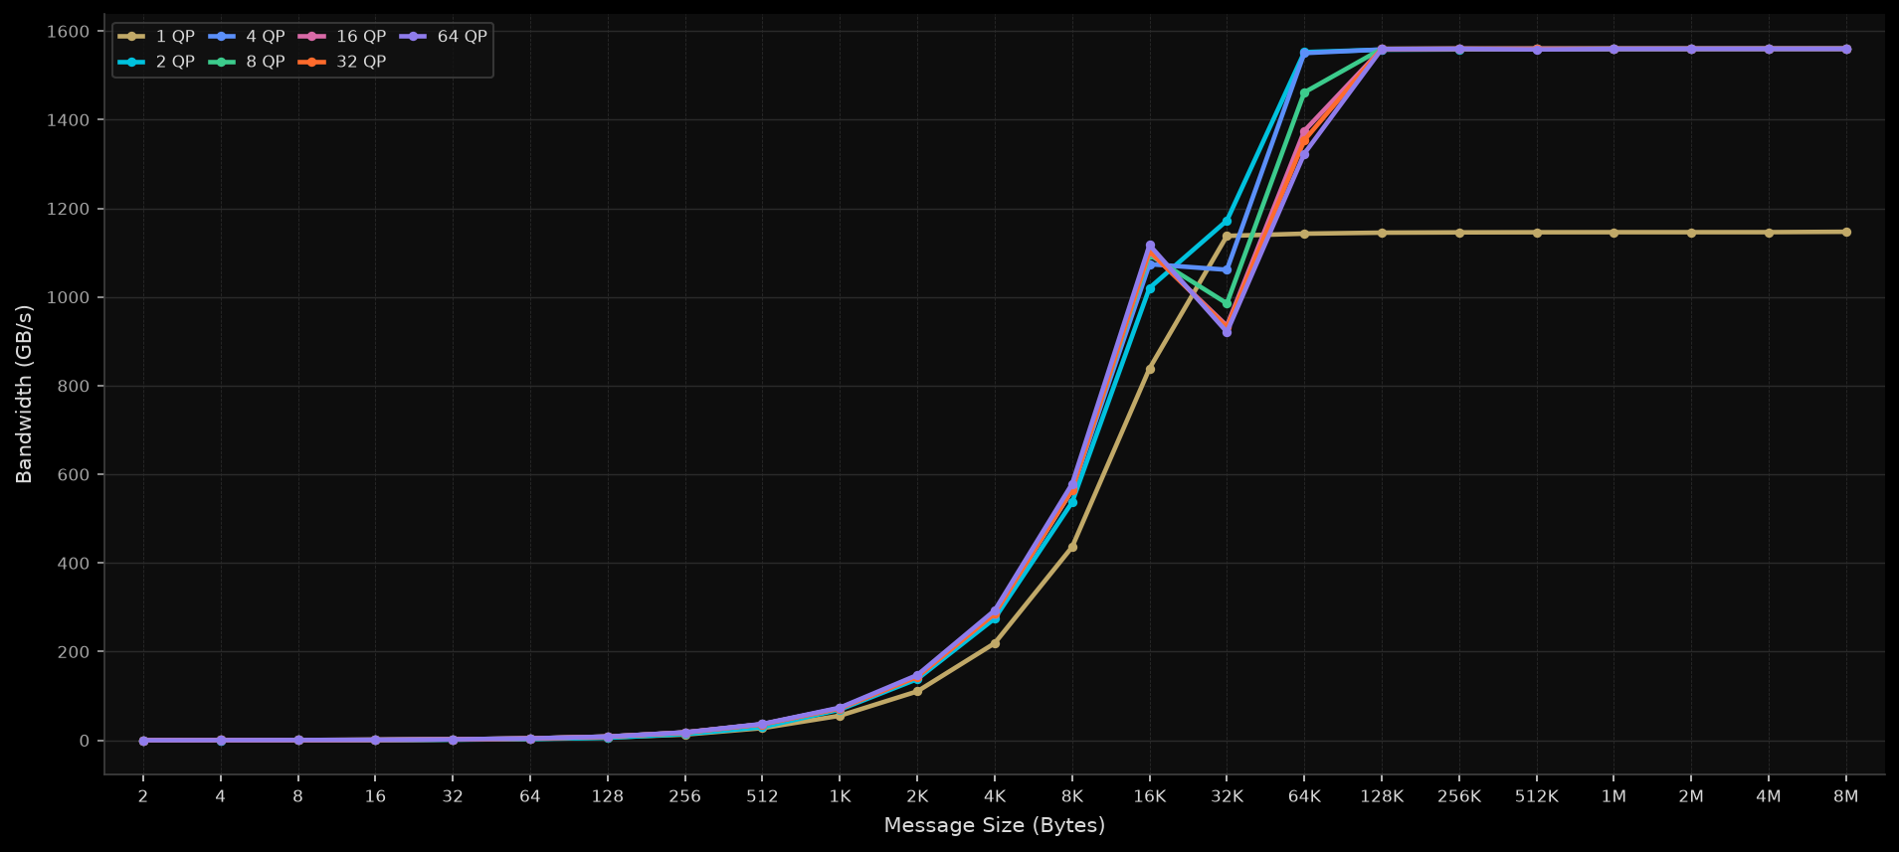
IB Write BW (Bi-direction) — Build 118 + Resp Rx S0

Slide 3
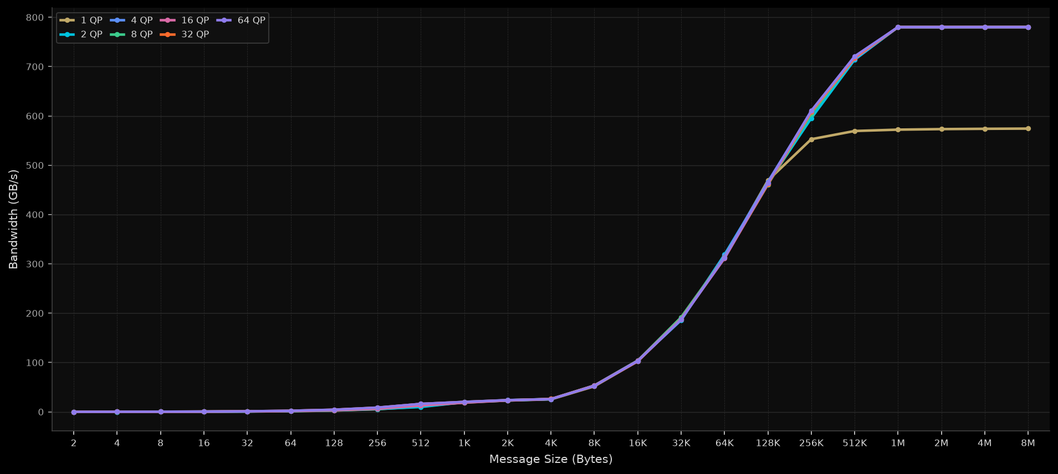
IB Write Imm BW (Uni-direction) — Build 118 + Resp Rx S0

Slide 4
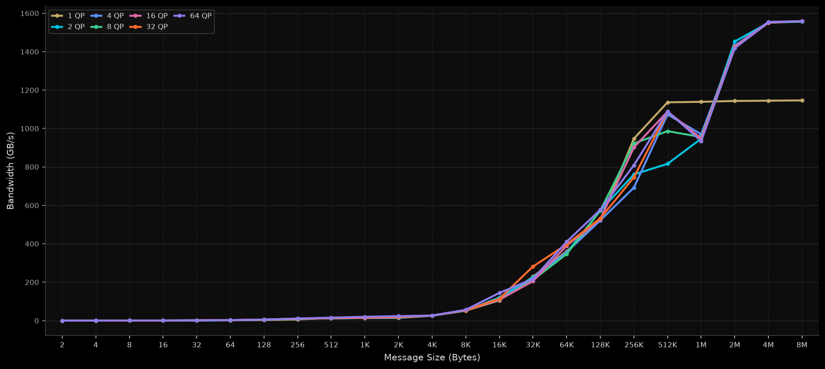
IB Write Imm BW (Bi-direction) — Build 118 + Resp Rx S0

