Slide 1
Docker: Containerization
Atul Kahate

Slide 2
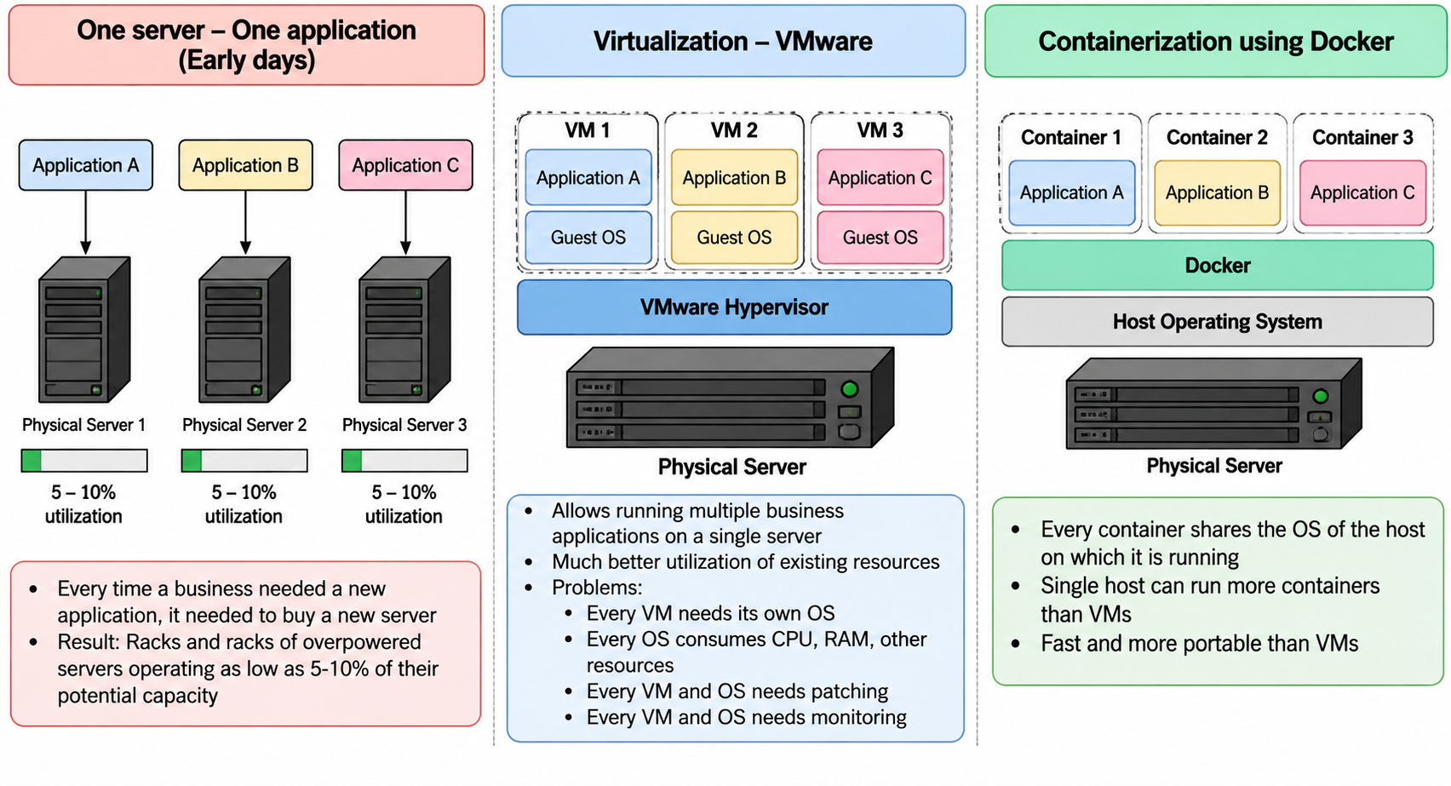

Slide 3
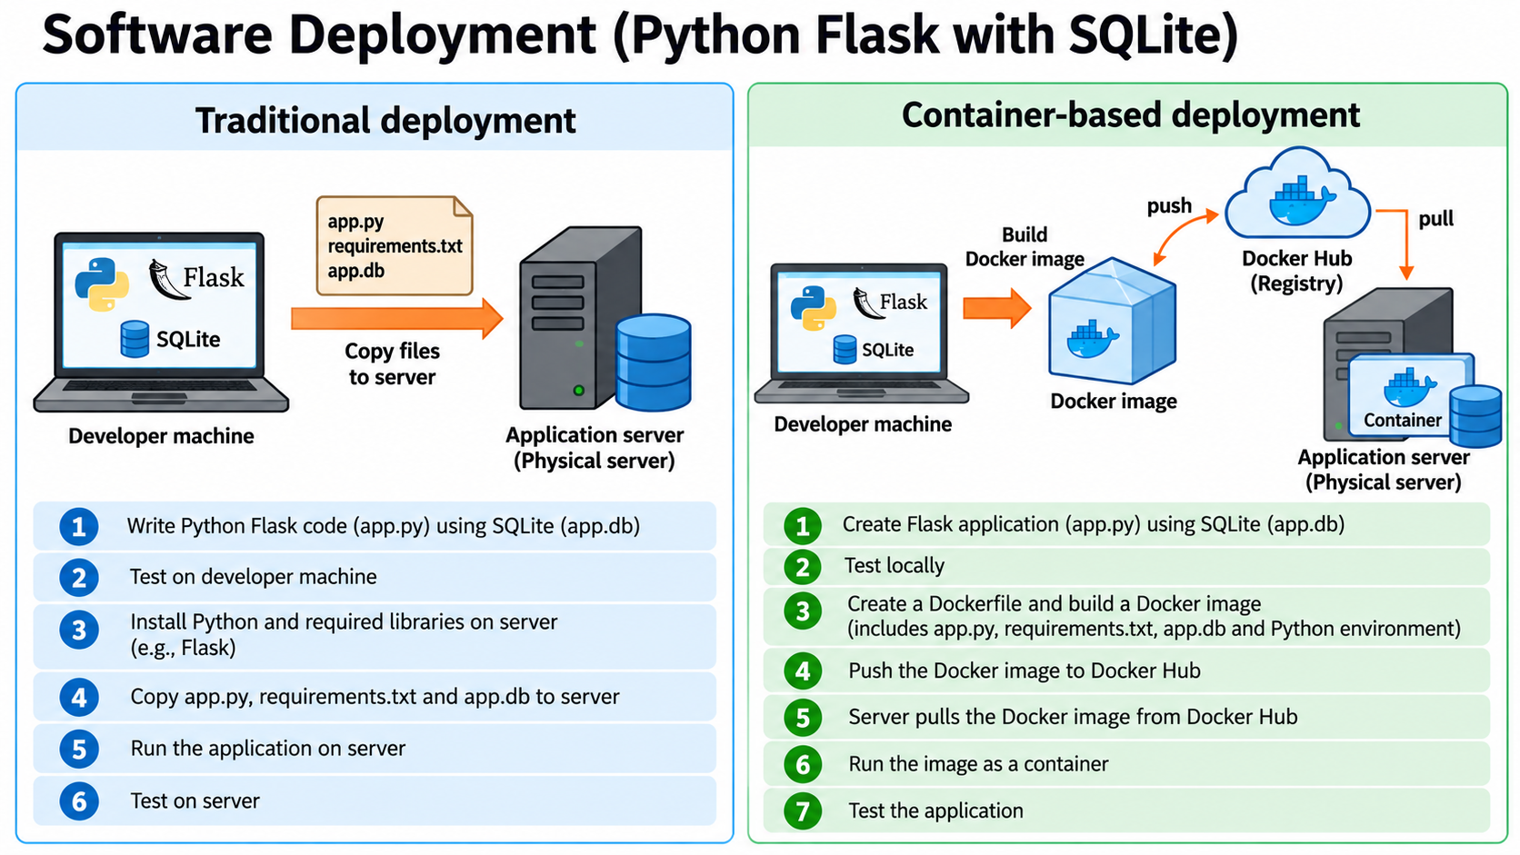

Slide 4


What is Docker?
HelloWorld.class
Docker: Container technology
Container = Complete and isolated software
Runs an application in a sandbox
Portable
Contains all dependencies
We can run several containers on a machine at the same time
Self-contained: Do not alter the host system they run on
Docker is light-weight, unlike VM
If something works in Development, it will work in Production, too

Slide 5
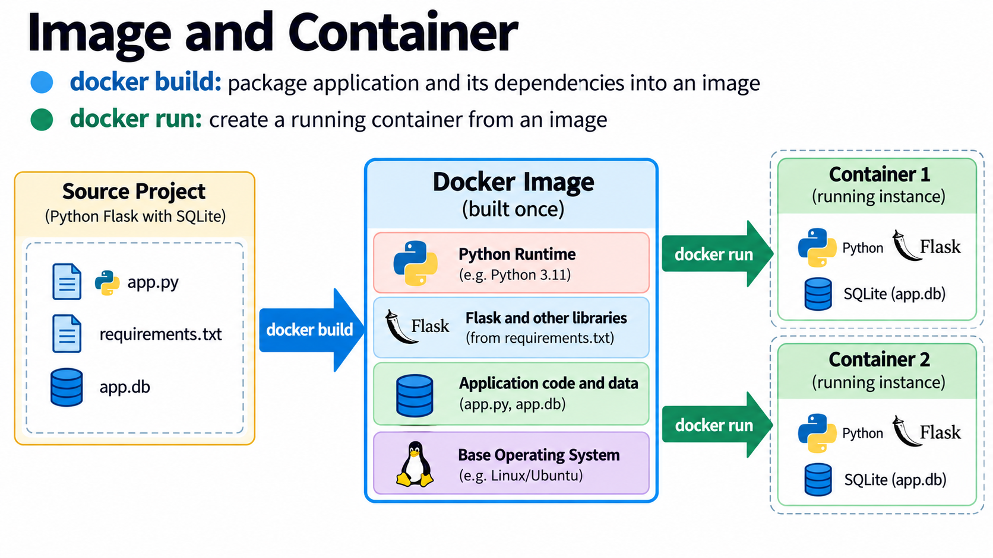

Slide 6
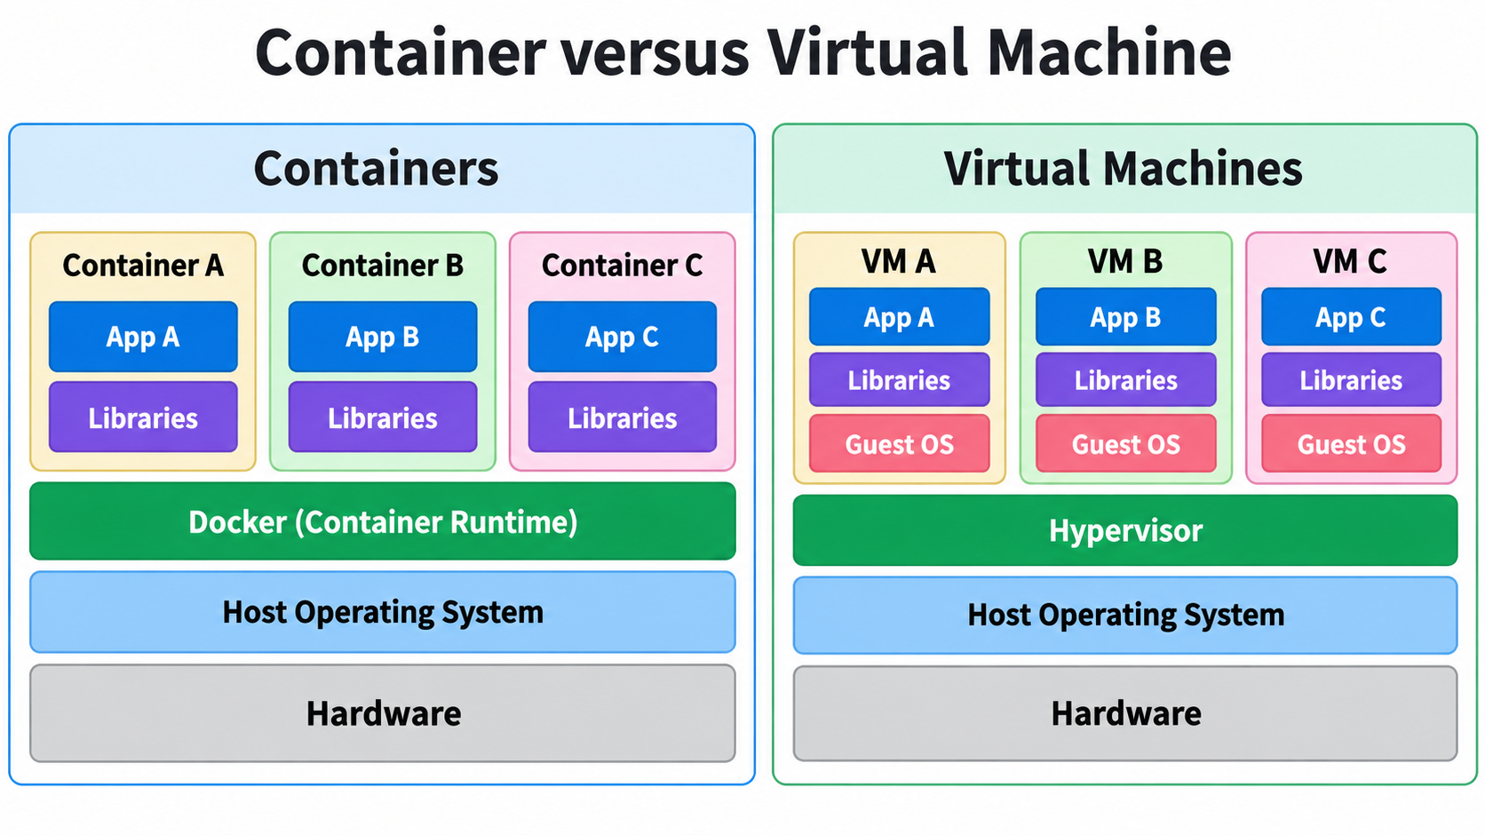

Slide 7
Docker and Windows
Microsoft tried hard to bring Docker containers to Windows platform
Currently, Windows supports (a) Windows and (b) Linux containers
Windows containers: Run Windows apps and require a host system with Windows kernel
Linux containers: Can run on Windows using WSL (Windows Subsystem for Linux) 2
Practically, almost all containers are Linux containers
Mac: There are no Mac containers, but Linux containers run on Mac using Docker Desktop software

Slide 8
Container-related Standards and Projects
Term | Full Form | What It Is | Main Purpose | Example / Key Point
OCI | Open Container Initiative | An open standard for container formats and runtimes | Ensures containers run consistently across platforms | Defines container image format and runtime specifications
CNCF | Cloud Native Computing Foundation | An organization that hosts and promotes cloud-native open-source projects | Supports technologies like containers, orchestration, and microservices | Home of Kubernetes, Prometheus, and Envoy
Moby Project | — | Open-source project created by Docker, Inc. | Provides modular components to build container systems | Forms the open-source base behind Docker

Slide 9
Installing Docker on Ubuntu
Step | Command / Action
1 | Go to https://docs.docker.com/engine/install/ubuntu/
2 | Copy all commands together from “1. Set up Docker's apt repository” and run in terminal together
3 | Copy the command from “2. Install the Docker packages” and run
4 | sudo groupadd docker
5 | sudo usermod -aG docker $(whoami)
6 | sudo reboot
7 | docker ps

Slide 10
Alternative: Installing Docker on Ubuntu
Step | Command | Explanation
1 | sudo snap install docker | Installs Docker using the Ubuntu Snap package manager - Installs both the Docker client and daemon service.
2 | sudo docker --version | Verifies that Docker has been installed successfully and displays the installed version
3 | sudo groupadd docker | Creates a docker group so non-root users can run Docker commands without using sudo - If the group already exists, this step may return a harmless message
4 | sudo usermod -aG docker $(whoami) | Adds the current logged-in user to the docker group, -aG means append the user to the group without removing existing groups
5 | sudo reboot | Restarts the system so that the new group membership takes effect properly - This is the most reliable way to refresh permissions
6 | docker ps | Verifies that Docker is running correctly and that the user can access the Docker daemon without sudo - It lists running containers (if any)

Slide 11
The “Ops” View
Step | Task | Command
1 | Check if Docker is working fine | docker version
2 | Download an image | docker images docker pull nginx:latest docker images
3 | Start a container from the image | docker run --name test -d -p 8080:80 nginx:latest Then in the browser: localhost:8080 docker ps
4 | Execute a command inside the container | docker exec -it test /bin/bash ls exit
5 | Delete the container | docker ps docker stop test docker rm test docker ps -a

Slide 12
Commands on the Previous Slide
Command | Description
docker images | List all Docker images available on your machine
docker pull nginx:latest | Download the latest Nginx image from Docker Hub
docker run ... nginx:latest | Create and start a container using the Nginx image
docker exec -it <container_name> /bin/bash | Open an interactive terminal inside a running container
docker ps | Show all currently running containers
docker stop test | Stop the container named test
docker rm test | Remove the container named test
docker ps -a | Show all containers (running + stopped)

Slide 13
The “Dev” View
Step | Task | Command
1 | Clone an app from a GitHub repo | cd ~ git clone https://github.com/newdelthis/webappdemo.git
2 | Inspect the app’s Dockerfile | cd webappdemo cat Dockerfile
3 | Containerize the app | docker build -t test:1.0 . docker images
4 | Run the app as a container | docker run -d --name web-1 -p 9999:8080 test:1.0 In the browser: localhost:9999 docker ps docker rm web1 -f docker rmi test:1.0

Slide 14
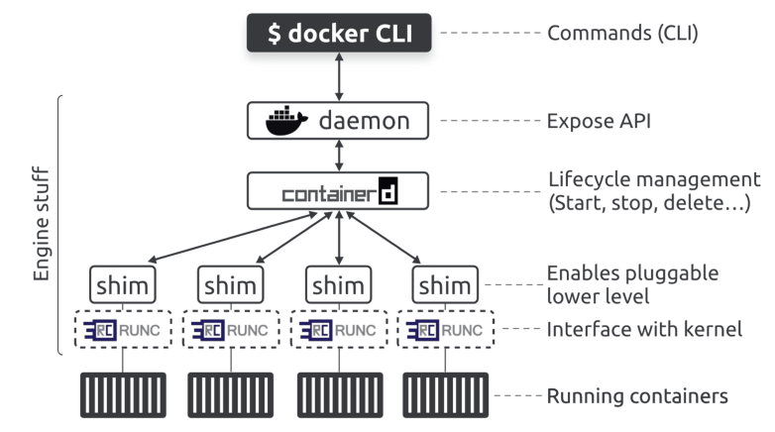
The Docker Engine
Docker Engine = Server-side components of Docker that run and manage containers
Original architecture
Monolithic
Everything in daemon
Now split

Slide 15
containerd (“Container-d”)
Topic | Details
Definition | containerd is a core container runtime that manages the complete lifecycle of containers
Role | Pulls images, creates containers, starts, stops, pauses, and deletes containers
Origin | Originally developed by Docker, Inc. and later donated to Cloud Native Computing Foundation
Used By | Docker, Kubernetes, cloud-native platforms (CNCF)
Need | Explanation
Lightweight runtime | Runs containers without full Docker CLI overhead
High performance | Faster and more efficient for production workloads
Kubernetes support | Preferred runtime for Kubernetes worker nodes
Image management | Pull, push, store, and manage OCI-compliant images
Lifecycle control | Create, run, stop, and remove containers

Slide 16
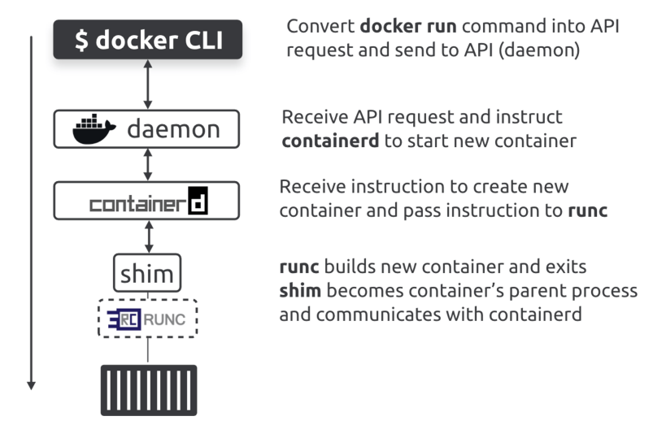
Starting a New Container
File / Executable | Component Name | Purpose
/usr/bin/dockerd | Docker Daemon | Main background service of Docker that receives CLI/API requests and manages images, networks, volumes, and containers
/usr/bin/containerd | containerd | Core container runtime responsible for image handling and container lifecycle management (start, stop, delete)
/usr/bin/containerd-shim-runc-v2 | Shim Process | Intermediate process that keeps the container running independently of the daemon and manages I/O, exit status, and lifecycle communication
/usr/bin/runc | OCI Runtime | Low-level runtime that actually creates and runs containers using Linux namespaces and cgroups
docker run -d --name ctr1 nginx

Slide 17
Ready Docker Images
Image | Use | Example Command
ubuntu | Base OS | docker run -it ubuntu
nginx | Web server | docker run -d -p 80:80 nginx
mysql | Database | docker run -d -e MYSQL_ROOT_PASSWORD=1234 mysql
mongo | NoSQL DB | docker run -d -p 27017:27017 mongo
python | Runtime | docker run -it python

Slide 18
Run a Container
Command / Syntax | Description / Behavior
docker run -d -it <container name> | Runs a container in detached mode with interactive terminal support
docker run ubuntu | Starts a container but it immediately stops (no interactive process running)
docker ps | Lists all currently running containers
docker run -it ubuntu | Runs container in interactive mode; stays active until you exit the terminal
docker run -dit ubuntu | Runs container in background (detached mode); continues running even after exiting terminal
docker exec -it <container id> /bin/bash | Opens an interactive terminal inside a running container

Slide 19
Docker Container Lifecycle
Syntax | Purpose | Example
docker run <image> | Start and stop a container | docker run ubuntu docker ps
docker run -it <image> | Start a container and directly open an interactive terminal in it | docker run -it ubuntu exit docker ps
docker run -dit <image> | Run in detached mode, so container is running in the background | docker run -dit ubuntu docker ps
docker exec -it <container_id> /bin/bash | Access container | docker exec -it b3 /bin/bash
docker stop <container_id> | Stop container (by ID) | docker stop b3
docker stop <container_name> | Stop container (by name) | docker stop beautiful_joe
docker ps | Verify running containers | docker ps
docker ps -a | List all containers | docker ps -a

Slide 20
Docker Image Commands
Command | Purpose | Example
docker pull <image> | Download image from Docker Hub | docker pull ubuntu
docker images | List all downloaded images | docker images
docker rmi <image> | Remove an image | docker rmi ubuntu

Slide 21
docker prune – Containers
Step | Command | What happens
1 | docker run -d --name c1 nginx | Container c1 created
2 | docker run -d --name c2 nginx | Container c2 created
3 | docker stop c1 c2 | Both containers stopped
4 | docker ps -a | Shows c1, c2 (stopped)
5 | docker container prune | Deletes ALL stopped containers
6 | docker ps -a | No stopped containers should appear

Slide 22
docker prune - Images
Step | Command | What happens
1 | docker pull nginx | Image downloaded
2 | docker run -dit --name t1 nginx | Container created
3 | docker stop t1 | Container stopped
4 | docker rm t1 | Container removed
5 | docker images | nginx image still present
6 | docker image prune -a | Removes unused images

Slide 23
Inspect a Container
Command | Purpose | Description | Example
docker inspect <container_id> | Get detailed container info | Displays low-level JSON details (IP, mounts, config, status, etc.) | docker inspect b3
docker inspect <container_name> | Inspect by name | Same as above, using container name | docker inspect beautiful_joe
docker inspect <image> | Inspect image | Shows metadata about image (layers, config) | docker inspect ubuntu
docker inspect -f "<format>" <container> | Filter specific info | Extract specific fields using Go template | docker inspect -f "{{.NetworkSettings.IPAddress}}" b3

Slide 24
Naming a Docker Container
Command / Syntax | Purpose | Description | Example
docker run --name <name> <image> | Assign name while creating container | Gives a custom name instead of random name | docker run -it --name myubuntu ubuntu
docker run -dit --name <name> <image> | Name + detached mode | Runs container in background with a custom name | docker run -dit --name webserver nginx
docker ps | Verify container name | Shows assigned container name in output | docker ps
docker rename <old_name> <new_name> | Rename existing container | Changes name of an already created container | docker rename webserver myweb

Slide 25
Docker Logs Command
Command / Syntax | Purpose | Description | Example
docker logs <container> | View container logs | Displays output (stdout/stderr) of a container | docker logs mycontainer
docker logs <container_id> | View logs by ID | Same as above using container ID | docker logs b3
docker logs -f <container> | Follow logs (live) | Streams logs in real-time (like tail -f) | docker logs -f mycontainer
docker logs --tail <n> <container> | Show last N lines | Displays only recent log entries | docker logs --tail 10 mycontainer
docker logs -t <container> | Show timestamps | Adds timestamps to log output | docker logs -t mycontainer

Slide 26
Docker Networking
Suppose we run an nginx container: docker run -dit nginx
Getting the container IP: docker inspect <container id/name>
Concept | Explanation
Default network | Containers run in bridge mode by default
IP address | Each container gets a private IP (e.g., 172.17.0.2)
Internal port | NGINX listens on port 80 inside container
Isolation | Each container has its own network namespace

Slide 27
Port Publishing
A container runs inside its Docker’s default bridge network
Its ports (like 80) are not directly accessible from our computer
We need to use port mapping to connect:
Our Computer (Host) → Container
Port mapping = Making a container service visible outside
Example: docker run -d -p 8080:80 nginx
  We type http://localhost:8080
  It goes to Container → port 80 → NGINX

Slide 28
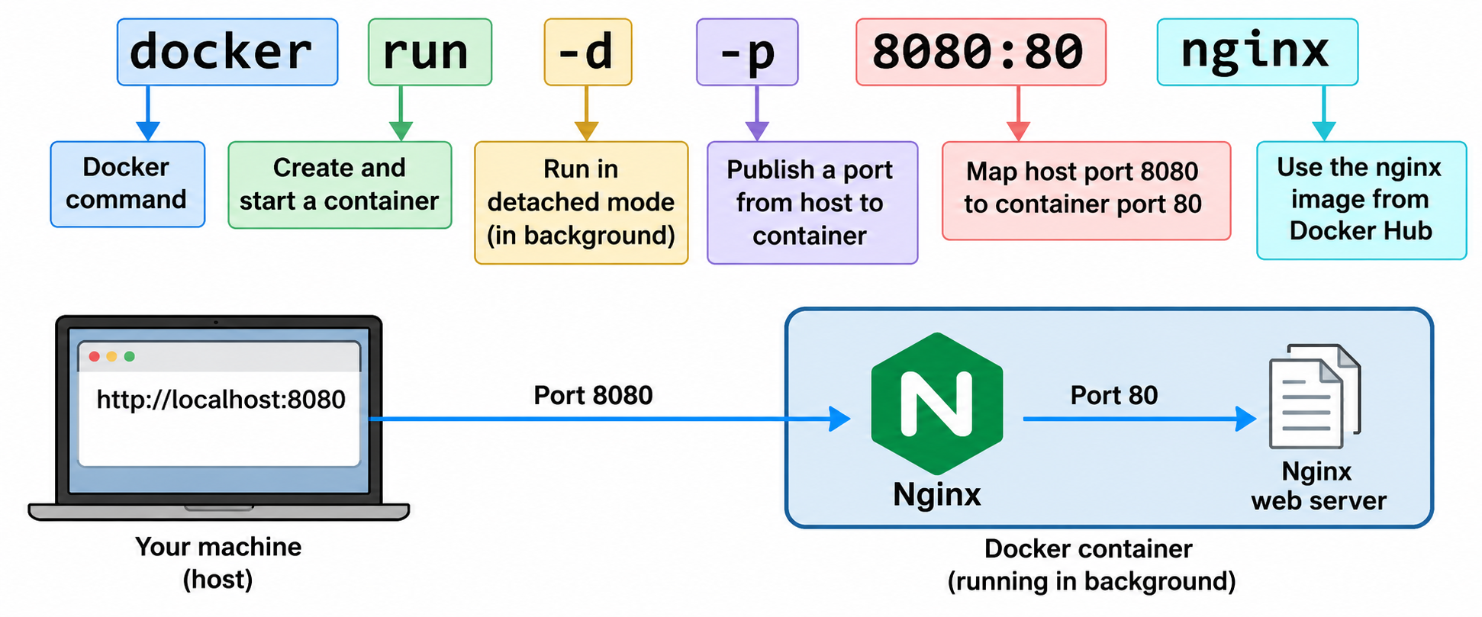

Slide 29
Docker Bridge Networks Comparison
Aspect | Default Bridge Network | User-Defined Bridge Network
Creation | Automatically created by Docker | Manually created (docker network create mynet)
Container Communication | Uses IP addresses (less convenient) | Uses container names (DNS) (easy & reliable)
Isolation | All containers share same network (low isolation) | Strong isolation from other networks
Security | Any container can talk to any other → risk | Only containers in same network communicate → safer
Flexibility | Limited control | Full control (custom networks, aliases, etc.)
Use Case | Quick testing, simple setups | Production, multi-container apps

Slide 30
Docker Networking Hands-on
BusyBox: Tiny open-source software that packages many common UNIX utilities into one executable binary
Step | Command
Start container 1 | docker run -it busybox
Start container 2 | docker run -it busybox

Slide 31
Docker Networking Hands-on
Check IP addresses and host names
Communication in default bridge
Conclusion: Only IP-based communication works
Action | Command
Get IP address | hostname -i
Get hostname | hostname
Test | Result
Ping using hostname | Fails
Ping using IP | Works

Slide 32
Create Custom Network
Creating and inspecting a custom bridge network
Run containers inside the custom bridge network
Command | Purpose
docker network create custom | Create new network
docker network ls | List networks
docker network inspect custom | View details
Command | Purpose
docker run -it --network custom --name busybox1 busybox | Run container 1 in custom network
docker run -it --network custom --name busybox2 busybox | Run container 2 in custom network

Slide 33
Communication in Custom Bridge Networks
Try pinging
Conclusion
Test | Result
Ping using IP address | Works
Ping using host name | Works
Ping using custom name | Works
Network Type | Communication Method
Default bridge | IP only
Custom bridge | IP + hostname + container name

Slide 34
Docker Networking
Browser -> https://github.com/newdelthis/docker_networking.git
Fork the repository and come to the terminal
cd ~
git clone https://github.com/newdelthis/docker_networking.git
Note: Change the user id above to YOUR github id
Run MySQL container …
  docker run -d --name mysql-db -e MYSQL_ROOT_PASSWORD=root -e MYSQL_DATABASE=school -p 3306:3306 mysql:8
Build and run
  cd docker_networking
  docker build -t student-app .
  docker run --name app student-app Error!!!
  docker stop app
  docker stop mysql-db
  docker container prune

Slide 35
Docker Networking - app.py
import mysql.connector
conn = mysql.connector.connect(
host="localhost", # wrong in Docker
user="root",
password="root",
database="school"
)
cursor = conn.cursor()
cursor.execute("CREATE TABLE IF NOT EXISTS students (name VARCHAR(50), age INT)")
cursor.execute("INSERT INTO students VALUES ('Alice', 20)")
conn.commit()
print("Inserted!")
cursor.close()
conn.close()

Slide 36
Dockerfile
FROM python:3.9
WORKDIR /app
COPY app_old.py .
RUN pip install mysql-connector-python
CMD ["python", "app_old.py"]

Slide 37
Solution: Change app.py
import mysql.connector
# Use container name
conn = mysql.connector.connect(
host="mysql-db",
user="root",
password="root",
database="school"
)
cursor = conn.cursor()
cursor.execute("CREATE TABLE IF NOT EXISTS students (name VARCHAR(50), age INT)")
cursor.execute("INSERT INTO students VALUES ('Alice', 20)")
conn.commit()
print("Inserted!")
cursor.close()
conn.close()

Slide 38
Using Network
First edit Dockerfile to change app_old.py to app.py at two places
docker build -t student-app .
docker network create mynet
docker run -d --network mynet --name mysql-db -e MYSQL_ROOT_PASSWORD=root -e MYSQL_DATABASE=school mysql:8
docker run --network mynet --name app student-app
docker exec -it mysql-db mysql -uroot -proot
mysql> USE school;
mysql> SELECT * FROM students;
exit

Slide 39
Docker Volume
Docker containers
Problem
Concept | Explanation
Ephemeral / Stateless | Containers are short-lived and disposable
Lifecycle | Can be easily created, destroyed, and recreated
Data behavior | Data inside container is lost when it is removed
Scenario | Outcome
Run MySQL container | Database works normally
Remove container | All data is lost
Recreate container | Starts fresh (no previous data)

Slide 40
Docker Volume
Solution: Docker Volume
With Volume
Concept | Explanation
Docker Volume | Storage outside container on host machine
Purpose | Persist data even after container removal
Location | Stored on local disk (managed by Docker)
Scenario | Outcome
Run container with volume | Data stored in volume
Remove container | Data remains safe
Recreate container | Data is restored

Slide 41
Docker Volume Syntax
Basic syntax
What are A and B?
Syntax | Plain Meaning | Example
-v A:B | Connect A (outside) to B (inside container) | -v mysql-data:/var/lib/mysql
Part | Meaning
A (left side) | Where data is stored outside container
B (right side) | Where app stores data inside container

Slide 42
Docker Volume: Three Common Cases
Case | Syntax Example (MySQL) | Meaning
Named volume | -v mysql-data:/var/lib/mysql | Docker creates storage mysql-data and connects it to MySQL’s data folder
Local folder | -v /home/user/mysql-data:/var/lib/mysql | Our local folder stores MySQL database files
Only path | -v /var/lib/mysql | Docker auto-creates storage and connects it to MySQL data folder
Case | Syntax Example (NGINX) | Meaning
Named volume | -v web-data:/usr/share/nginx/html | Docker creates storage for website files
Local folder | -v /home/user/html:/usr/share/nginx/html | Our local website files are served by NGINX
Only path | -v /usr/share/nginx/html | Docker auto-creates storage for web content

Slide 43
Volume versus Bind Mount
Aspect | Volume | Bind Mount (Local Folder)
Managed by | Docker | You (host filesystem)
Location | Hidden (Docker internal) | Visible folder
Portability | High | Low (path dependent)
Use case | Databases, production | Development, testing
Risk | Safer | Can overwrite system files

Slide 44
Volume Commands
Command | Purpose | Example
docker volume create <name> | Create volume | docker volume create myvol
docker volume ls | List volumes | docker volume ls
docker volume inspect <name> | View details | docker volume inspect myvol
docker volume rm <name> | Remove volume | docker volume rm myvol
docker volume prune | Remove unused volumes | docker volume prune

Slide 45
Volume Lifecycle
Action | What Happens
Container created | Volume attached
Container stopped | Volume remains
Container removed | Volume still exists
Volume removed | Data permanently lost

Slide 46
Step 1.1: MySQL Without Volume
Step | Command / Action
1 | docker run -d --name my-mysql -e MYSQL_ROOT_PASSWORD=root123 -p 3306:3306 mysql:8
2 | docker exec -it my-mysql mysql -uroot -proot123

Slide 47
Step 1.2: Create and Verify Data
Step | Command | Purpose
1 | CREATE DATABASE cdac; | Create database
2 | USE cdac; | Select database
3 | CREATE TABLE IF NOT EXISTS student ( id INT PRIMARY KEY AUTO_INCREMENT, name VARCHAR(100), score INT ); | Create table
4 | INSERT INTO student (name, score) VALUES ('Amit', 85); | Insert data
5 | SELECT * FROM student; | Verify data
6 | exit | Exit MySQL
7 | docker stop my-mysql | Stop container
8 | docker rm my-mysql | Remove container

Slide 48
Step 1.3: Verify If Data Exists
Step | Command / Action | Purpose
1 | docker run -d --name my-mysql -e MYSQL_ROOT_PASSWORD=root123 -p 3306:3306 mysql:8 | Run MySQL container
2 | docker exec -it my-mysql mysql -uroot -proot123 | Connect to MySQL inside container
3 | use cdac; | No such database

Slide 49
Step 2.1 MySQL with Docker Volume
Step | Command / Action
1 | docker volume create mysql-data
2 | docker run -d --name my-mysql -e MYSQL_ROOT_PASSWORD=root123 -v mysql-data:/var/lib/mysql -p 3306:3306 mysql:8
3 | docker exec -it my-mysql mysql -uroot -proot123

Slide 50
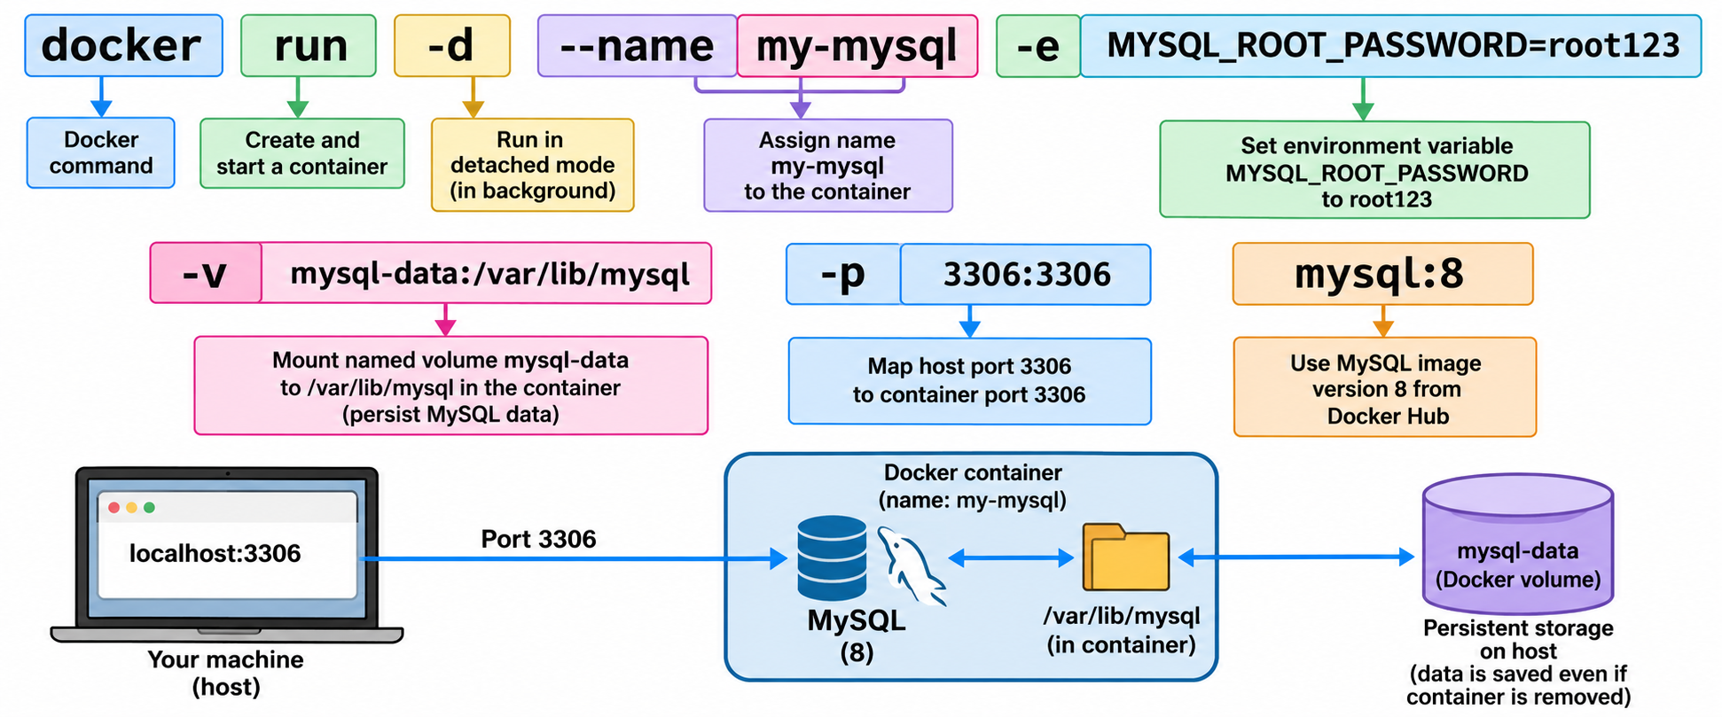

Slide 51
Step 2.2 Create and Verify Data
Step | Command | Purpose
1 | CREATE DATABASE cdac; | Create database
2 | USE cdac; | Select database
3 | CREATE TABLE IF NOT EXISTS student ( id INT PRIMARY KEY AUTO_INCREMENT, name VARCHAR(100), score INT ); | Create table
4 | INSERT INTO student (name, score) VALUES ('Amit', 85); | Insert data
5 | SELECT * FROM student; | Verify data
6 | exit | Exit MySQL
7 | docker stop my-mysql | Stop container
8 | docker rm my-mysql | Remove container

Slide 52
Step 3.1 Verify If Data Exists
Step | Command / Action | Purpose
1 | docker run -d --name my-mysql -e MYSQL_ROOT_PASSWORD=root123 -v mysql-data:/var/lib/mysql -p 3306:3306 mysql:8 | Run MySQL container with volume
2 | docker exec -it my-mysql mysql -uroot -p | Connect to MySQL inside container
3 | use cdac; | Should be present
4 | SELECT * FROM student; | Should be present

Slide 53
Cleanup
Step | Command
Stop container | docker stop my-mysql
Remove container | docker rm my-mysql
Remove volume | docker volume rm mysql-data
List volumes | docker volume ls

Slide 54
NGINX with Volume
Step | Command / Action
1 | mkdir ~/webpages
2 | cd webpages
3 | echo "Hi from inside our CDAC nginx container!" > index.html
4 | cd ..

Slide 55
NGINX with Volume
Platform | Command
Windows | docker run -p 8080:80 --name another_nginx -v %cd%/webpages:/usr/share/nginx/html -d nginx
Linux | docker run -p 8080:80 --name another_nginx -v ${PWD}/webpages:/usr/share/nginx/html -d nginx
Test: localhost:8080

Slide 56
Real-time Update with Docker Volume
Step | Command / Action | What to Show
1 | Edit file | echo "Updated from host machine!" > webpages/index.html
2 | Refresh browser | Page updates immediately
3 | Edit again | echo "Second update!" > webpages/index.html
4 | Refresh again | Instant change visible

Slide 57
Viewing the Update Inside Container
Step | Command | Result
Enter container | docker exec -it another_nginx /bin/bash | Access container shell
Check file | cat /usr/share/nginx/html/index.html | Same updated content seen

Slide 58
Build Image Using Dockerfile
Dockerfile: Contains instructions that we want to give to Docker for building an image … Main instructions …
Instruction | Use
FROM | Set the base image
CMD | Command to be executed when the image is run as a container (Or pass options to ENTRYPOINT)
RUN | Executes a command to help build our image
EXPOSE | Opens network ports
VOLUME | Sets a disk share
COPY | Copies files from the local disk to the image
ENV | Add an environment variable
ENTRYPOINT | Determines which executable runs when a container starts (Use CMD to pass options to the executable)

Slide 59
Python “Hello World”
Step | Command / File | Content / Action | Purpose
1 | Create directory | mkdir ~/docker_python_hello | Project folder
2 | Create Python file | hello.py | print("Hello World")
3 | Create Dockerfile | Dockerfile | Next slide
4 | Build image | docker build -t my-hello-python . | Build Docker image
5 | Run container | docker run my-hello-python | Executes program

Slide 60
Dockerfile
Instruction | Value | Purpose
FROM | python:3.9-slim-buster | Base Python image
WORKDIR | /app | Set working directory
COPY | hello.py /app | Copy file into image
CMD | ["python", "hello.py"] | Run Python script when we use the docker run command later

Slide 61
Push to DockerHub
Step | Command | Purpose
DockerHub ID | Visit DockerHub website and create an ID for yourself, if you do not have one | Docker image pushing
Login on terminal | docker login | Authenticate
Tag image | docker tag my-hello-python your-id/my-hello-python:1.0 | Prepare for push
Push image | docker push your-id/my-hello-python:1.0 | Upload to DockerHub

Slide 62
Example: Docker CMD versus ENTRYPOINT
Dockerfile
Example
Instruction | Value | Meaning
FROM | ubuntu | Base image
ENTRYPOINT | ["echo"] | Fixed command
CMD | ["Hello from CMD"] | Default argument
Case | Command | What Runs Internally | Output
Case 1: No arguments | docker run myimage | echo Hello from CMD | Hello from CMD
Case 2: With arguments | docker run myimage "Hi CDAC" | echo Hi CDAC | Hi CDAC

Slide 63
Java “Hello World”
Step | Command / File | Content / Action
1 | Create directory | mkdir ~/docker_java_hello
2 | Create Java file | HelloWorld.java
3 | Create Dockerfile | Dockerfile
4 | Build image | docker build -t docker-id/cdac-java:1.0 .
5 | Run container | docker run docker-id/cdac-java:1.0
public class HelloWorld {
public static void main(String[] args) {
System.out.println (“Hello, World!”);
}
}
FROM eclipse-temurin:17-jdk-alpine
WORKDIR /app
COPY HelloWorld.java /app
RUN javac HelloWorld.java
CMD ["java", "HelloWorld"]
HelloWorld.java
Dockerfile

Slide 64
Push to DockerHub
Step | Command
Login | docker login
Push image | docker push docker-id/cdac-java

Slide 65
Python Add Two Numbers
mkdir ~/docker_python_add
cd ~/docker_python_add
nano Dockerfile
FROM python:3.11-slim
WORKDIR /myapplication
COPY add.py /myapplication
CMD ["python", "add.py"]
nano add.py
num1 = float(input("Enter the first number: "))
num2 = float(input("Enter the second number: "))
total = num1 + num2
print(f"The sum is: {total}")
docker build -t python-sum-app .
docker run python-sum-app ERROR!!!
docker run -it python-sum-app

Slide 66
Saving/Loading Docker Images (Local Disk)
Step | Command | Purpose | Output / Result
1 | docker pull ubuntu | Download image from Docker Hub | Image available locally
2 | docker save ubuntu -o ubuntu.tar | Save image as a file | ubuntu.tar created
3 | Copy file | Transfer ubuntu.tar to another machine | File moved
4 | docker load -i ubuntu.tar | Load image from file | Image restored locally

Slide 67
Stop and Remove All Running Containers
Command | Purpose | Explanation
docker stop $(docker ps -a -q) | Stop all containers | Gets all container IDs and stops them
docker rm $(docker ps -a -q) | Remove all containers | Deletes all containers (after stopping)
Part | Meaning
docker ps -a | List all containers (running + stopped)
-q | Show only container IDs
$(...) | Pass output as input to another command

Slide 68
Problem
Create a C program to take input from the user and test it
Then create an image using Dockerfile
Test image by the running container
Then push the image to the docker hub repository
Then also export the image in a “cprogback.tar” file

Slide 69
Create a C Program and Dockerfile
mkdir ~/docker_c_example
cd ~/docker_c_example
nano user_input.c
#include <stdio.h>
int main() {
char name[100];
printf ("Enter your name: ");
scanf ("%s", name);
printf ("Hello, %s!\n", name);
return 0;
}
nano Dockerfile
FROM gcc:latest
WORKDIR /cdac/ditiss/mycode
COPY user_input.c /cdac/ditiss/mycode
RUN gcc -o user_input user_input.c
CMD ["./user_input"]

Slide 70
Build and Execute
# Build the Docker image
docker build -t my-ditiss-c .
# Run the Docker container
docker run my-ditiss-c PROBLEM!
docker run -it my-ditiss-c

Slide 71
Push to DockerHub and Also Save As a tar File
docker login
docker tag my-ditiss-c newdelthis/my-ditiss-c:1.0
docker push newdelthis/my-ditiss-c:1.0
docker save my-ditiss-c -o cprogback.tar

Slide 72
Web Application: Running a Tomcat Container
docker run -dit --rm --name tomcat-container -p 7777:8080 tomcat:8.0
Browser: localhost:7777
docker exec -it tomcat-container /bin/bash
  cd webapps/examples
  echo “Hello from DITISS” > cdac.html
Browser: localhost:7777/examples/cdac.html

Slide 73
Problem
Create an httpd container running on port 8000
Name the container as web5
Do not map any directory
Create an “index.html” file & copy this file inside the container and check if the website displays your webpage
Again, modify the “index.html” file and copy it inside the container, and check if the website is updated or not

Slide 74
Solution
docker run -dit --name web5 -p 7777:80 httpd
On the local machine, create index.html
<html>
<body>
<h1>Hello from CDAC!</h1>
</body>
</html>
docker cp index.html web5:/usr/local/apache2/htdocs/index.html
Open browser: localhost:7777
Modify index.html to have <h1>Hello from DITISS!</h1>
docker cp index.html web5:/usr/local/apache2/htdocs/index.html
Open browser: localhost:7777

Slide 75
Docker Volume and Docker Network Example
Run a Tomcat container and a MySQL container
Put them in the same Docker network
From the Tomcat container, create a Student table in MySQL container
It will have three columns: PRN, Name, Course
Custom Docker Network
Docker Volume
Tomcat container
MySQL container

Slide 76
Docker Networking Example
docker network create my-network
docker container run --name mysql-container -v /data/mysql_data:/var/lib/mysql --network my-network -e MYSQL_ROOT_PASSWORD=pass -d mysql:latest
docker container run --name tomcat-container --network my-network -p 7777:8080 -v /data/mytomcat_data:/usr/local/tomcat/webapps -d tomcat:8

Slide 77
Docker Networking Example
Connect to the Tomcat container and verify that it can access MySQL
  docker exec -it tomcat-container /bin/bash
  apt-get update
  apt-get install -y mysql-client
  mysql -h mysql-container -uroot -ppass
Create a database, a table, and add 1 row:
  CREATE DATABASE ditiss;
  USE ditiss;
  CREATE TABLE student_tbl (prn integer, name char(30));
  INSERT INTO student_tbl VALUES (1, “My name”);
  SELECT * FROM student_tbl;

Slide 78
Docker Compose
Aspect | Explanation
What is it? | Tool to run multiple containers together
File used | docker-compose.yml
Purpose | Define and manage multi-container applications
Example | Web app + Database together
Key idea | Everything defined in a single YAML file
Command | Purpose
docker compose up | Start all services
docker compose up -d | Run in background
docker compose down | Stop and remove all
docker compose ps | List services

Slide 79
Docker Compose Python-MySQL
Directory structure
  student-app/
  app.py
  requirements.txt
  Dockerfile
  docker-compose.yml

Slide 80
app.py
from flask import Flask
import mysql.connector
import time
app = Flask(__name__)
def get_db():
return mysql.connector.connect(
host="db",
user="root",
password="root123",
database="college"
)
@app.route("/")
def students():
conn = get_db()
cur = conn.cursor()
cur.execute("""
CREATE TABLE IF NOT EXISTS student (
id INT PRIMARY KEY,
name VARCHAR(50),
marks INT
)
""")
cur.executemany(
"INSERT IGNORE INTO student VALUES (%s, %s, %s)",
[(1, "Amit", 85),
(2, "Neha", 90),
(3, "Raj", 78)]
)
conn.commit()
cur.execute("SELECT * FROM student")
rows = cur.fetchall()
cur.close()
conn.close()
html = "<h2>Student Records</h2><table border='1'>"
html += "<tr><th>ID</th><th>Name</th><th>Marks</th></tr>"
for row in rows:
html += f"<tr><td>{row[0]}</td><td>{row[1]}</td><td>{row[2]}</td></tr>"
return html + "</table>"
if __name__ == "__main__":
app.run(host="0.0.0.0", port=5000)

Slide 81
requirements.txt
flask
mysql-connector-python

Slide 82
Dockerfile
FROM python:3.12-slim
WORKDIR /app
COPY requirements.txt .
RUN pip install --no-cache-dir -r requirements.txt
COPY app.py .
CMD ["python", "app.py"]

Slide 83
docker-compose.yml
services:
db:
image: mysql:8
environment:
MYSQL_ROOT_PASSWORD: root123
MYSQL_DATABASE: college
volumes:
- mysql-data:/var/lib/mysql
healthcheck:
test: ["CMD", "mysqladmin", "ping", "-h", "localhost", "-proot123"]
interval: 5s
timeout: 3s
retries: 20
app:
build: .
ports:
- "5000:5000"
depends_on:
db:
condition: service_healthy
volumes:
mysql-data:

Slide 84
Run the application
Terminal: docker compose up --build -d
Browser: http://localhost:5000
Verification
  docker compose ps
  docker network ls
  docker compose logs app

Slide 85
Docker Compose Example
cd ~
mkdir docker_compose_files
cd docker_compose_files
Download https://github.com/newdelthis/demo/blob/main/docker-compose.yml in this directory
Run: docker compose up
Browser
  localhost:8080 -> nginx
  localhost:8081 -> PHPMyAdmin (User = root, Password = root123)
Run: docker compose down

Slide 86
Creating a Docker Compose yaml File
Write the top-level section: services
services:
web:
db:
Keyword | Meaning
services: | List of containers to run together

Slide 87
Creating a Docker Compose yaml File
Give each service an image
services:
web:
image: nginx
db:
image: mysql:8
Key | Meaning | Example
image: | Which ready image to use | nginx, mysql:8

Slide 88
Creating a Docker Compose yaml File
Add ports if needed
services:
web:
image: nginx
ports:
- "8080:80"
Key | Meaning | Example
ports: | Map host port to container port | "8080:80"

Slide 89
Creating a Docker Compose yaml File
Add environment variables if needed
services:
db:
image: mysql:8
environment:
MYSQL_ROOT_PASSWORD: root123
MYSQL_DATABASE: cdac
Key | Meaning | Example
environment: | Pass settings into container | MySQL password, DB name

Slide 90
Creating a Docker Compose yaml File
Add volumes if needed
services:
db:
image: mysql:8
environment:
MYSQL_ROOT_PASSWORD: root123
volumes:
- mysql-data:/var/lib/mysql
Key | Meaning | Example
volumes: under service | Attach storage to container | mysql-data:/var/lib/mysql

Slide 91
Creating a Docker Compose yaml File
Add container name if needed
services:
db:
image: mysql:8
container_name: my-mysql
Key | Meaning | Example
container_name: | Give fixed container name | my-mysql

Slide 92
Docker Compose File: Key Points
Line | Meaning
services: | Start defining containers
web: | First service
image: nginx | Use NGINX image
ports: | Expose port
db: | Second service
image: mysql:8 | Use MySQL image
environment: | Set MySQL variables
volumes: | Store DB data persistently

Slide 93

Docker Compose
Docker compose: Tool for automating the building and running of containers
How: Create a docker-compose.yml file
docker-compose.yml: Replaces the docker build and docker run commands
Dockerfile: Will still be needed for the actual step-by-step instructionns
Dockerfile
Usual details for creating image
docker-compose.yml
Replaces the docker build and docker run commands
docker compose build
docker compose up
docker compose down

Slide 94
HelloWorld.java Dockerfile
mkdir ~/java_docker_compose
cd ~/java_docker_compose
public class HelloWorld {
public static void main(String[] args) {
System.out.println("Hello, World!");
}
}
FROM eclipse-temurin:17-jdk-alpine
WORKDIR /my-compose-app
COPY HelloWorld.java /my-compose-app
RUN javac HelloWorld.java
CMD ["java", "HelloWorld"]

Slide 95
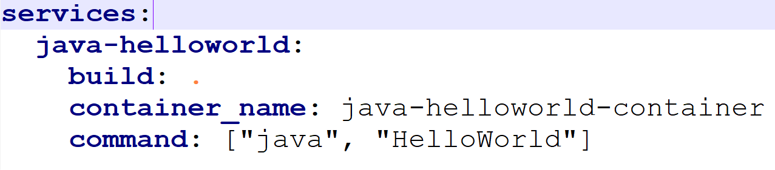
docker-compose.yml
To run and then remove:
docker compose up
docker compose down

Slide 96
Docker Swarm
Docker Swarm: Docker’s built-in container orchestration tool
Alternative to Kubernetes
Not so popular
docker info
If it shows Docker Swarm not active: docker swarm init
If it gives multiple interfaces error:
docker swarm init --advertise-addr 192.168.0.151 (Replace this IP with one of the IPs it has shown)
Swarm: Single-node cluster
docker node ls

Slide 97
Docker Swarm Service Example
service: We create a service in Docker Swarm to run containers inside it … It is a logical group of multiple copies of the same container
docker service create nginx
Get more details: docker service ls
docker service ps <service id>
docker service update <service id> --replicas <Number>
docker ps
docker container stop <container id>
docker container rm -f <container id>
docker container ls … Note that a replacement container has started
docker service rm <service name> … Remove the service itself

Slide 98
Docker Swarm Problem
Create a new docker image using NGINX
Push it to docker hub
Create a service on Dockerswarm
Keep initial replicas as 1 and then increase the replicas to 10
Reduce the replicas to 2
Create a new image by modifying “index.html”
Push to docker hub and then update the service for a new image

Slide 99
Solution – 1
mkdir nginx_project
cd nginx_project
echo "<h1>Welcome to my custom NGINX server</h1>" > index.html
sudo nano Dockerfile
FROM nginx:latest
COPY index.html /usr/share/nginx/html/index.html
docker build -t newdelthis/custom-nginx:1.0 .
docker run -d -p 9999:80 newdelthis/custom-nginx:1.0
Browser: localhost:9999
docker login
docker push newdlethis/custom-nginx:1.0

Slide 100
Solution – 2
docker swarm init
docker service create --name nginx-service --replicas 1 -p 9999:80 newdelthis/custom-nginx:1.0
docker service ls
docker service scale nginx-service=10
docker service ps nginx-service
docker service scale nginx-service=2
docker service ps nginx-service

Slide 101
Solution – 3 (New index.html)
echo "<h1>Welcome to the updated NGINX server</h1>" > index.html
docker build -t newdelthis/custom-nginx:2.0 .
docker push newdelthis/custom-nginx:2.0
docker service update --image newdelthis/custom-nginx:2.0 nginx-service
docker service ps nginx-service
Browser: localhost:9999
docker service rm nginx-service

Slide 102
Running a Container and Stopping it After Displaying a Message
Run an Alpine container that displays Hello World
docker run --rm alpine sh -c "echo 'hello world'"

Slide 103
Trivy: Scan Docker Images for Security
Run Trivy as a Docker container: docker run aquasec/trivy
Scan an image: docker run --rm -v /var/run/docker.sock:/var/run/docker.sock aquasec/trivy:latest image newdelthis/docker_jenkins_demo:1.0

