Slide 1
Kubernetes (K8S)
Atul Kahate

Slide 2
Agenda
1
2
3
Why Kubernetes
From containers on one host to a cluster
Architecture
Control plane, worker nodes, kubectl apply
Pods and Deployments
Install minikube, run Pods, self-healing
4
5
6
Writing YAML
Pod → Deployment → scale, step by step
Services
ClusterIP, NodePort, LoadBalancer
Rolling Updates
Zero-downtime release and rollback

Slide 3
Why Kubernetes
From containers on one host to a self-healing cluster

Slide 4
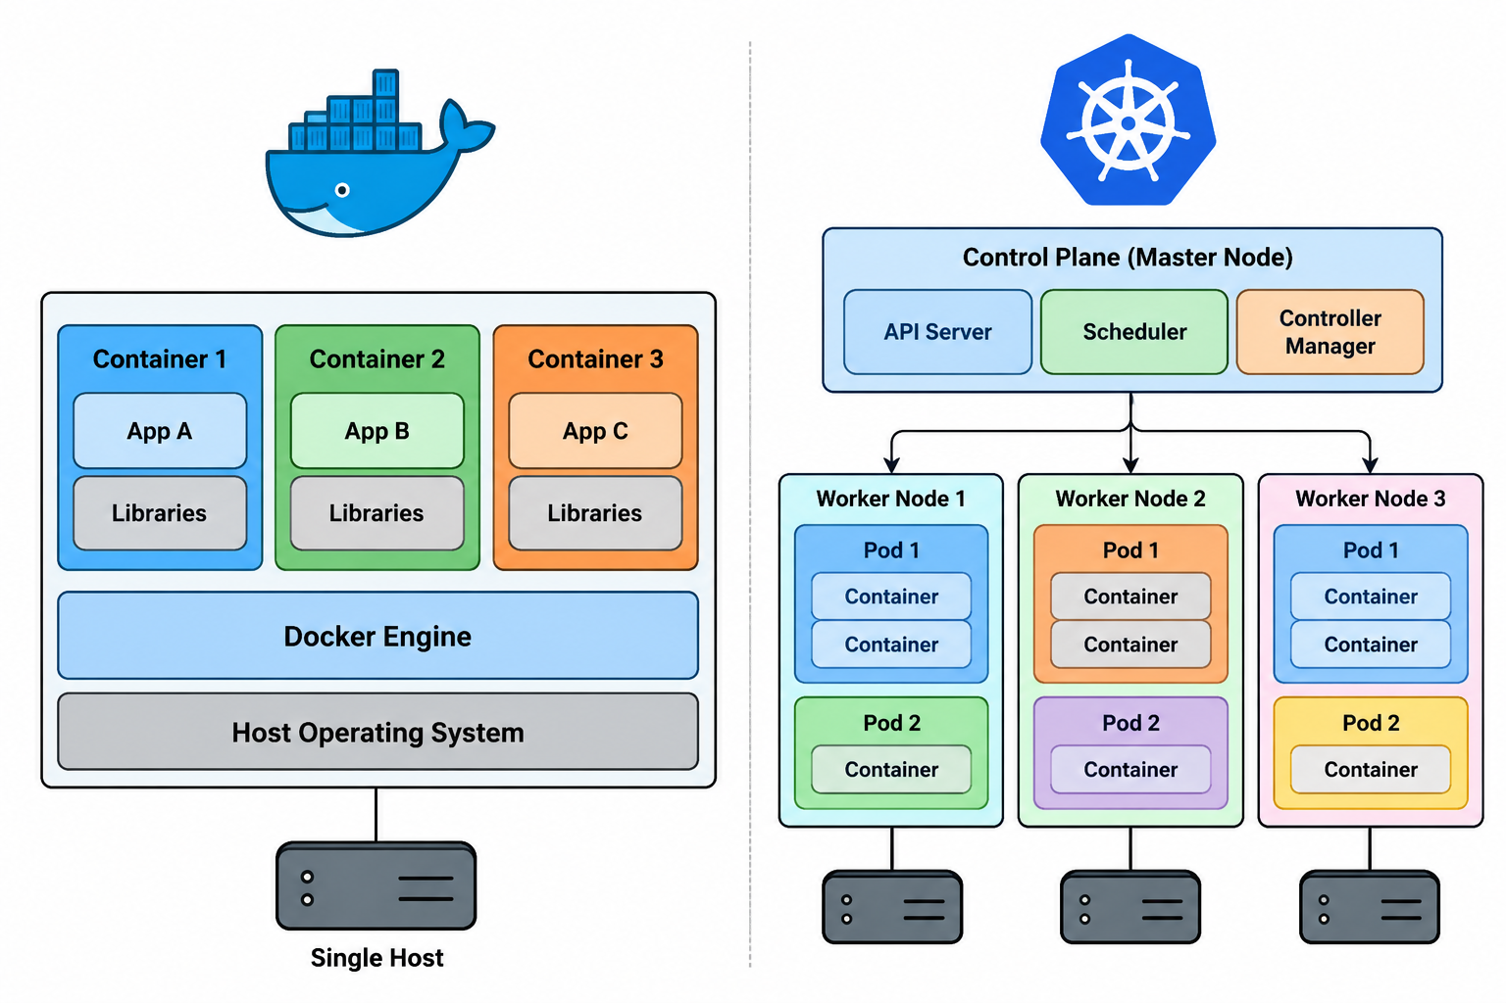
Docker Host vs Kubernetes Cluster

Slide 5
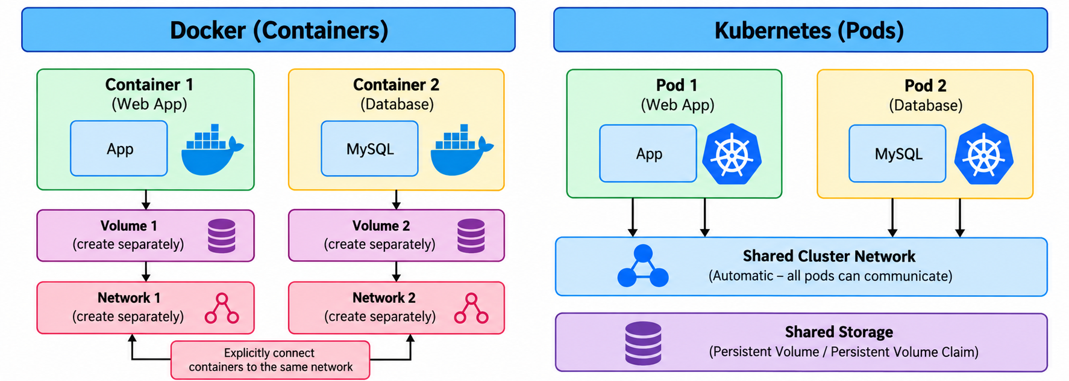
Containers in Docker vs Pods in Kubernetes
Docker on its own
Volumes and networks are created and attached per container (Compose automates this per project)
Containers on different hosts need extra setup to talk to each other
Restarts, scaling and placement are handled host by host
Kubernetes
Every Pod gets its own IP on one flat cluster network and can reach any other Pod
Storage is requested with a PersistentVolumeClaim; the cluster provisions and attaches the volume
Network (CNI) and storage (CSI) plugins are managed by the cluster, not per container
Notes:
The original bottom panels said 'no need to create a separate volume per pod'. A PVC is still created per workload; what changes is that the cluster provisions and attaches it.

Slide 6
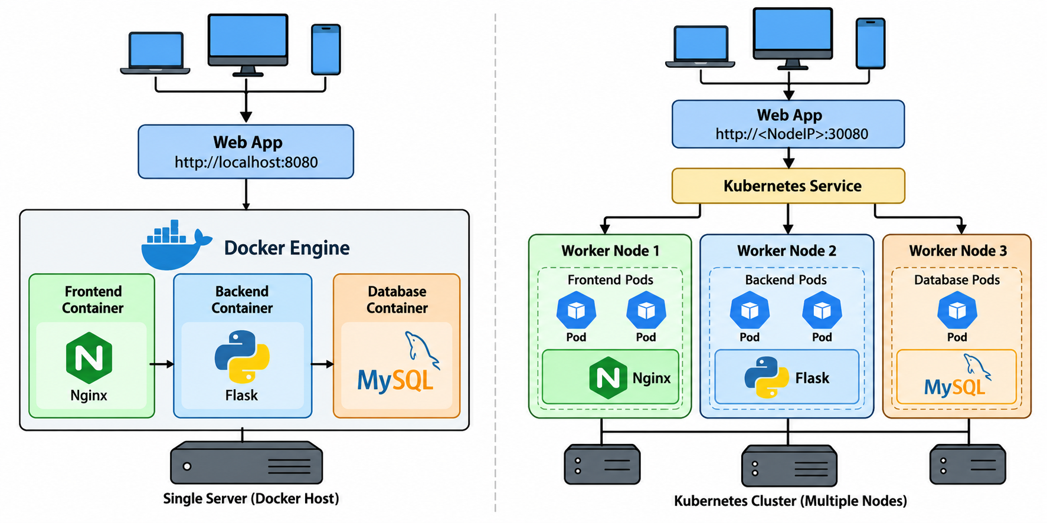
Same App: Docker Host vs Cluster

Slide 7
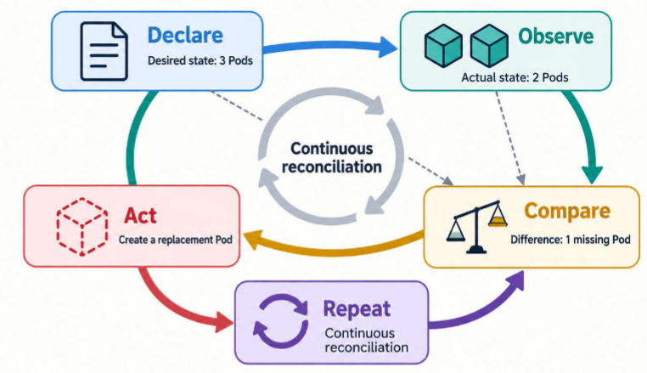
Kubernetes
Kubernetes: A desired-state control system for running containerized workloads across a pool of machines
  Desired state: Outcome recorded as intent
  Container: Isolated process environment created from a packaged image
Kubernetes continually compares what should be running with what is actually running, then acts to reduce the difference

Slide 8
Kubernetes Approach – Declarative and Desired State based
Declarative (“What?”)
  A declarative system is told the state that should exist, rather than only the sequence of actions to execute
  A declarative instruction says, “keep three instances of this workload running”
Imperative (“How?”)
  An imperative instruction says, “start a container on server A”
Desired state: Intent recorded in Kubernetes objects
Actual state: What the cluster currently observes: existing Pods, assigned nodes, container states, network endpoints, and other reported conditions

Slide 9
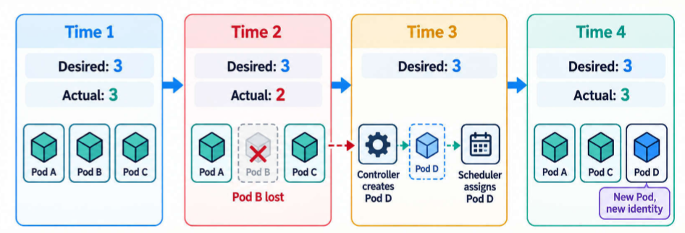
Example: Replica Loss and Convergence
Desired replicas: 3. Actual Pods: 3
One Pod is deleted or lost with its node
Desired replicas: 3. Actual usable Pods: 2
The workload controller creates a replacement Pod object
The scheduler selects a node for the new Pod
The node starts the requested container
Status converges toward three available replicas again
Kubernetes restores the declared replica count; it does not restart the same process
Applications should therefore tolerate instance replacement

Slide 10
Kubernetes Key Features
Feature | What It Solves
Auto Scaling | Automatically adds or removes pods based on CPU usage, memory, or custom metrics
Service Discovery | Automatically assigns DNS names and cluster IPs so services can find and talk to each other easily
Load Balancing | Distributes incoming traffic across all healthy instances (pods) of a microservice
Self Healing | Restarts crashed containers, reschedules failed pods, and replaces unhealthy ones automatically
Zero Downtime Deployments | Performs rolling updates of applications without taking the service offline — supports rollback if needed

Slide 11
Architecture
Control plane, worker nodes and what happens on kubectl apply

Slide 12
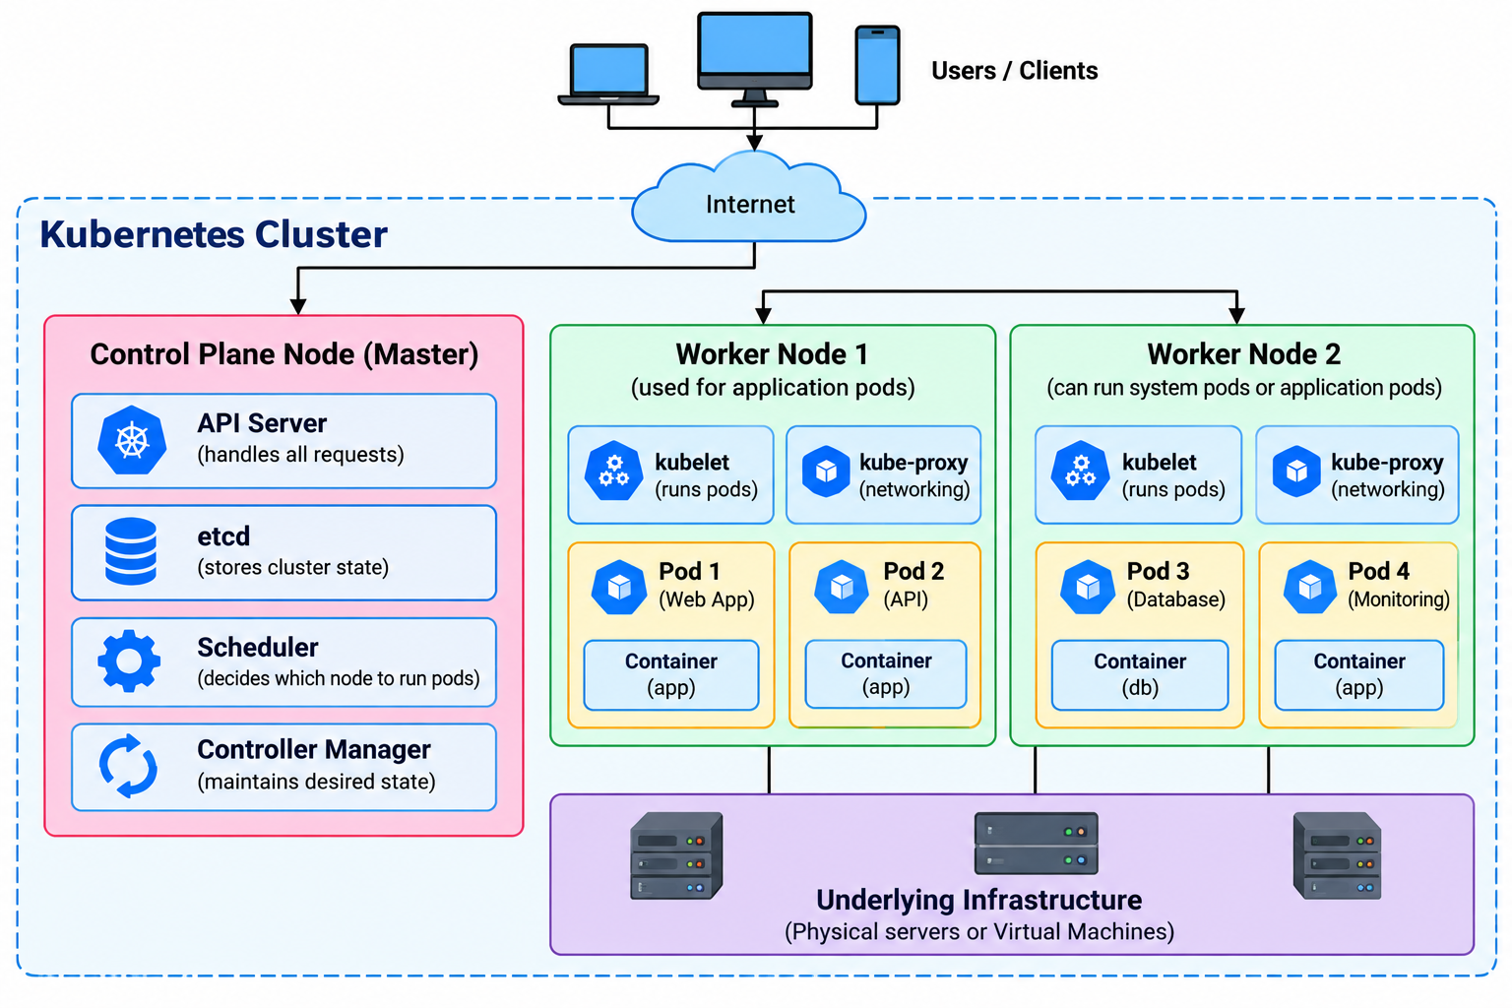
Kubernetes Architecture at a Glance

Slide 13
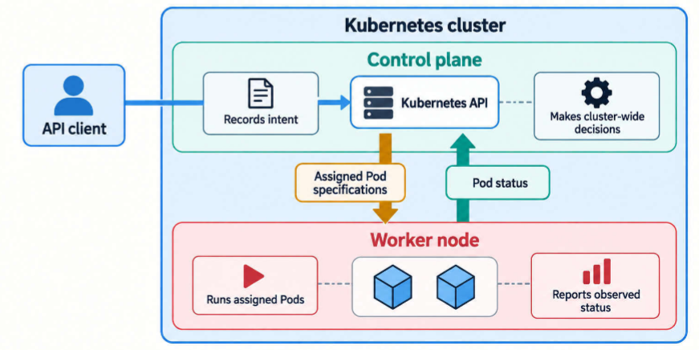
Kubernetes Cluster
Control plane: Set of components that expose the Kubernetes API, store cluster state, select nodes, and run controllers
Worker node: A machine that provides CPU, memory, networking, and storage access for application Pods
One control plane controls multiple worker nodes

Slide 14
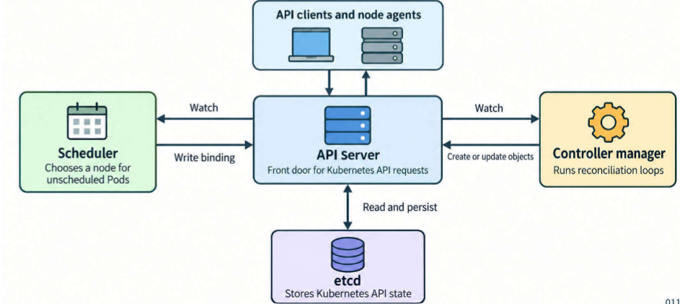
Control Plane
Component | Primary responsibility | What it does not normally do
API server | Accepts and serves Kubernetes API requests | Does not directly start application containers
etcd | Stores the control plane’s Kubernetes state | Does not store every application’s business data
Scheduler | Selects a node for a Pod that has no node assignment | Does not launch the container on that node
Controller manager | Runs built-in reconciliation loops | Does not replace application-specific logic

Slide 15
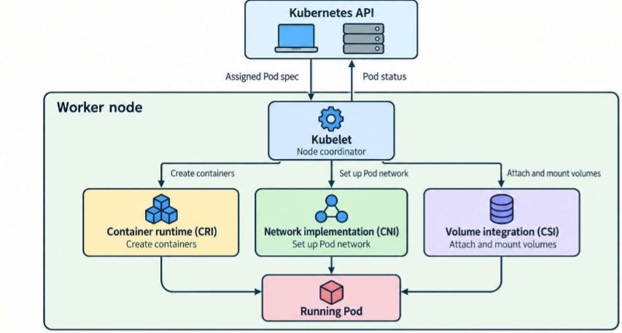
Worker Node
Component | Primary responsibility | What it does not normally do
Kubelet | Ensures Pods assigned to its node are running and reports their status | Does not decide the desired replica count or normally move Pods to another node
Container runtime (CRI) | Creates and runs containers on the worker node | Does not decide which node a Pod should run on
Network implementation (CNI) | Sets up Pod networking | Does not schedule Pods or create application containers
Volume integration (CSI) | Attaches and mounts storage volumes for Pods | Does not decide Pod placement or manage application logic
kube-proxy | Programs Service routing rules on the node so traffic to a Service reaches its Pods | Does not run application containers or choose which Pods back a Service

Slide 16
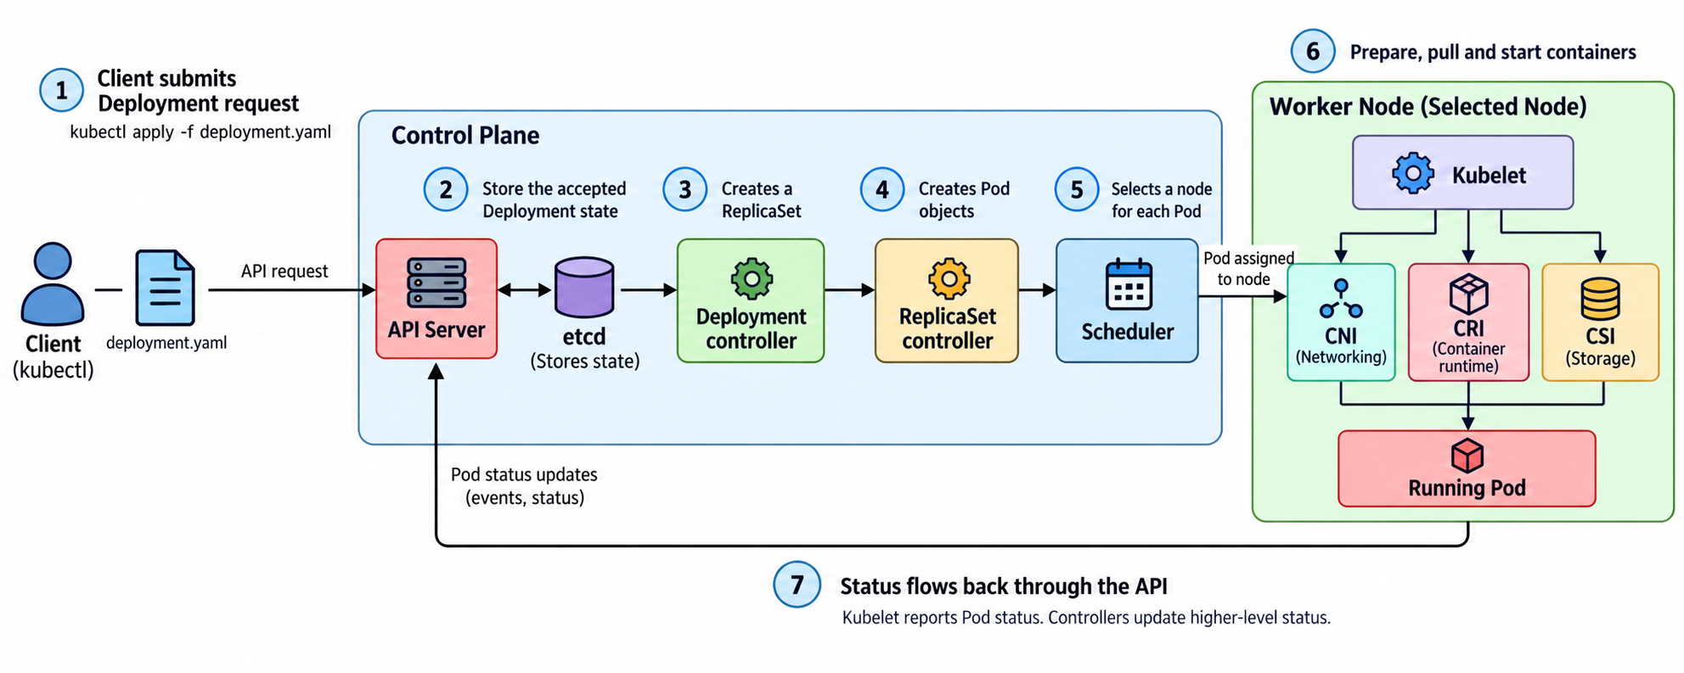
From kubectl apply to Running a Container

Slide 17
Hands-on: Pods and Deployments
Install minikube, run Pods, watch self-healing

Slide 18
Installing minikube (Ubuntu)
Task | Command
Download minikube | curl -LO https://storage.googleapis.com/minikube/releases/latest/minikube-linux-amd64
Install it | sudo install minikube-linux-amd64 /usr/local/bin/minikube
Let your user run Docker (once) | sudo usermod -aG docker $USER && newgrp docker
Start the cluster (first run takes a few minutes) | minikube start --driver=docker
Check the cluster is running | minikube status
Check the node is Ready | minikube kubectl -- get nodes
Create a kubectl shortcut | echo 'alias kubectl="minikube kubectl --"' >> ~/.bashrc
Load the shortcut | source ~/.bashrc
Verify | kubectl get nodes
Notes:
Docker must already be installed. If minikube start fails with 'permission denied' on the Docker socket, the usermod step was skipped or the shell was not restarted.

Slide 19
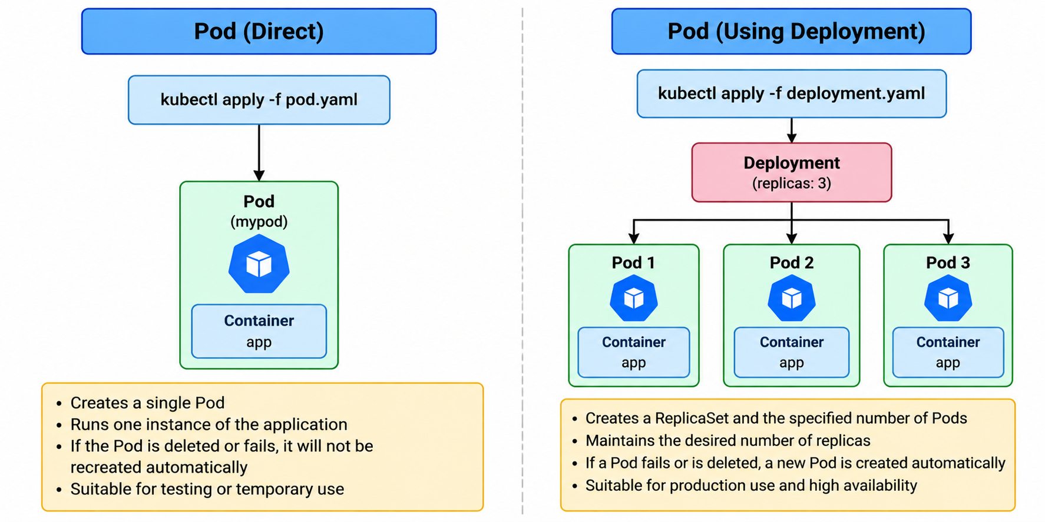
Pod Directly vs Pod via a Deployment

Slide 20
Pod Creation and Details
No. | Task | Command
1 | Run an Nginx pod | kubectl run nginx --image=nginx
2 | List pods | kubectl get pods
3 | Display detailed pod information | kubectl describe pod nginx
4 | View pod logs | kubectl logs nginx
5 | Execute a command inside the pod | kubectl exec nginx -- nginx -v
6 | Display the pod's YAML configuration | kubectl get pod nginx -o yaml
7 | Display the pod's IP address and node | kubectl get pod nginx -o wide
8 | Verify that Nginx is responding inside the pod | kubectl exec nginx -- curl -I http://localhost
9 | View the pod status continuously | kubectl get pods -w
10 | Delete the pod | kubectl delete pod nginx

Slide 21
Deployment
No. | Task | Command
1 | Create an Nginx Deployment | kubectl create deployment nginx --image=nginx
2 | List Deployments | kubectl get deployments
3 | List Pods created by the Deployment | kubectl get pods
4 | Display detailed Deployment information | kubectl describe deployment nginx
5 | Display detailed information about a Pod | kubectl describe pod <pod-name>
6 | View logs of a Pod | kubectl logs <pod-name>
7 | Display the Deployment configuration in YAML | kubectl get deployment nginx -o yaml
8 | Display the Pod IP address and worker node | kubectl get pods -o wide
9 | Scale the Deployment to three replicas | kubectl scale deployment nginx --replicas=3
10 | Delete the Deployment and its managed Pods | kubectl delete deployment nginx

Slide 22
Self-Healing: Pod Crash Simulation
No. | Task | Command
1 | Create an Apache Deployment with 5 replicas | kubectl create deployment apache --image=httpd --replicas=5
2 | In a second terminal, watch the Pods | kubectl get pods -w
3 | Delete one Pod manually | kubectl delete pod <pod-name>
4 | Observe the replacement Pod appear (terminal 2) | (new name, new IP)
5 | Verify that 5 replicas are maintained | kubectl get deployment apache
6 | See the ReplicaSet doing the work (DESIRED / CURRENT / READY) | kubectl get replicasets
7 | Delete another Pod; compare names, IPs and nodes | kubectl get pods -o wide
8 | Delete the Deployment and its managed Pods | kubectl delete deployment apache

Slide 23
Writing YAML
Pod → Deployment → Service → rolling update, one step at a time

Slide 24
From Commands to YAML
Imperative (what we did so far)
kubectl create deployment web ...
Quick to type
Nothing is saved: hard to review, repeat or share
Declarative (from now on)
kubectl apply -f deployment.yaml
The file is the source of truth, kept in Git
Apply it again anytime: same result
Let kubectl write the first draft for you
kubectl run web --image=nginx:1.26 --dry-run=client -o yaml > pod.yaml
kubectl create deployment web --image=nginx:1.26 --dry-run=client -o yaml > deployment.yaml
kubectl explain pod.spec.containers # built-in docs for any field
--dry-run=client builds the object without creating it; -o yaml prints it as YAML. Delete the empty status: {} and creationTimestamp lines.
Notes:
This bridges slides 15-17 (imperative) and the YAML steps. Desired state on slide 5 = the spec in these files.

Slide 25
Every Manifest Has the Same Four Parts
Field | Answers | Pod | Deployment | Service
apiVersion | Which API group and version? | v1 | apps/v1 | v1
kind | What type of object? | Pod | Deployment | Service
metadata | What is it called? Which labels? | name, labels | name | name
spec | What do I want? (desired state) | containers | replicas, selector, template | type, selector, ports
spec vs status
spec = desired state: you write it
status = actual state: Kubernetes fills it in
See both: kubectl get pod web -o yaml
YAML rules that bite
Indent with spaces, never tabs
key: value needs a space after the colon
- starts a list item (containers, ports)

Slide 26
Step 1: A Pod in YAML
1 Pod
2 Deployment
3 Scale
4 Service
5 Selectors
6 ClusterIP
7 One file
8 Rollout
9 Rollback
pod.yaml
Task | Command
Create | kubectl apply -f pod.yaml
Check | kubectl get pods -o wide
Inspect | kubectl describe pod web
Delete | kubectl delete pod web
Check again | kubectl get pods
apiVersion: v1
kind: Pod
metadata:
name: web
labels:
app: web # used later
spec:
containers:
- name: web
image: nginx:1.26
ports:
- containerPort: 80
Result
The Pod is gone for good: nothing recreates a bare Pod
That is why real workloads use a Deployment (next step)
Notes:
Same as kubectl run nginx on slide 15, but now the definition lives in a file.

Slide 27
Step 2: Wrap the Pod in a Deployment
1 Pod
2 Deployment
3 Scale
4 Service
5 Selectors
6 ClusterIP
7 One file
8 Rollout
9 Rollback
deployment.yaml blue = new vs Step 1
What changed
apps/v1 and kind: Deployment
replicas: 3 = desired state
selector says which Pods it owns
The Pod spec moved under template
apiVersion: apps/v1
kind: Deployment
metadata:
name: web
spec:
replicas: 3
selector: # must match labels below
matchLabels:
app: web
template: # the Pod from Step 1
metadata:
labels:
app: web
spec:
containers:
- name: web
image: nginx:1.26
ports:
- containerPort: 80
Try it
kubectl delete pod web
kubectl apply -f deployment.yaml
kubectl get deploy,rs,pods
kubectl delete pod <one-pod-name>
kubectl get pods -w
Notes:
kubectl get deploy,rs,pods shows the three levels of ownership: Deployment -> ReplicaSet -> Pods. Deleting one Pod shows a replacement appear, as on slide 17, but now from YAML.

Slide 28
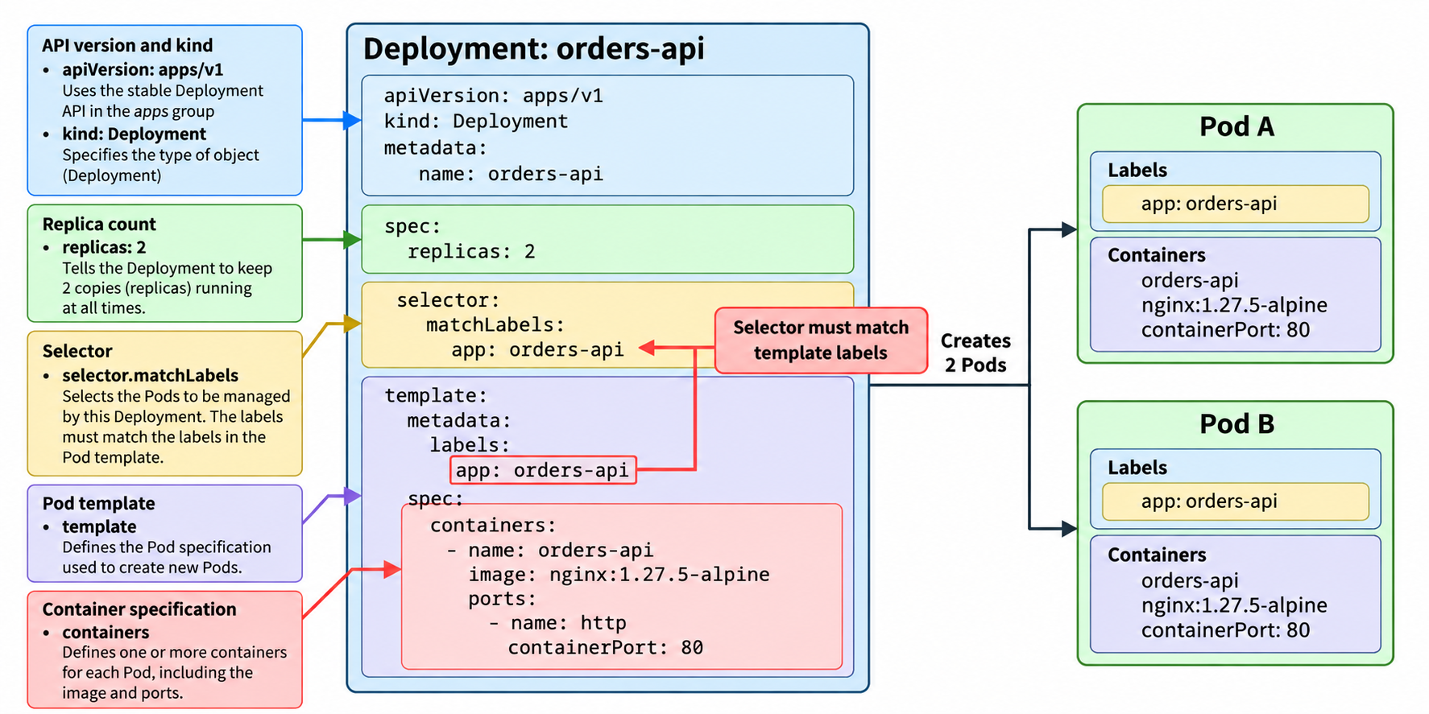
Deployment YAML: Anatomy

Slide 29
Labels and Selectors
Deployment web
selector: app=web
Pod web-7d4-abc
app=web
Rules
A label is a key=value tag on any object
A selector is a query: all Pods with app=web
Pod names change; labels don't, so everything links by label
Pod web-7d4-def
app=web
Pod web-7d4-xyz
app=web
Service web-svc
selector: app=web
Pod db-0
app=db
not selected
Two ways it goes wrong
Deployment selector ≠ template labels: apply is rejected
Service selector matches nothing: no endpoints, no traffic (Step 5)
Check with kubectl get pods --show-labels and kubectl get pods -l app=web

Slide 30
Step 3: Scale by Editing the File
1 Pod
2 Deployment
3 Scale
4 Service
5 Selectors
6 ClusterIP
7 One file
8 Rollout
9 Rollback
Before
After
Commands
kubectl apply -f deployment.yaml
kubectl get pods
spec:
replicas: 3
spec:
replicas: 5
kubectl scale vs editing the file
kubectl scale deployment web --replicas=5 also works (slide 16)...
...but the file still says 3, so the next kubectl apply quietly scales back to 3
With YAML, change the file and re-apply: the file stays the source of truth (slide 5)
Try it: scale to 5 with kubectl scale, then apply the file again and watch two Pods disappear

Slide 31
Services
Giving Pods a stable address: ClusterIP, NodePort, LoadBalancer

Slide 32
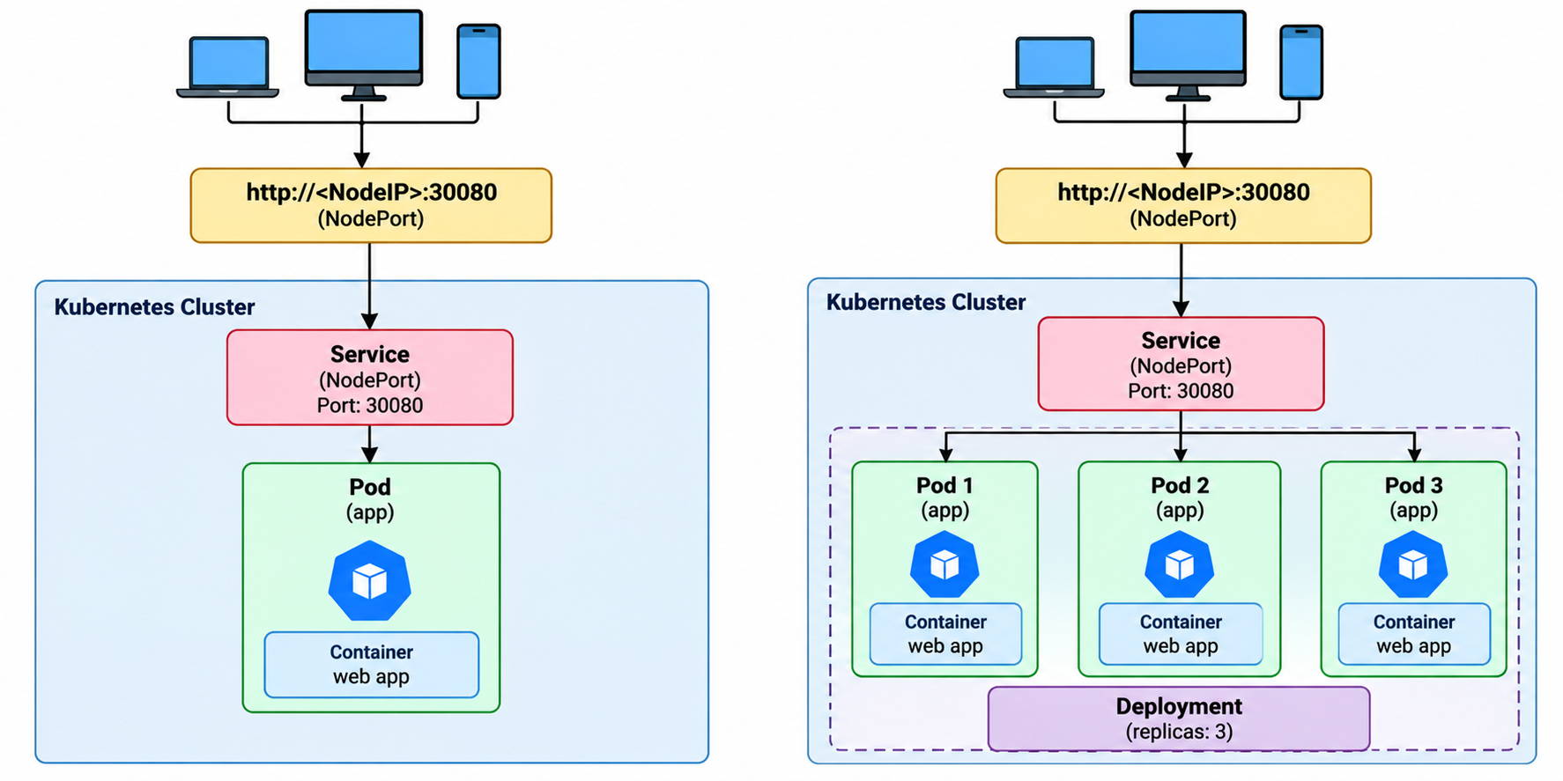
A Service in Front of Pods

Slide 33
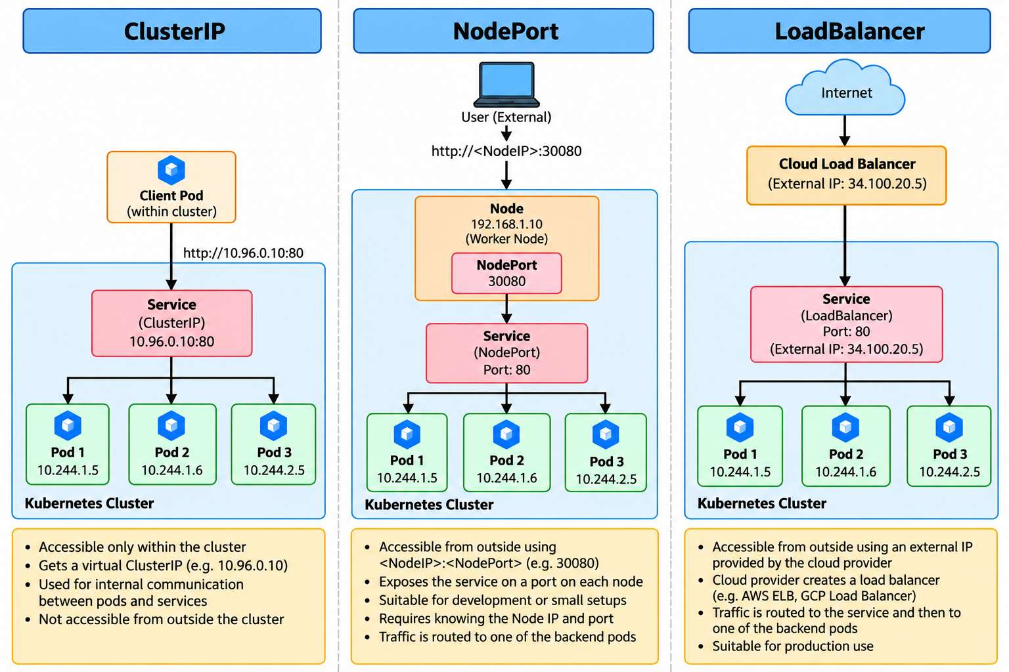
Three Service Types at a Glance

Slide 34
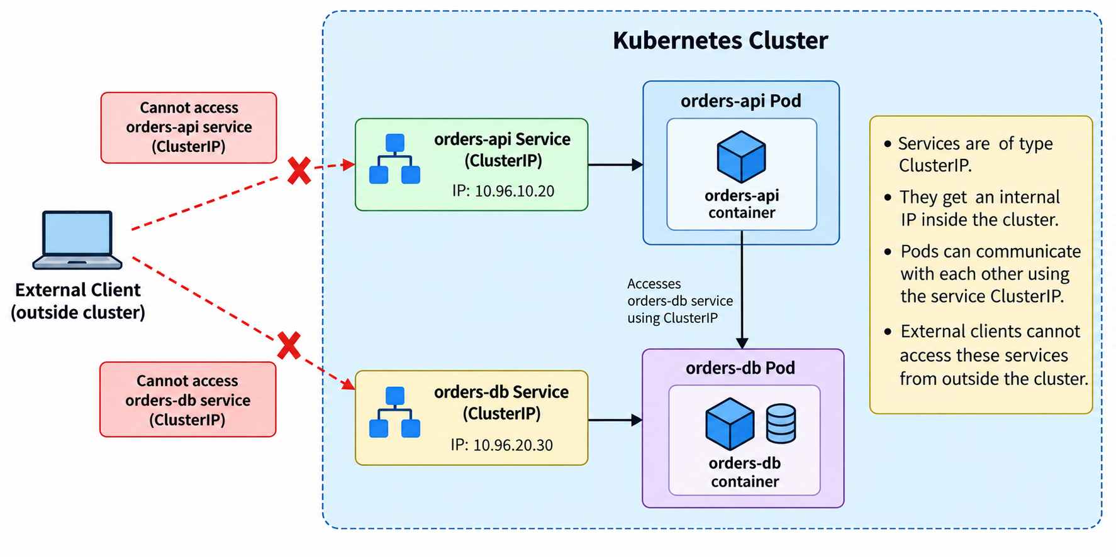
ClusterIP

Slide 35
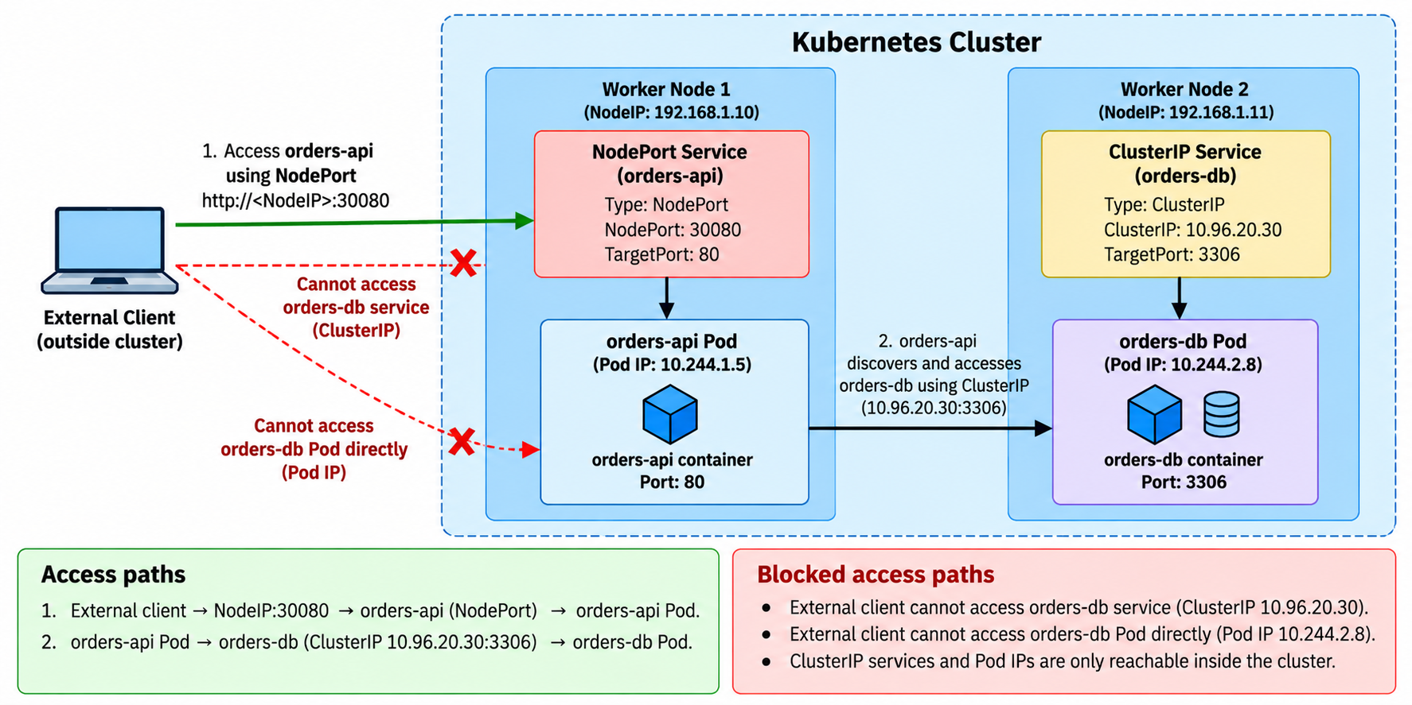
NodePort

Slide 36
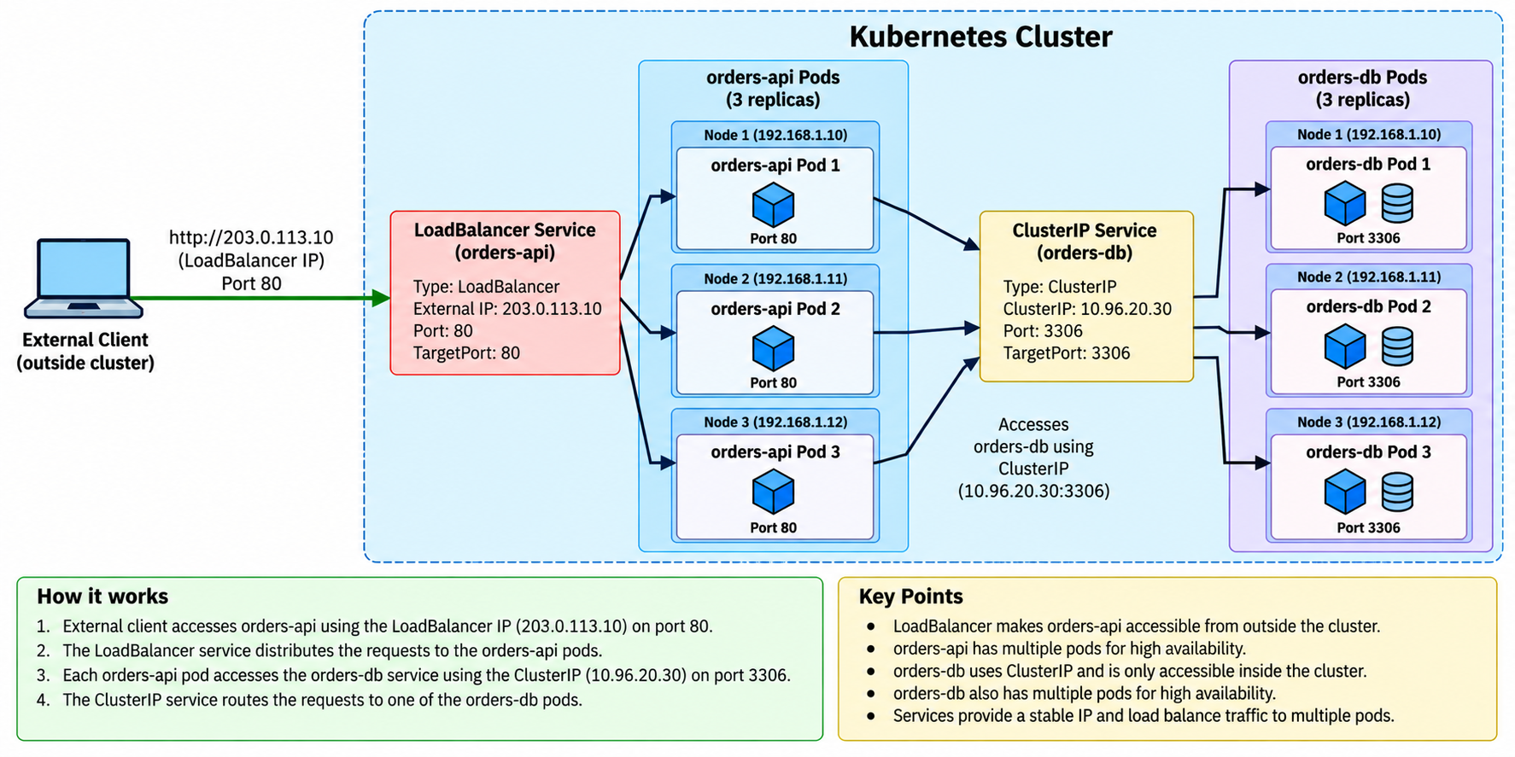
LoadBalancer
On minikube: run minikube tunnel in a separate terminal, otherwise EXTERNAL-IP stays <pending>.

Slide 37
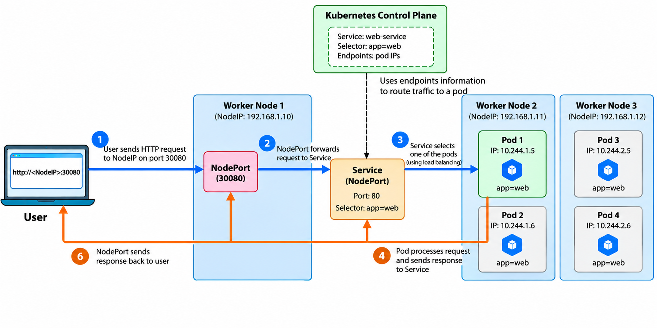
NodePort: Path of a Request

Slide 38
Step 4: Add a NodePort Service
1 Pod
2 Deployment
3 Scale
4 Service
5 Selectors
6 ClusterIP
7 One file
8 Rollout
9 Rollback
service.yaml
Browser
Check
get endpoints lists one IP per Pod
Scale to 5 and the list grows
apiVersion: v1
kind: Service
metadata:
name: web-svc
spec:
type: NodePort
selector:
app: web # Pods with this label
ports:
- port: 80 # Service port
targetPort: 80 # containerPort
nodePort: 30080 # 30000-32767
Node
nodePort 30080
Service web-svc
port 80
Pod
targetPort 80
Commands
kubectl apply -f service.yaml
kubectl get endpoints web-svc
minikube service web-svc --url
Notes:
Most confusion is port vs targetPort vs nodePort. The chain on the right is the path of a request, matching slide 20.

Slide 39
Step 5: What If the Selector Is Wrong?
1 Pod
2 Deployment
3 Scale
4 Service
5 Selectors
6 ClusterIP
7 One file
8 Rollout
9 Rollback
service.yaml (deliberate mistake)
# | Do | See
1 | kubectl apply -f service.yaml | configured
2 | kubectl get endpoints web-svc | <none>
3 | Refresh the browser | Connection fails
4 | kubectl get pods | All Pods still Running
5 | Set app: web again; apply | Endpoints are back
selector:
app: wrong # typo
Lesson
The Pods are fine: the Service simply cannot find them
First check when a Service “doesn't work”: kubectl get endpoints

Slide 40
Step 6: ClusterIP Is Internal Only
1 Pod
2 Deployment
3 Scale
4 Service
5 Selectors
6 ClusterIP
7 One file
8 Rollout
9 Rollback
service.yaml
Commands
kubectl apply -f service.yaml
kubectl get svc web-svc
kubectl run tmp --rm -it --image=busybox \ -- wget -qO- http://web-svc
spec:
type: ClusterIP # the default
selector:
app: web
ports:
- port: 80
targetPort: 80 # nodePort removed
From your browser
No port 30080 any more: not reachable from outside
That is the point of ClusterIP (slide on ClusterIP)
From inside a Pod
wget prints the nginx welcome page
web-svc is resolved by cluster DNS: this is service discovery
Notes:
Switch back to NodePort (Step 4 file) before Step 8 if you want to watch the rollout in the browser.

Slide 41
Step 7: One File: Deployment + Service
1 Pod
2 Deployment
3 Scale
4 Service
5 Selectors
6 ClusterIP
7 One file
8 Rollout
9 Rollback
k8s/deployment.yaml (from the kubernetes-static demo repo)
apiVersion: apps/v1
kind: Deployment
metadata:
name: cdac-web
spec:
replicas: 3
selector:
matchLabels:
app: cdac-web
template:
metadata:
labels:
app: cdac-web
spec:
containers:
- name: web
image: cdac-web:v1
imagePullPolicy: IfNotPresent
ports:
- containerPort: 80
---
apiVersion: v1
kind: Service
metadata:
name: cdac-web
spec:
type: NodePort
selector:
app: cdac-web
ports:
- port: 80
targetPort: 80
nodePort: 30080
Why one file
--- separates objects in one file
One apply -f creates both; delete -f removes both
Notes:
imagePullPolicy: IfNotPresent because the demo image is built inside minikube's Docker (eval $(minikube docker-env)), not pulled from a registry.

Slide 42
Kubernetes Demo
git clone https://github.com/newdelthis/kubernetes-static.git
Follow the steps in README.md file
  Build the v1 image inside minikube: eval $(minikube docker-env)
  Deploy: kubectl apply -f k8s/deployment.yaml
  Self-healing and scaling
  Rolling update to v2, then roll back to v1
v1
“Welcome to C-DAC” in blue
v2
Text in red, plus “This is Kubernetes”

Slide 43
Accessing a Pod Using a Service
Task | Command
Create the Deployment and Service | kubectl apply -f k8s/deployment.yaml
Check the Deployment | kubectl get deployments
Check the three Pods | kubectl get pods -o wide
Check the Service and NodePort | kubectl get svc cdac-web
Get the URL (works on any OS) | minikube service cdac-web --url
Or build it from the node IP (Linux) | echo "http://$(minikube ip):30080"
minikube ip returns e.g. 192.168.49.2, so open http://192.168.49.2:30080
On Docker Desktop (Windows/Mac) the node IP is not reachable from the browser: use minikube service cdac-web --url
Old page after an update? Hard refresh (Ctrl+Shift+R)

Slide 44
Rolling Updates and Rollback
Ship a new version with zero downtime, and undo it

Slide 45
Rolling Updates
Topic | Details
Definition | Rolling update is the process of updating application pods gradually without downtime
Best for | Stateless microservices such as web APIs, catalog, authentication, cart
Benefit | Zero / minimal downtime
Controller | Managed automatically by the Deployment Controller
Example | Update catalog-service:1.0 → catalog-service:1.1 (and roll back if needed)
Step | Pods Running | Explanation
Before update | 5 × v1.0 | All pods running old version
Step 1 | 4 × v1.0 + 2 × v1.1 | 1 old pod removed, 2 new pods started
Step 2 | 2 × v1.0 + 4 × v1.1 | New pods Ready: 2 more old pods replaced
Final | 5 × v1.1 | Last old pod replaced; all pods updated
maxSurge 1 / maxUnavailable 1 (next slide): at most 6 Pods, at least 4 available. Defaults if omitted: 25% / 25%.

Slide 46
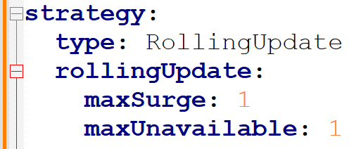
Rolling Updates
Never have more than one pod above the desired state, meaning we can have a maximum of 5 + 1 = 6 pods if rs = 5
Never have more than one pod below the desired state, meaning minimum number of pods must be 5 - 1 = 4
Conclusion: This rollout will update 2 pods at a time (delta between 6 and 4)
YAML Line | Meaning | Example with 5 Replicas
type: RollingUpdate | Update pods gradually | Pods are replaced a few at a time (here 2)
maxSurge: 1 | 1 extra pod can be created during update | Total pods may become 6 temporarily
maxUnavailable: 1 | At most 1 pod can be down during update | Minimum 4 pods remain available

Slide 47
Step 8: Rolling Update from YAML
1 Pod
2 Deployment
3 Scale
4 Service
5 Selectors
6 ClusterIP
7 One file
8 Rollout
9 Rollback
deployment.yaml
Where | Command
Terminal 2 | kubectl get pods -w
Terminal 1 | kubectl apply -f deployment.yaml
 | kubectl rollout status deployment/web
 | kubectl get rs
 | kubectl exec deploy/web -- nginx -v
 | kubectl rollout history deployment/web
spec:
replicas: 5
strategy:
type: RollingUpdate
rollingUpdate:
maxSurge: 1
maxUnavailable: 1
minReadySeconds: 10 # time to watch
...
containers:
- name: web
image: nginx:1.27 # was 1.26
Truly zero downtime
Old ReplicaSet is scaled to 0 and kept for rollback
Real apps add a readinessProbe, so a Pod only gets traffic once it can actually serve
Pin versions
With image: nginx:latest there is nothing new to roll to

Slide 48
Step 9: Bad Update and Rollback
1 Pod
2 Deployment
3 Scale
4 Service
5 Selectors
6 ClusterIP
7 One file
8 Rollout
9 Rollback
deployment.yaml
# | Do | See
1 | kubectl apply -f deployment.yaml
2 | kubectl get pods | 2 new Pods ImagePullBackOff; 4 old Pods Running
3 | kubectl rollout status deployment/web | Never completes (Ctrl+C)
4 | kubectl rollout undo deployment/web | Back to 5 Running on 1.27
5 | nano deployment.yaml | Set image back to 1.27, or the next apply repeats the mistake
image: nginx:9.99 # no such tag
Why the app stayed up
maxUnavailable: 1 lets only 1 of the 5 old Pods go before new Pods are Ready
The new Pods never become Ready, so the rollout stalls with 4 old Pods still serving
rollout undo switches back to the previous ReplicaSet
Notes:
This is the 'zero downtime + rollback' promise from the Key Features slide, demonstrated.

Slide 49
Rolling Updates
Step | Command | What to look for
1 | cd ~ git clone https://github.com/newdelthis/rolling_initial.git cd rolling_initial
2 | kubectl apply -f deployment.yml kubectl apply -f service.yml minikube service cdac-service | Browser shows version 1.0
3 | kubectl get pods -w | Run in a second terminal and leave it open
4 | nano deployment.yml | Change image to newdelthis/rolling:2.0
5 | kubectl apply -f deployment.yml kubectl rollout status deployment/cdac-demo | Pods replaced 2 at a time; refresh the browser
6 | kubectl get rs kubectl rollout history deployment/cdac-demo | Old ReplicaSet scaled to 0, kept for rollback
7 | kubectl rollout undo deployment/cdac-demo | Browser back on version 1.0
Notes:
service.yml does not need re-applying for a rollout: only the Deployment's Pod template changed. minReadySeconds: 30 in the repo slows the rollout down so students can watch it.

Slide 50
Wrap-up
Troubleshooting and a kubectl cheat sheet

Slide 51
Common Errors and First Checks
What you see | Usual cause | First command
Pending | No node has enough CPU/memory | kubectl describe pod <name>
ErrImagePull / ImagePullBackOff | Wrong image name or tag; image built outside minikube | kubectl describe pod <name>
CrashLoopBackOff | Container starts, then exits (app error, bad command) | kubectl logs <name> --previous
Service gives no response | Selector matches no Pods, so no endpoints | kubectl get endpoints <svc>
apply rejected: selector does not match template labels | matchLabels ≠ template labels | Compare both in the YAML
YAML parse error (mapping values not allowed...) | Tabs or wrong indentation | Re-indent with spaces
Rollout never finishes | New Pods never become Ready | kubectl rollout undo deployment/<name>
Notes:
describe -> look at the Events section at the bottom.

Slide 52
kubectl Cheat Sheet
Look
kubectl get pods -o wide
kubectl get deploy,rs,svc
kubectl describe pod <name>
kubectl logs <name>
kubectl get pod <name> -o yaml
Change
kubectl apply -f <file>
kubectl delete -f <file>
kubectl scale deployment <d> --replicas=N
kubectl exec <pod> -- <cmd>
kubectl explain <kind.field>
Rollouts
kubectl rollout status deployment/<d>
kubectl rollout history deployment/<d>
kubectl rollout undo deployment/<d>
kubectl set image deployment/<d> <c>=<img>
minikube
minikube start --driver=docker
minikube status
minikube service <svc> --url
minikube tunnel
minikube stop

