Slide 1
Fraud Detection
Enhancing detection with CTGAN-generated synthetic data

Slide 2

Introduction
Generative AI addresses a core challenge: class imbalance in fraud datasets by producing realistic synthetic fraud samples using CTGAN.
This approach aims to augment training data to improve model performance and detection metrics, particularly recall and F1-score.

Slide 3
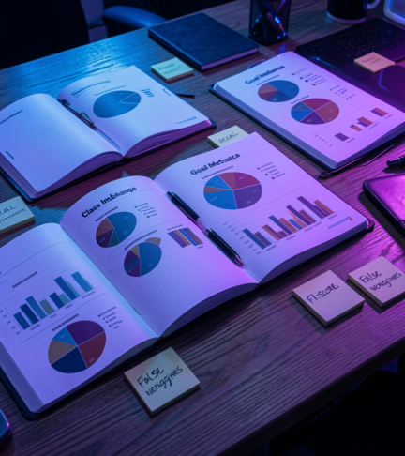
01
Problem & Goals

Slide 4
Class imbalance
The Credit Card Fraud dataset has fraud cases 1%, causing models to under-detect fraud and yield low recall.
Imbalanced classes lead to many false negatives and poor real-world performance.

Slide 5

Objective: synthesize fraud
Train CTGAN on existing fraud samples to generate realistic synthetic fraud, then augment the dataset and retrain models (Random Forest).
Goal: achieve higher recall and improved F1-score, reducing false negatives.

Slide 6
Evaluation metrics
Key metrics: Recall, Precision, F1-score, and AUC.
Focus on recall to minimize missed frauds while monitoring precision to control false positives.
Use confusion matrix and class-wise reporting to track improvements after augmentation.

Slide 7
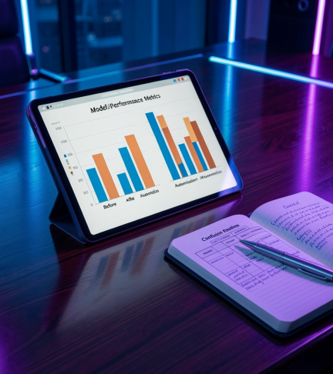
01
Method & Results

Slide 8
CTGAN data generation
Train CTGAN on the minority class (fraud) to learn tabular distributions and correlations.
Generate realistic synthetic fraud samples that preserve feature relationships and variability.

Slide 9
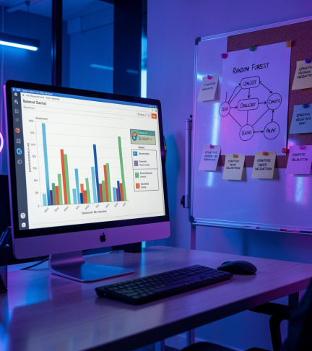
Augmentation + Random Forest
Combine synthetic fraud with original data to create a balanced training set.
Retrain a Random Forest classifier using stratified validation to evaluate gains.

Slide 10
Improvements: recall & F1
Post-augmentation results show higher recall and improved F1-score, indicating fewer missed frauds.
Monitor precision and AUC to ensure overall classifier robustness.

Slide 11
Conclusions
Augmenting imbalanced fraud data with CTGAN-generated samples substantially improves detection performance, notably recall and F1.
This generative approach offers a scalable solution to class imbalance, with further gains possible through model tuning and deployment in real-time pipelines.

Slide 12
Thanks!
Do you have any questions?
youremail@freepik.com
+91 620 421 838
yourcompany.com
Please keep this slide for attribution

