Slide 1
FEC Campaign Finance Project

Slide 2
Background
Campaign costs have accelerated rapidly
Record number of candidates to keep track of this cycle
Currently, most deadline compiling done by hand at CNN
Very time-consuming
Reporters/producers spend time compiling records together – taking away from time to analyze them for stories
Competition frequently has beaten us to the punch on deadline nights

Slide 3
What we needed
Capability to track and analyze campaign reports in real time as they are filed with the FEC
Ability to see summary-level comparisons of the candidates instantly
Capacity to do quick-turnaround deadline and innovative analysis
Power to fuel data visualizations for digital and broadcast

Slide 4
What we needed
Capability to track and analyze campaign reports in real time as they are filed with the FEC
Ability to see summary-level comparisons of the candidates instantly
Capacity to do quick-turnaround deadline and innovative analysis
Power to fuel data visualizations for digital and broadcast

Slide 5
What we’ve built
Relational database updated in real time to pull in and parse into clean data columns the presidential, congressional and PAC reports
Allows for sophisticated analyses, such as state and zip code comparisons, timeline explorations, tracking “mega-donors,” etc.
Will connect directly into the future CNN election API – feeding the data to all digital and broadcast platforms
Easy-to-use website for CNN staffers to pull interactive results on deadline
Summary-level information to compare across all campaigns (e.g. raised, spent, cash)
Common calculations done for us and ready to go (e.g. burn rate)
Individual contributions and disbursements for each candidate

Slide 6
How We’ve Built It
Created a cross-functional team consisting of editorial, engineering, development and design folks
Worked in tandem with each other throughout the process to focus on the user experience and business needs
Utilized agile concepts and philosophies to fuel collaboration
Consistently improved the product vision along the way in response to user feedback from reporters, editors and designers
Contracted a subject-matter expert in FEC data and backend development, Alex Cohen, to build the database and accompanying tool
Expedited the development process from months to weeks
Leveraged existing CNN internal cloud resources to host and deploy the tools
No additional overhead beyond the incremental cloud computing costs

Slide 7
Value Added
Proof of concept that a dedicated cross-functional unit combining both technical and editorial members could lead to a successful outcome
CNN now can compete with other outlets with existing FEC capabilities on deadline and on enterprise
CNN can begin creating rich interactive experiences around political money on its website, mobile platforms and on television
Staff time that had previously been spent on less-valuable data entry and compiling tasks can instead be spent on reporting and analyzing
Across the board, CNN now has a single source of campaign finance information everyone can pull from for their journalism and other products

Slide 8
Some story examples: What’s now possible?
***zip maps will be updated later tonight

Slide 9
Zip Code Analysis
Comparing Candidates Head-to-Head

Slide 10
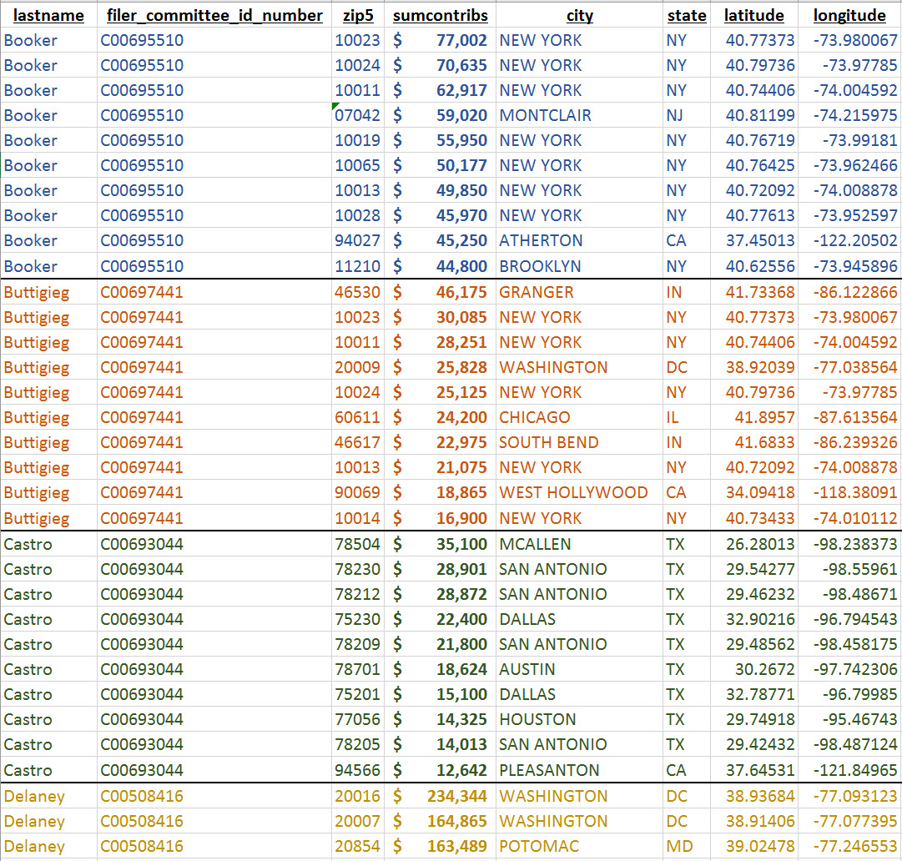
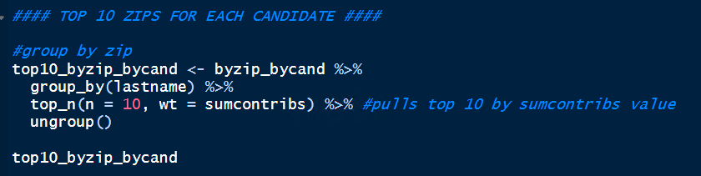
Top 10 Zips for each candidate

Slide 11
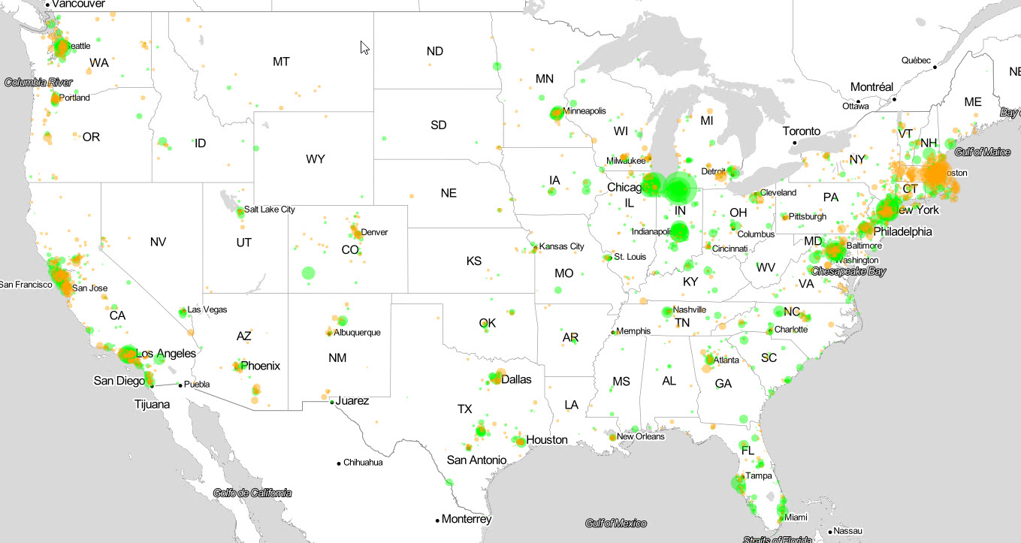
Buttigieg (green) vs Warren (orange) Who raised more in each zip code

Slide 12
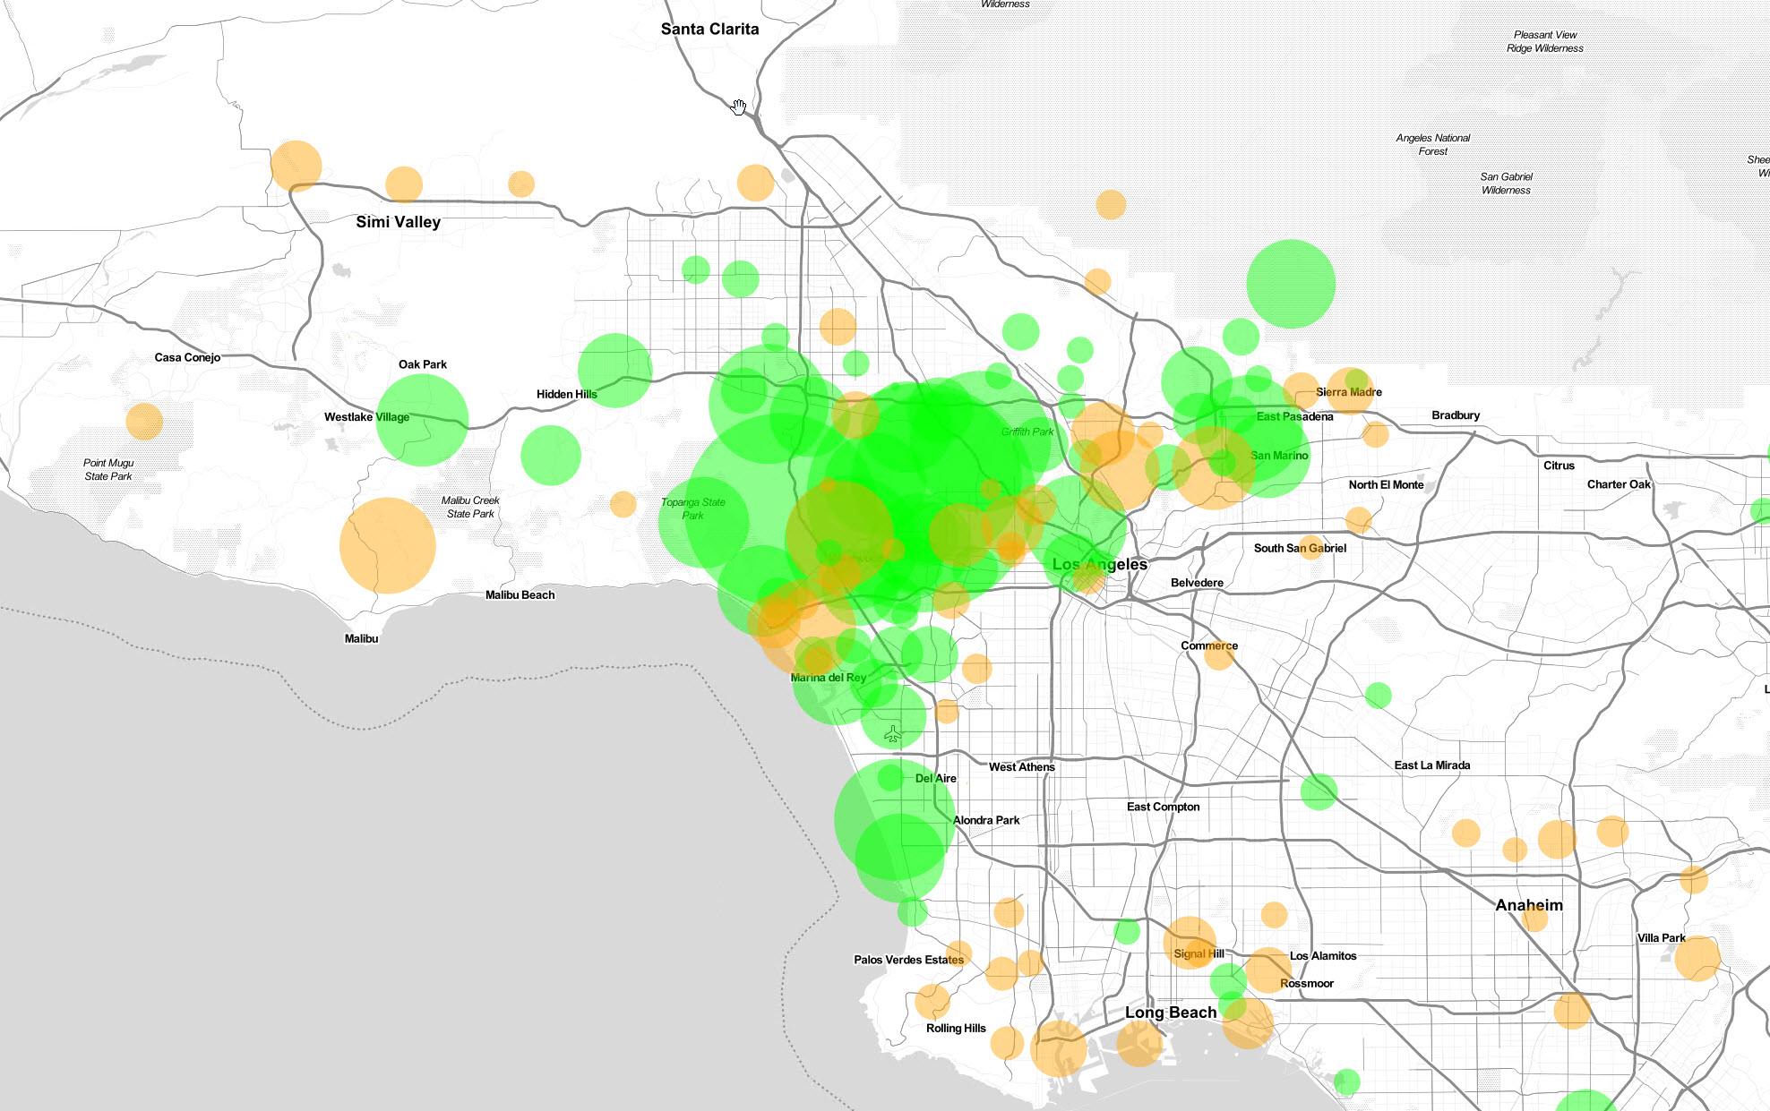
Buttigieg vs Warren Los Angeles

Slide 13
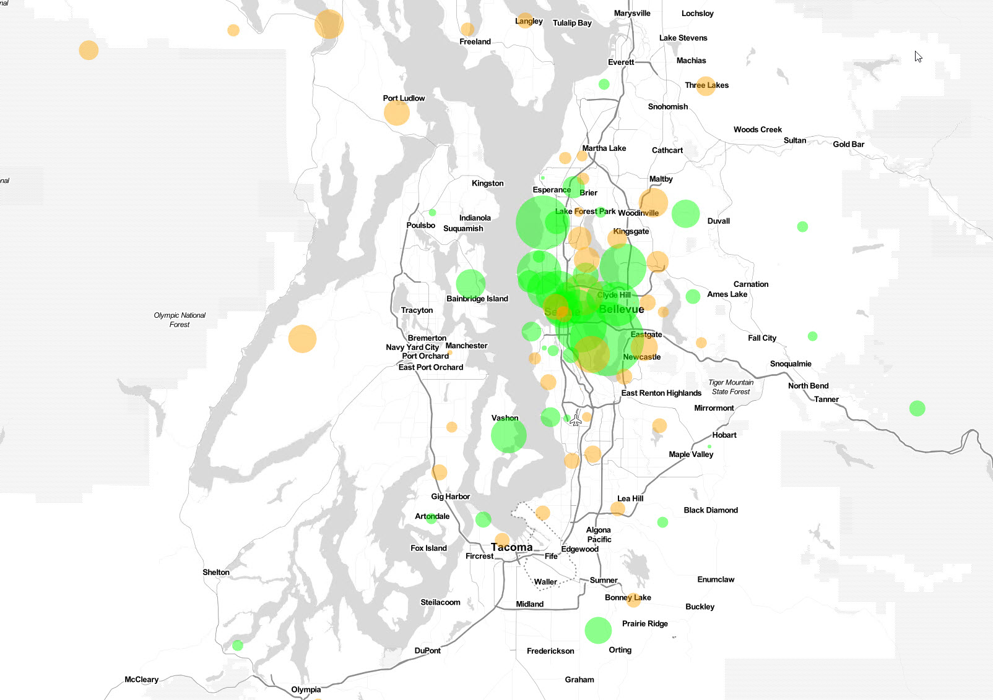
Buttigieg vs Warren Seattle

Slide 14
Timelines
Daily Contribution Trends

Slide 15
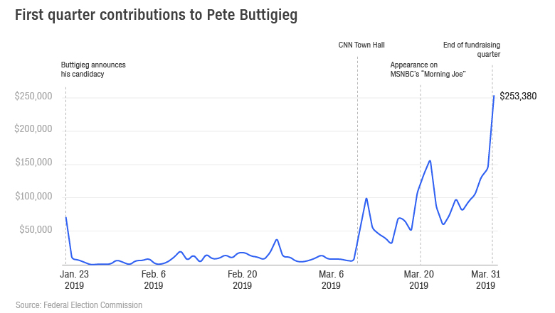

Slide 16
Interactive Data Tool Demo
Let’s take a look!

Slide 17
Demo demo demo etc etc etc

