Slide 1
FEC Campaign Finance Project

Slide 2
Background
Campaign costs have accelerated rapidly
Record number of candidates to keep track of this cycle

Slide 3
What we needed
Capability to track and analyze campaign reports in real time as they are filed with the FEC
Ability to see summary-level comparisons of the candidates instantly
Capacity to do quick-turnaround deadline and innovative analysis
Power to fuel data visualizations for digital and broadcast

Slide 4
What we’ve built
Relational database updated in real time to pull in and parse into clean data columns the presidential, congressional and PAC reports
Easy-to-use website for CNN staffers to pull interactive results on deadline

Slide 5
How We’ve Built It
Created a cross-functional team consisting of editorial, engineering, development and design folks
Contracted a subject-matter expert in FEC data and backend development, Alex Cohen, to build the database and accompanying tool
Leveraged existing CNN internal cloud resources to host and deploy the resulting tools

Slide 6
An Example: Zip Code Analysis

Slide 7
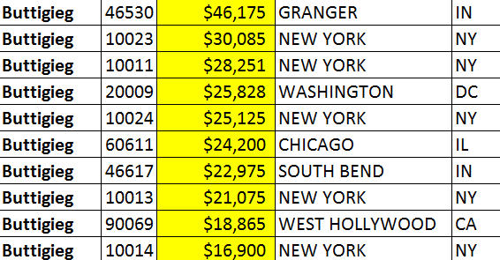
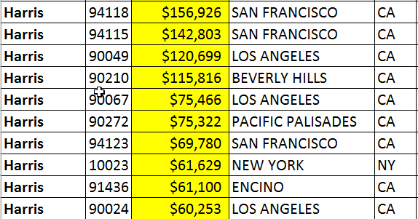
Top 10 Zips for each candidate

Slide 8
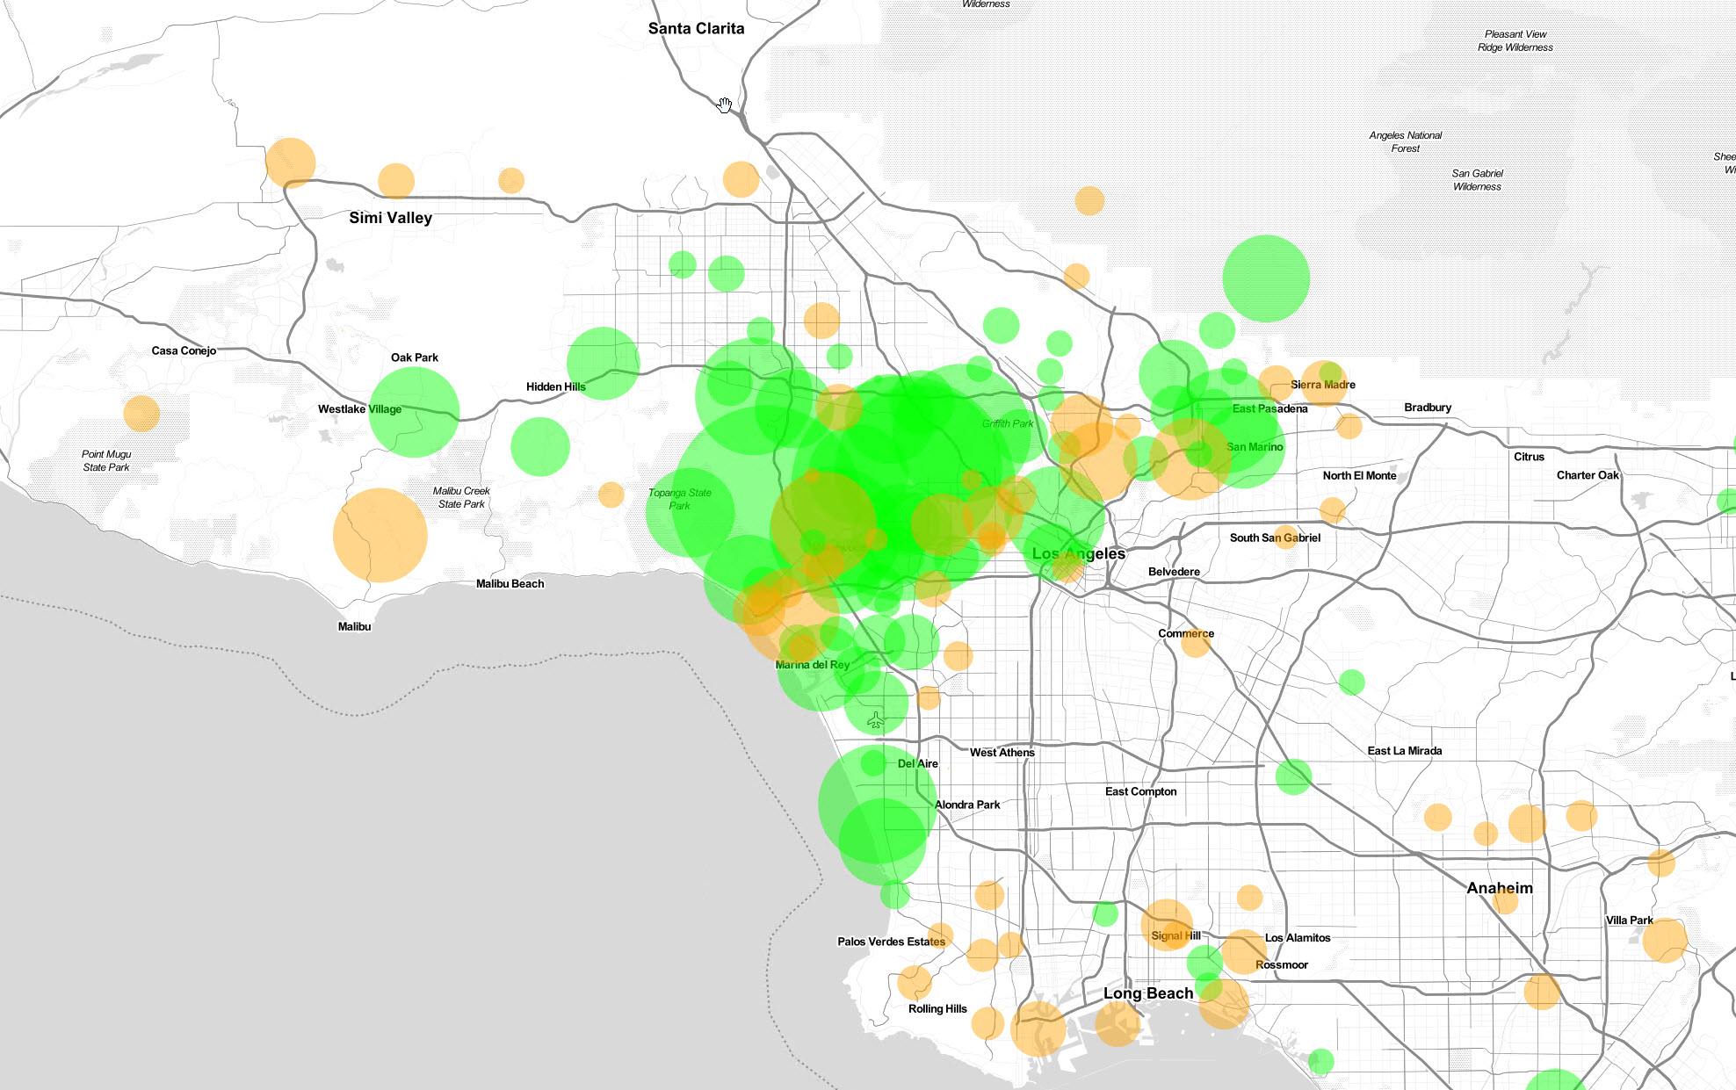
Buttigieg vs Warren Los Angeles Area

Slide 9
***Add Booker vs. Harris NYC Map here

Slide 10
Daily Contribution Trends
Matching Patterns to Known Events

Slide 11
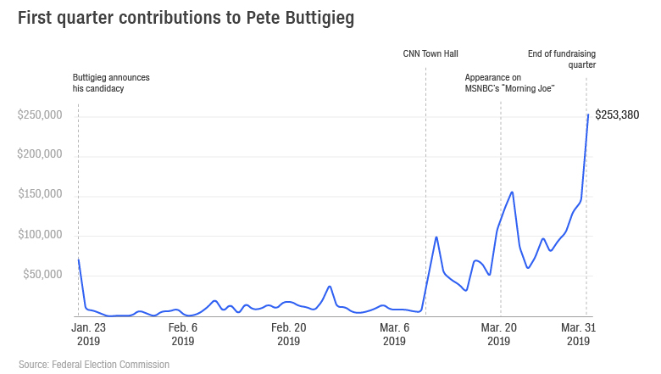

Slide 12
Magic Wall Integration
Top States and Counties for Contributions

Slide 13
***MW screenshots

Slide 14
Interactive Data Tool Demo
Let’s take a look!

