Slide 1
Qardy – 2024 Achievements
Abdelrahman Kamel

Slide 2
Product Releases Overview
01

Slide 3
User Portal Release Versions by Quarter
01
02
03
04
Q1 Releases
Q2 Releases
Q3 Releases
Q4 Releases
Version 1.0.0: This release includes our newest product of micro-financing, designed to give access to micro companies and individuals to get their loans in the fastest way possible through our Qardy platform along with minor updates in real-time notifications.
Version 1.0.1: Microfinance Phase 2 improvements
Version 1.0.2: Enhancements & updates for Microfinance & Supply Chain Finance
Version 1.0.3: Microfinance Phase 3, signup user activation process, & minor supply chain finance updates.
Version 1.0.4: Supply chain finance Notification Triggers & a fix in invoice value validation.
Version 1.0.5: Notification for returned apps.
Version 1.0.6: SME Loan Cycle Update
Version 1.0.7: SME & Micro Apps Updates w/ Docs Previewer.
Version 1.0.8: User Profile & Documents Verification.
Version 1.0.9: Invoice Payment Plan on User.
Version 1.1.1: Export Feature for payment plans.

Slide 4
Finance Portal Release Versions by Quarter
01
02
03
04
Q1 Releases
Q2 Releases
Q3 Releases
Q4 Releases
Version 1.0.0: Adding microfinance product on finance portal
Version 1.0.1: Bank Portal Revamp (Phase 1) & UI improvements
Version 1.0.2: Supply Chain Finance updates & Loan Apps extra features
Version 1.0.3: Dismiss reason flow & bug fixes.
Version 1.0.4: Return App Notification & Searching in Arabic.
Version 1.0.5: SME loan cycle updates & bug fixes
Version 1.0.6: Bank Roles & Permissions & new FI Dashboard
Version 1.0.7: SME & Micro Apps Updates w/ Docs Previewer Version 1.0.8: FI Notes on Finance.
Version 1.0.9: Invoice Payment Plan on FI & Dashboard updates.
Version 1.1.1: Export Feature for payment plans.
Version 1.1.2: Rejection Reasons

Slide 5
Admin Portal Release Versions by Quarter
01
02
03
04
Q1 Releases
Q2 Releases
Q3 Releases
Q4 Releases
Version 1.0.0: Adding microfinance product on admin portal & loan applications cycle improvements
Version 1.0.1: Admin updates and improvements for loan apps
Version 1.0.2: New Filters & General improvements
Version 1.0.3: Dismiss reason flow & bug fixes.
Version 1.0.4: Returned Apps Cycle & Other improvements.
Version 1.0.5: SME loan cycle updates & bug fixes
Version 1.0.6: Bank Roles & Permissions on Admin
Version 1.0.7: SME & Micro Apps Updates w/ Docs Previewer Version 1.0.8: FI Notes on Admin.
Version 1.0.9: Invoice Payment Plan on Admin.
Version 1.1.1: Export Feature for payment plans.
Version 1.1.2: Rejection Reasons

Slide 6
New Main Products
02

Slide 7
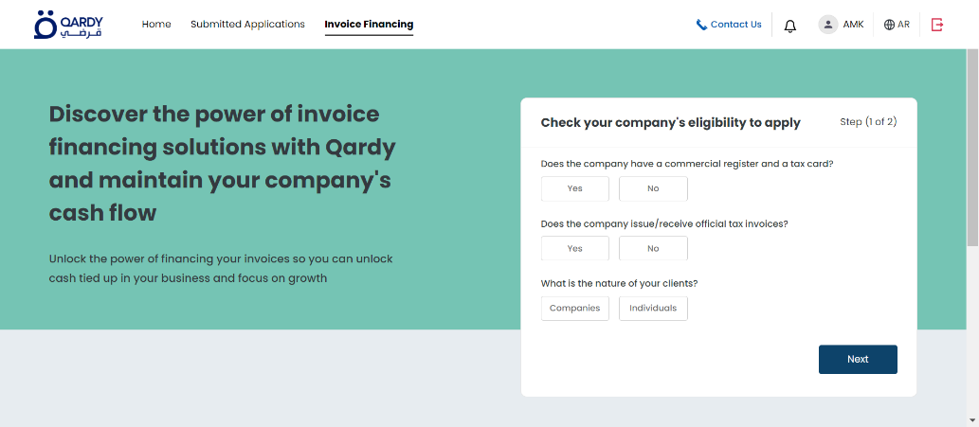
Supply Chain Finance
Product Overview
01
Supply Chain Finance is designed to streamline financial operations within supply chains, offering real-time tracking and automated payment solutions.
02
Market Impact
The product has significantly played a pivotal role in the digital transformation of supply chain financing.
Key Features
03
Real-time transaction monitoring, automated invoice processing, and user-friendly interface to handle financing lines.

Slide 8
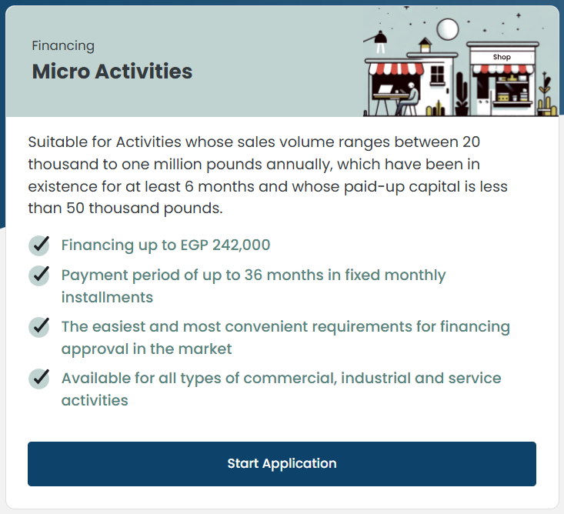
Microfinance
01
Product Overview
Microfinance is a financial service that provides very small loans, savings accounts, and other financial products to low-income individuals and who traditionally lack access to such services from traditional banks.
02
Market Impact
Qardy has empowered thousands of individuals through the addition of the microfinance product.
03
Key Features
Streamlined application process, flexible loan options, and easy-to-use.

Slide 9
Thank you for listening.
Any Questions?

