Slide 1
Federated Learning
Team 18
Andrew Lagattuta, Tian Lu, Clay McCollum, Anthony Mensah

Slide 2
Outline
Introduction
Definition
Problem Statement
Research Paper 1
Research Paper 2
Who wrote it
What is the focus of the research
Coding demo
Ethical concerns
Future of Federated Learning

Slide 3
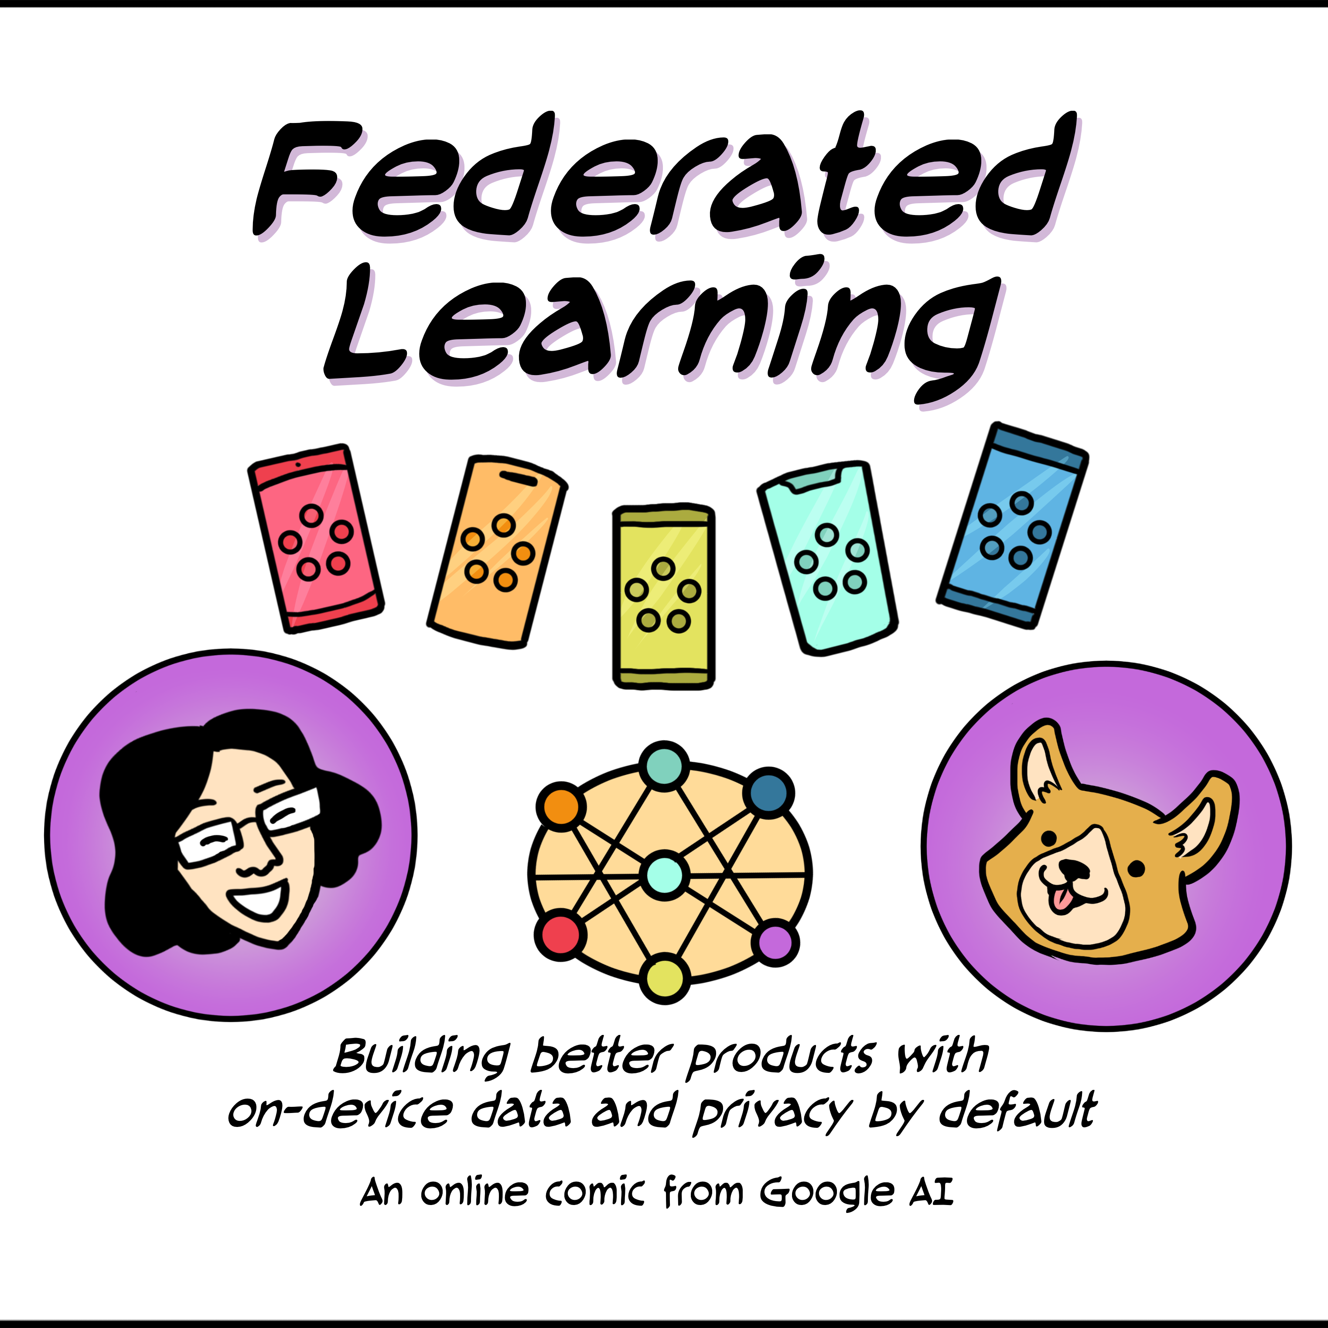
Introduction
Federated Learning is a machine learning technique that allows multiple parties to collaborate and train a model without sharing their data with each other.
In this approach, each party trains a local model using its own data, and then the local models are aggregated to create a global model that is more accurate than any individual local model.

Slide 4
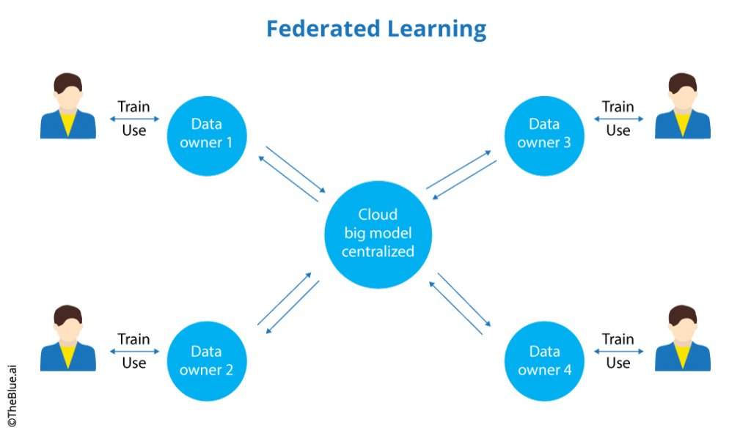
How it works
To implement Federated Learning, each participating party first trains a local model using its own data.
The local models are then sent to a central server, which aggregates them to create a global model. This global model is then sent back to the participants for further training and improvement.
The user data is never sent to a central server.

Slide 5
Problem statement
Dataset: Fashion MNIST
Background: Fashion retailers may want to improve their clothing recognition models by collaborating on training the models using their own customer data. However, due to privacy concerns, they cannot simply share their data with each other.
Solution: Federated Learning provides a solution to these challenges by allowing organizations to collaborate and improve their models without sharing their sensitive data. Instead, each organization trains its model locally, and only the model parameters are shared among them. This ensures that sensitive data remains private while still allowing the organizations to improve their models.

Slide 6
Research paper 1
Florian Hartmann, Software Engineer, Google Research
Predicting Text Selections with Federated Learning
November 22, 2021
text selection link

Slide 7
research
Smart Text Selection, launched in 2017 as part of Android O, is one of Android’s most frequently used features, helping users select, copy, and use text easily and quickly by predicting the desired word or set of words around a user’s tap, and automatically expanding the selection appropriately
According to him, they used Federated learning to train the neural network model on user interactions responsibly while preserving user privacy to improve the performance of Smart Text Selection

Slide 8
federated learning training process
A standard federated learning training process works as follows:
(a) The server starts by initializing the model.
(b) devices get sampled
(c) selected devices improve the model using their local data
(d) then the devices send back only the improved model, not the data used for training.
(e) The server then averages the updates it received to create the model that is sent out in the next iteration.

Slide 9
Benefit with this approach challenges
User privacy is achieved
Superior model quality is achieved
Challenges encountered - High error as the loss was not converged and predictions were random.
To overcome this challenge, we carefully designed high-level metrics that gave us an understanding of how the model behaved during training. Such metrics included the number of training examples, selection accuracy, and recall and precision metrics for each entity type.

Slide 10
Research paper 2
Federated Learning: Challenges, Methods, and Future Directions (IEEE)
Tian Li, Anit Kumar Sahu, Ameet Talwalker, Virginia Smith
May 2020
link

Slide 11
Privacy
Communicating model updates can reveal training data
Secure multiparty computation
Differential privacy
Accuracy – privacy tradeoff
Notes:
Changing model updates can reveal training data, by looking at how the central model changed before and after training
Cryptographic technqiues
Secure multiparty computation: each party holds data privately and compute a function without revealing inputs to each other
Differential privacy:
Change of one input does not result in output changing as much
Add noise randomly to the data, at intermediate computations
May sacrifice accuracy because adding random noise
SO have to balance, want to maintain privacy without losing accuracy

Slide 12
Systems heterogeneity
Local devices vary in hardware, network connectivity, power
Stragglers likely
Fault tolerance
Notes:
Hardware (CPU and memory) Network connectivity (3G, 4G, 5G, wifi) Power (battery) vary a lot
Because of this stragglers:
Parallel computing one node takes much longer than others, others wait, instead do asynchronous parallel computing, don’t wait for slow nodes
Because of discrepancies in local devices: anticipate low participation, tolerate different hardware, have fault tolerance: do not allow device failures to lead to system failures
If ignoring device failure
Bias towards devices with better network conditions
So, use dropout to reduce overfitting, training model will be prepared for devices dropping out and perform better

Slide 13
Statistical heterogeneity
Data generation will be different across devices
Meta learning
Notes:
Data generation will be different: varied language, number of data points, data distribution, quality of data
Data normalization: normalize by scaling
Meta learning: personalized, device specific modeling
Learning to learn
Good for few shot learning (when not much training data)
So good for federated learning when some devices don’t produce much data

Slide 14
Expensive communication
Bandwidth, energy, power are variable across devices
Difficult to send large updates over network
Parallel computing
Cryptographic techniques
Notes:
Computation may not always be efficient because bandwidth, energy, and power are different across devices
It is difficult to send the entire data set and large updates over the network
So, send smaller messages and updates iterably
How you do parallel computing: asynchronous or synchronous may make it more or less efficient
Cryptographic techniques to ensure privacy like Secure Multi Party computation and differential priacy are computationally expensive
Overall problem this paper proposes:
Beyond providing privacy guarantees, you need to ensure the model is computationally cheap and tolerant to dropped devices—without compromising accuracy.

Slide 15
Coding demo
https://colab.research.google.com/drive/1ZS63KOJRsH_FloynyQtgdNw_FQBi2RQ9?authuser=1#scrollTo=TURTA9Zgy1zc
Notes:
Computation may not always be efficient because bandwidth, energy, and power are different across devices
It is difficult to send the entire data set and large updates over the network
So, send smaller messages and updates iterably
Privacy techniques apply here because parallel computing improves efficiency: asynchronous is probably best as we discussed previously and also
Secure multi party computation and differential privacy
Fed Avging as discussed earlier: update model parameters before communicating with central server: reduce communication

Slide 16
Ethical concerns
Privacy
Bias
Security
Dummy data/sabotage
Transparency
Notes:
Privacy is the whole point of federated learning
Expands deep learning to sensitive and confidential data (healthcare finance)
But failing to keep this private will have consequences for the companies who volunteered their data and whoever is running the model
Bias: failed local devices may result in bias, big problem in healthcare/finance
Make sure training data is representative of population if put into use
Security: if data gets leaked/attacked, sensitive data may be exposed: risk for entities, this takes me to the next point:
Dummy data: use fake training data so they get access to the big model without putting their own data at risk
OR
Bad actors may sabotage the central model with bad training data
Transparency: if you cant see the data you trained on, how can you trust it? Have to trust the parties you are training your data with

Slide 17
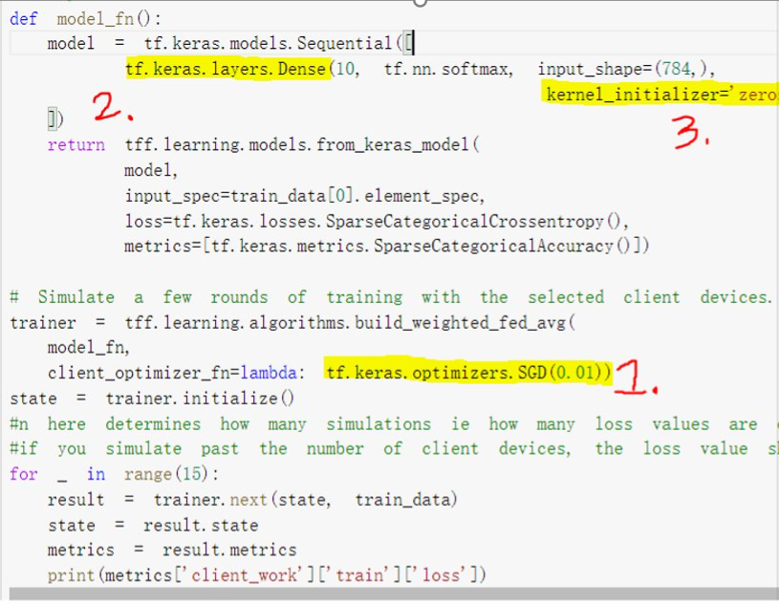
What is next?
Learning Rate: One potential improvement is to experiment with different optimization techniques. Using adaptive learning rates that adjust to the data distribution across client devices could lead to more efficient and effective training.
Model Layers: Experiment with different model architectures, such as adding more layers to the neural network. Make better performance and more accurate models.
Kernel Initializer: Current code uses a kernel initializer of 'zeros', which initializes all weights to zero. Experimenting with different kernel initializers, such as 'glorot_uniform', could lead to better model performance and faster convergence.

Slide 18
What is next?
Another important next step for Federated Learning is to improve scalability, allowing more client devices to participate in training without sacrificing performance or privacy.
Achieving scalability requires developing algorithms and architectures that are flexible and adaptable, allowing new client devices to be added to the training process with minimal overhead or disruption.
To enhance scalability, Federated Learning will need to evolve towards more model-based updates, where only the model weights are transmitted between devices, making the training process faster and more efficient.

Slide 19
Citations
Hartmann, F. (2021, November 22). Predicting Text Selections with Federated Learning [web log]. Retrieved April 11, 2023, from https://ai.googleblog.com/2021/11/predicting-text-selections-with.html.
T. Li, A. K. Sahu, A. Talwalkar and V. Smith, "Federated Learning: Challenges, Methods, and Future Directions," in IEEE Signal Processing Magazine, vol. 37, no. 3, pp. 50-60, May 2020, doi: 10.1109/MSP.2020.2975749.

