Slide 1
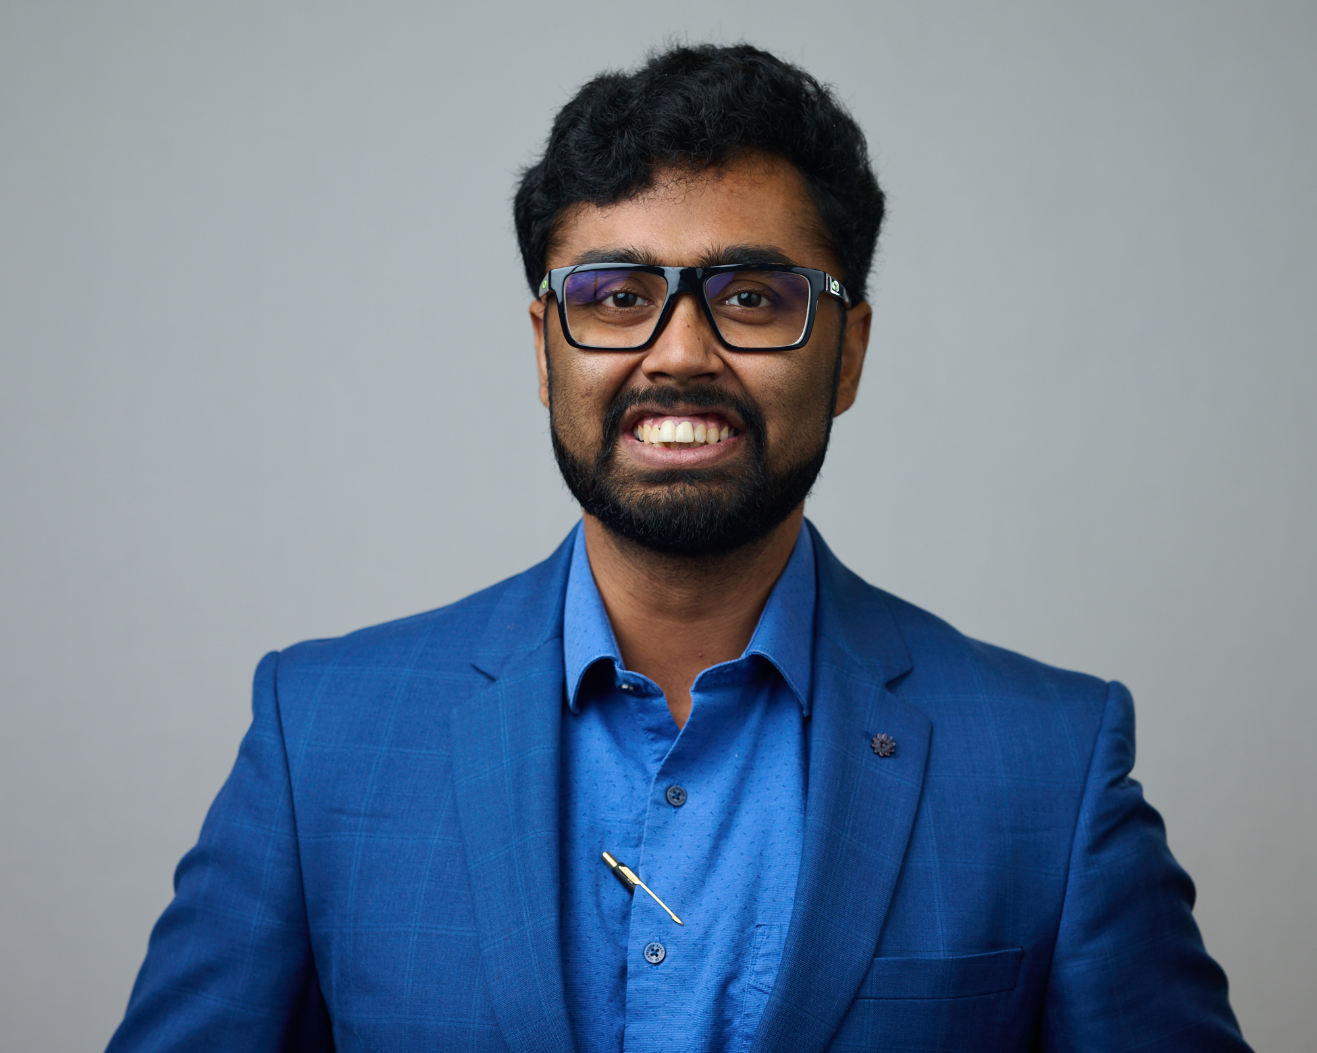
Curriculum Vitae
Amlan Datta
Graduate Research Assistant, Ames National Laboratory, Iowa state University, Ames, US.
Contact No.: +1-5157156903
Email: adatta@iastate.edu, pikuamlan@gmail.com Website: https://sites.google.com/view/adatta/home
Educational qualifications
PhD (ongoing), Ames National Lab and Iowa State University, Ames, US.
CGPA: 3.79/4.00
BS-MS Physics, IISER Kolkata, India. SGPA: 10.00/10.00, CGPA: 8.30/10.00
Research Interest
Superconducting materials for quantum computing applications
Superconductivity and coexisting long range orders like magnetism, CDW etc.
Novel properties of superconductors and magnetic materials
Research experiences
Studying superconducting properties of quantum computing technology relevant novel materials along with understanding coexisting long range orders in exotic magnetic materials. (US, 2021-present)
Modeling of spin noise using a modified form of the quantum master equation (India, 2020-2021)
Weak measurements in Optics (India, 2020)
Experimental and theoretical investigation of photofragmentation mechanisms of polycyclic aromatic hydrocarbons (PAHs) exposed to XUV radiation (Germany, 2019)
Measurement of the surface tension and the viscosity of a liquid using the capillary waves as diffraction grating (India, 2017)
Entanglement entropy and mutual information of many-body localized quantum system (India, 2017)
Publications
Ghimire S.,..., Datta A. et al. (2025). PRB 111, 054507
Datta, A. et al. (2024). SUST 37(9), 095006.
Ghimire S., Joshi K.R., Datta A. et al. (2024). MQT 4 045201.
Oh J.S.,…, Datta, A. et al. (2024). Acta Materialia, 276, 120153.
Ghimire S.,..., Datta, A. et al. (2024). PR Research 6(1), 013124.
Joshi, K.R., Datta A. et al. (2023). PR Applied 20(2), 024031.
Tikhonov D. S., Datta A. et al. (2020). ZPC 234(7-9), 1507-1531
Instrumentation
Built and running cryo-free Magneto optical setup (base temp. 3.5 K)
Working on closed cycle He3 Bender (base temp. 400 mK) for non-destructive qubit characterization
Running He3 based Tunnel Diode Resonator (base temp. 300 mK)
Computer Skills
Programming languages: Julia, Python, MATLAB
Softwares: LATEX, gnuplot, Origin Lab, Mathematica, ImageJ
Teaching experiences
Introduction to Classical Physics II Lab, Spring’25 at Iowa State University, Ames, Iowa, US.
Introduction to Classical Physics II Lab, Spring’24 at Iowa State University, Ames, Iowa, US.
General Physics II Laboratory, Spring’23 at Iowa State University, Ames, Iowa, US.
Introduction to Classical Physics II & Lab, Fall’22 at Iowa State University, Ames, Iowa, US.
Introduction to Classical Physics I & Lab, Spring’22 at Iowa State University, Ames, Iowa, US.
Introduction to Classical Physics II & Lab, Fall’21 at Iowa State University, Ames, Iowa, US.
Computational Physics, 2021 at IISER Kolkata, India.
Mechanics II, 2020 at IISER Kolkata, India.
Intro. to Computation, 2020 at IISER Kolkata, India.
Achievements and Awards
Best poster award at US Quantum Information Science Summer School at ORNL, Tennessee, US
Richard G. Patrick Award for Teaching Excellence in 2024 at Iowa State University, US.
Richard G. Patrick Award for Teaching Excellence in 2023 at Iowa State University, US.
Graduate College Teaching Excellence Award in 2022 at Iowa State University, US.
INSPIRE Fellow (2016-2021) by Department of Science and Technology, Govt. of India.

