Slide 1
VLSI DESIGN LAB
Design of Full Subtractor
Design of 4x1 MUX
Report made and submitted by:-
Amlan Sahoo, Roll No. 117EC0322

Slide 2
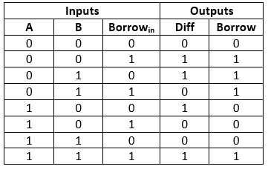
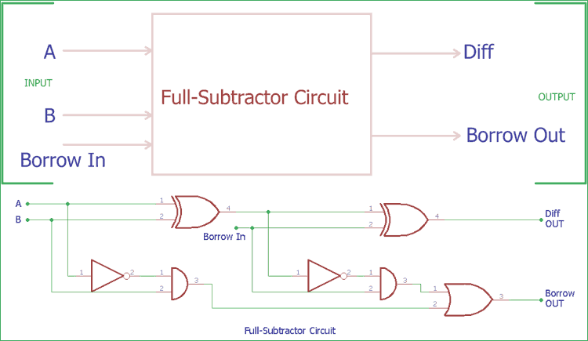
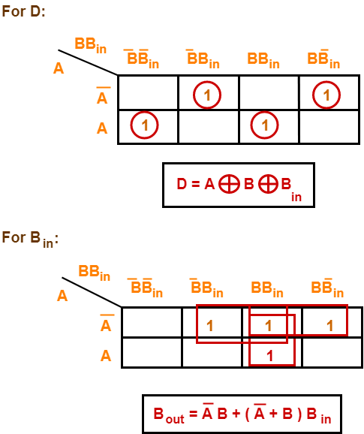
FULL SUBTRACTOR
TRUTH TABLE
CIRCUIT DIAGRAM
LOGIC EQUATIONS

Slide 3
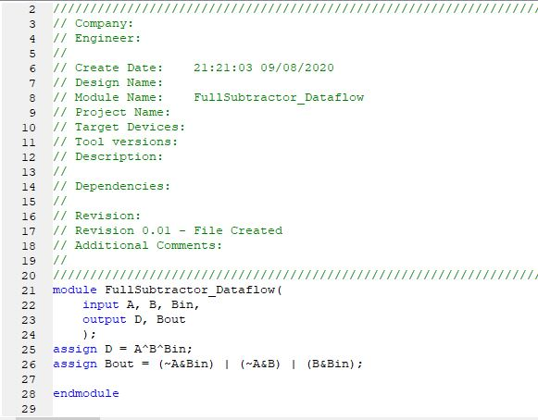
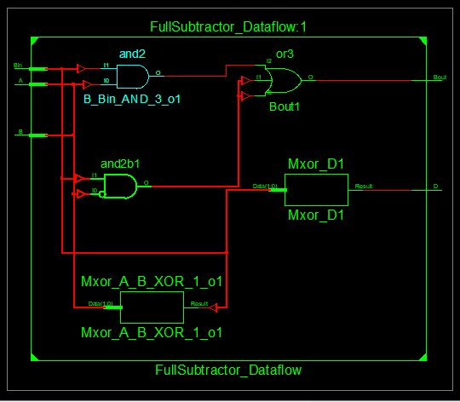
FULL SUBTRACTOR - DATAFLOW
Code for Dataflow Model
Schematic for Dataflow Model

Slide 4
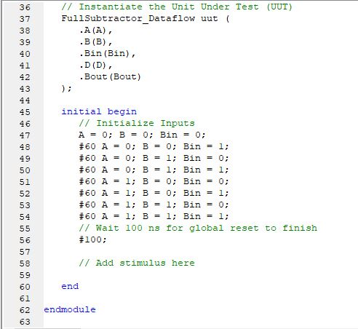
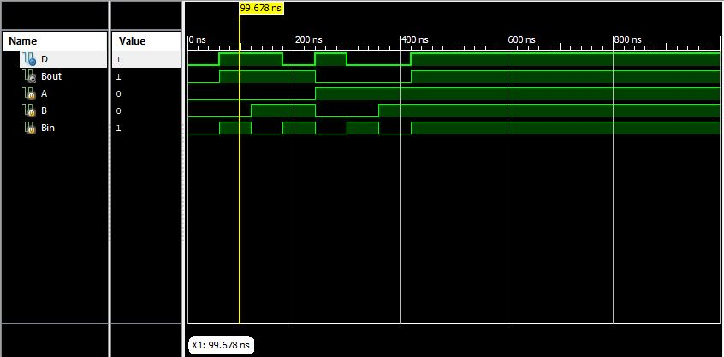
FULL SUBTRACTOR - DATAFLOW
Waveform for Dataflow Model:
The input value of 0,0,1 for A,B,Bin gives output
value of 1,1 for D and Bout resp. which confirms
with the TruthTable.
Code for Testbench

Slide 5
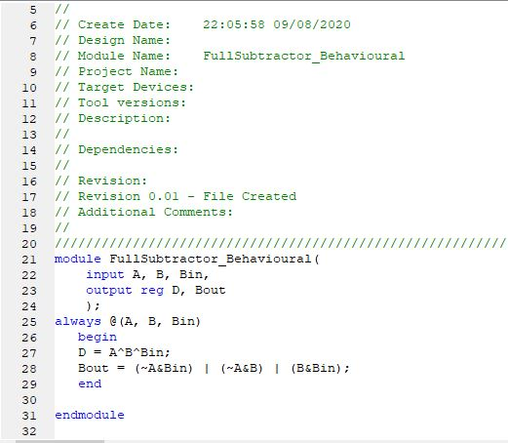
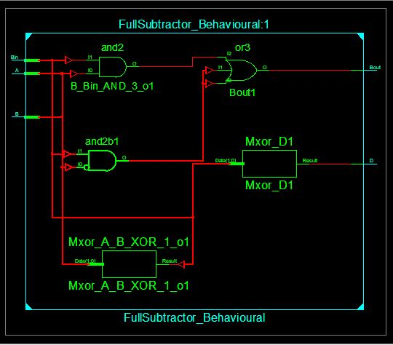
FULL SUBTRACTOR - BEHAVIOURAL
Code for Behavioural Model
Schematic for Behavioural Model

Slide 6
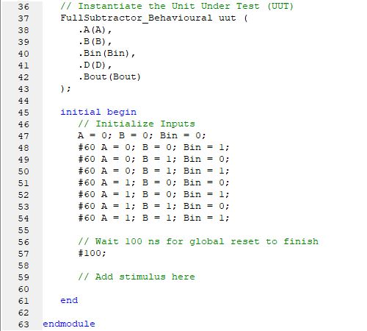
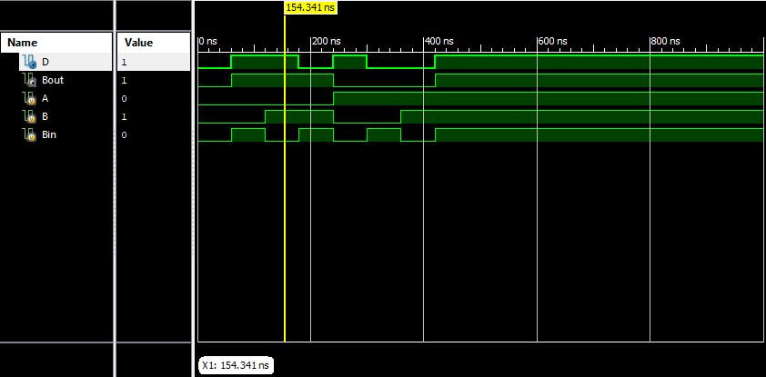
FULL SUBTRACTOR - BEHAVIOURAL
Waveform for Behavioural Model:
The input value of 0,1,0 for A,B,Bin gives output
value of 1,1 for D and Bout resp. which confirms
with the TruthTable.
Code for Testbench

Slide 7
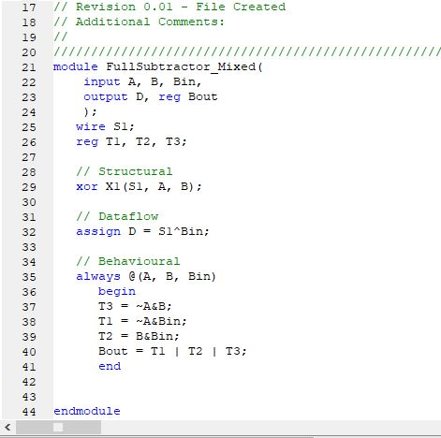
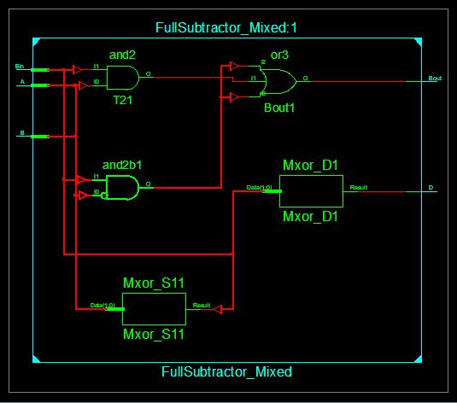
FULL SUBTRACTOR – MIXED MODELLING
Code for Mixed Model
Schematic for Mixed Model

Slide 8
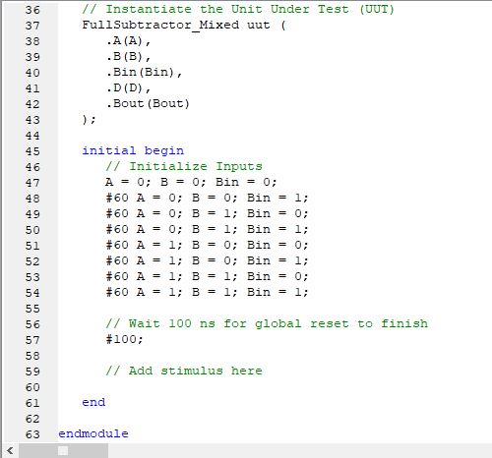
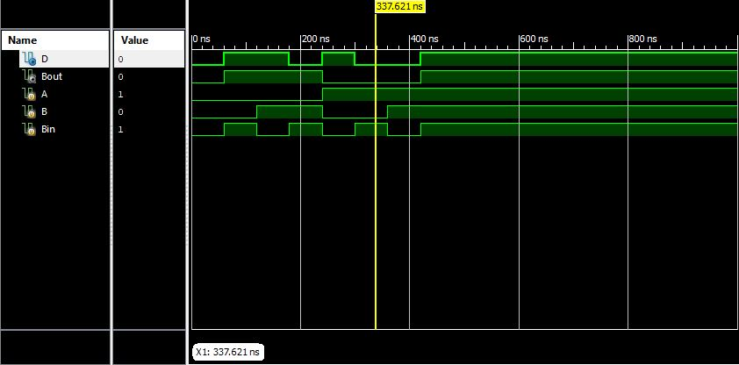
FULL SUBTRACTOR – MIXED MODELLING
Waveform for Mixed Model:
The input value of 1,0,1 for A,B,Bin gives output
value of 0,0 for D and Bout resp. which confirms
with the TruthTable.
Code for Testbench

Slide 9
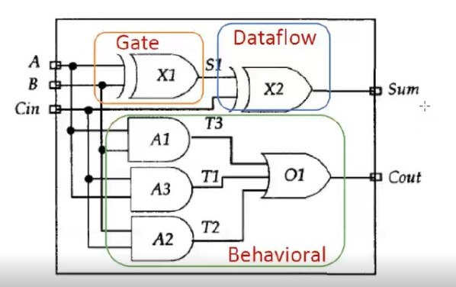
FULL SUBTRACTOR – MIXED MODELLING
The mixed style of modelling was
based upon this particular style
discussed in class for a Full Adder.

Slide 10
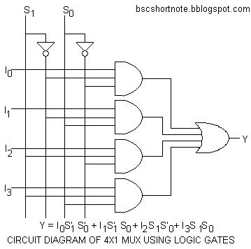
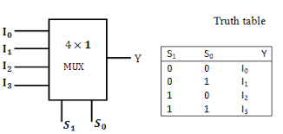
4x1 MULTIPLEXER
TRUTH TABLE
CIRCUIT DIAGRAM AND LOGIC EQUATION

Slide 11
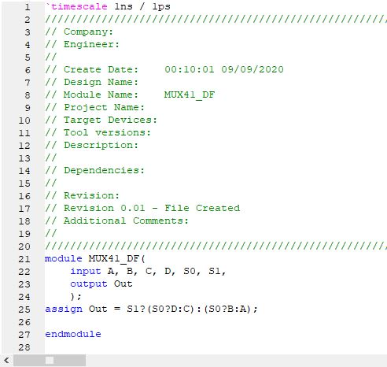
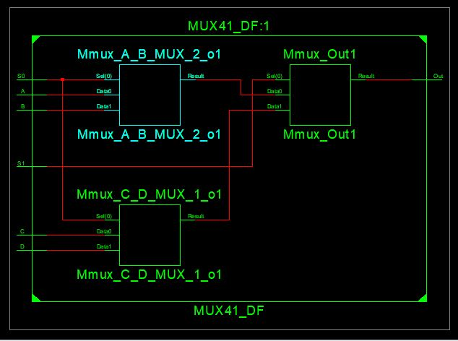
4x1 MUX – DATAFLOW
Code for Dataflow Model
Schematic for Dataflow Model

Slide 12
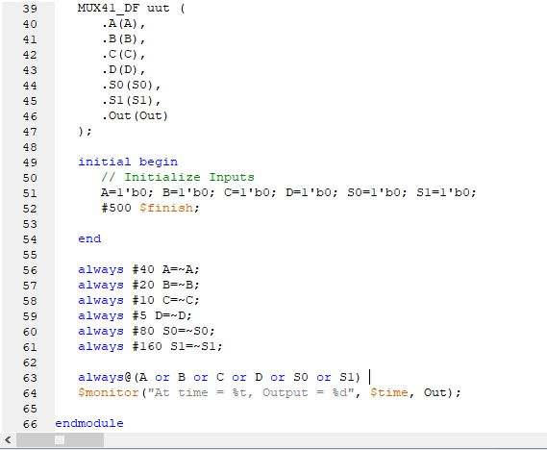
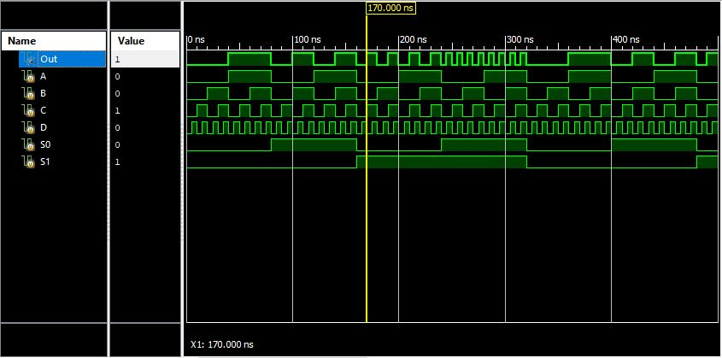
4x1 MUX – DATAFLOW
Waveform for Dataflow Model:
The input value of 1,0 for S1,S0 indicates that
the output value should be equal to the third
data input, i.e., C which is exactly the case here
Code for Testbench

Slide 13
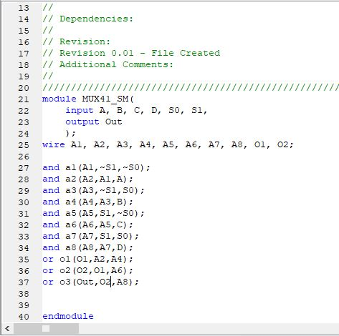
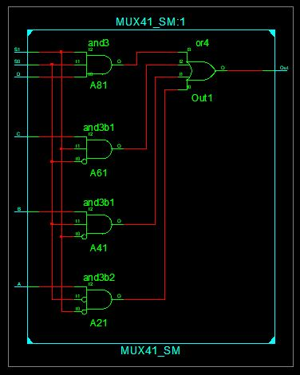
4x1 MUX – STRUCTURAL
Code for Structural Model
Schematic for Structural Model

Slide 14
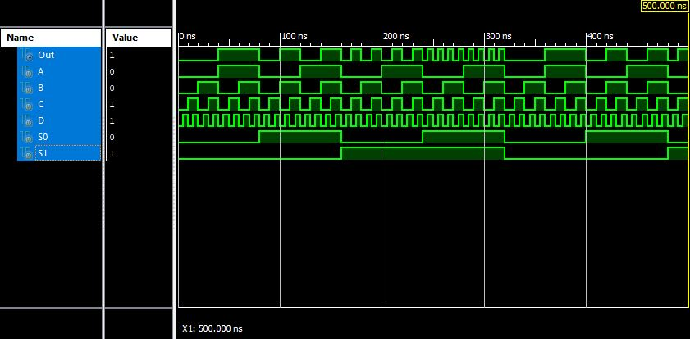
4x1 MUX – STRUCTURAL
Waveform for Structural Model:
The input value of 1,0 for S1,S0 indicates that
the output value should be equal to the third
data input, i.e., C which is exactly the case here
Code for Testbench

Slide 15
FINAL DISCUSSIONS
For Full Subtractor circuit, all the three types of modelling gave the same RTL schematic diagrams because they were mostly based on algorithms and data flow rather than gate level logics.
For 4x1 MUX, I could see the difference in RTL Schematics for Dataflow and Structural(Gate Level) Models.
I was unable to search for a method to implement a single test bench for all type of models but the resulting waveforms were same and matching with the truth tables confirming the correctness of the designing and simulations.
By the help of this assignment I learnt about Verilog coding and HDL abstraction levels. I covered behavioural, dataflow and structural modelling since it was in the scope of this assignment and read about the switch level of modelling too.
Overally, I was able to get familiar with Verilog code, Test benches and the Xilinx environment with the help of this assignment.

