Slide 1
Discourse2Draft
Amlan Talukder

Slide 2
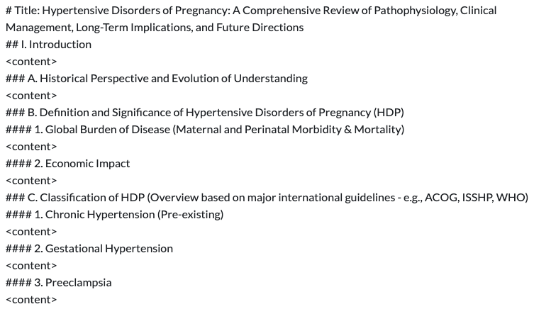
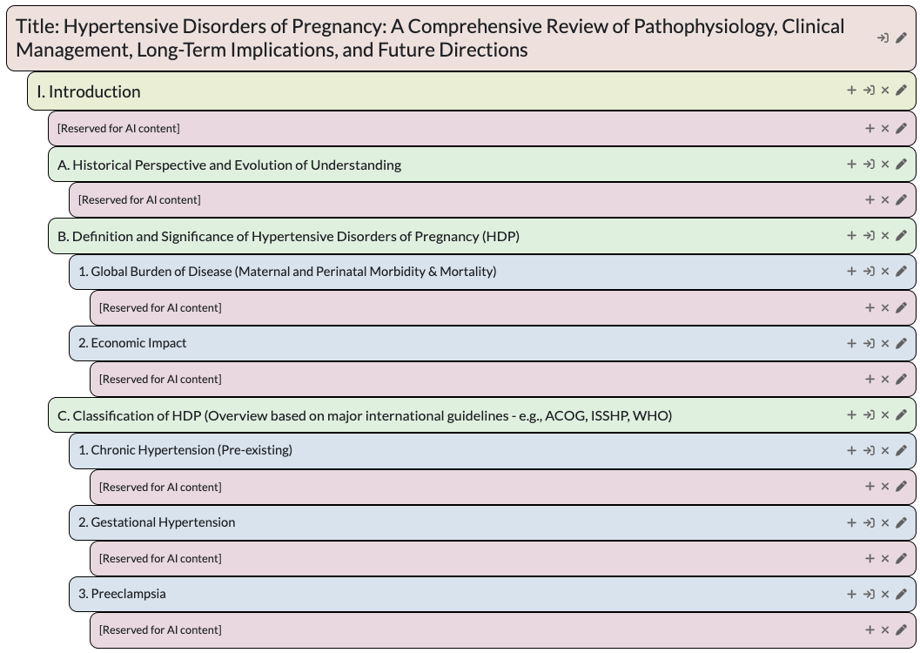
Raw outline
Processed outline

Slide 3
Content Generation Architectures
Query (with optional context)
(User provided)
Basic
RAG
Literature
RAG + Literature
Provides content from training data
Provides content from uploaded documents.
Provides content from literature search (pubmed).
Provides content from literature search (pubmed) and uploaded documents.
Structured Outline
(Generated by AI Or User Provided)
Start
Start
Start
Start
Summarize Previous Content
Summarize Previous Content
Summarize Previous Content
Summarize Previous Content
Outline Processing
(Breaks down outline to create a hierarchical structure of section headers)
Generate Content
Analyze Content Header
Analyze Content Header
Analyze Content Header
Summarize Generated Content
Gather Context from Documents
Add Literature
Add Literature
Gather Context from Documents
Detects next content tag
(The place where AI would write the content)
Generate Content
Gather Context from Literature
Gather Context from Literature
Wait for the Other Branch
End
Summarize Generated Content
Generate Content
Generate Content
Summarize Generated Content
Summarize Generated Content
Gathers content section header and previous content
End
End
End

Slide 4
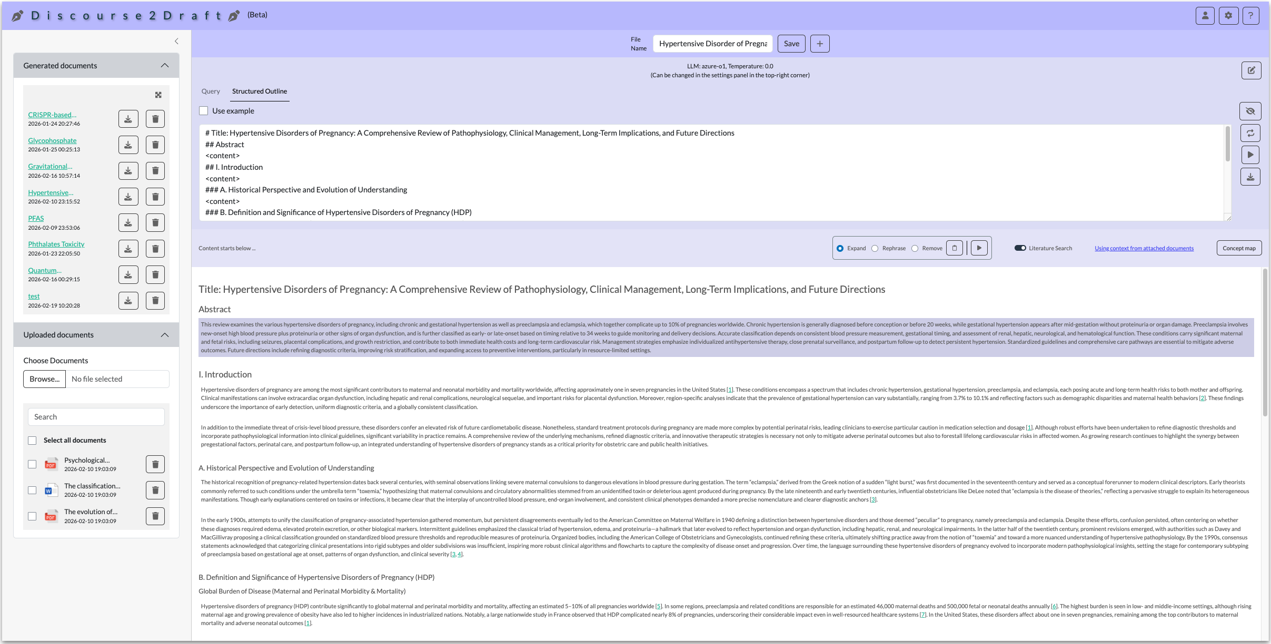

Slide 5
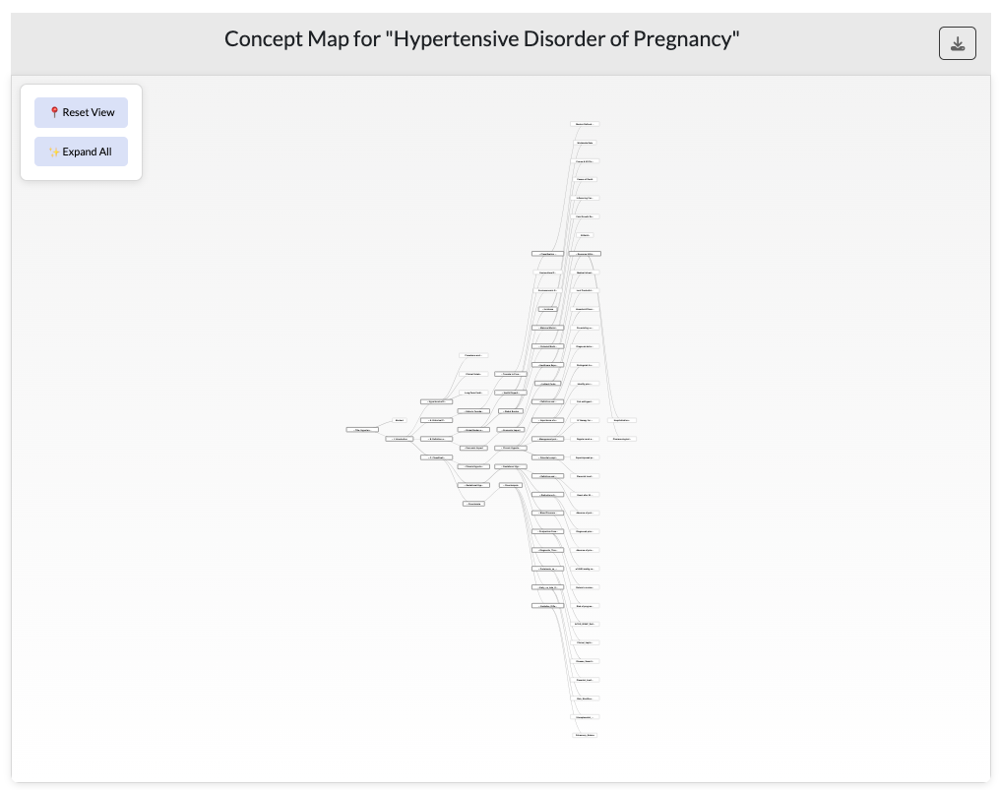
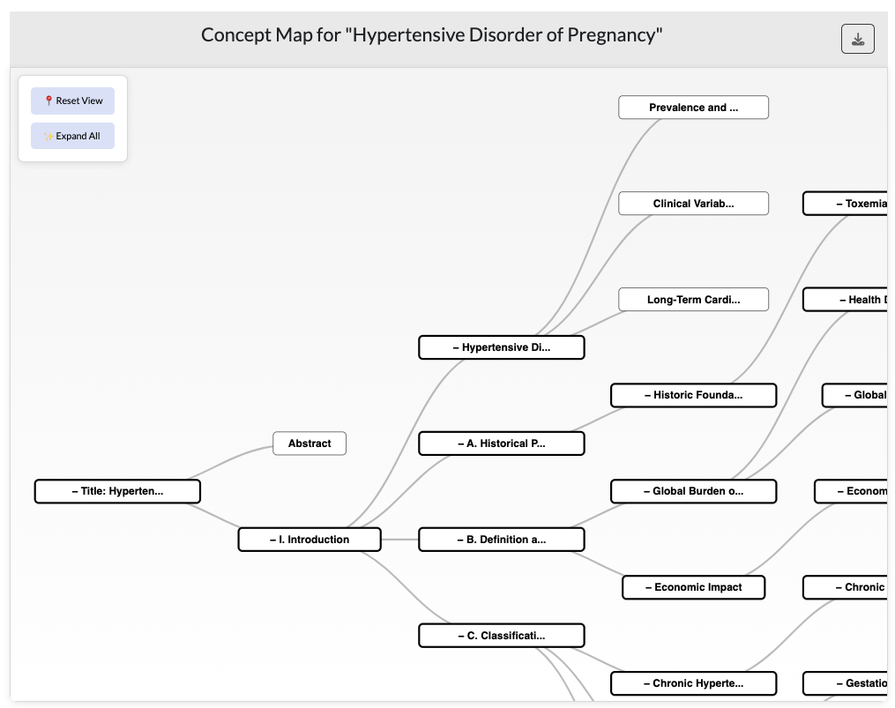
Concept Map (Full)
Concept Map (Partial and Zoomed)

Slide 6



A I P R O C E S S I N G W E B D E V E L O P M E N T
Technology Stack

Slide 7
