Slide 1

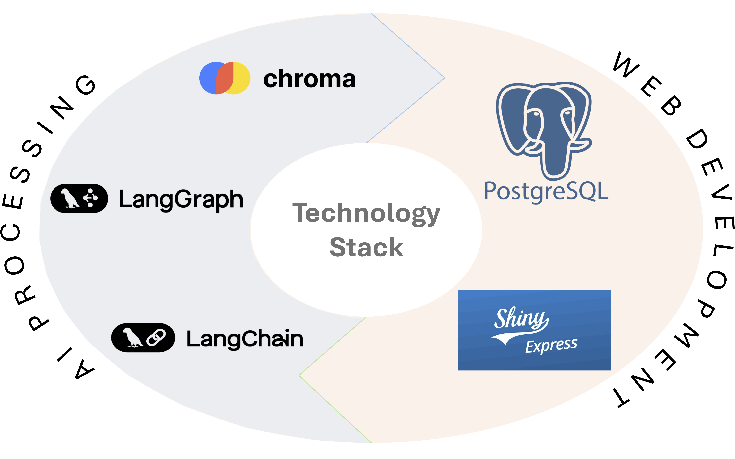
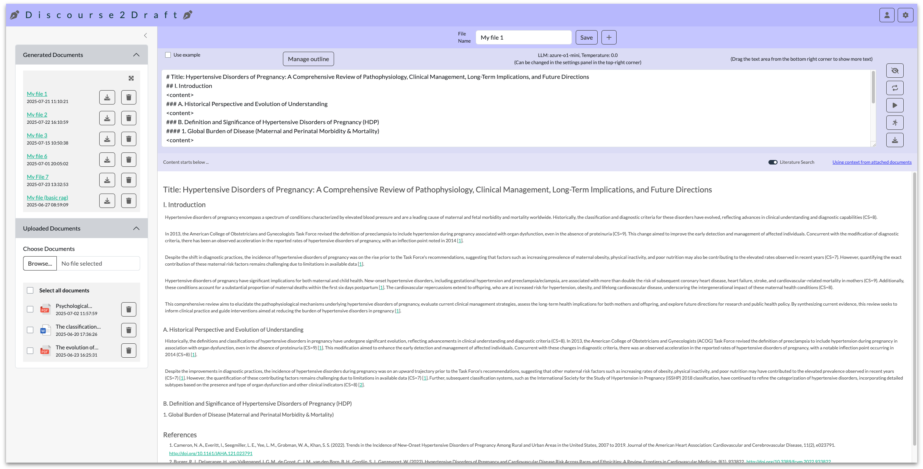
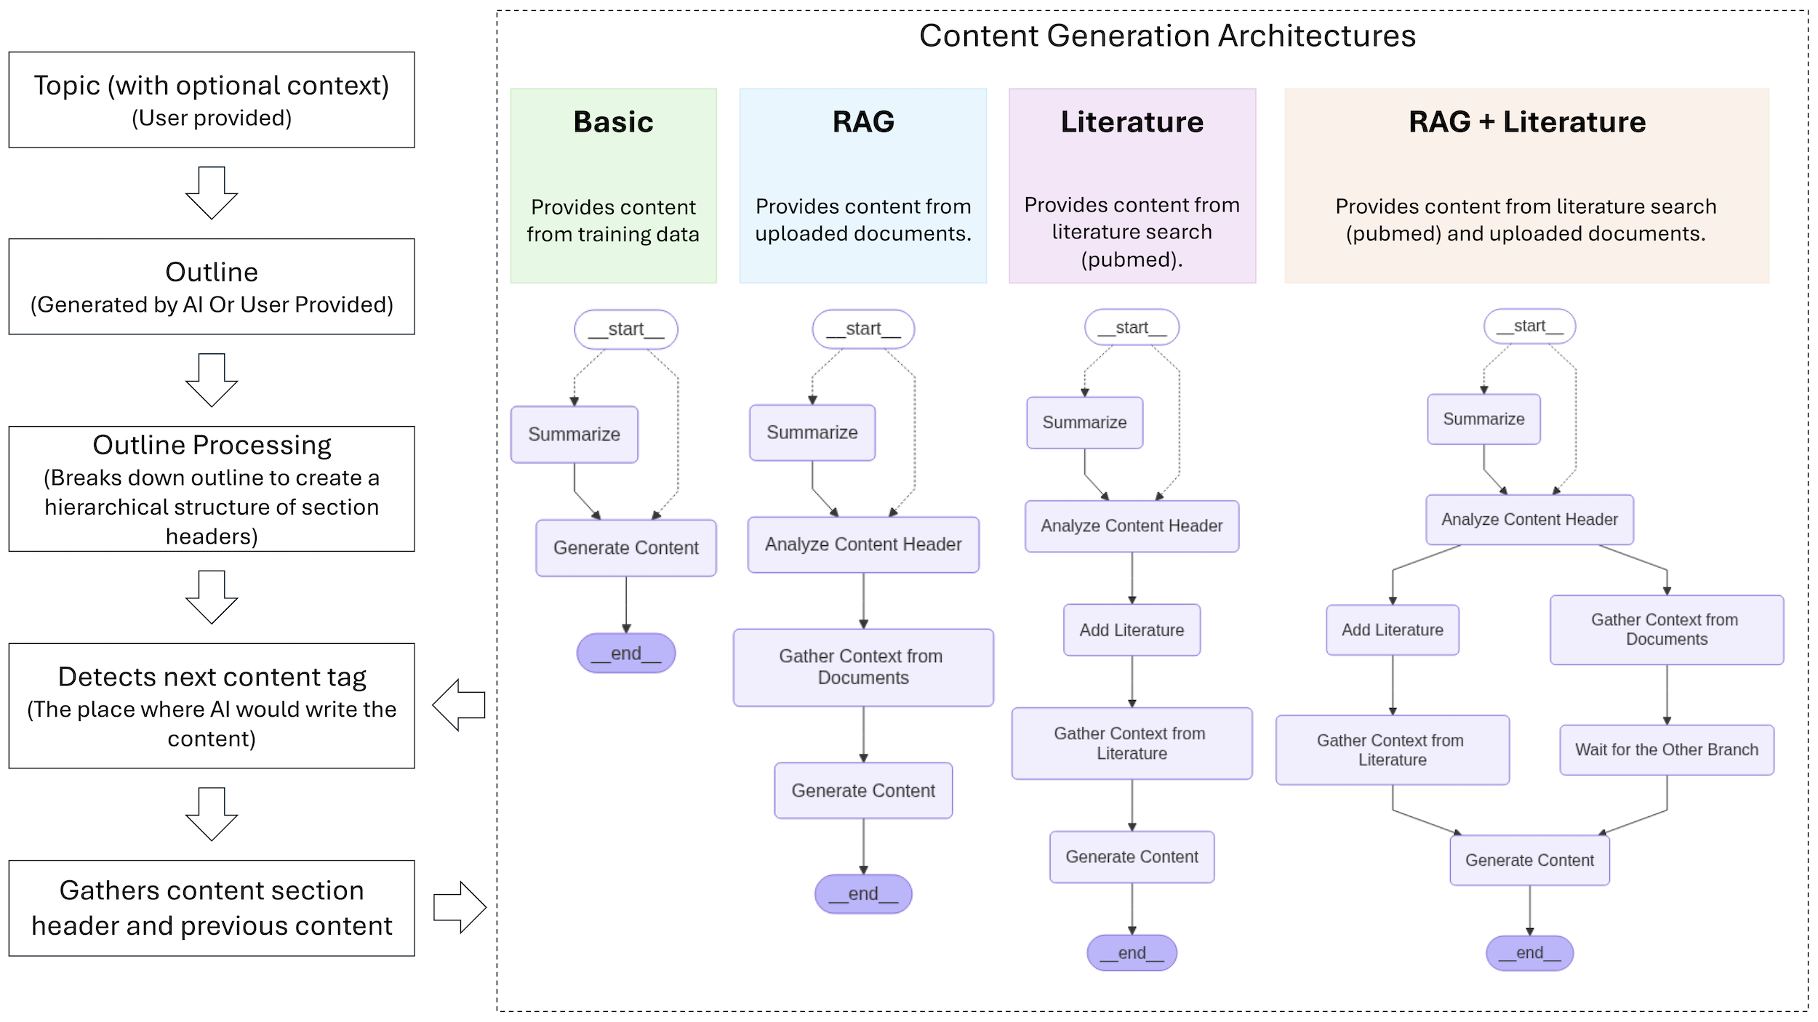
NIH RESEARCH FESTIVAL
Discourse2Draft - An AI powered app to help write documents with hierarchical outline and references
NIEHS SCIENCE DAY, 2025
Amlan Talukder¹, Trey Saddler², Charles Schmitt¹, Scott Auerbach²
¹Office of Data Science, NIEHS
²Predictive Toxicology Branch, Division of Translational Toxicology, NIEHS
Discourse2Draft
Features
Although numerous AI tools are being created every day that can be used to create structured content on a given topic, most of these tools suffer from issues of hallucination and lack of authentication.
Discourse2Draft is an AI powered app to generate structured content for research manuscripts from a user provided topic (with optional context) with the ability to gather literature references in user intended format.
In terms of usability, Discouse2Draft can wear many hats, such as scientific report generation, research proposal generation, manuscript writing, literature search or generation of content for any types of topic that has a user (or AI) provided structured outline.
In addition, user can manage generated contents and download contents and bibliography in multiple formats.
Content Generation
Use AI base models from different providers: OpenAI, Google, Anthropic, Meta and Mistral.
Generate document content with customized instructions.
Regenerate paragraphs with revised instructions.
Extract and cite content from user provided documents and/or from literature databases (e.g. pubmed).
Document Management
Keep track of generated files in individual profile.
Upload documents in multiple text formats: PDF, DOCX and TXT
Download document in various formats (.md, .docx, etc.)
Download bibliography of the cited sources in bibtex format.
Behind the scene
App (https://rstudio.niehs.nih.gov/word)

