Slide 1
Using Alt-Coins for Proof-of-Bandwidth Incentivized Onion Routing
Cs 407 Cryptography Project
Alex Lawson

Slide 2

Tor Browser - Onion Routing
Alice Sends a Message to Bob
  Doesn’t want Eavesdropper to know Message -> Use Encryption
  Doesn’t want Eavesdropper to know she Sent to Bob -> Use Routers
Asymmetric Key Encryption with Each Router
“Layers of Encryption”

Slide 3
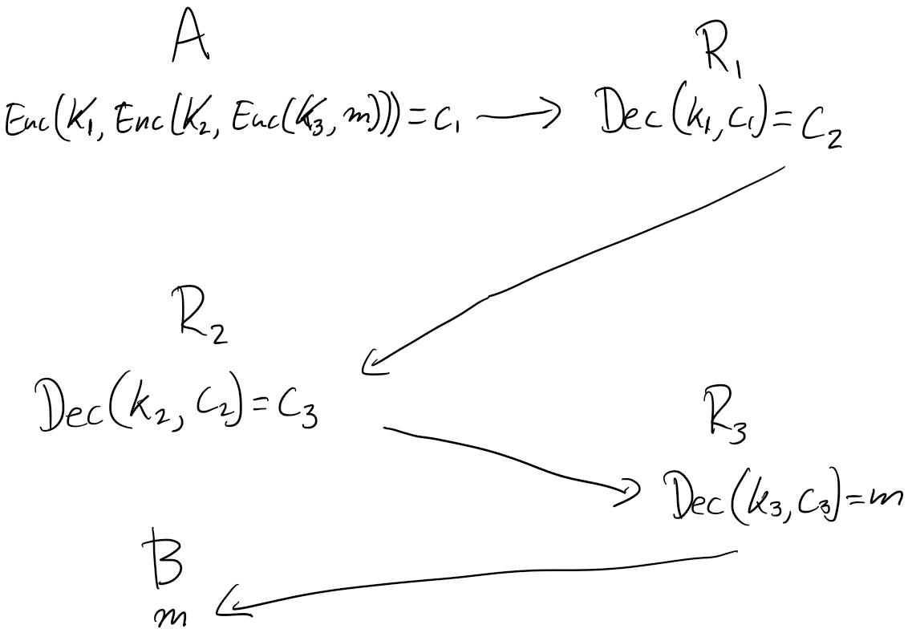
Onion Routing
c_i Can Also Contain address of R_i

Slide 4
Problems with Tor
Timed attacks
R3 sends fully decrypted message to Bob
Why should routers bother-> Volunteer routers make Tor slow
  ONE Solution: Cryptocurrency rewards for Routers
  Specifically new currency generation as a reward for Routers

Slide 5
Proof-of-Work vs Proof-of-Bandwidth Cryptocurrency
Proof of Work:
  Block_i = (Hash(Block_i-1),
  List of signed transactions,
  Block Maker get 1 coin,
  chosen ‘x = 0100010110010’)
  x chosen such that
  Hash(Block_i) = ……0000000000. -> publish block to other miners
  ISSUE: “Work” is not meaningful.

Slide 6
Proof of Bandwidth
Block_i = (Hash(Block_i-1),
  List of signed transactions,
  Block Maker get 1 coin,
  Verifiable Proof Maker Routed X Gb of Messages)
  Blocks are considered valid when Miners/Routers who publish them route enough messages

Slide 7
A TorPath to TorCoin: Proof-of-Bandwidth Altcoins for Compensating Relays - Mainak Ghosh, Miles Richardson, Bryan Ford, and Rob Jansen

Slide 8
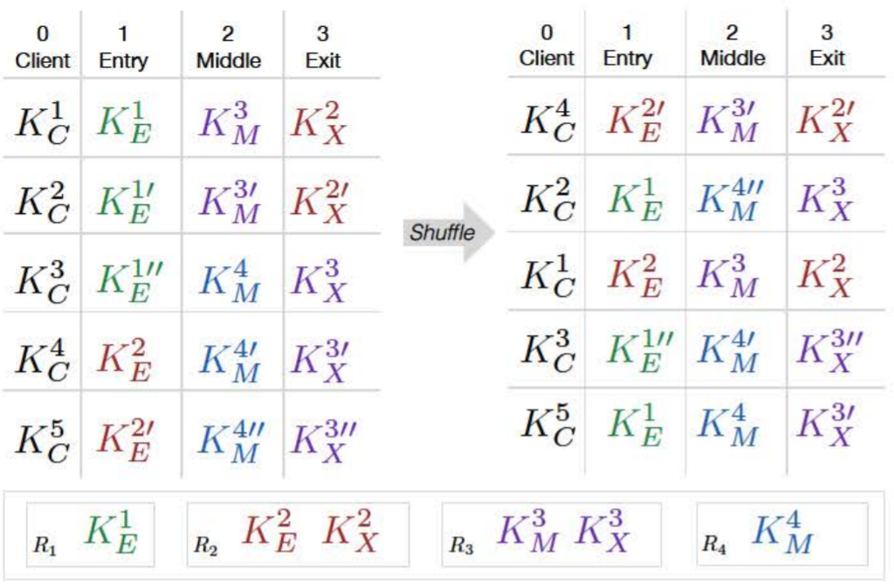
TorPath- How to determine and verify path?
Uses Assignment Servers (Trusted and Run by TorCoin).
Clients and Relays send public keys speak to servers
Servers Verifiably Shuffle (Neff Shuffle) to assign paths
Keys are all public/published, but shuffle prevents anyone but participants from knowing whose.
M =
5 Clients and 4 Relays

Slide 9
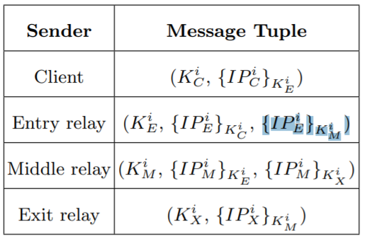
Making Paths
Each Client/ Relay uses their secret key to obtain IP of others in chain.

Slide 10
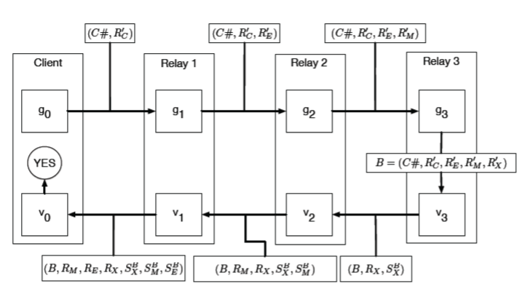
Verifying and Paying
TorCoin- Altcoin generated for relay by proof-of-Bandwidth
Only Alice/Client Decides on and knows full Path (This Later).
R = Temporary key, unknown whose
R’ = Hash(R)
C# = number of coins send in this circuit
S^B_X = Verifiable Signature of X on B
with (sk for K)

Slide 11

Verifying and accrediting
Create New coin in Hash(P) = …000000. -> Alice Sends to Miner/Relays
If Signatures Verifiable, one of the Lines in the consensus matrix (K_X, K_Y, K_Z) and Path Valid (R_X, R_E, R_C) in Consensus Matrix M

Slide 12
Pros
Alice cannot easily choose preferred servers-> to choose who makes money
  If Alice controls ½ of active relays only 1/8 chance of preferred circuit
Path not publicly known- only know neighbors’ IP

Slide 13
Cons/Issues/not addressed:
Consensus Groups- Reliance on Trusted Servers
Reliance on large number of Simultaneous Routers/Clients.
Alice compromises her Path Paying out Relays on public Block (Zerocoin, Mixcoin, or CoinShuffle suggested)
Client Makes Money

Slide 14
AlexTorPathCoin – An Alternative Protocol
Routers / Clients broadcast to miners that they wish to participate with IP:
  List of n Participant IPs published in Block numerical order.
  Each has IP_i, key K_i and place in order ip_i
  Hash(Block_i) = H_i.
  o is set by protocol “number of options”
Each ip only allows for only o of n options as next router
Alice chooses full path. -> Preference may be okay -> Each has public “reliability score”
Instructions for next relay is sent with Relays encrypted message

Slide 15
Pathmaking
  Alice choses path fully, except that ip_i+1 == H(H(Block_i), ip_(i)) mod n/o.
    Small chance some relays not allowed to participate
    Floor(n/o) may better (assume n/o integer for simplicity)
  Alice can’t buy up preferred IP addresses: (Block_i includes list of all IPs)
  If Allice colludes, has some chance of preferred path.

Slide 16
Alice’s chance of preferred path
Length L, Suppose 0=<a=<1 is fraction of those colluding:
Alice can get k colluders at each step of correct path with probability: p(k) = (o!/(o-k!k!))*a^k(1-a)^(o-k)
For whole run we have:
P_coll_path_L = SUM_k=1^o [(o!/(o-k!k!))* (a* Prob_coll_path_L-1)^k (1 - a* Prob_coll_path_L-1)^(o-k)]
(In Python File)

Slide 17
Paying out
R_i “publishes” that received (good) message from R_(i-1):
  M = (“R_i-1 did x Gb routing to R_i”), Sign(M, K_i)
  All can Verify that R_i is a “valid next” from R_i-1 via H(H(block), R_i-1) = R_i mod n/o
  Waits until many Recognitions before Publishing

Slide 18
Paying out
Number of recognitions counted by all listeners:
  RELIABILITY: Number of recognitions/ Number of times recognized public: Makes up score. -> Ideally = L-1/L
  Alice may choose not to rout use people with low recognition score
When Relay has X total gigabytes validated routing, publish Block with Relay gets 1 ATPC.

Slide 19
Pros/SemiPros
Alice can choose preferred servers-> Those with High Reliability, but cannot choose from many options ->
Hard to make preferred Path if Path Long- Need to make Long path for Alice to have Security- (o^L destinations)

Slide 20
SemiPros/Cons/Discussion
Relays can lie to give each other free money- but reduces reliability.
  Relays can pay out anyone who hashes to Them
Inflation Explosion possible
Alice still gets paid, gains reliability
When does a Block’s IP Queue Expire?
How Do We Choose o, L?
Alice does
Would be nice to link Recognitions to being Recognized instead of Counting

