Slide 1
Humans Work for AI. AI Works for Compliance.
AMLClaw — Open Source AI Compliance Platform
github.com/amlclaw

Slide 2
You're Still Paying Humans to Read PDFs?
💸
🐌
⏰
🙈
$500K–$1M / year
4 Weeks
Half a Day
80%
Cost of a compliance team
To write one policy for one jurisdiction
To screen a single address manually
Of crypto startups skip compliance entirely
"Most compliance teams cost more than the seed round."

Slide 3
The Compliance Assembly Line
Every step is manual. Every step costs money.
👤 Lawyer
👤 Compliance Officer
👤 Engineer
👤 Analyst
👤 Manager
→
→
→
→
Read regulations
Write policy
Build rules
Screen addresses
Monitor
2 weeks
2 weeks
1 week
half day each
spot checks
5 humans × 12 months = 💰💰💰

Slide 4
What If We Flip It?
 | OLD |  | NEW
Read regulations | 👤 Humans | → | 🤖 AI
Write policies | 👤 Humans | → | 🤖 AI
Build rules | 👤 Humans | → | 🤖 AI
Screen addresses | 👤 Humans | → | 🤖 AI
Monitor 24/7 | 👤 Humans | → | 🤖 AI
Humans work FOR AI — train, guide, supervise
AI works FOR compliance — read, write, execute, monitor

Slide 5
One Pipeline. Full Compliance.
📄
📋
⚙️
🔍
📡
Documents
Policies
Rules
Screening
Monitoring
40+ regs pre-loaded
→
AI generates in 2 min
→
AI converts to JSON
→
On-chain trace + rule matching
→
7×24 automated
Human uploads
Human reviews
Human approves
Human decides
Human sleeps 😴
AI does 95% of the work. Humans review at key checkpoints.

Slide 6
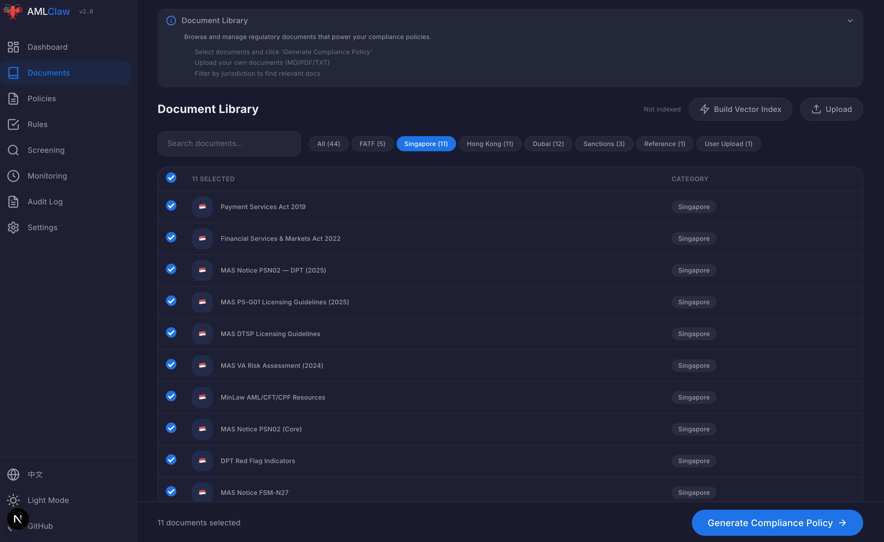
From Regulation to Screening in 5 Minutes
📄 Step 1: Load Regulations & Documents

Slide 7
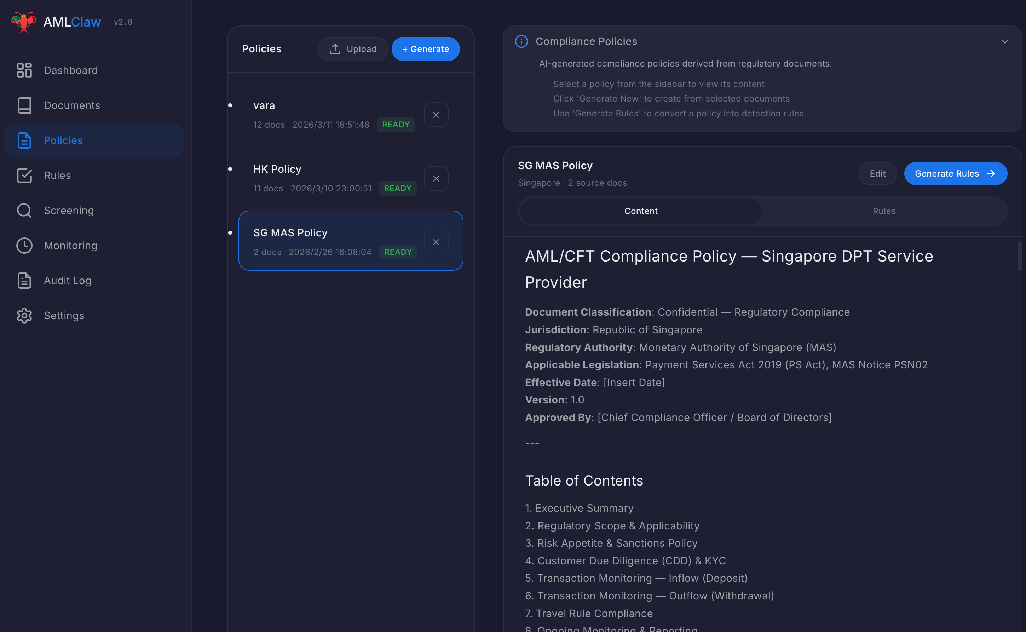
From Regulation to Screening in 5 Minutes
📋 Step 2: AI Generates Compliance Policies

Slide 8
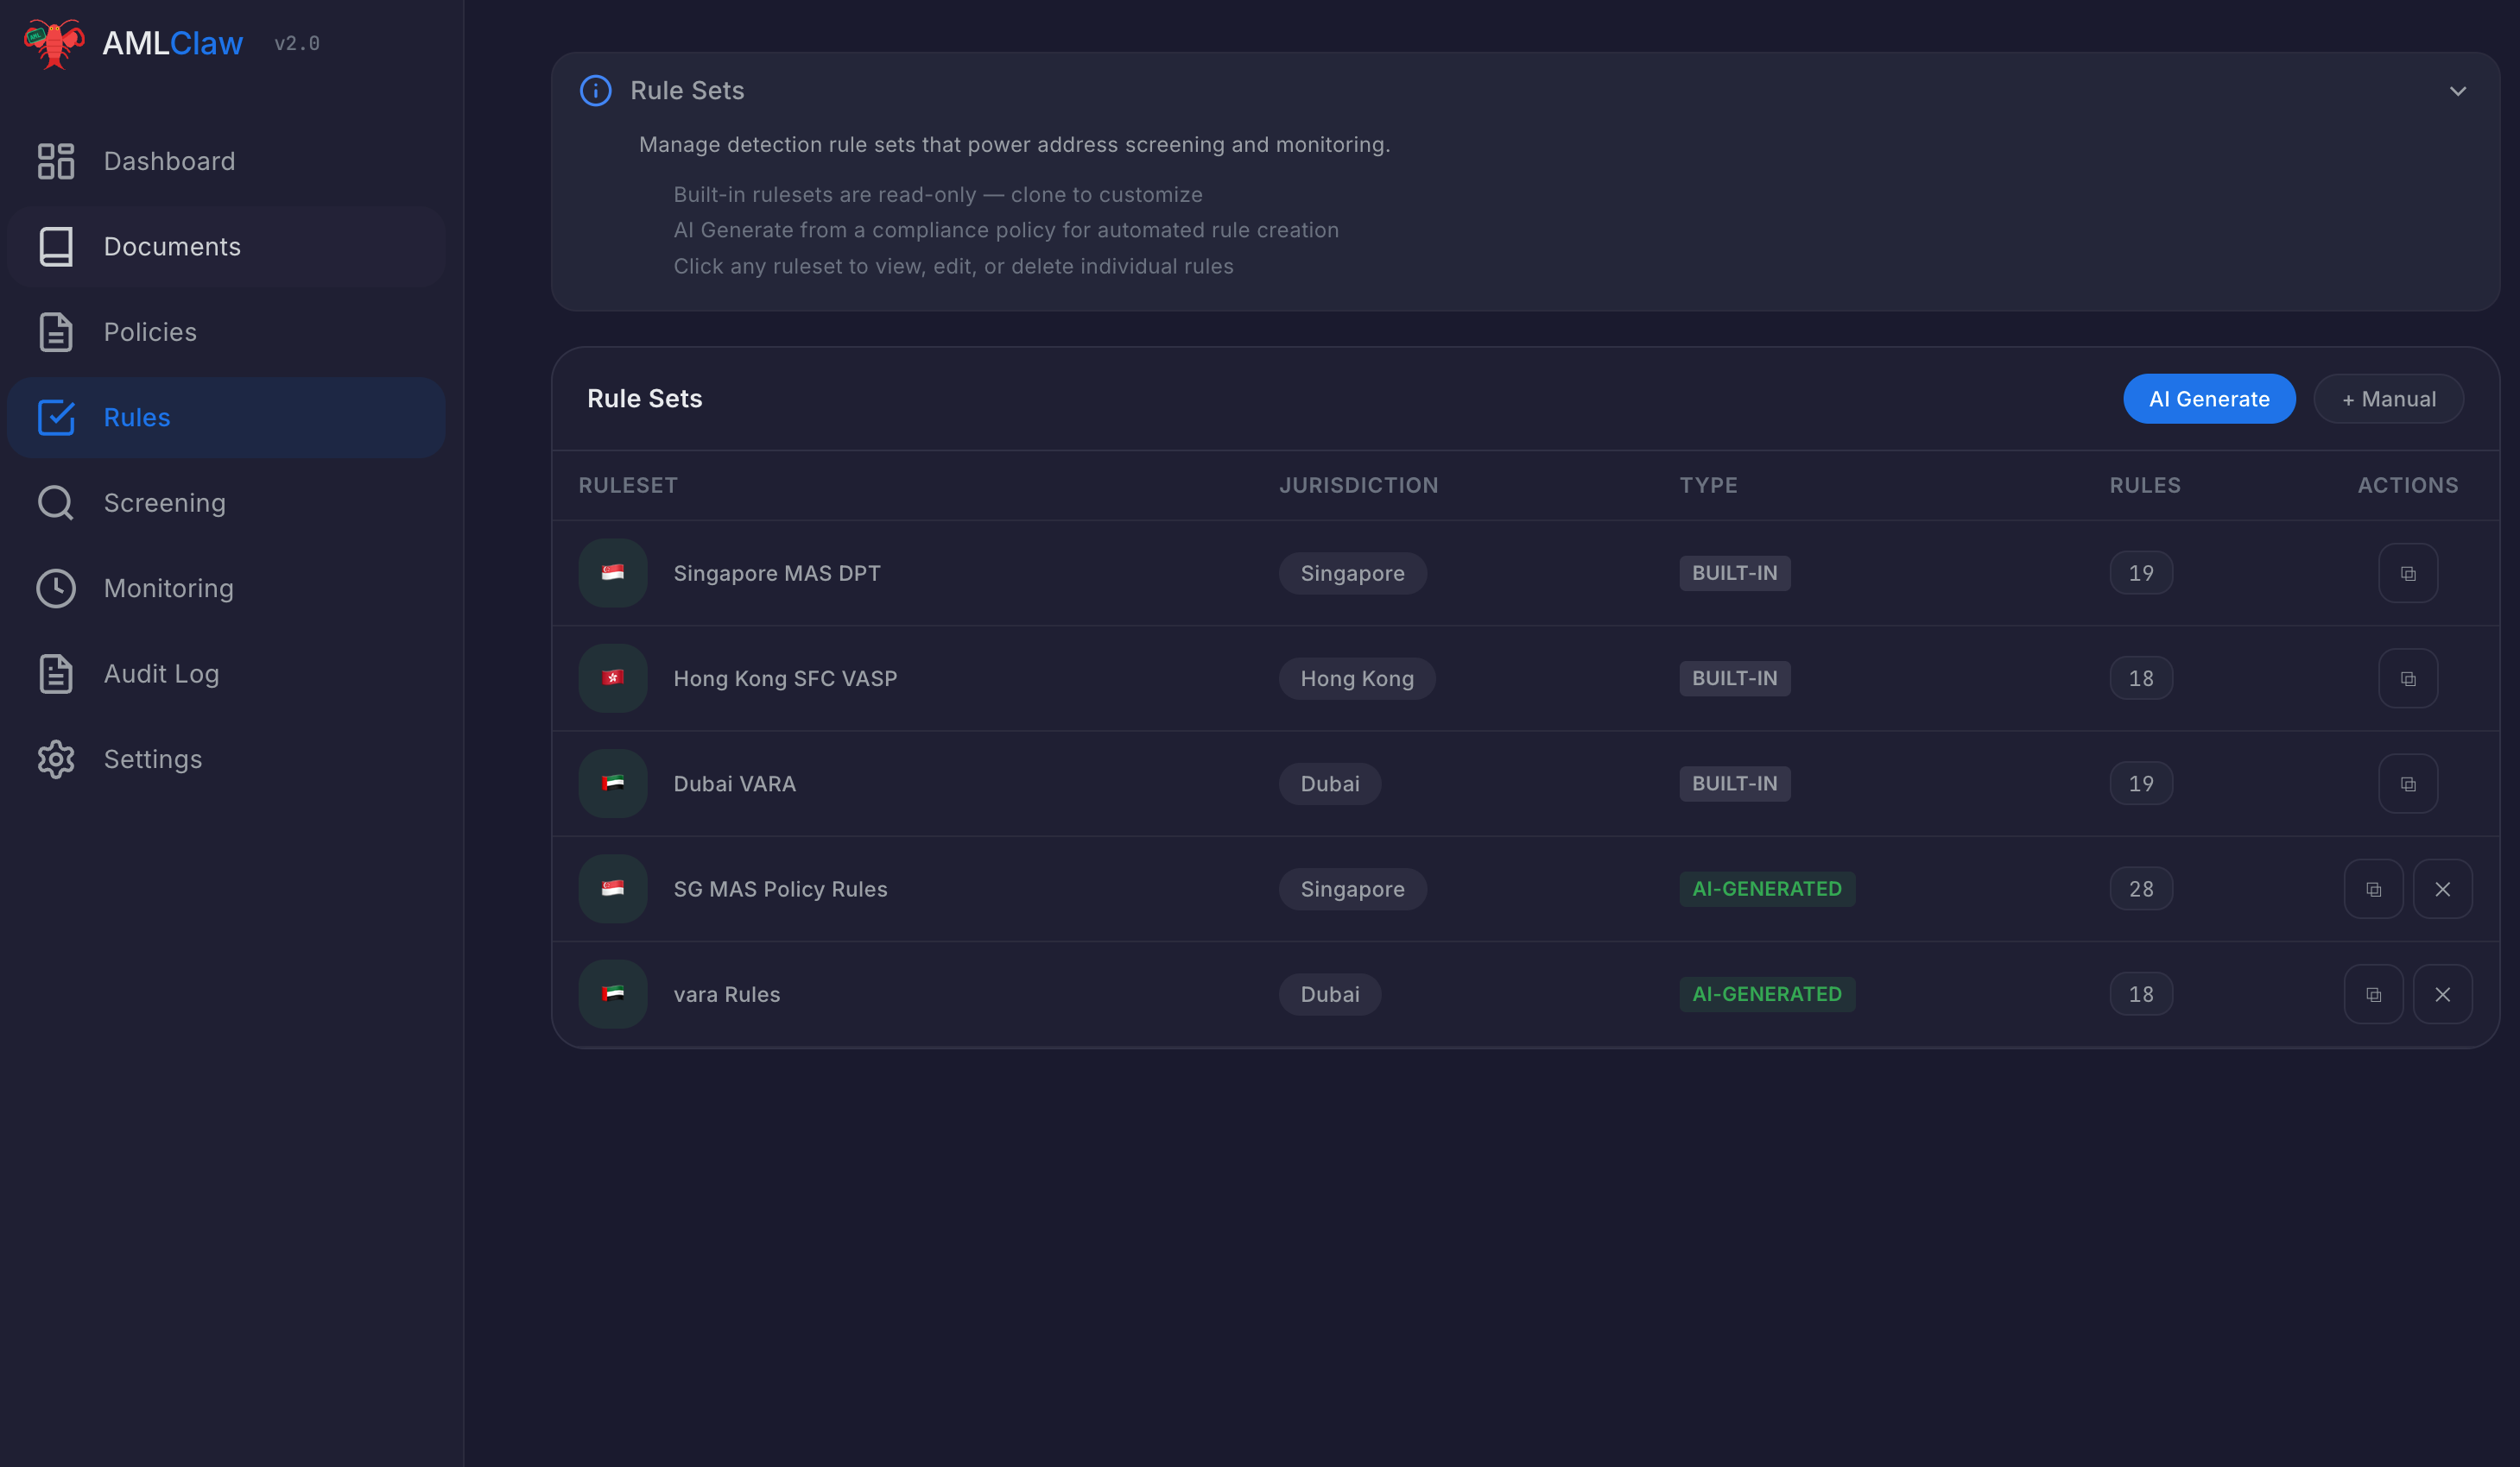
From Regulation to Screening in 5 Minutes
⚙️ Step 3: Convert Policies to Executable Rules

Slide 9
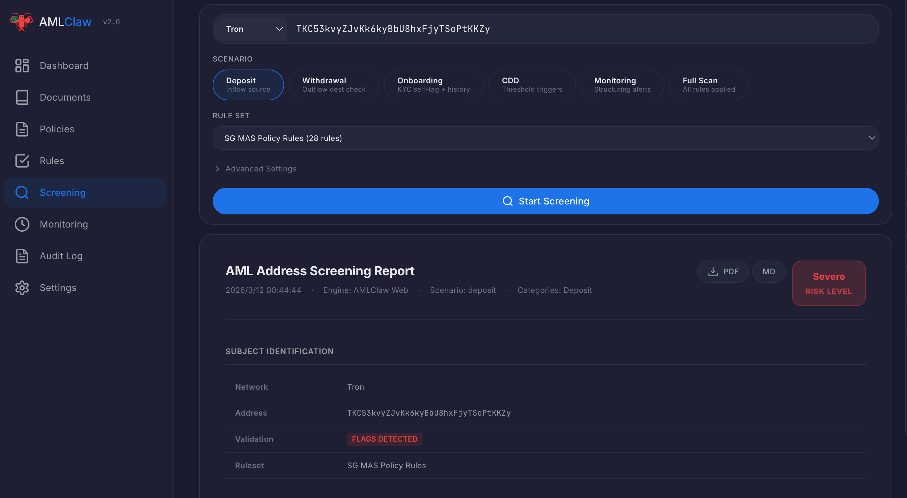
From Regulation to Screening in 5 Minutes
🔍 Step 4: Screen Addresses Against Rules

Slide 10
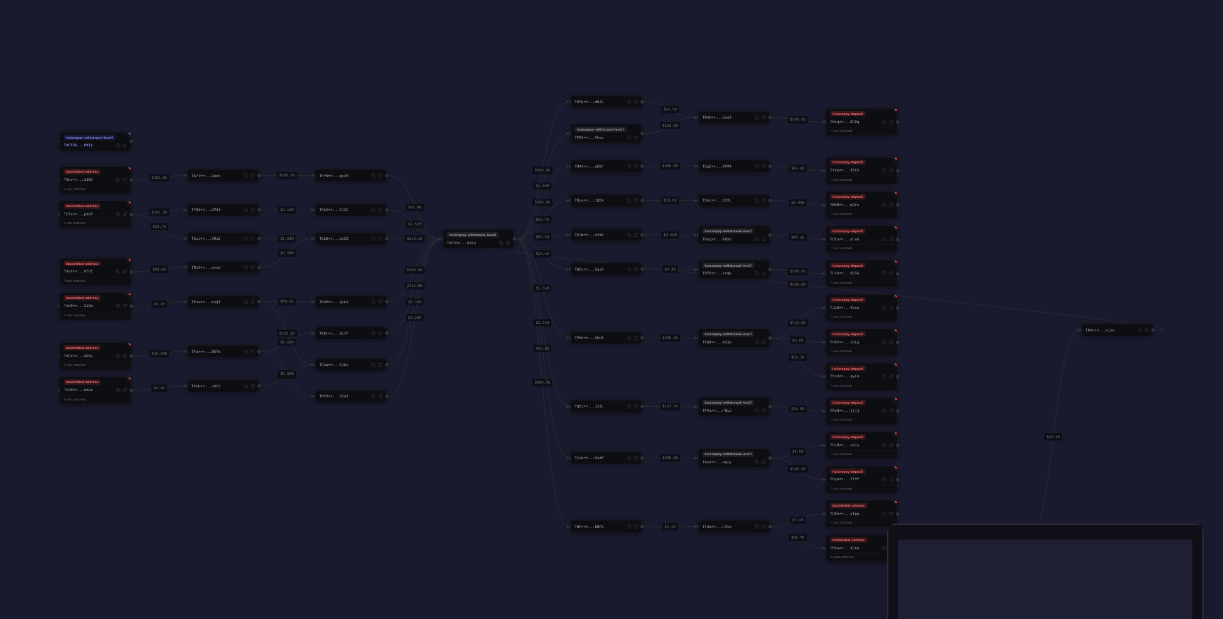
From Regulation to Screening in 5 Minutes
🕸️ Step 5: Visualize On-Chain Relationships

Slide 11
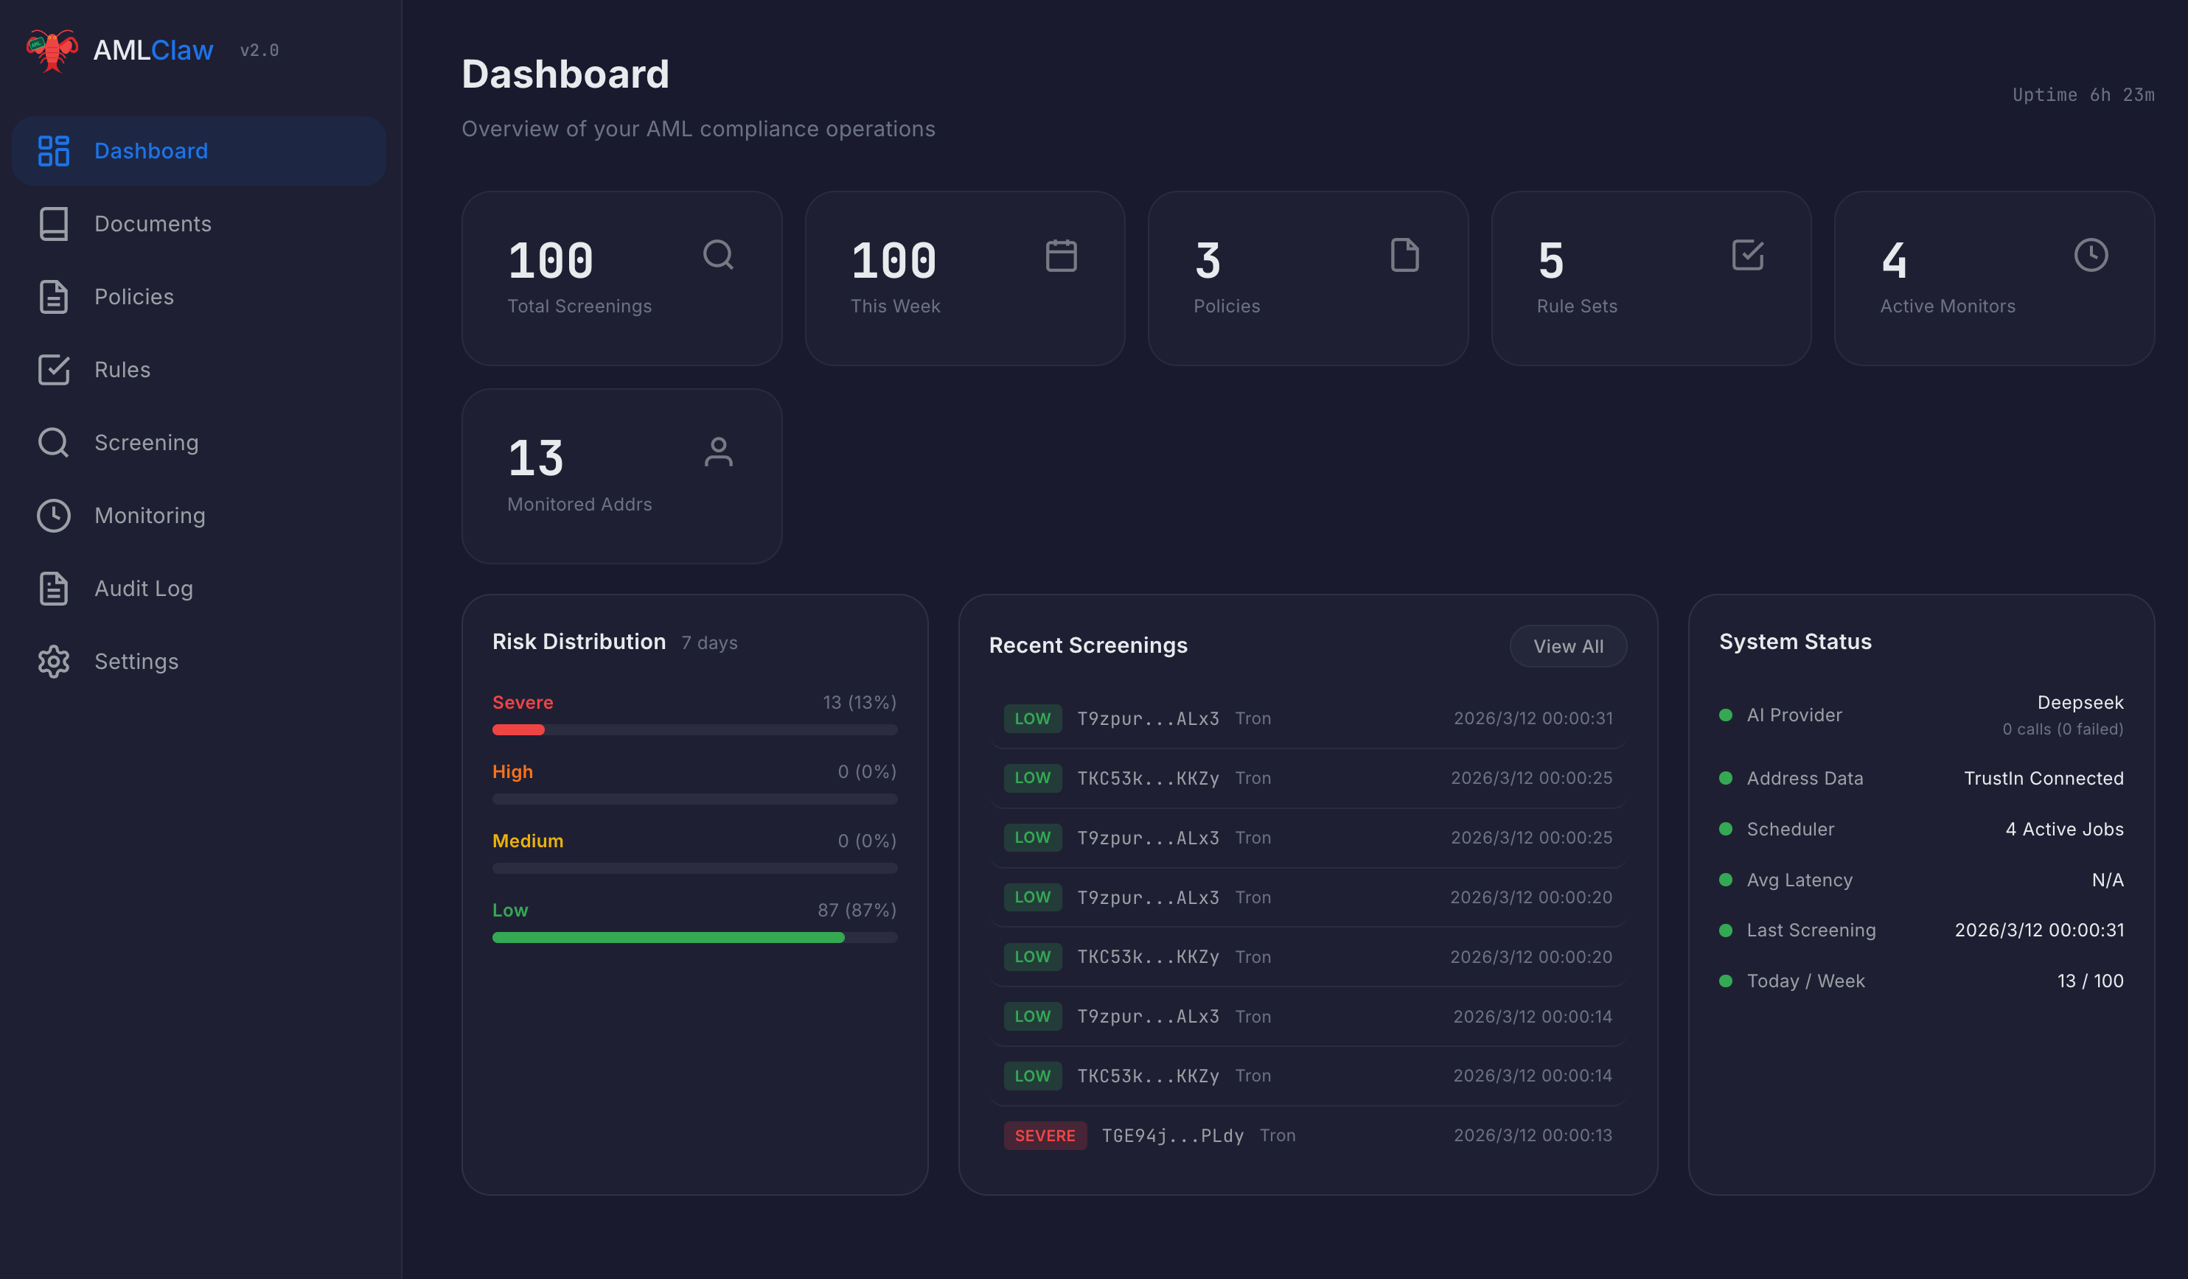
From Regulation to Screening in 5 Minutes
📡 Step 6: Monitor Everything From One Dashboard

Slide 12
Built Different
🤖 Multi-AI
📁 No Database
🔓 Open Source
Claude · DeepSeek · Gemini Switch anytime, no vendor lock-in
File-based JSON storage Deploy anywhere, backup = cp
MIT License Every rule visible, full transparency
📝 Audit Trail
🌍 Bilingual
🐳 Docker Ready
Append-only JSONL Tamper-resistant, compliance-ready
English + 中文 Dark & Light theme
One command to deploy Self-hosted, data stays yours

Slide 13
Two Products. Both Free. Both Yours.
🦅 AMLClaw Skill
🖥️ AMLClaw Dashboard
For AI Agents
For Humans
• Install in one sentence • Claude Code / OpenClaw / any framework • CLI-based, lightweight • Ships as SKILL.md entry point
• Full Web UI (Next.js) • Visual flow graphs & reports • Monitoring dashboard • Self-hostable, Docker-ready
$ clawhub install amlclaw
$ docker compose up -d
github.com/amlclaw/amlclaw
github.com/amlclaw/amlclaw.com

Slide 14
The Math Is Embarrassingly Simple
 | Traditional Team | AMLClaw
Annual Cost | $500K – $1M | ~$50–200/mo AI API *
Setup Time | 3–6 months | 5 minutes
Policy Generation | 2–4 weeks | 2 minutes
Address Screening | Half a day | < 5 minutes
Monitoring | Spot checks | 24/7 automated
Transparency | Black-box scores | Open source, every rule visible
* AI API cost depends on usage. ~$50/mo covers most small-to-mid operations. Platform itself is free.

Slide 15
What's Next
NOW
✅ 3 Jurisdictions (SG, HK, Dubai) ✅ 40+ Regulations ✅ Tron Chain
NEXT
🔗 Bitcoin + Multi-chain Stablecoins 🪪 KYC + Travel Rule — TrustIn acquired a KYC company, building identity + on-chain compliance 🇪🇺 MiCA (EU) 🇺🇸 FinCEN (US) 🔌 Plugin System
Why Open Source? TrustIn already runs the SaaS. AMLClaw is the open-source edition — making AML accessible to everyone. Compliance shouldn't be a privilege. It should be infrastructure.

Slide 16
Try It Now. On Your Phone. ⚡
1
Open OpenClaw on your phone 🦞
2
Tell your agent: "Search GitHub for amlclaw and install it"
3
Done. Your AI agent is now a compliance expert.
"You just deployed a compliance team in 10 seconds."

Slide 17
The End Game of Compliance Isn't More People — It's a Better System.
github.com/amlclaw
MIT License · Free Forever

