Slide 1

The Great Audio Race
Created by: That1Group
Designed by: Brandon Scott, Andrew Rauh, Andrew Lees, Taran Pennebacker

Slide 2
What’s on topic for today?
Social appeal of the game.
About the final game.
Status of game.
Test run of game.
Closing remarks.

Slide 3
Why The Great Audio Race?
Relevance to Autism Spectrum Disorder.
Reaction to multiple stimuli.
Reason why the game is prevalent.

Slide 4
What is The Great Audio Race?
User racing through space.
User dodging obstacles.
User reacting to multiple stimuli.
User collects rewards throughout level.

Slide 5
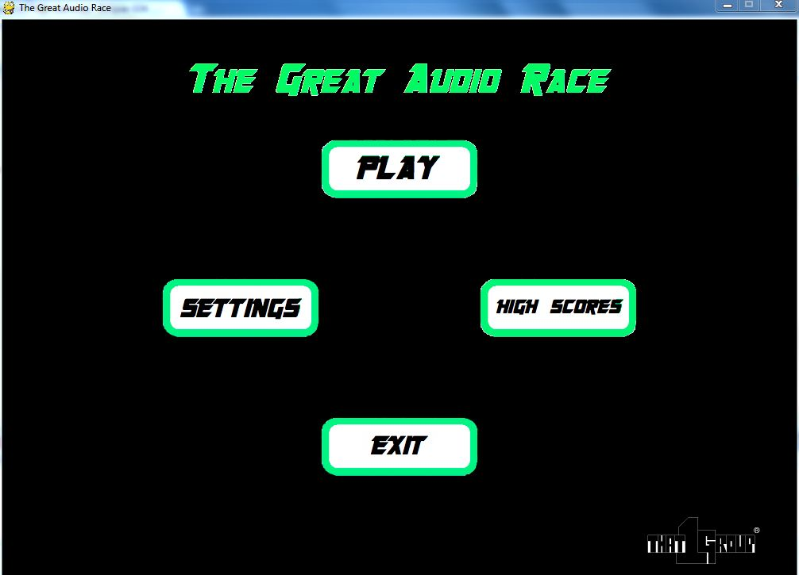
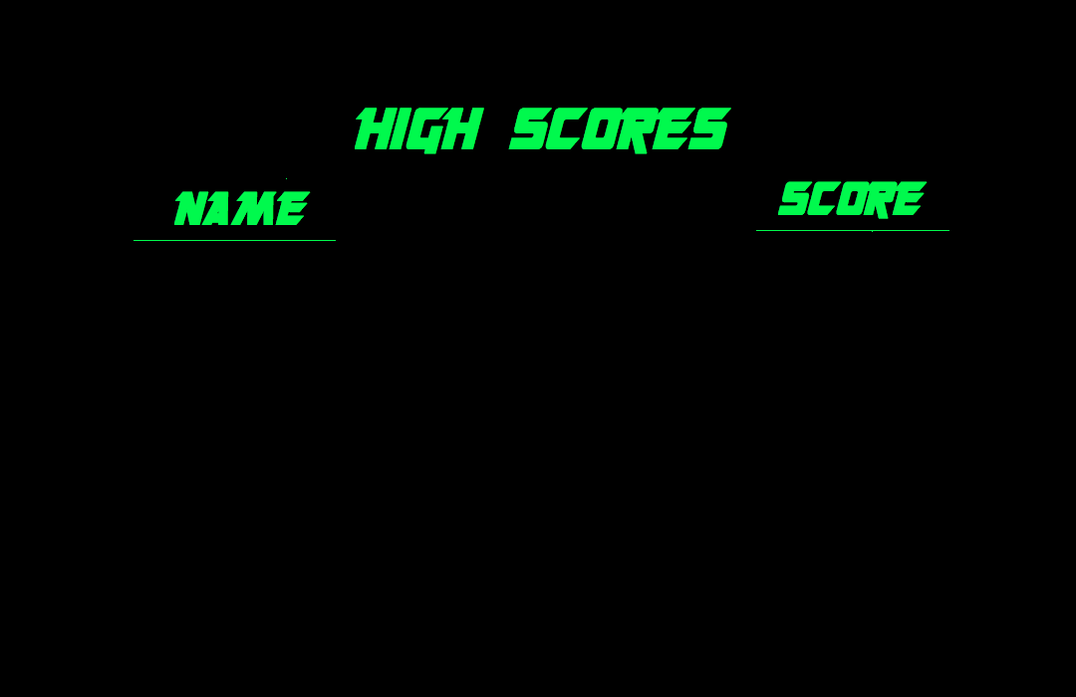
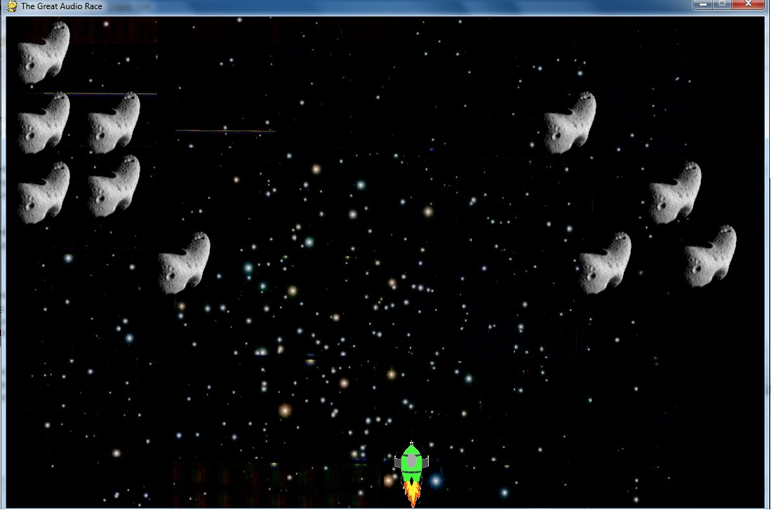

Slide 6
How’d we create The Great Audio Race?
Fourier Transform
∫f(t)cos(ωt) dt
Fourier Windowing
∫f(t)cos(ωt)*e^{-(t-to)/(s^2)} dt
Fast Fourier Transform
∫f(t)cos(ωt)*e^{-(t-to)/(s^2)} * ∫f(t)cos(ωt)dt

Slide 7
How does The Great Audio Race work?
Collision with a group of sprites.
Creation of multiple difficulty levels.
Generate obstacles based on frequency.
Implementation of the algorithm.

Slide 8
How was The Great Audio Race Designed?
Use of Autocad for sprite creation.
Use of Seashore for image editing.
Use of GIMP to finalize images.

Slide 9
What’re the tasks for The Great Audio Race?
Collect data and analyze frequency.
Create initial game menus.
Map sprites to respond to input.
Create skeleton of first few levels.
Have basic collision detection.
Add major features.
Debug code by testing.

Slide 10
Gantt Chart

Slide 11
What tasks are complete?
Create initial game menus and windows.
Map sprites to respond to input.
Have basic collision detection.

Slide 12
What do we still have to do?
Collect data and analyze frequency.
Have sprite respond to user input.
Finish and finalize user interfaces.
Create skeleton of levels.
Implement advanced music selection.
Debug and clean up code.

Slide 13
TEST THE GAME HERE
We will put a test of the game on this slide

Slide 14
What did we cover?
The social aspects of the game.
The final product’s ins and outs.
The progress of the product thus far.
The testing of the final product.

Slide 15
Contact Us?
The Great Audio Race Team:
Brandon Scott
Email: bjpscott@umich.edu
Phone: 517-227-6662
Twitter: BrandonJPScott
Andrew Rauh
Email: arauh@umich.edu
Phone: 313-300-1749
Twitter: a_j_r
Taran Pennebacker
Email: pennetar@umich.edu
Phone: 941-224-8130
Twitter: TaranItUpp
Andrew Lees
Email: amlees@umich.edu
Phone: 734-834-2720
Twitter: N/A

