Slide 1

The Great Audio Race
Created by: That1Group
Designed by: Brandon Scott, Andrew Rauh, Andrew Lees, Taran Pennebacker
Date: December 7th, 2011

Slide 2
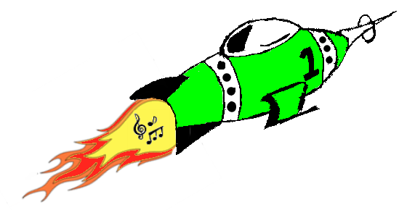
The Great Audio Race
Your music, your map, your game!

Slide 3
Agenda
Motivation for the game
Background of the game
Overview of game
Customization of game
Rewards of game
Closing remarks

Slide 4
How it Began
Motivation for the game
Criteria for the game
Relevance to ASD of the game
Marketability of game

Slide 5
The Idea Behind it
Game is based entirely on customization
Game targets an older audience
Games helps reacting to multiple stimuli
Game gives rewards based on performance
(insert photo or selecting music file)

Slide 6
What it Really is
User trying to race themselves
User dodging obstacles
User collecting coins to earn points
User breaking new records
User overcoming social inabilities
User becoming more than just a user

Slide 7
How it Really Works
Fourier Transform
∫f(t)cos(ωt) dt
Fourier Windowing
∫f(t)cos(ωt)*e^{-(t-to)/(s^2)} dt
Fast Fourier Transform
∫f(t)cos(ωt)*e^{-(t-to)/(s^2)} * ∫f(t)cos(ωt)dt

Slide 8
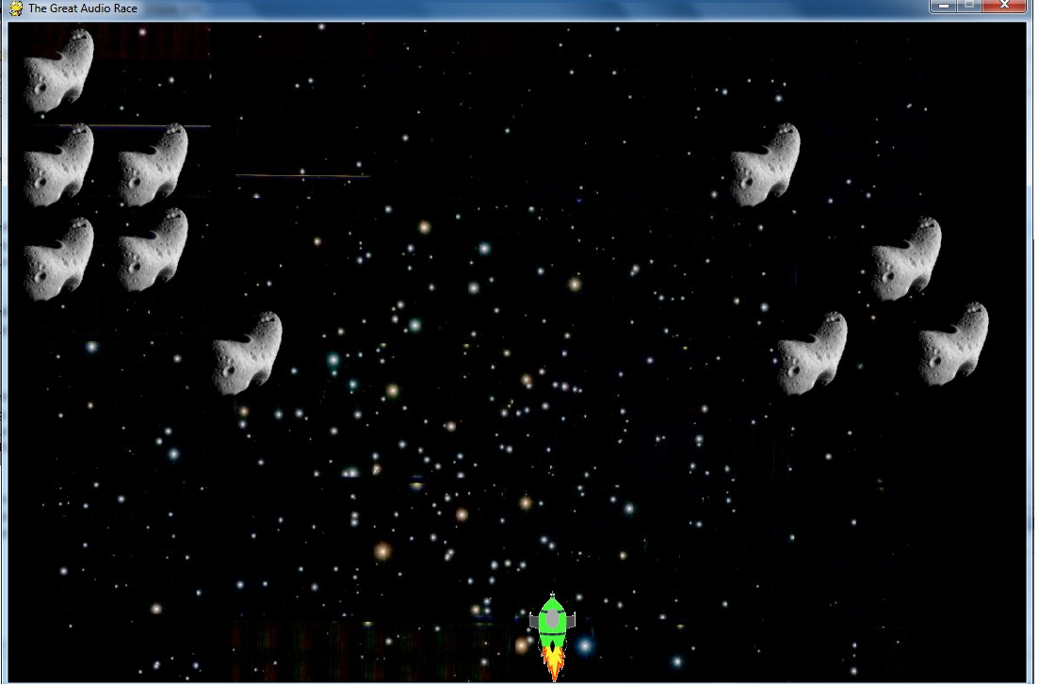
Design of the Game
Use of Autocad for sprite creation.
Use of Seashore for image editing.
Use of GIMP to finalize images.

Slide 9
Customization to the Next Level
Customization is the game itself
Customization in the menu
Customization in the ship
Customization in the controls
(photo of the song choice [maybe of two differenent songs being played])

Slide 10
Rewarding and Satisfying
Points for precision
Points for speed
Points for time
Points add up, and so do high scores
(Add a photo of rewards system)

Slide 11
WE NEEDZ ANOTHER SLIDE

Slide 12
Conclusion
Motivation of game
Background of game
Complete overview of game
Customization of game
Rewards of game

Slide 13
Contact Us
The Great Audio Race Team:
Brandon Scott
Email: bjpscott@umich.edu
Phone: 517-227-6662
Twitter: BrandonJPScott
Andrew Rauh
Email: arauh@umich.edu
Phone: 313-300-1749
Twitter: a_j_r
Taran Pennebacker
Email: pennetar@umich.edu
Phone: 941-224-8130
Twitter: TaranItUpp
Andrew Lees
Email: amlees@umich.edu
Phone: 734-834-2720
Twitter: N/A

