Slide 1
ABOUT me
~15 Year s of experience in software development
Currently working as Principal Consultant in an IT company
TOGAF certified architect primarily involved in Big data technologies on cloud
Has rich experience in system design using various programming language

Slide 2
Ethical Hacking
-Amlendu Choudhary

Slide 3
Site for practicing Hacking
https://list.ly/list/euz-15-vulnerable-sites-to-legally-practice-your-hacking-skills

Slide 4
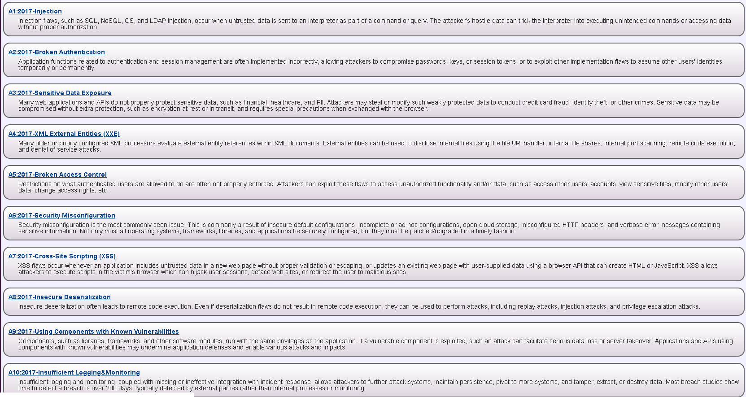
OWASP TOP 10

Slide 5
What is SQL injection
SQL injection is a code injection technique that might destroy your database.
SQL injection is one of the most common web hacking techniques.
SQL injection is the placement of malicious code in SQL statements, via web page input.
Source:W3Schools

Slide 6
Types of Injection
Error based
Union Based
Blind
Boolean Based
Time Based

Slide 7
Web Site Security
Types of attack on website
Attack on Client
Attack on Server
Defense Mechanism

Slide 8
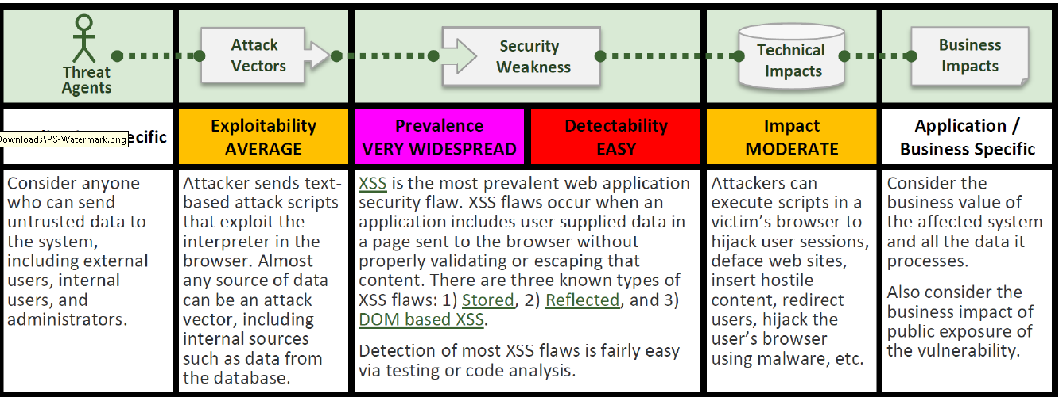
XSS(Cross Site Scripting)

Slide 9
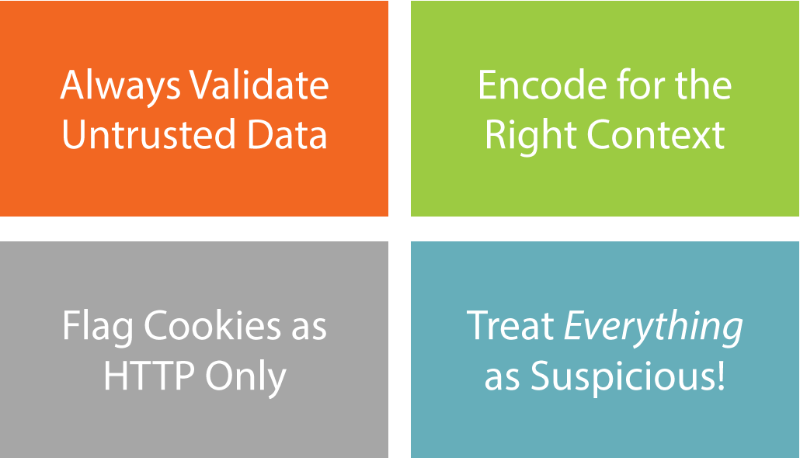
Defense against XSS

Slide 10
Demo
Single Character Injection – A form of Error Injection
Tautology
A formula that is true in every possible interpretation
Access Control
Notes:
Open site - http://localhost:4298/ or http://hackyourselffirst.troyhunt.com
Click on Cylinder layout
http://localhost:4298/CarsByCylinders?Cylinders=V12‘ – Will give error
Unhandled exception – Tell there is SQL server and tells it is MVC application – Internal implementation
Underlaying Query is
CarsByCylinders?Cylinders=V12‘
Select ID,Name FROM SuperCar where Cylinders=‘V12’
Change the query Structure
CarsByCylinders?Cylinders=V12‘ or 1=1--

Slide 11
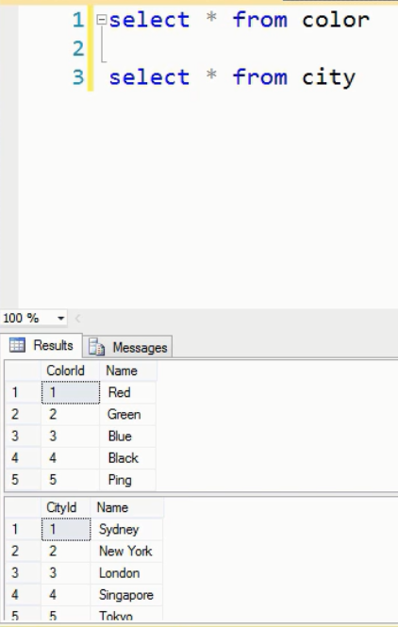
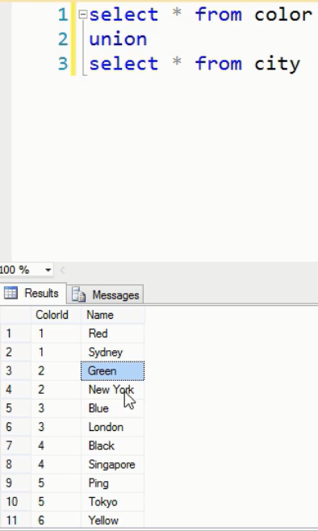
UNION INJECTION
Discover Schema and Extract data

Slide 12
Demo
Notes:
Type http://localhost:4298/CarsByCylinders?Cylinders=V12’ union select * from vote--

Slide 13
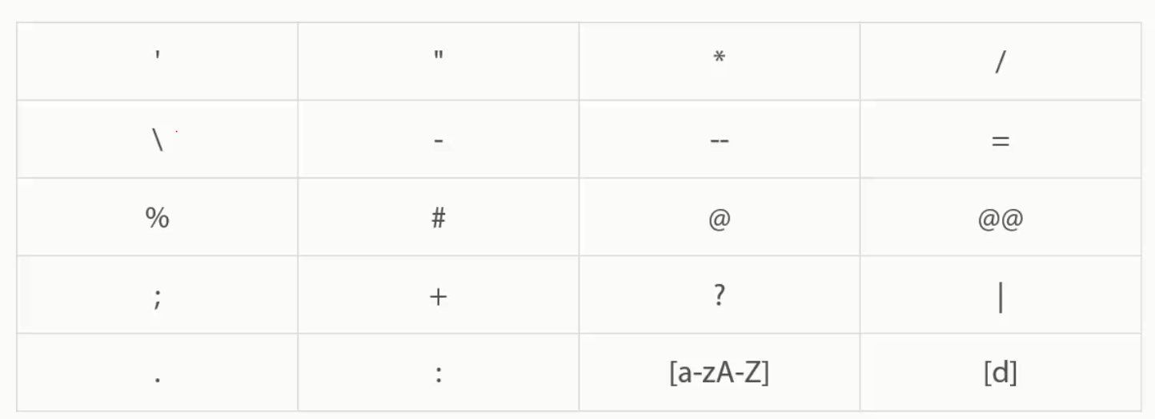
Mitigation
Identify Risk in Code
Sanitize input

Slide 14
Mitigation
Query Paramterization
Stored Procedure

Slide 15
Query Strings
http://website.com/widgets?id=27
https://website.com/widgets?order-by=name
Resource
Resource ID
Action

Slide 16
ROUTING
http://website.com/widgets/27
https://website.com/widgets/27/delete
Resource
Resource ID
Action

Slide 17
HTTP Verbs
GET http://website.com/widgets/27
https://website.com/widgets/27/delete

Slide 18
Reconnaissance is a set of processes and techniques (Footprinting, Scanning & Enumeration) used to covertly discover and collect information about a target system

