Slide 1
LEAD SCORING CASE Study
SUBMITTED BY:
Amlesh Dwivedi
harsh Vardhan singh jeena
Anirudh yerra

Slide 2
Problem Statement
The typical lead conversion rate at X education is around 30%
Company wants to identify the most potential leads, also know as 'Hot Leads’
Identify the leads that are most likely to convert into paying customers( ball park figure 80%)
Build a logistic regression model to assign a lead score between 0 and 100

Slide 3
STEPS Included In the process
Loading and understanding the data set
Cleaning of the Data Frame
EDA
Data Preparation for Modelling
Building The Model
Model Evaluation
Making Predictions on Test Set
Calculating the Lead Score
Feature Selection

Slide 4
DATa cleaning
We removed the unnecessary columns from the data set eliminating the data set with high % of null values
The columns with skewed values were also removed
After removing we were left with 14 columns to work ahead

Slide 5
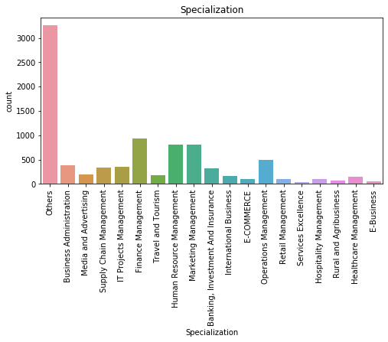
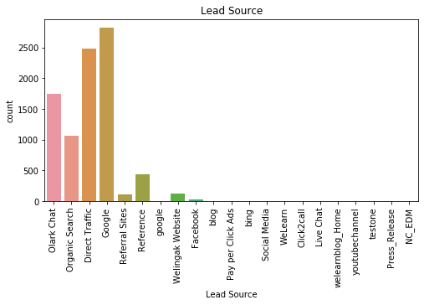
EDA
Univariate and Bivariate analysis were performed on the data set

Slide 6
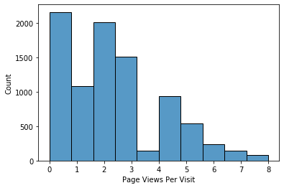
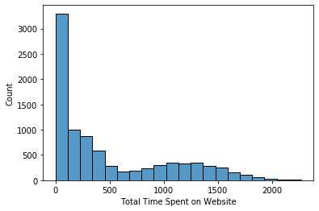
EDA

Slide 7
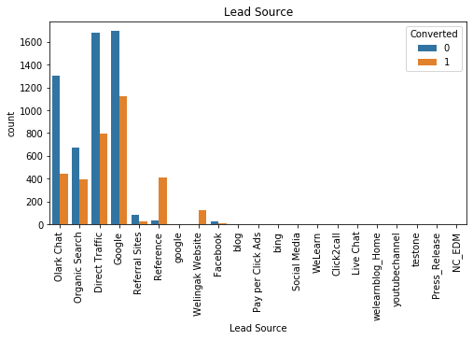
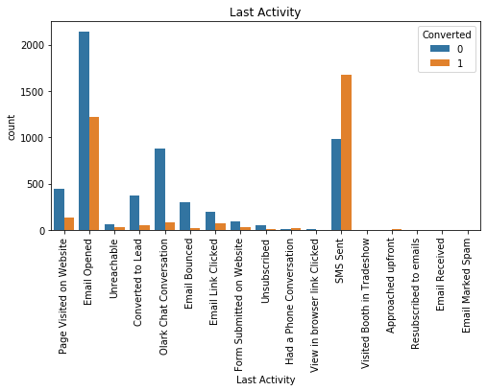
EDA

Slide 8
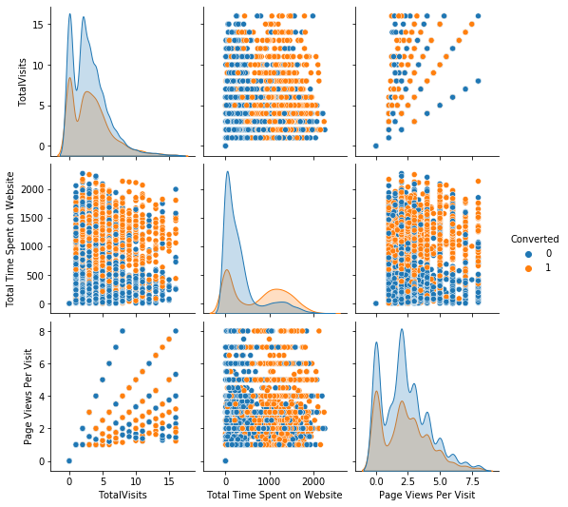
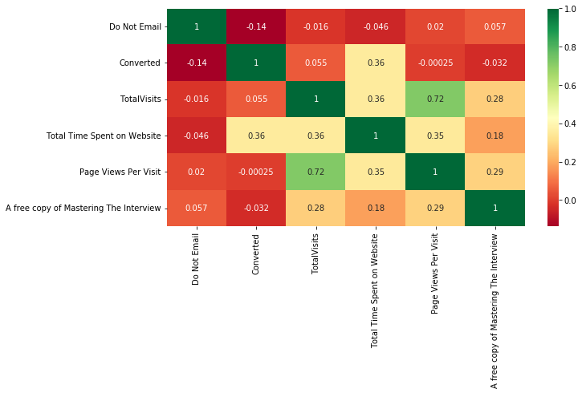
EDA

Slide 9
Model preparation
Dummy variables were created for the categorical columns
Scaling of the data was done
The test train split on the data was carried out
Features selection was done on the data set with the help of RFE
VIF was also used to check the optimal features
p-value 0.05 and RFE < 5

Slide 10
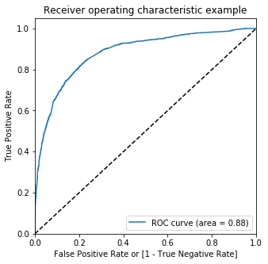
Model evaluation
ROC Curve

Slide 11
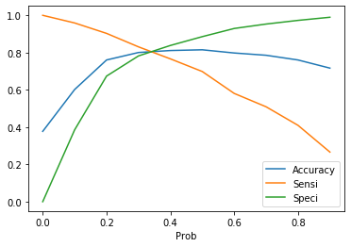
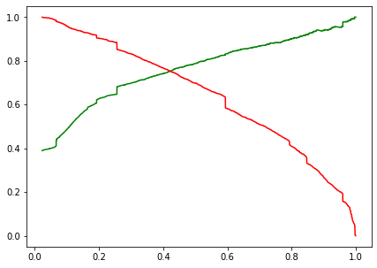
Model evaluation TRAin
1. Acuracy: 81.49 2. Sensitivity: 69.84 3. Specificity: 88.55

Slide 12
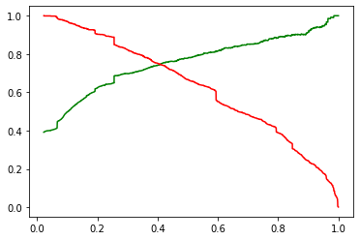
Model evaluation test
Accuracy: 80.06%
Sensitivity: 80%
Specificity: 79.48%

Slide 13
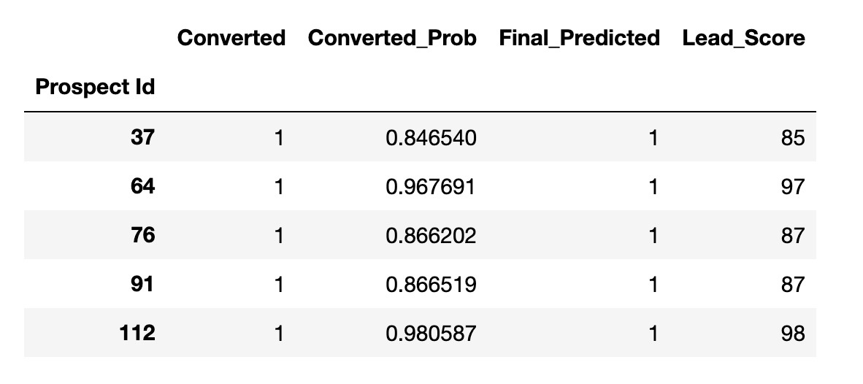
Hot leads based on score

Slide 14
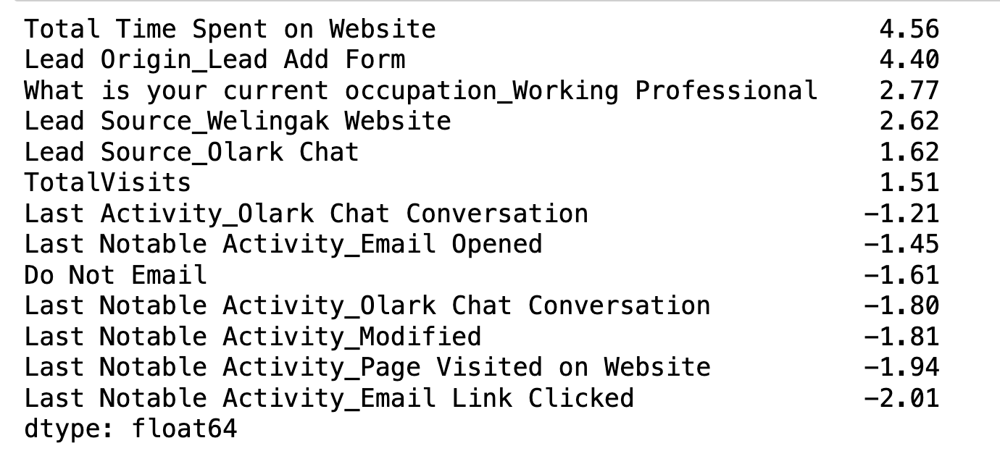
Feature Selection

Slide 15
THANK YOU

